Slide 1
Frightening Finances: Master Your Budget with Spooky Formulas
Cayce Lay Lamas, Director of Finance, Town of Westlake
Meg Jakubik, Director of Budget Services, Town of Flower Mound
Aaron Rector, Interim City Manager, City of Keller

Slide 2
Please download and install the Slido app on all computers you use
Join at slido.com #7237058
ⓘ Start presenting to display the joining instructions on this slide.

Slide 3
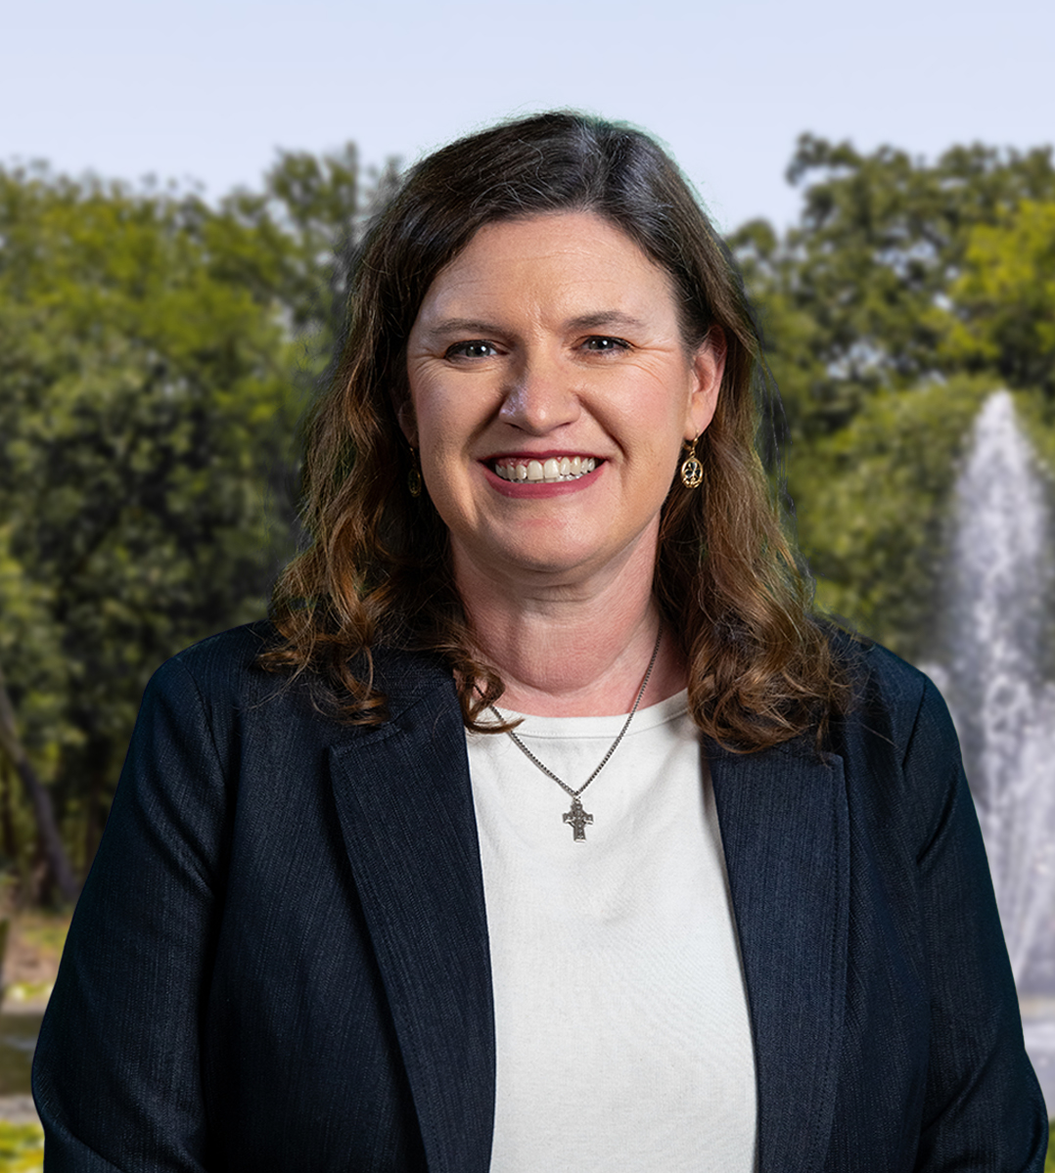
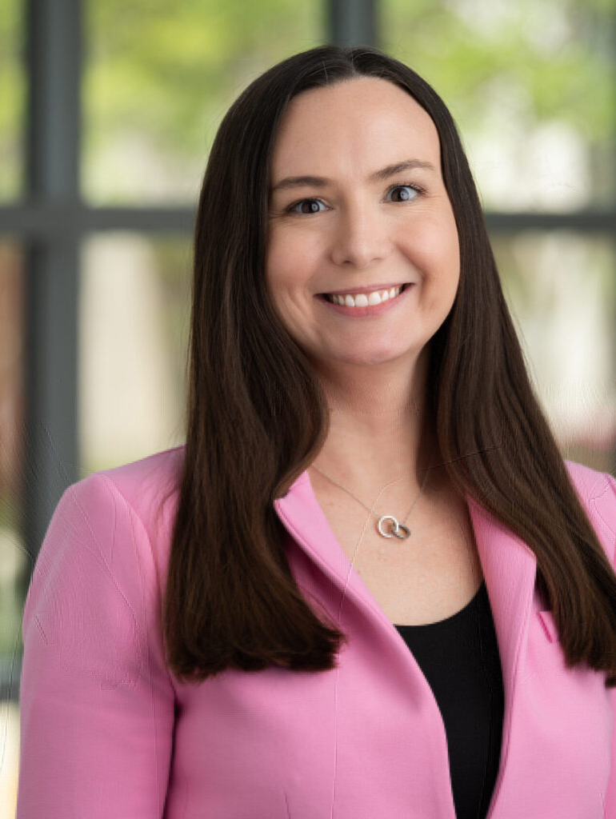
Introductions
Speakers
Aaron Rector
Interim City Manager,
City of Keller
Co-Chair Program Committee, North Area Rep
Meg Jakubik
Director of Budget Services,
Town of Flower Mound
GFOA Representative
Cayce Lay Lamas
Director of Finance,
City of Westlake
Communications Chair

Slide 4
Agenda
Frighteningly Accurate Long-Range Forecasts – Forecast Models
Bewitching Sales Tax Forecasting – Sales Tax Models
Haunted Hourly Rates – Salary Calculations
Eerie Projections – Projecting Current Year Revenue & Expenditures
Diabolical Debt – Future I&S Rates and Debt Impact

Slide 5
Please download and install the Slido app on all computers you use
What is your budget role?
ⓘ Start presenting to display the poll results on this slide.

Slide 6
Please download and install the Slido app on all computers you use
How long have you been in budget?
ⓘ Start presenting to display the poll results on this slide.

Slide 7
Please download and install the Slido app on all computers you use
What is your ERP (Finance Software)?
ⓘ Start presenting to display the poll results on this slide.

Slide 8
Frighteningly Accurate Long-Range Forecasts
Notes:
Cayce

Slide 10
Incremental Forecasting
Utilize a known increment for a projection
The increment will differ based on judgement, most often relies on historical or gathered information
Formula
Actual
Increment
Projection

Slide 11
Incremental Forecasting
Example: We are projected to grow by 200 homes next year with the current developments we have in place.
(Taxable Values From Prior Year) + (200*average taxable value/100*current tax rate) = property tax values for next year
This assumes your property tax base is not decreasing.

Slide 12
Trend Analysis
“Trend analysis“ estimates the growth pattern of a revenues/expenditures based on its short-term historic trend
When used in forecasting it assumes revenues/expenditures will continue to exhibit the same growth patterns
Formula
(Period 2 - Period 1)
Period 1
% Change
Example:
10% = (110,000-100,000)/100,000

Slide 13
Trend Analysis
Trend Analysis is an analytical tool that can help you ask better questions.
Example: Sales Tax on average has gone up 11% the past two years.
You should not immediately use 11% as the projection, you should dig further to see why it increased each year.
Once you obtain the why, then you can know if the pattern will continue.

Slide 14
GFOA Best Practice
Financial Forecasting in the Budget Preparation Process
Forecast major revenues and expenditures – several years into the future
Key Steps
Define Assumptions
Gather Information
Preliminary/Exploratory Analysis
Select Methods
Implement Methods
Use Forecasts

Slide 15
Council Goal Setting
Summary of City Council Priorities
These priorities will help you forecast
Should tie to your strategic plan
Must address Compensation
Public Safety (Largest overall Expenditure)
Reaffirm Financial Policies

Slide 16
Example Timeline of the Five-Year Forecast
Month 1
Month 2
Month 3
Month 4
Month 5
Develop forecast models and send forecast memo to executive leadership
Initial meetings with departments and develop initial long term current service forecast
Council Goal setting session to receive policy priorities
Discuss future program changes and service delivery changes with City Management to include in forecast
Present five year forecast to Council

Slide 17
Five Year Financial Forecast & Budget
Financial Forecast is an early financial outlook and should include all major funds
Provides an opportunity for continued Council policy discussion on upcoming annual budget
Forecast is not a budget

Slide 18
Forecast Methods

Slide 19
Call out Your Growth Assumptions
REVENUE SOURCES | FY 2023 | FY 2024 | FY 2025 | FY 2026 | FY 2027
Property Tax | 6.4% | 5.0% | 4.5% | 3.0% | 3.0%
Sales Tax | 3.5% | 3.0% | 4.0% | 4.3% | 4.3%
Charges for Current Services | 7.7% | 1.5% | 8.9% | 7.5% | 10.8%
Business and Franchise Taxes | (3.8%) | (3.5%) | 0.0% | 0.0% | 0.0%
Other Resources | 4.8% | 3.4% | 2.5% | 2.2% | 2.2%

Slide 20
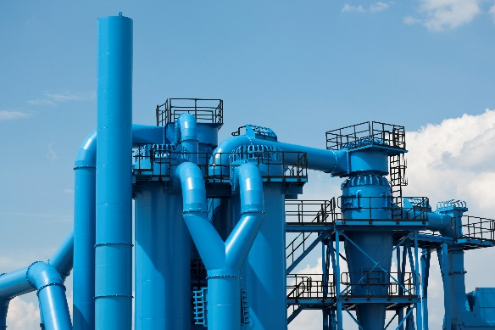
Other Major Funds
Water & Sewer Operations
Stormwater Operations
Hotel Occupancy Tax
Operational Costs
Capital Investments
Debt Issuances
Operational Costs
Capital Investments
Debt Issuances
Fee on Hotel Room Stays
Occupancy rates
Allowable expenses

Slide 21
Expenditure Assumptions
Personnel Calculations
Use current employees as a base
Include any step-plan increases
TMRS Forecast
Healthcare assumptions
Consumer Price Index
Multi-year contracts, grant cash matches, operating costs from capital projects
Financial Policies and Council Direction

Slide 22
Economic Outlook & Perspective
A forecast of the City’s finances recognizes that the fiscal health is directly linked to the success of local, national, and global economies
Unemployment rate and employment growth
CPI growth
Housing prices and inventory
Hotel demand
Know what is applicable to your community

Slide 23
Provide an Overview
City of Bedford Long Range Plan
Notes:
Meg

Slide 24
Excel Worksheet – Recession Planning

Slide 25
Questions

Slide 26
Bewitching Sales Tax Forecasting
Notes:
Meg

Slide 27
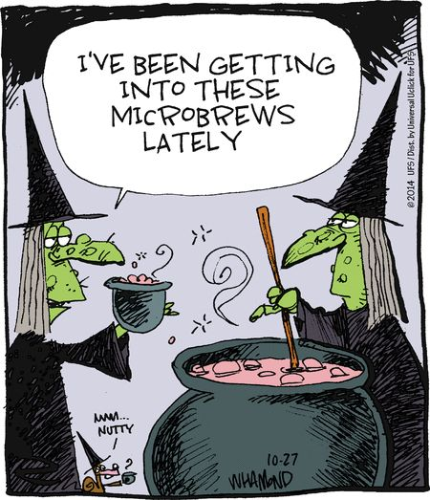

Slide 28
Please download and install the Slido app on all computers you use
How accurate is your internal sales tax modeling?
ⓘ Start presenting to display the poll results on this slide.

Slide 29
Sales Tax Calculation
Use a conservative trend approach
Request the Comptroller Confidential Detail report
Excel / Access
Third party software
Formula Concept
1. Determine the Base = Overall Sales Tax – Opened in Year
2. Average annual base growth = ~ % to increase
3. Add annual impact of opened in year
4. Add known opening development – Use leakage discount
5. Subtract one-times & corrections
6. Total for estimate

Slide 30
Helpful Links - Sales Tax
Comptroller Confidential Information Report Request Info
https://comptroller.texas.gov/transparency/open-data/by-request.php
Comptroller Monthly Payment Detail
https://mycpa.cpa.state.tx.us/allocation/AllocDetail
Comptroller Sales Tax Publications – What is Taxable
https://comptroller.texas.gov/taxes/publications/#sales

Slide 31
Things to Consider – Sales Tax
Comptroller Confidential Information
New Development Spike
Development Saturation
City Border Activity
On-Line Sales Activity
Economic Development
Insight on Market
380 Agreements

Slide 32
Excel Worksheet – Sales Tax Projections

Slide 33
Software Options – Sales Tax & Property Tax

Slide 34
Questions

Slide 35
Break

Slide 36
Please download and install the Slido app on all computers you use
What is your favorite upcoming holiday?
ⓘ Start presenting to display the poll results on this slide.

Slide 37
Please download and install the Slido app on all computers you use
What is your favorite candy?
ⓘ Start presenting to display the poll results on this slide.

Slide 38
Please download and install the Slido app on all computers you use
What is your favorite scary movie?
ⓘ Start presenting to display the poll results on this slide.

Slide 39
Haunted Hourly Rates

Slide 40
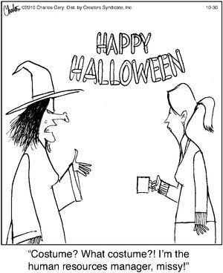

Slide 41
Please download and install the Slido app on all computers you use
What unique salary challenges does your organization face?
ⓘ Start presenting to display the poll results on this slide.

Slide 42
Salary Calculations
Non-Exempt = Hourly rate x 2080 hours
Exempt = Bi-weekly rate x 26 weeks
Public Safety = Varies by City
Part-Time =
“Full-Time” – Library Staff
Temporary/Seasonal – Lifeguards
Overtime = Base on average spending or allocate per employee
Education/Certificate
Allowances
Longevity

Slide 43
Compensation Adjustments (CA)
Market – Adjustment tied to changes in comparison cities
COLA – Adjustment tied to changes in economy/inflation
Merit – Performance based pay
Reclassification – Change in job responsibilities
Step Plan – Pay schedule outlining salary per year with entity
Lump Sum – One-time payment

Slide 44
Benefits
Salary Based Benefits
Retirement – TMRS (3 Months at Current Rate; 9 Months at New Rate)
Worker’s Compensation
Life Insurance
Social Security/Medicare
Fixed Benefits
Health/Dental Insurance
HSA Contribution

Slide 45
Compensation Formula
Salary X (CA*% of year) + Other Comp = Compensation
Compensation X (TMRS+WC+LI+SS/MC) = Salary Benefits
Insurance Cost + HSA = Fix Benefits
Personnel Costs

Slide 46
Excel Worksheet – Compensation Example

Slide 47
Software Options– Compensation Example

Slide 48
Questions

Slide 49
Eerie Projections
Notes:
Meg

Slide 50
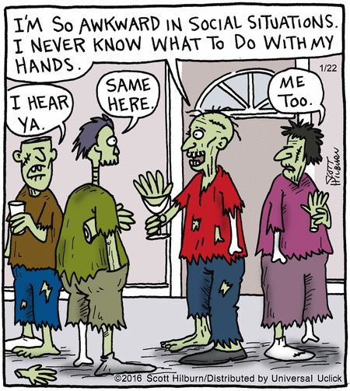

Slide 51
Department (Non-Personnel) Projections
Department input is necessary for most accurate current year spending projections
Challenges
ERP Software Limitations
Departments turn in all projections as BUDGET!
Department users have limited financial backgrounds

Slide 52
Information Gathering
Personnel
Number of Payrolls – Completed
Financial Data
Adopted/Amended Budget
Formulas
Remaining Pay Periods
Number of Payrolls Remaining
Number of Past/Remaining Insurance Payrolls
Split of Fiscal Years
Number of payrolls in current month
Estimated Vacancy Fill Dates
Upcoming Retirements
Current Month Expenditures
Current YTD Expenditures
Prior YTD Expenditures
Prior Year Total Expenditures
Remaining Insurance Pay Periods
Monthly Average
Current Month being New
Current YTD Same % as Prior
Matching Budget
Current YTD = Total

Slide 53
Department User Assistance & Reminders
Include filters for G/L Columns
Allow for manual adjustments
Hide reference columns in worksheet
Enter projections into ERP/Operational Budgeting Software

Slide 54
Excel Worksheet – Current Year Projections: Revenue & Expenditures

Slide 55
Questions

Slide 56
Diabolical Debt
Notes:
Meg

Slide 57
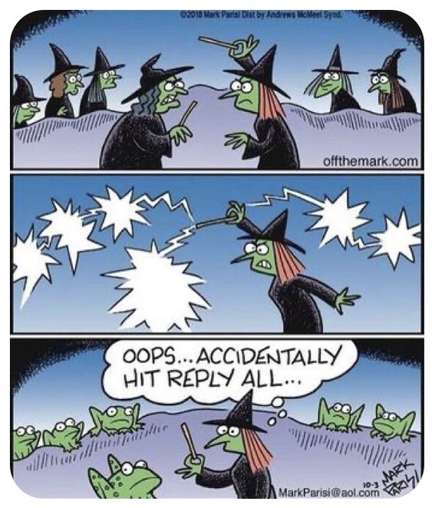

Slide 58
FY 2024-25 Debt Service Summary
Funding Source | Annual Payment* | Outstanding Principal* | Proposed Issuance^
Water / Wastewater | $2,482,651 | $21,505,000 | $-
Drainage | $ - | $- | $-
Total All Debt | $2,482,651 | $21,505,000 | $ 5,889,000
^ - Five-Year CIP includes ~$32M in CO’s

Slide 59
FY 2024-25 Water/Wastewater Obligations - Current

Slide 60
Water/Wastewater Obligations – Current & Proposed
Future Debt ends in FY 49

Slide 61
DEBT & CAPACITY
OPPORTUNITIES TO REFINANCE & CAPTURE INCREMENT
Issuance | Amount
Series 2025 | $ 59,810,000
Series 2026 | $ 23,480,000
Series 2027 | $ 21,995,000
Series 2028 | $ 15,475,000
Series 2029 | $ 13,810,000
Series 2030 | $ 17,100,000
Series 2031 | $ 12,800,000
Series 2032 | $ 13,200,000
Series 2033 | $ 16,480,000
Series 2034 | $ 5,850,000
Total | $ 200,000,000
Notes:
This is accomplished by utilizing refinancing strategically to make larger up front payments, which also saves on interest costs.

Slide 62
Estimated Debt Formula
PMT (Rate, NPER, PV)
Rate = Estimated Interest Rate
NPER = Number of Payments/Years
PV = Present Value – Issuance Amount
Enter a negative symbol before formula

Slide 63
Questions

Slide 64
Contact Information
Cayce Lay Lamas, CPA | Meg Jakubik, CGFO | Aaron Rector, CGFO
Director of Finance | Director of Budget Services | Interim City Manager
Town of Westlake | Town of Flower Mound | City of Keller
817-490-5721 | 972-874-6082 | 817-743-4026
claylamas@westlaketx.gov | Meg.Jakubik@flowermound.gov | arector@cityofkeller.com

