Slide 1
ACCOUNTING ACADEMY
Day 4

Slide 2
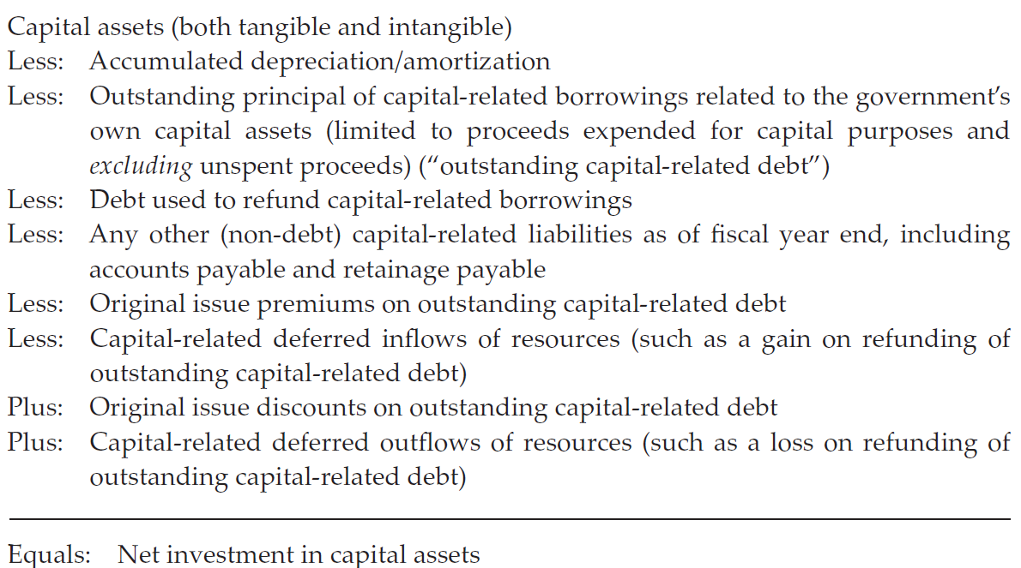
REVIEW - Net Investment in Capital Assets Calculation
Notes:
NOW WE ARE GOING TO PREPARE TO DO AN EXERCISE ON CALCULATING NET INVESTMENT IN CAPITAL ASSSETS
LET’S REVIEW THE CALCULATION WE DISCUSSED BEFORE – REVIEW SLIDE

Slide 3
REVIEW - Net Investment in Capital Assets
Include
  All of the government’s own capital assets (tangible and intangible), even if acquired without borrowing
  Debt used to construct, acquire, or improve a government’s own capital asset (including any related premiums or discounts)
Exclude
  Amounts related to debt proceeds not yet expended
  Borrowings within the primary government
  Borrowings related to capital assets of another government
  Proceeds applied for noncapital purpose, i.e., debt service “reserve fund” or issuance costs
Notes:
REVIEW – WHAT TO INCLUDE AND EXCLUDE
REVIEW SLIDE

Slide 4
Calculation of Net Investment in Capital Assets
EXERCISE
4
Notes:
NOW FOR THE EXERCISE – THIS IS EXERCISE #7 IN YOUR HANDOUTS
NEXT SLIDE

Slide 5
Calculation of Net Investment in Capital Assets
Three examples
In each example, calculate the net investment in capital assets for governmental activities only
Notes:
Three examples
For each example - calculate the net investment in capital assets related to governmental activities only.
WE WILL GIVE UP TO ONE HOUR FOR THE TOTAL EXERCISE
ABOUT 40 MINUTES TO PREPARE THE ANSWERS
ABOUT 20 MINUTES TO REVIEW THE ANSWERS
WE WILL WORK EXAMPLE 1 TOGETHER AND THEN YOU WILL WORK EXAMPLE 2 AND 3

Slide 6
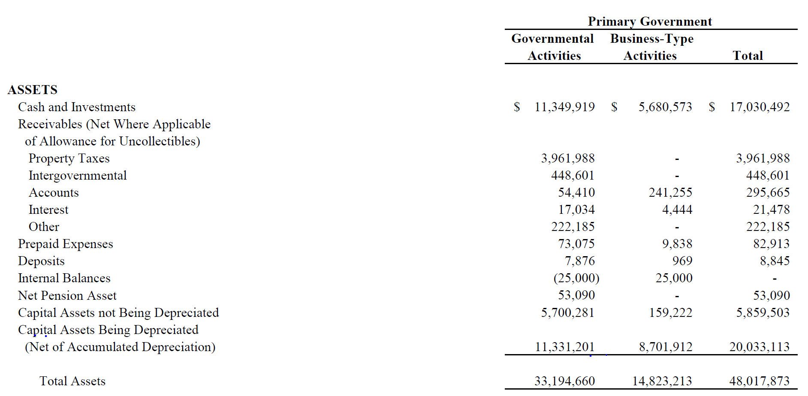
Statement of Net Position - Assets
$17,031,482
Notes:
WE MUST REVIEW THE DETAILS GIVEN FROM THE ACFR TO FIND THE NUMBERS WE NEED FOR THE CALCULATION
REMEMBER WE ARE DOING GOVERNMENTAL ACTIVITIES ONLY FOR THE EXERCISE
LOOK AT THE AMOUNTS NEEDED FOR THE CALCUATION – GO BACK TO PREVIOUS SLIDE FOR LIST
TOTAL CAPITAL ASSETS – MUST ADD TOGETHER CAPITAL ASSETS NOT DEPRECIATED AND CAPITAL ASSETS BEING DEPRECIATED
NOTE – THE CAPITAL IS ALREADY NET OF DEPRECIATION

Slide 7
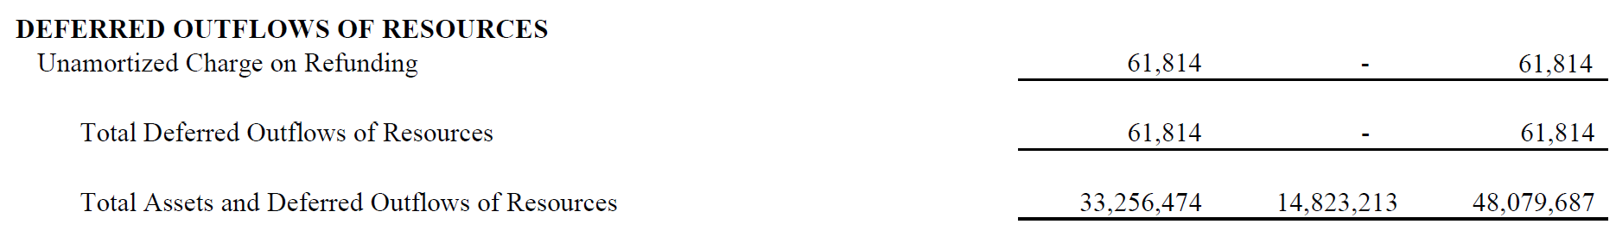
Statement of Net Position –
Deferred Outflows of Resources
Notes:
NEXT WE WILL PICK UP THE CAPITAL-RELATED DEFERRED OUTFLOWS OF RESOURCES AMOUNT
LATER WE WILL SEE THEY HAVE TOLD US TO ASSUME ALL OUTSTANDING LONG-TERM DEBT FOR GOVERNMENTAL IS CAPITAL RELATED
THERE FOR THE $61,814 DEFERRED OUTFLOW IS CAPITAL RELATED SINCE IT HAS TO DO WITH A REFUNDING

Slide 8
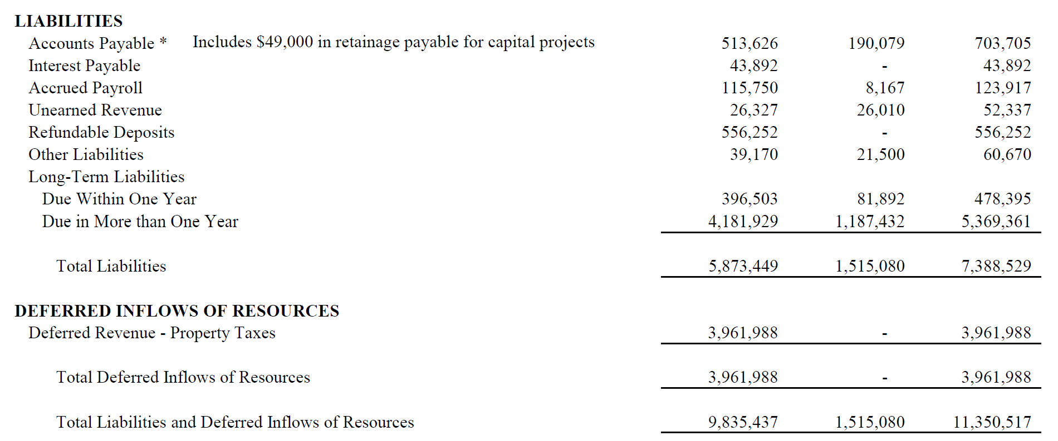
Statement of Net Position – Liabilities and
Deferred Inflows of Resources
Notes:
THEN WE SEE THAT UNDER ACCOUNTS PAYABLE THEY HAVE NOTED THAT $49,000 IS FOR RETAINAGE PAYABLE FOR CAPITAL PROJECTS
WE WILL NEED THIS FOR CAPITAL-RELATED LIABLITIES

Slide 9
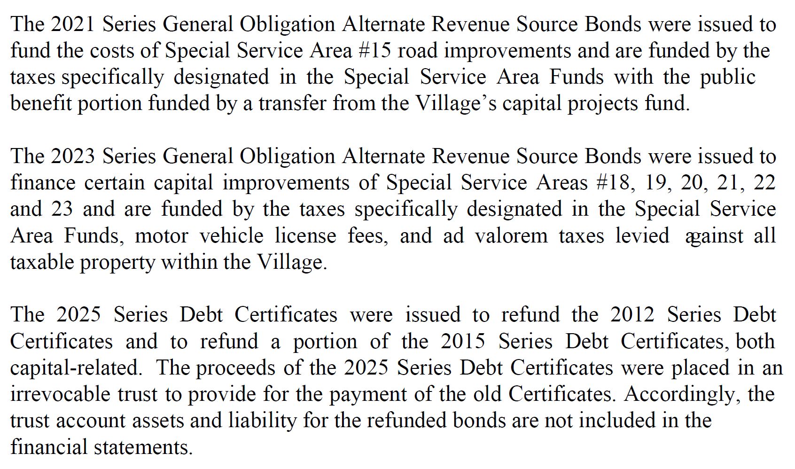
Note Disclosures – Long Term Liabilities (cont.)
Capital
Capital
Capital
Notes:
THEY HAVE ALREADY TOLD US THAT ALL LONG-TERM BONDS ARE CAPITAL RELATED HOWEVER
THE DISCRIPTION OF EACH BOND ISSUE IS ALSO A GOOD RESOURCE FOR KNOWING WHAT THE BONDS WERE ISSUED FOR – ALL OF THESE NOTE CAPITAL TYPE PROJECTS
THE REFUNDING WOULD ALSO BE CAPITAL SINCE WE ARE ASSUMING ALL LONG TERM BONDS ARE CAPITAL RELATED

Slide 10
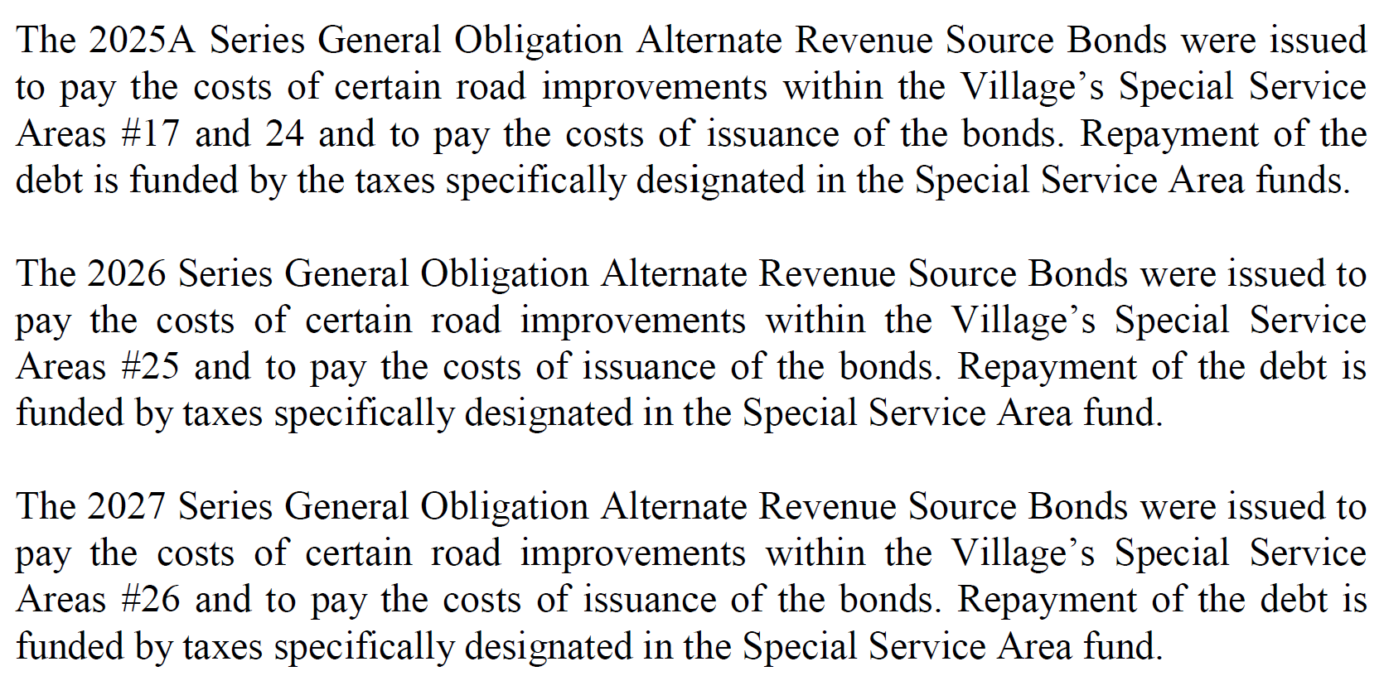
Note Disclosures – Long Term Liabilities (cont.)
Capital
Capital
Capital
Notes:
MORE BOND ISSUE DETAIL

Slide 11
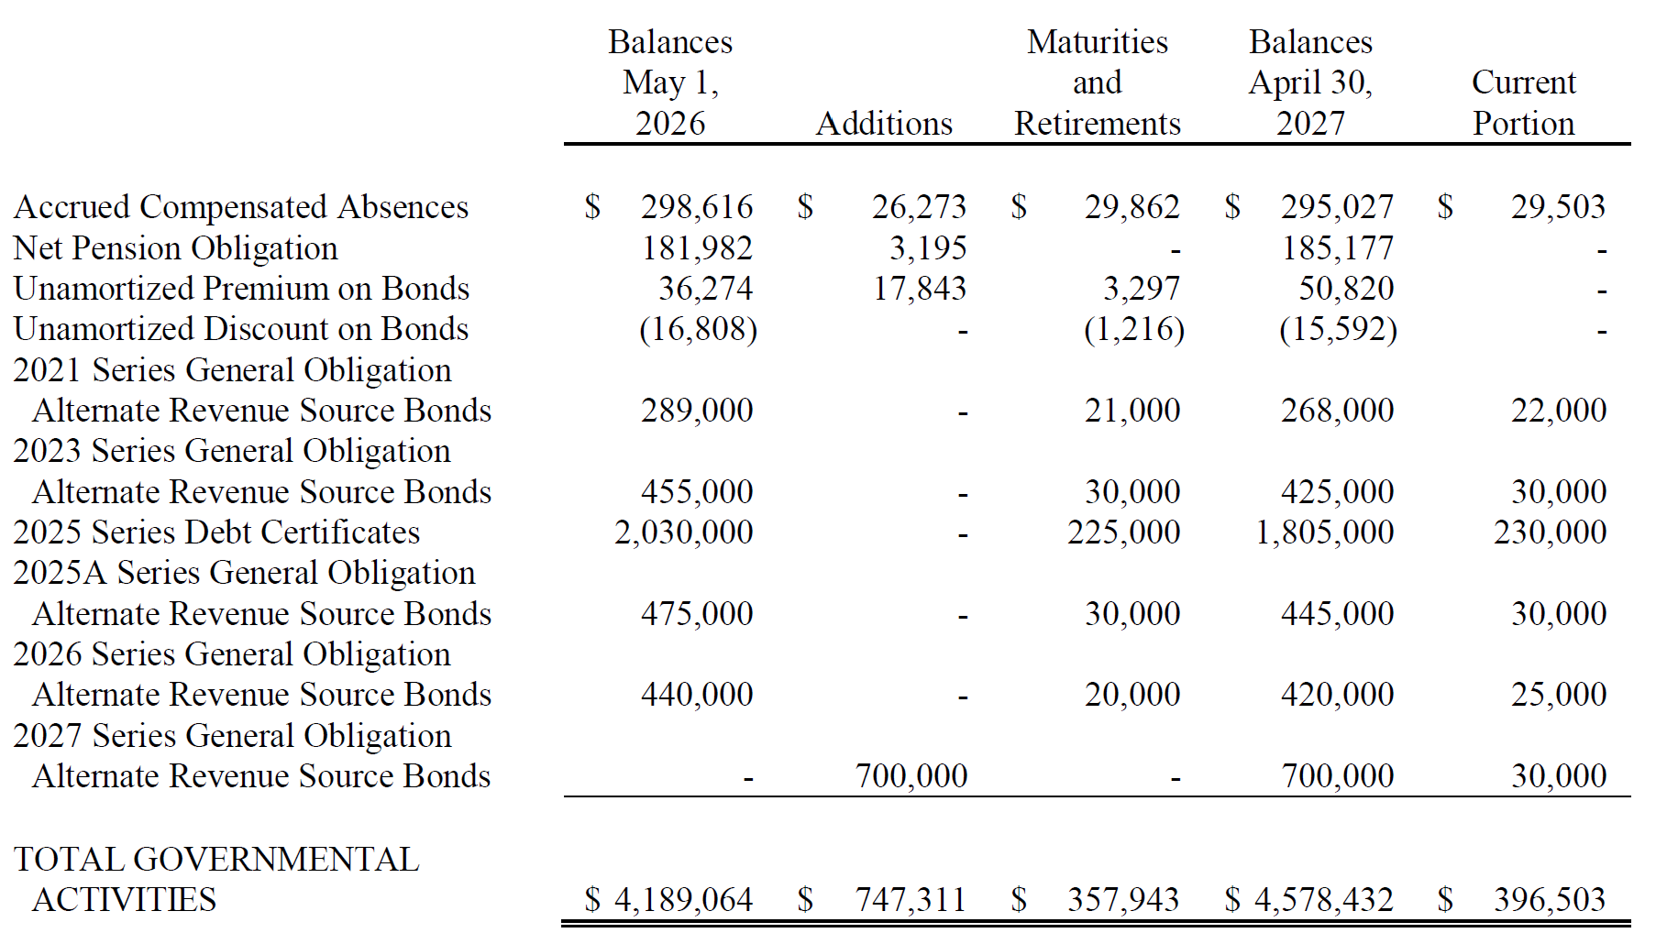
Note Disclosures – Long Term Liabilities
Not Capital
$480,204
$4,578,432 - $480,204 = $4,098,228
Notes:
WE MUST REVIEW THE LONG-TERM DEBT SCHEDULE PROVIDED IN NOTE 5 TO SEE WHAT ALL IS INCLUDED
THE FINANCIAL STATEMENT SHOWS LONG TERM LIABILITIES OF
$396,503 DUE WITHIN ONE YEAR
$4,181,929 DUE IN MORE THAN ONE YEAR
$4,578,432 TOTAL
WE MUST REVIEW THE DETAILS IN THE FOOTNOTES…
NOTE: THE FIRST TWO ITEMS LISTED ARE NOT CAPITAL RELATED
ACCRUED COMPENSATED ABSENCES
NET PENSION OBLIGATION
ALL OTHER ITEMS - UNAMORTIZED PREMIUM AND DISCOUNT ON BONDS AND THE OUTSTANDING BOND ISSUES – ALL ARE RELATED TO CAPITAL
WE CAN THEN TAKE THE TOTAL FROM THE SCHEDULE, SUBTRACT THE FIRST TWO ITEMS THAT ARE NOT CAPITAL RELATED AND GET OUR AMOUNT FOR CAPITAL RELATED BORROWINGS (EXCLUDE UNSPENT PROCEEDS)
NOTE – THE TOTAL WILL ALREADY INCLUDE ORIGINAL ISSUE DISCOUNTS ON CAPITAL DEBT AND ORIGINAL ISSUE PREMIUMS ON CAPITAL DEBT

Slide 12
Example #1 – ANSWER KEY
Notes:
LET’S DROP OUR NUMBERS IN THE CALCULATION
REVIEW EACH NUMBER
NOTE
OUR CAPITAL ASSET NUMBER IS ALREADY NET OF DEPRECIATION
OUR CAPITAL RELATED BORROWINGS NUMBER ALREADY INCLUDES
ORIGINAL ISSUE DISCOUNTS
ORIGINAL ISSUE PREMIUMS
ON CAPITAL-RELATED BORROWINGS IS SAYS TO EXCLUDE UNSPEND PROCEEDS
WE KNOW ALL PROCEEDS HAVE BEEN SPENT SINCE THERE IS NO RESTRICTED CASH ON THE STATEMENTS (REVIEW ASSET SECTION OF STATEMENT – SLIDE 6)
OUR NET INVESTMENT IN CAPITAL ASSETS IS $12,946,068
NOW WE WILL GIVE YOU TIME TO WORK THROUGH EXAMPLE 2 AND 3 – REMEMBER WE ARE DOING GOVERNMENTAL ACTIVITIES ONLY - LET US KNOW IF YOU HAVE ANY QUESTIONS

Slide 13
Example #2 – ANSWER KEY
Notes:
USE MY HAND OUT NOTES TO REVIEW THE ANSWERS

Slide 14
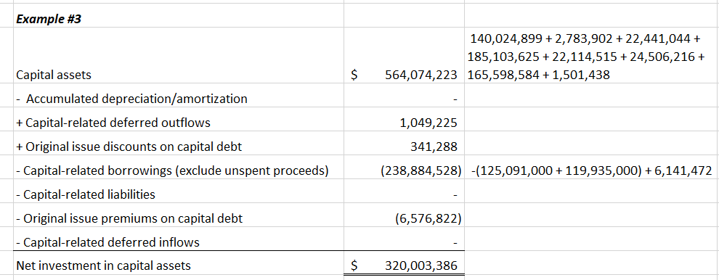
Example #3 – ANSWER KEY
Notes:
USE MY HAND OUT NOTES TO REVIEW THE ANSWERS

Slide 15
Annual Comprehensive Financial Report (ACFR)
15

Slide 16
Place in Authoritative Standards
16
Basic financial statements and RSI = minimum required for fair presentation

Slide 17
Challenges to Financial Statement Users
Governments differ from one another in important ways (structure, authority, services provided)
The basic financial statements provide individual fund data only for major funds
Basic financial statements may not be sufficient to demonstrate compliance with finance-related legal or contractual provisions
Trend data and nonfinancial information are needed to provide context
Users also desire management’s subjective assessment

Slide 18
ACFR
18
Provides users of the government’s financial statements with important additional information
  Profile of the government
  Information on individual funds
  Demonstrating compliance
  Context for analysis
  Subjective analysis
Authoritative accounting and financial reporting standards encourage governments to prepare an ACFR, but it is not required

Slide 19
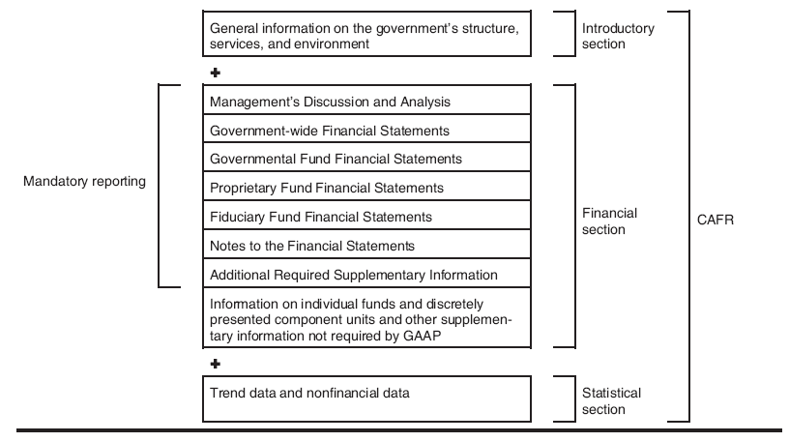
Structure of an ACFR
19
ACFR
Notes:
SAY
This graphic shows a summary of the elements within the main three sections.
In the financial section, notice we have mandatory reporting and also some additional reporting.
TRANSITION
Let’s see how the required supplementary reporting relates to the basic financial statements.

Slide 20
Overview of an ACFR
20
Three basic sections
INTRODUCTORY SECTION
-Table of Contents
-Letter of Transmittal
-Organizational Chart
-List of Principal Officials
-Certificate of Achievement for Excellence in Financial Reporting
FINANCIAL SECTION
-Auditor’s Report
-Management’s Discussion & Analysis
-Basic Financial Statements & Notes
-RSI
-Combining Statements
-Individual Fund Statements
STATISTICAL SECTION
-Financial Trends
-Revenue Capacity
-Debt Capacity/Limitations
-Demographic/Economic Information
-Operating Information
Notes:
These are the required sections for all governments.
Additional sections are required for postemployment benefit plans and for investment pools
Other sections are optional, such as for a federal funds Single Audit
We’re going to
look very quickly at the introductory section
Spend most of our time on the financial section
Just look at contents of the stat section (pretty much what’s here)

Slide 21
Additional Specialized Sections
21
Investment section
  Pension and other postemployment benefit plans
  Investment pools
Actuarial section
  Pension and other postemployment benefit plans

Slide 22
The Financial Statement Audit
22

Slide 23
Assessment of Quantitative Materiality
23
Government-wide financial statements
  Assessed by activity column
Major funds
  Assessed by individual fund
Nonmajor funds
  Assessed in the aggregate, regardless of fund type*
Discretely presented component units
  Assessed in the aggregate*
  *Nonmajor funds and discretely presented component units may be aggregated if not material to the primary government

Slide 24
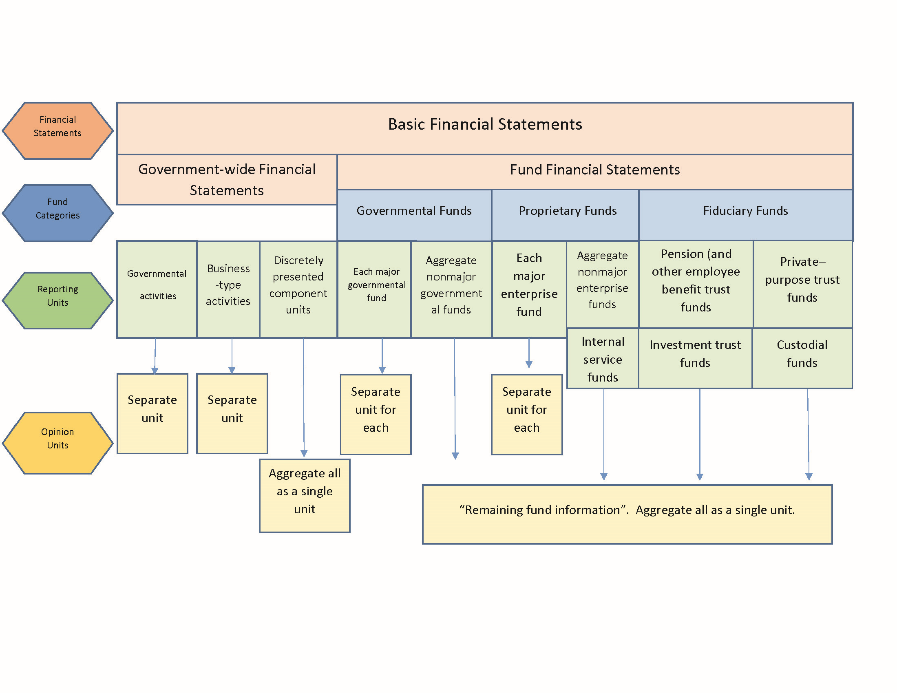
Application of Quantitative Materiality
24

Slide 25
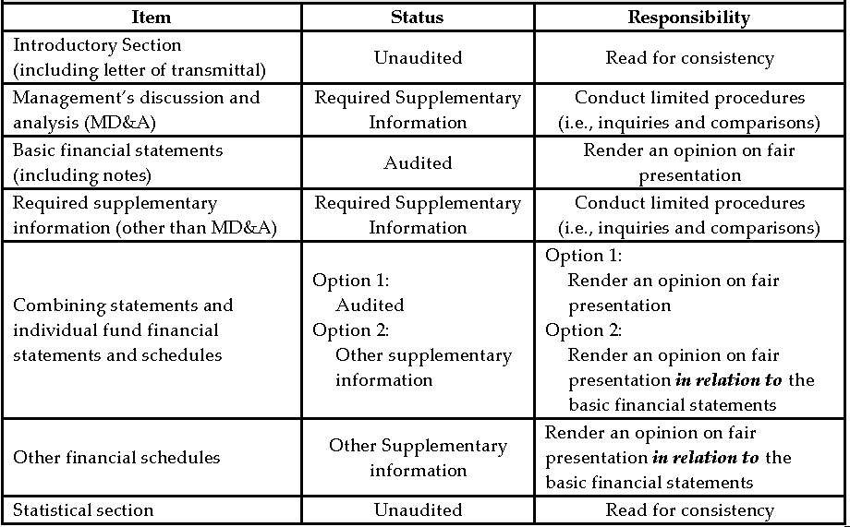
Which Sections are Audited?
25

Slide 26
Auditing Standards
26
Generally accepted auditing standards (GAAS)
Generally accepted government auditing standards (GAGAS)
  Government Auditing Standards (GAS)
  “Yellow Book”
  Use
    Single audits, state mandate, grant requirement, or voluntary use

Slide 27
Relationship Between GAAS and GAGAS
27
GAGAS general standards
  Replace GAAS general standards
GAGAS performance standards
  Build upon GAAS performance standards
GAGAS reporting standards
  Build upon GAAS reporting standards

Slide 28
Reporting: GAAS vs. GAGAS
28
GAAS
  Fair presentation of financial statements
GAGAS
  Fair presentation of financial statements
  Internal control and compliance
    Disclose deficiencies identified during the audit
    No opinion rendered
    Findings vs. letter to management

Slide 29
Audit Findings
29
Four elements
  Criterion/criteria
  Condition
  Cause
  Effect or potential effect
Notes:
<<Add notes>>
<<Add brief recap of slides 77 - 83>>
TRANSITION
Next, we’ll look at MD&A.

Slide 30
Audit Procurement
30
Closely tied to audit quality
Process should
  Be open and competitive
  Produce a comprehensive request for proposals (RFP)
  Give priority to auditor qualifications
  Be documented in a written agreement
Other GFOA recommendations
  Use a multi-year audit contract (five-year minimum)
  Do not mandate auditor rotation

Slide 31
Introductory Section
31
Notes:
NOW WE WILL GET INTO THE OTHER SECTIONS LAUREN IDENTIFIED
I WILL SAY AGAIN
HAVING QUALIFIED AUDITORS THAT SPECIALIZE IN LOCAL GOVERNMENT IS VITALLY IMPORTANT
YOUR AUDITORS SHOULD BE A GREAT RESOURCE FOR YOU BEYOND THE AUDIT
FIRST, WE WILL DISCUSS THE INTRODUCTORY SECTION

Slide 32
Sources of Guidance
32
Authoritative standards prescribe
  Table of contents
  Letter(s) of transmittal (no detail)
  “Other material deemed appropriate by management”
Government Finance Officers Association (GFOA) recommends the inclusion of
  Organizational chart/list of principal officials
  Reproduction of the Certificate of Achievement for Excellence in Financial Reporting (if applicable)
GFOA also offers guidance on the basic contents of the letter of transmittal
Notes:
SOURCE OF GUIDANCE ON WHAT TO INCLUDE IN THE INTRODUCTORY SECTION
Authoritative standards prescribe
Table of contents
Letter(s) of transmittal (no detail)
“Other material deemed appropriate by management”
Government Finance Officers Association (GFOA) recommends the inclusion of
Organizational chart/list of principal officials
Reproduction of the Certificate of Achievement for Excellence in Financial Reporting (if applicable)
GFOA also offers guidance on the basic contents of the letter of transmittal
Your GAAFR (Governmental Accounting, Auditing, and Financial Reporting; otherwise known as the Blue Book) is another great resource.

Slide 33
Table of Contents
33
Clearly delineate basic sections of the report
  Introductory
  Financial
  Statistical
  Additional section(s) if applicable (Single Audit report)
Subdivide financial section
  ACFR audit
  Management’s discussion and analysis
  Basic statements (include notes)
RSI other than MD&A
Other supplementary information
Full title for statements and schedules
Notes:
Here’s what makes UP the TABLE OF CONTENTS – REVIEW THE SLIDE
There should be a clear distinction between the basic sections of the report.
Also, clear distinctions for key subdivisions within section
Introductory sections are often numbered using lower roman numerals, rather than as part of numbering of rest of comprehensive ACFR; tradition, not required
For every financial report, notes to financial statements are part of the Basic Financial Statements; Reconciliations are part of fund financial statements
Statements and schedules should include full names, even if it takes up three lines to do it!
REFER TO THE TABLE OF CONTENTS IN YOUR ACFR

Slide 34
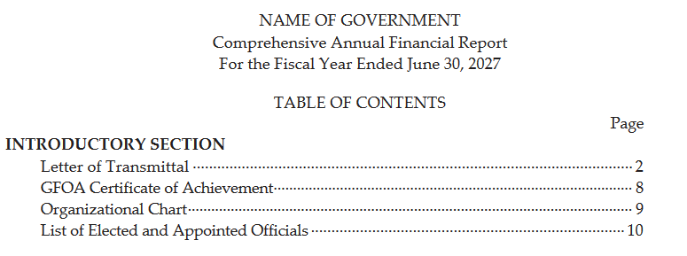
Example - Table of Contents
34
Notes:
HERE IS AN EXAMPLE OF THE INTRODUCTORY SECTION OF THE TABLE OF CONTENTS

Slide 35
Letter of Transmittal
35
Notes:
NOW WE WILL DISCUSS THE LETTER OF TRANSMITTAL

Slide 36
What is a Letter of Transmittal?
36
Purpose
  Introduce the government and its financial statements
  Serve as formal ‘cover letter’ for the ACFR
  Provide financial and economic analyses
  Avoid duplication with management’s discussion and analysis “MD&A”
The Letter of Transmittal is the only place in the ACFR where you can include prospective/subjective information
Notes:
WHAT IS THE PURPOSE OF THE LETTER OF TRANSMITTAL?
Letter of transmittal is essentially the cover letter for the ACFR
There is wide latitude on content & arrangement
Highlights about government, finances and economy
Really try to avoid repetition.
NYC – Had descriptions of each of their CUs in the LOT, MD&A, and note disclosures
This is the Only place for any substantive subjectivity. Brag away, so long as it doesn’t conflict.
Not subject to audit

Slide 37
Format
37
Presented on government’s letterhead
Dated (no earlier than date of independent auditor’s report)
Normally addressed to citizens and the governing board
Keep discussion simple and straightforward
Use charts and graphs
Signatures
  Chief financial officer (minimum)
  Chief executive/operating officer
  May have two separate letters
Notes:
FORMAT
Presented on government’s letterhead
Dated (no earlier than date of independent auditor’s report)
Normally addressed to citizens and the governing board
Keep discussion simple and straightforward
Use charts and graphs
Optional: don’t see a huge number but many have at least a couple.
Don’t want to have same content as MD&A.
Signatures
Chief financial officer (minimum)
Chief executive/operating officer
May have two separate letters
LOOK AT THE LETTER OF TRANSMITTAL IN YOUR ACFR – WHO SIGNED THE LETTER?

Slide 38
Format (cont.)
38
  Four Parts
  Formal transmittal
  Profile of government
  Information useful in assessing the
  government’s economic condition
  Awards/Acknowledgments
Required for the GFOA’s Certificate of Achievement for Excellence in Financial Reporting Award
Authoritative guidance requires a comprehensive report include a letter of transmittal, however, the format and content of the letter are not specified. (GASB COD 2200.704-1; GASBIG 2016-1 Q 5.10)
Notes:
Having a transmittal is required by GAAP but no guidance about what should be in it.
GFOA requires at least these FOUR PARTS, as applicable, for Certificate of Achievement program.
The content can be arranged in any order within the letter of transmittal.
HOW MANY OF YOU APPLY FOR GFOA’s CERTIFICATE OF ACHIEVEMENT FOR EXCELLENCE IN FINANCIAL REPORTING?
TRANSITION
Let’s look at each of these four parts in more detail.

Slide 39
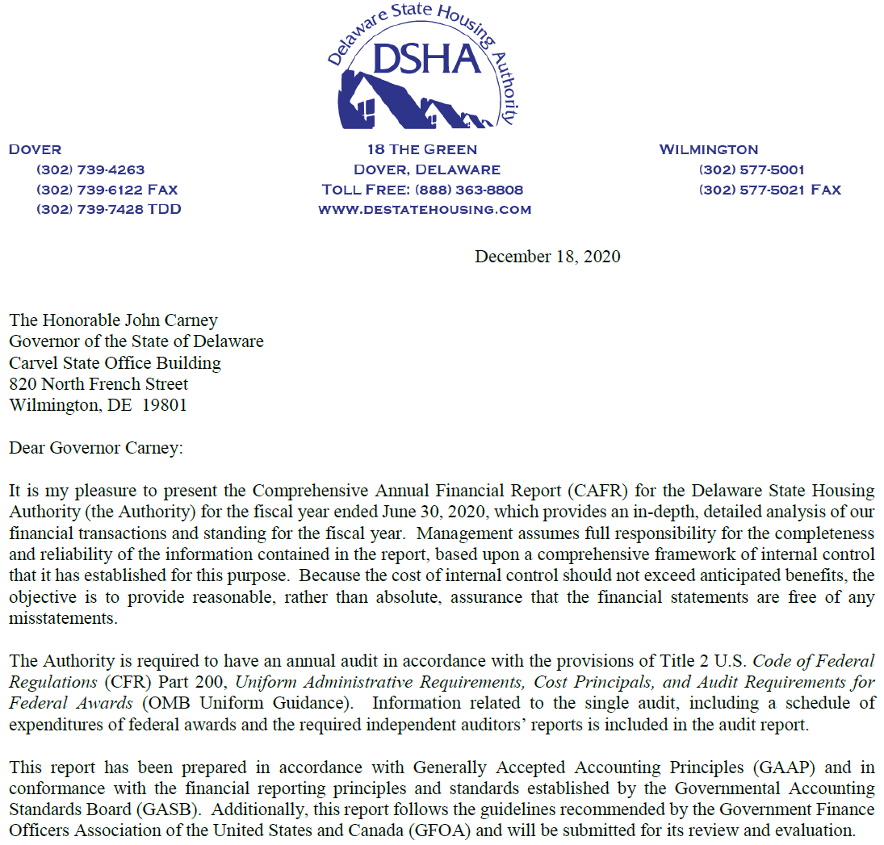
Example - Formal Transmittal
39
Management assumes full responsibility for the completeness and reliability of the information contained in the report, based upon a comprehensive framework of internal control that it has established for this purpose.
The Authority is required to have an annual audit in accordance with the provisions of Title 2 U.S. Code of Federal
Regulations (CFR) Part 200, Uniform Administrative Requirements, Cost Principals, and Audit Requirements for
Federal Awards (OMB Uniform Guidance).
Notes:
HERE IS AN EXAMPLE OF THE FIRST PART OF A LETTER OF TRANSMITTAL:
On letter head, dated same or later than auditor’s opinion
[CLICK] Management’s assumption of responsibility, acknowledgement of limitations of internal control
[CLICK] Delaware State Housing Authority (DSHA) includes it’s Federal funds Single Audit report as part of its ACFR
HOW MANY OF YOU INCLUDE YOUR SINGLE AUDIT AS PART OF YOUR ACFR?
OTHERWISE, THE SINGLE AUDIT IS A SEPARATE REPORT

Slide 40
Profile of the Government
40
Who does the government serve?
How do they govern?
Possible factors for inclusion:
  Population
  Structure (e.g., council-manager vs. mayor-council)
  Types and levels of services provided
  Component units
    Any potential component units excluded
  Brief summary of budget process
  Governmental funds with annual/biennial appropriated budget
  Legal level of budgetary control
Notes:
NEXT GIVE A PROFILE OF THE GOVERNMENT
Who does the government serve?
How do they govern?
Possible factors for inclusion:
Population
Structure (e.g., council-manager vs. mayor-council)
Types and levels of services provided
Component units and any potential component units excluded
Brief summary of budget process
Governmental funds with annual/biennial appropriated budget
Legal level of budgetary control

Slide 41
Information Useful in Assessing Economic Condition
41
Function = To identify factors that could cause today’s financial position to improve or deteriorate in the future
Types of information useful for this purpose
  Information regarding the local economy
  Results of long-term financial planning
  Relevant financial policies
  Major initiatives
  Budget
Notes:
THEN PROVIDE INFORMATION USEFUL FOR THE READER TO ASSESS THE ECONOMIC CONDITION OF YOUR ENTITY
Identify factors that could cause today’s financial position to improve or deteriorate in the future
Types of information useful for this purpose
Information regarding the local economy
Results of long-term financial planning
Relevant financial policies
Major initiatives
Budget
THE ACFR (ALONG WITH OUR ANNUAL BUDGET DOCUMENT) SHOULD BE A GREAT RESOURCE ON WHAT IS GOING ON IN YOUR CITY/ENTITY

Slide 42
Awards and Acknowledgements
42
Awards
  Objective indicators of the quality of the government’s financial management
    Certificate of Achievement for Excellence in Financial Reporting
    Other awards
Acknowledgements
  Those who played a significant role in preparing the report or internal control
Notes:
AWARDS AND ACKNOWLEDGEMENTS
Awards
Objective indicators of the quality of the government’s financial management
Certificate of Achievement for Excellence in Financial Reporting
Other awards
Acknowledgements
Those who played a significant role in preparing the report or internal control

Slide 43

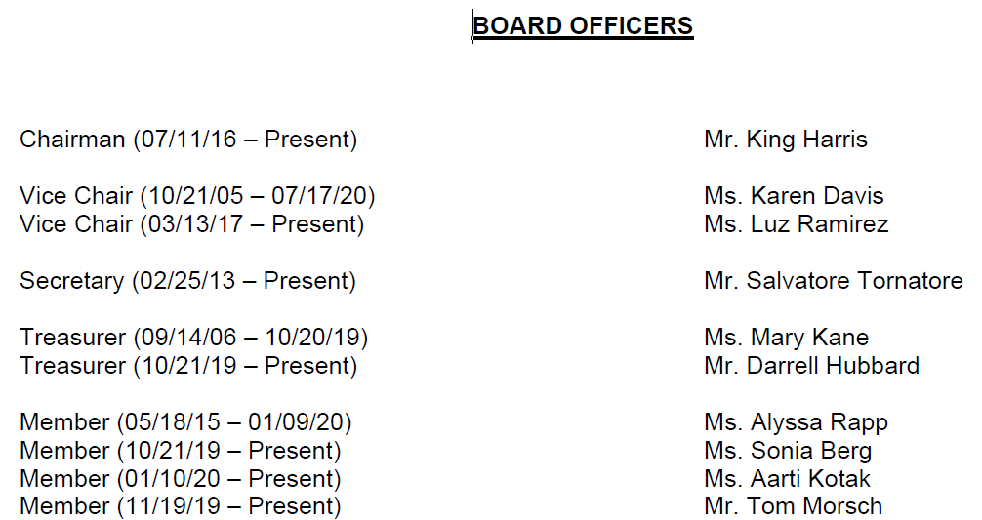
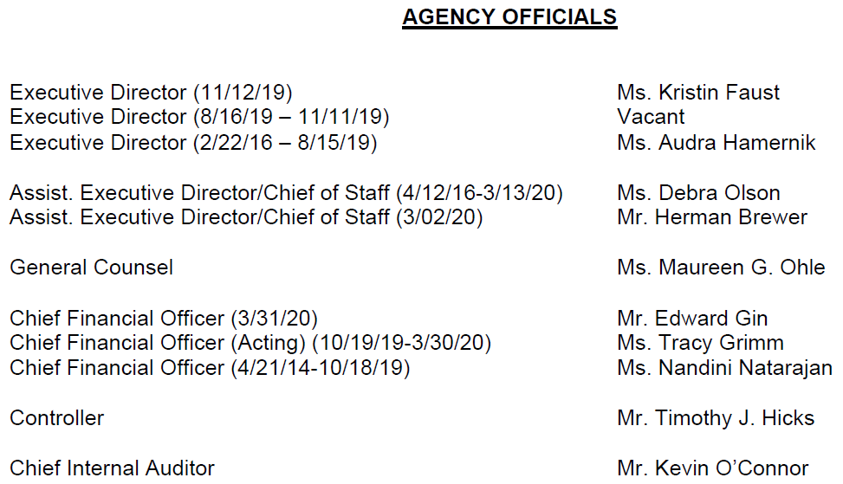
List of Principal Officials
43
Notes:
THIS IS AN EXAMPLE OF A LIST OF PRINCIPAL OFFICIALS (ILLINOIS HOUSING DEVELOPMENT AUTHORITY)
NOTE THE LIST OF PRINCIPAL OFFICIALS IN YOUR ACFR

Slide 44
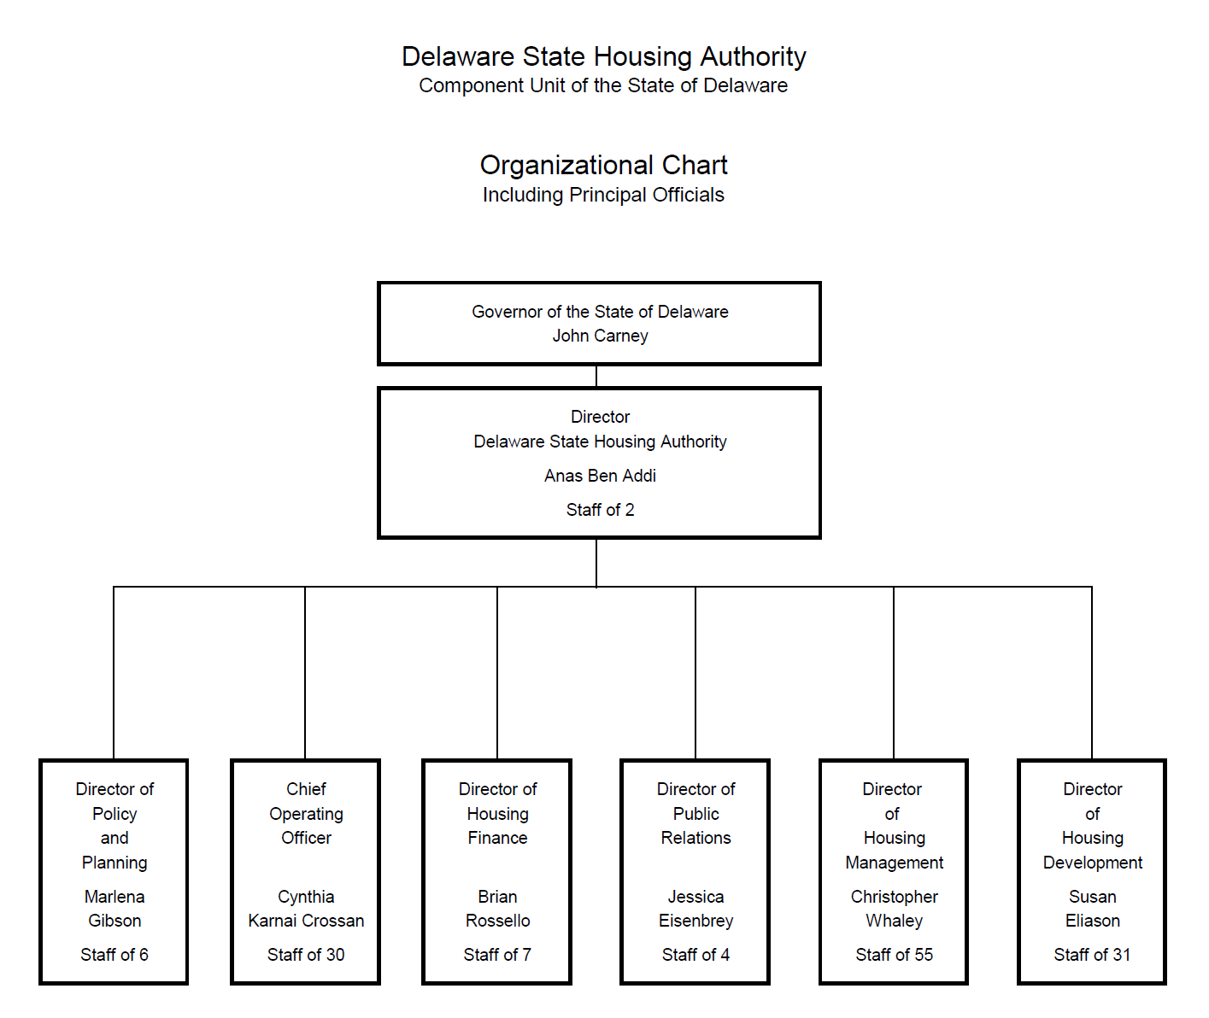
Organizational Chart - Example
44
Notes:
THIS IS AN EXAMPLE OF A LIST OF AN ORGANIZATIONAL CHART (DELAWARE STATE HOUSING AUTHORITY)
NOTE THE LIST THE ORG CHART IN YOUR ACFR – MAKE SURE IT IS UPDATED TO CURRENT CHART EACH YEAR AT YEAR-END

Slide 45
Certificate of Achievement
45
Reproduce the Certificate of Achievement for the preceding year
Notes:
CERTIFICATE OF ACHIEVEMENT – FOR THE PRECEDING YEAR

Slide 46
Management Discussion and Analysis (MD&A)
46
Notes:
NOW WE WILL DISCUSS THE MANAGEMENT DISCUSSION AND ANALYSIS SECTION
THE MD&A
TURN TO THE MD&A IN YOUR ACFR

Slide 47
What is Management’s Discussion and Analysis?
47
Required supplementary information
Purpose
  Analysis of financial position and results (why things are the way they are
  “Objective and easily readable”
Currently known facts, decisions, or conditions
Focus on primary government
Reference notes, but do not duplicate notes
Topics limited by GASB Codification 2200.109 (GASB Statement No. 34)
  “Minimum is the maximum”
Notes:
WHAT IS THE MD&A?
IT IS REQUIRED SUPPLEMENTARY INFORMATION
THE PURPOSE
To introduce the reader to the Basic Financial Statement
To provide the reader an analytical overview of the govt’s financial activities
The analysis should be objective and easily readable.
Currently known facts
Why things are the way they are
Unlike the Letter of Transmittal, the MD&A cannot provide any “subjective” information
Information should be facts based; only currently known facts, decisions, or conditions; things that have already happened. It should discuss current year results in comparison with prior year; emphasis on current year. Discuss both positive and negative results.
Focus of the MD&A is always on primary govt; normally do not include info on any CUs, unless, it has a significant relationship w/primary govt. If a govt must include CU information in MD&A; should always discuss primary govt first, and clearly distinguish CU from the PG.
It’s very common for the MD&A to address something that is covered in the notes, for example a major capital construction project. Summarize in MD&A and refer readers to notes for more info. Do not duplicate
Authoritative standards limit the MD&A to 8 topics only (we will review the 8 topics next)- Minimum is the maximum. All must be addressed, unless it doesn’t apply to your particular government, and only those topics.
Try to avoid boilerplate discussions and focus on the most important information.

Slide 48
What’s Included in MD&A?
48
Discussion of the basic financial statements
Condensed comparative data
Analysis of financial position and results of operations - overall
Analysis of the balances and transactions - by individual funds
Budgetary variations analysis
Description of long-term activity - capital assets and debt
Discussion of infrastructure (if modified approach is used)
Discussion of currently known items expected to have significant effect in future
Notes:
HERE ARE THE EIGHT REQUIRED ELEMENTS
Read list of 8 elements.
We’ll discuss the modified approach to infrastructure further when get to #7.
Adding colorful charts and graphs to supplement this information is a great idea and encouraged. It makes it easier for your readers to interpret some of the information that is presented. The term “easily readable” is right in the GASB Codification section on the MD&A. We need to remember who our FS readers are not just rating agencies and banks, but average citizens as well. The charts and graphs can’t replace the narrative information, but it can supplement it.
TRANSITION
We’re going to take a closer look at each of these eight elements.

Slide 49
1. Discussion of the Basic Financial Statements
49
Financial statement overview
  Parts of the financial report
  Relationship between government-wide financial statements and fund financial statements
    Analysis of significant differences resulting from the use of a different measurement focus and basis of accounting
  Other funds reported
Notes:
#1 Brief discussion of the Basic Financial Statements and the relationships of the statements to each other
For example, the govt-wide statements’ relationship to the fund statements. This discussion should include the significant differences in the information they provide.
Any other funds reported

Slide 50
1. Discussion of the Basic Financial Statements (cont.)
50
Financial highlights
  Total revenues, expenses by activity type (governmental and business-type)
  Net position by activity type
  Total fund revenues by major source; total fund expenditures/expenses by major function/activity
  Restrictions on fund balance/net position
  Significant changes in debt balances
Notes:
The MD&A should also include financial highlights – a brief overview and analysis of your govt’s activities for the year.
Total revenues, expenses by activity type (governmental and business-type)
Net position by activity type
Total fund revenues by major source; total fund expenditures/expenses by major function/activity
Restrictions on fund balance/net position
Significant changes in debt balances
The MD&A Analysis should answer the question why?
As we will be repeating throughout the training, make sure the data you are reporting in the financial highlights and the entire MD&A ties to the data in the BFS.
LOOK IN YOUR ACFR MD&A SECTION – DOES IT INCLUDE A HIGHLIGHTS SECTION?

Slide 51
2. Condensed Comparative Data
51
Specific format (see next slide)
Government-wide
  Report governmental activities and business-type activities separately
Report two years – current and prior years only
  If basic financial statements are comparative, report three years
May use charts and graphs to supplement the required presentation, but not as a substitute
Often times, overall analysis (part 3) is combined with the condensed comparative data
Notes:
#2 PROVIDE CONDENSED COMPARATIVE DATA
Financial info from the govt-wide statements comparing current yr to prior yr
Report two years.
If your govt. presents comparative basic financial statements,
Then within this condensed data section of the MD&A, must present 3 yrs of financial data
Current and two prior yrs.
We’ll look at the specific format for each on the next slide
May use charts and graphs to supplement the required presentation, but not as a substitute
Often times, overall analysis (part 3) is combined with the condensed comparative data

Slide 52
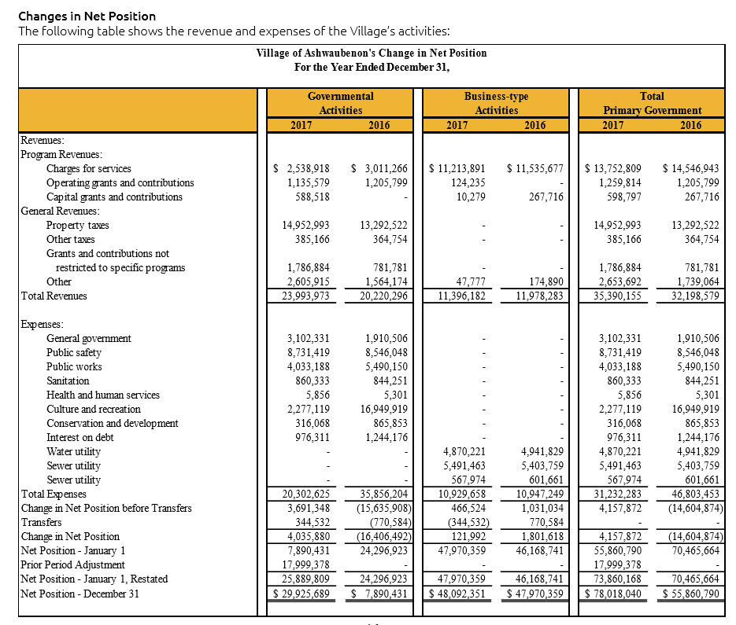

Example - Condensed Comparative Data
52
Notes:
EXAMPLE – CONDENSED COMPARATIVE DATA
Example of Condensed comparative data on change in net position.
Separate columns for governmental and business-type activities then total primary government.

Slide 53
3. Overall Analysis
53
Government’s overall financial position and results of operations
  Improved or deteriorated?
  Focus on reasons for significant changes – Answer the question “Why?”
  Address governmental and business-type activities separately
  Economic factors that affected results of operations
Notes:
3rd requirement is analysis of govt’s overall financial position and results of operations
Help readers determine whether the financial position has improved or deteriorated over the past year.
Most often combined with the comparative data in #2, which is how your govt. presents it as well.
Address both governmental activities and business-type activities separately
Include reasons for significant changes from the prior year. Answer question why?
Focus on significant- don’t need to report all changes; be brief.
Discuss important economic factors that significantly affected operating results for the year as well, such as changes in the tax base, or employment base (perhaps you lost a major retailer, which significantly affected your sales tax base).
This is a great area to supplement with colorful charts or graphs.
Again, you should discuss govtl activities separately from business-type activities.

Slide 54
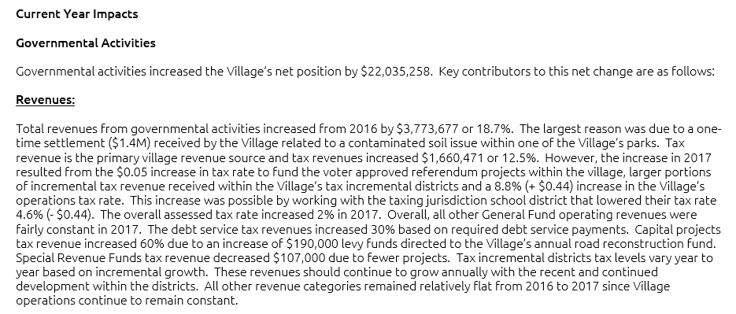
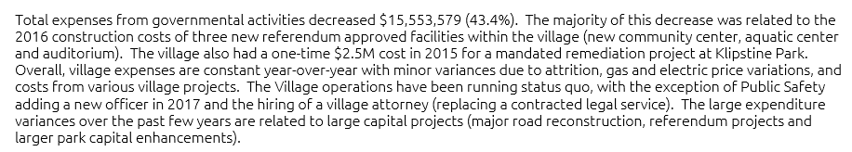
Example - Overall Analysis
54
Notes:
Example of Providing analysis, not just numbers. Answer why?

Slide 55
4. Fund Analysis
55
Significant balances and transactions of individual major funds
  Focus on reasons for significant changes in fund balances (governmental funds) or fund net position (proprietary funds) – Explain why?
  Limitations on resource availability
Required for all major funds but may discuss nonmajor funds as well
Notes:
In the first three required sections of the MD&A, we provided a brief analysis of the govt. as a whole.
Next in the MD&A we must provide a Fund Analysis on the individual major funds. (#4)
Need to provide analysis- reasons for significant changes in fund balance or fund net position.
Also, whether there are any restrictions, commitments, or other limitations that may significantly affect the availability of fund resources for use in the future.
Required for all major funds (both governmental and proprietary major funds) but can discuss nonmajor funds as well. Although, suggest only discussing a nonmajor fund if there was a significant change that was important to the govt.
This is another great area in which to supplement with charts or graphs, for example when discussing a change in a major revenue source.

Slide 56
5. Budgetary Variations (General Fund Only)
56
Reasons for significant variations
  Original vs. final amended budget
  Final amended budget vs. actual
Currently known reasons for variations that are expected to have a significant effect on:
  Future service levels
  Liquidity
Explain why these variances occurred and how they may affect future activities
Notes:
The fifth required section is to include Budgetary Variations (GENERAL FUND ONLY)
Applies to the General Fund (or its equivalent) only.
Explain the underlying reasons for significant variations
Between original and final budget amounts; AND
Between final budget amounts and actual results.
For example, focus on what specific factors necessitated the budgetary amendments.
Include any currently known reasons for the variations that are expected to have a significant effect on future services or liquidity.
Explain why these variances occurred and how they may affect future activities

Slide 57
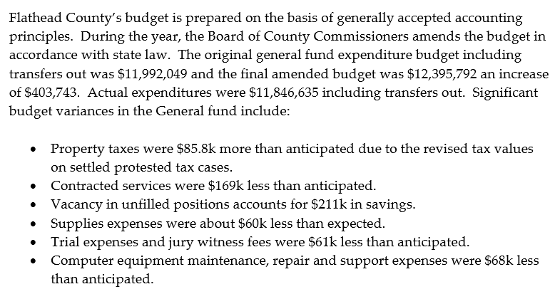

Example – Budgetary Variations
57
Notes:
An example of what the discussion of budgetary variations for the General Fund would look like.
FLATHEAD COUNTY – STATE OF MONTANA
NOTE
Identify major reasons for variances – not all variances

Slide 58
6. Capital Asset and Long-Term Debt Activity
58
Capital Assets
  Significant additions/deletions
  Construction commitments
Long-Term Debt
  Significant changes in balances
  Changes in credit ratings
  Effects on debt limitations
Exclude no-commitment special assessment debt, but not related asset
Summarize and reference notes but do not duplicate notes
Notes:
The sixth required section is Capital Asset and Long-Term Debt activity
Describe significant activity involving capital assets
Include: Commitments made for capital construction
Or significant additions or deletions to the govt’s CAs during the year
For example - completed construction and placed into service a major capital asset (water treatment plant)
Also need to address significant long-term debt activity
Which may include: Issuance of debt, retirement or refunding of debt, changes to credit ratings, or debt limitations that could affect the financing of capital facilities or services in the future.
This discussion would not include special assessment debt for which the govt. wasn’t obligated in any manner, since the obligation would not constitute debt for the govt.
Here is where we are going to see some overlap with the notes to the FS; as changes in capital assets and changes in long-term liabilities are reported in the notes.
In MD&A, shouldn’t simply report same information as in the notes, but summarize the relevant information in the MD&A and refer the readers to a specific note in the FS for more detailed information.

Slide 59
7. Infrastructure (If Modified Approach is Used)
59
Modified approach – Infrastructure assets that are a part of a network or subsystem of a network and are not required to be depreciated as long as two requirements are met. (1) Must manage the infrastructure using an asset management system; and (2) Must document that assets are being preserved approximately at or above the condition level disclosed by the government.
Compare current condition levels vs. target condition levels
Address significant changes in condition levels
Significant differences between estimated vs. actual amounts spent for current period maintenance and preservation
Notes:
OK, HERE IS SECTION #7 INFRASTRUCTURE (INCLUDE ONLY IF MODIFIED APPROACH IS USED)
WHAT IS THE MODIFIED APPROACH?
Governments have option to report certain networks or subsystems of infrastructure capital assets using the modified approach, which eliminates the need to record depreciation expense. If a government elects to use the modified approach for one or more of its networks or subsystems of infrastructure, some discussion of that infrastructure is required in the MD&A.
Read 1st bullet. Common examples: Bridges, tunnels, highway systems. Most often used by large governments, such as states, large counties, large cities.
Discussion should include:
Significant changes in condition level of the network or subsystem
How the current condition compares with the targeted condition level
Any significant differences between amount estimated to be necessary for maintaining or preserving the assets at the target condition level, and the actual amount of expense incurred for that purpose in the current period.
If your govt. doesn’t report any Capital Assets using the modified approach, you would simply skip this topic.

Slide 60
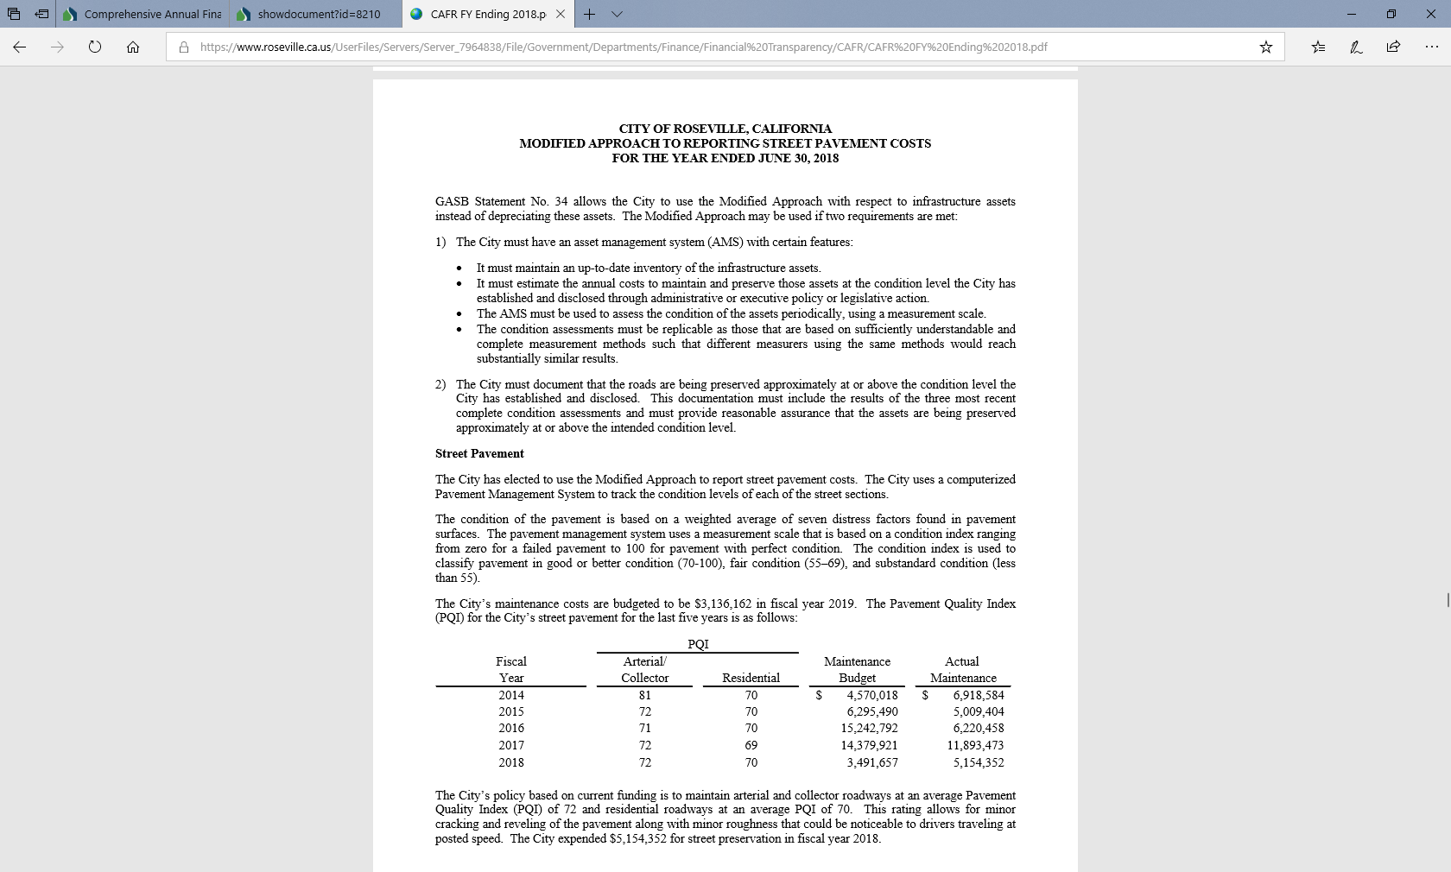

Infrastructure - Example
60
Notes:
Example of the City of Roseville, CA which uses the modified approach in reporting its network of streets.
DOES ANYONE USE THE MODIFIED APPROACH TO INFRASTRUCTURE?

Slide 61
8. Currently Known and Expected to Impact Future
61
Currently known facts, decisions, or conditions expected to have a significant effect on financial position or results of operations
  “Currently known” = known by management as of the date of the annual comprehensive financial report audit
  Factors already in place
    A bill that has been enacted
    A resolution has been adopted
    A decision has been agreed upon
    A contract that has been signed
  Cover both governmental and business-type activities
  Discuss all applicable items, both internal and external
  Refer to the notes but do not duplicate
Notes:
FINAL SECTION - #8 CURRENLTY KNOWN AND EXPECTED TO IMPACT FUTURE
Finally, MD&A should discuss facts, decisions, or conditions that are both currently known, and expected to have a significant effect on the govt’s net position or results from operations.
This also includes if there is a substantial doubt about the govt continuing as a going concern.
“Currently known” = known by management as of the date of the annual comprehensive financial report audit
Factors already in place
A bill that has been enacted
A resolution has been adopted
A decision has been agreed upon
A contract that has been signed
Cover both governmental and business-type activities
Discuss all applicable items, both internal and external
Refer to the notes but do not duplicate

Slide 62
Understanding the ACFR Introductory Section and Financial Section
EXERCISE
62
Notes:
NOW WE WILL COMPLETE ANOTHER EXERCISE ON THE ACFR INTRODUCTORY AND FINANCIAL SECTION
THIS IS EXERCISE #8 IN THE MATERIALS PROVIDED BEFORE CLASS
YOU NEED TO USE APPENDIX D OF THE 2020 GAAFR – PULL UP FILE FOR APPENDIX D
www.gfoa.org/GAAFR/AppendixD

Slide 63
Note Disclosures
63

Slide 64
Purpose of Note Disclosures
64
Note disclosures contain information that
  Explains, describes, or supplements the financial statements, and
  Is essential to users in making economic, social, or political decisions or assessing accountability
Notes are integral to BFS
Notes are necessary to make financial statements complete
  Thus the term basic financial statements includes note disclosures
Notes:
GASB Concepts Statement No. 7, Communication Methods in General Purpose External Financial Reports That Contain Basic Financial Statements: Notes to Financial Statements. Issued June 2022; amends Concepts Statement No. 3
No substantial changes from existing concepts statement

Slide 65
Criteria for Note Disclosures
65
Notes to financial statements are essential to users in making economic, social, or political decisions, or assessing accountability
Information in note disclosures should include
  Descriptions of accounting and finance-related policies underlying amounts recognized in financial statements
  Additional detail about, or explanations of, amounts recognized in financial statements
  Information about the financial position or inflows or outflows of resources that does not meet the criteria for recognition
  Other finance-related information associated with the accountability of the government

Slide 66
Criteria for Note Disclosures (cont.)
66
Information in note disclosures should not include
  Subjective assessments of the effects of reported information on government’s future financial position
    EXCEPTION: Assumptions about the future that are inputs to measures (estimates) in the current financial statements
  Predictions about the effects of future events on future financial position
  General or educational information that is not specific to the government
Notes:
No
Future predictions, even based on current information in note disclosures
Explanations in SSAP about fund types the government does not report!
Note again that this is different from the proposals on changes to the financial reporting model regarding MD&A, where some explanation of the different MFBAs used in different financial statements has been included.

Slide 67
Essentiality
67
Characteristics of essential information
  Information has, or is expected to have, a meaningful effect on users’ analysis for making decisions or assessing accountability
  A breadth or depth of users utilize, or are expected to utilize, the information in their analyses for making decisions or assessing accountability
Notes:
This is a key element of Cons 7, in that it is an attempt to provide meaningful guidance on what constitutes essential information.
GASB “test drove” this approach in developing the proposal for certain risk disclosures in their recent exposure draft (which Michele will discuss next). In that case, GASB puts the onus on users to be able to articulate how the information would have a meaningful impact on their analysis and assessment, rather than just saying that they would do so. Where a “breath or depth of users” included in a survey failed were unable to articulate a meaningful impact for certain contemplated disclosures, GASB ultimately excluded those from the proposals in the ED.
Based on interpretations of that “test drive” a loose explanation of what is meant by
“breadth of users” is that users in many categories of users (academic, citizen and advocacy, muni bond market participants) articulate how the information would meaningfully impact their analysis and assessment
“depth of users” is that a large proportion of users in at least one category of users articulate how the information would meaningfully impact their analysis and assessment
Previously, GASB may have been swayed (overly swayed?) by a more general response from analysts and others that they would use proposed additional disclosures. Many people, especially on the preparer side, recognize that a professed desire for more free information does not necessarily mean it is “essential,” and might unfairly weight the cost-benefit analysis that GASB’s due process requires before the issuance of pronouncements.

Slide 68
Summary of Significant Accounting Policies (SSAP)
68

Slide 69
SSAP Contents
69
Description of government-wide financial statements
Basis of presentation (including measurement focus and basis of accounting) – government-wide financial statements
  Component units (include specific criteria for incorporation)
  Governmental and business-type activities
Basis of presentation (including measurement focus and basis of accounting) – fund financial statements; including descriptions of activities for:
  Major funds (governmental and enterprise)
  Fund types (internal service, each type of fiduciary)
Notes:
SSAP—Describes all of the significant accounting policies used in the preparation of the basic financial statements
All other notes
CUs –
Whether entity is a CUs
Each CU and relationship, reason for inclusion, treatment (blending, DPCU), and reason for treatment

Slide 70
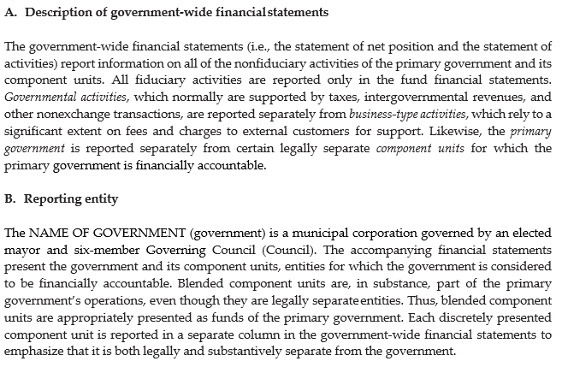
Description of the Reporting Entity
70

Slide 71
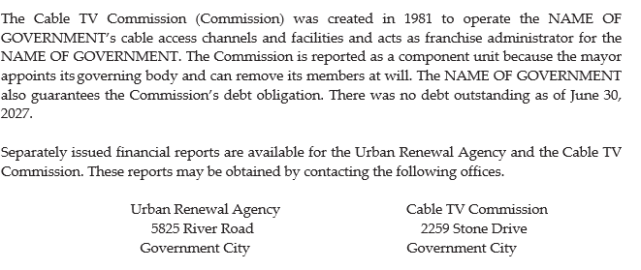
Description of the Reporting Entity (cont.)
71
Be specific!

Slide 72
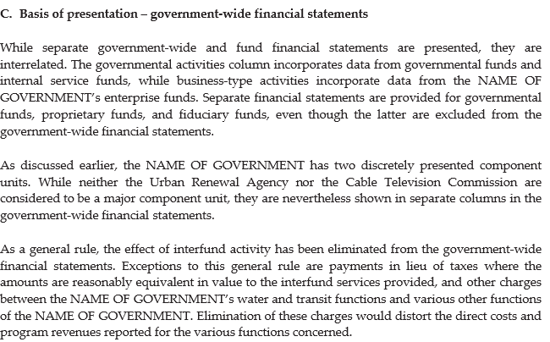
Basis of Presentation – Government-wide
72

Slide 73
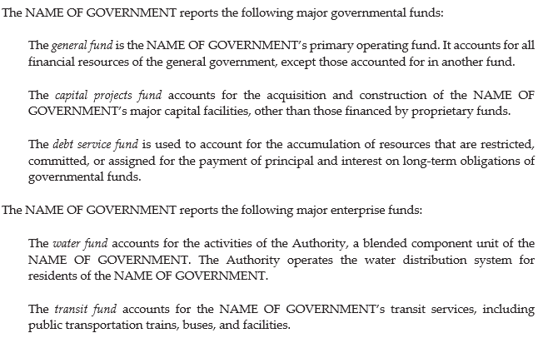
Basis of Presentation – Funds
73

Slide 74
SSAP Contents (cont.)
74
Other explanations and definitions, including
  Cash and cash equivalents
  Deferred resource flows
  Capitalization policies
  Valuation bases
  Flow policies for resources used
    Restricted v unrestricted
    Committed, assigned, unassigned

Slide 75
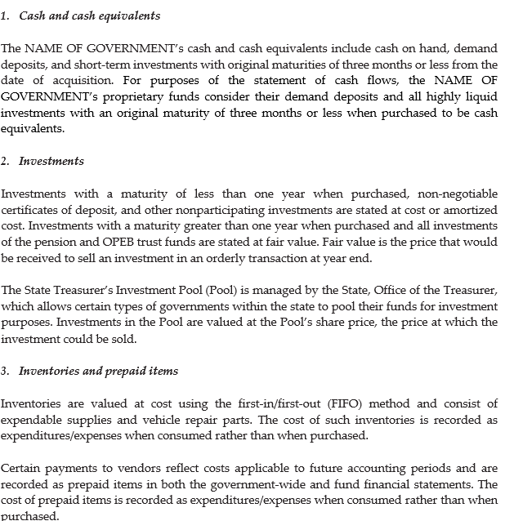
Elements of the Statement of Net Position
75

Slide 76
Budgetary Data
76
Budgetary basis of accounting
  Describe the budgetary basis of accounting (if other than GAAP) and how it differs from GAAP
Excess of expenditures over appropriations
  Disclose any excess of expenditures over appropriations in the
    General fund and
    individual major special revenue funds, for which an annual (or biennial) budget is legally adopted
    if not otherwise visible

Slide 77
Revenues and Expenditures/Expenses
77
Types of transactions included in program revenues in the government-wide statement of net position
Policy for allocating indirect expense to functions in the government-wide statement of activities
  Mention if indirect costs are reported as a functional expense as the result of an administrative cost recovery element built into a charge for centralized services

Slide 78
Revenues and Expenditures/Expenses (cont.)
78
Property tax revenue recognition
  Indicate the lien dates, levy dates, due dates, and the collection dates, along with the availability period used for property taxes
Compensated absences
  Are employees reimbursed for sick time upon retirement?
Define operating revenues and operating expenses in proprietary fund, and distinguish between operating and nonoperating revenues

Slide 79
Detailed Notes to the Financial Statements
79

Slide 80
What Must Be Disclosed?
80
Policies underlying the amounts displayed in the financial statements
  Additional detail or explanations concerning amounts displayed, and information on items that are not displayed because they do not meet the criteria for recognition (i.e. can’t be measured with sufficient reliability)
Must have a clear and demonstrable relationship to information in the financial statements, and be essential to the user’s understanding of the financial statements
Avoid negative disclosure

Slide 81
Major Categories of Note Disclosures Other Than SSAP
81
Reconciliations between government-wide and fund financial statements
Stewardship, compliance and accountability
Accounting changes
Bankruptcies
Going-concern considerations
Detailed disclosures on all activities and funds
Rare!

Slide 82
Detailed Disclosures on All Activities and Funds – Overview
82
All Activities and Funds
Other Disclosures
Assets
Deferred outflows of resources
Liabilities
Deferred inflows of resources
Net position
Fund balance
Interfund balances
Revenues
Expenditures/expenses
Interfund transactions
Segment information
Major discretely presented CUs
Related organizations, joint ventures and jointly governed organizations, and related-party transactions
Contingencies
Subsequent events
Budgetary reporting (when presented in BFS)

Slide 83
Details of a Summary Reconciliation
83
Required if a reconciling item in the basic financial statements involves netting or combines several balances or transactions

Slide 84

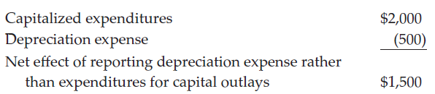
Example 1
84
Reconciling item that nets items
Detail

Slide 85

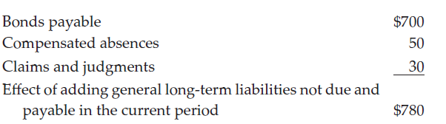
Example 2
85
Reconciling item that combines similar balances
Detail

Slide 86
Stewardship, Compliance, and Accountability
86
Violations of legal or contractual provisions
  Nature
  Action taken
Deficits in individual funds
  If not displayed

Slide 87
Disclosures for Accounting Changes and Error Corrections
87
Accounting changes
  Changes in accounting principle
  Changes in accounting estimates
  Changes to or within the financial reporting entity
Correction of errors

Slide 88
Summary of Significant Accounting Policies (SSAP) and Detailed Notes to the Financial Statements
EXERCISE
88
Notes:
NOW WE WILL COMPLETE ANOTHER EXERCISE ON THE SUMMARY OF SIGNIFICANT ACCOUNTING POLICIES AND DETAILED NOTES
THIS IS EXERCISE #9 IN THE MATERIALS PROVIDED BEFORE CLASS
YOU NEED TO USE APPENDIX D OF THE 2020 GAAFR – PULL UP FILE FOR APPENDIX D
www.gfoa.org/GAAFR/AppendixD

Slide 89
SSAP and Notes Section – Answer Key
89
Water Authority
60 days
a. State Treasurers Investment Pool
b. None listed
a. Ordinance
b. Restricted, committed, assigned, unassigned
a. 181,966,168
b. Fixed income securities and equities must have a weighted average of no less than investment
grade. Unrated securities limited to no more than 20% of total investments.
12,266,056
a. 52,886,606
b. 11,368,917

Slide 90
Combining and Individual Fund Financial Statements
90

Slide 91
Combining Financial Statements
91
Data for individual funds not presented as such in the basic financial statements
Purpose: Support the related column in the basic financial statements
    Nonmajor governmental funds
    Nonmajor enterprise funds
    Fund-type columns
    Discretely presented component units column
Notes:
COMBINING FINANCIAL STATEMENTS - Turn to this section in your ACFR
Thinking back to the fund statements within the Basic Financial Statements . Within these statements, we present major funds for the govt’l funds and enterprise funds in single columns, and nonmajor funds for the same are presented in the aggregate in a single column for govt’l funds and one for enterprise funds.
In addition, you’ll recall internal service funds are aggregated in a single column in the proprietary fund statements, and fiduciary fund statements are aggregated by type in the fund stmts (PN & OPEB trust, investment trust, etc.)
In addition, in the govt-wide stmts, discretely presented Cus may be aggregated in a single column.
So, in order to see the data for the individual funds and discretely presented CUs, we present combining statements in this financial subsection, and these combining statements support the single columns in the Basic Financial Statements that contained the aggregated data from more than one fund.
Basically, It allows the users of the Financial Statements to drill down to the underlying individual fund data.

Slide 92
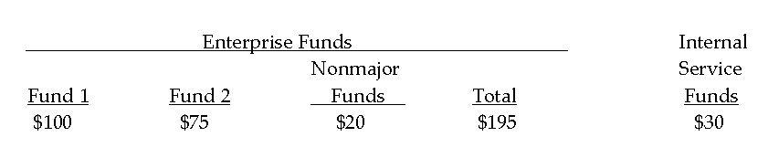
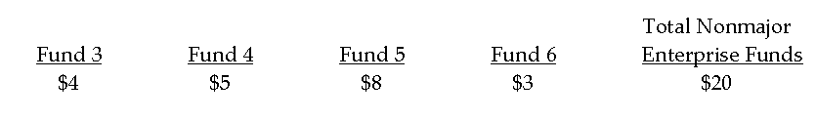
Example
92
Basic financial statements
Combining financial statements
Notes:
Example of a BFS for the proprietary funds, with a single column for multiple nonmajor enterprise funds.
In the combining statements, which would be presented in the financial subsection, you’ll find the data for the individual funds and the total for the nonmajor enterprise funds in the combining statement should tie to the total nonmajor enterprise funds presented in the BFS.

Slide 93
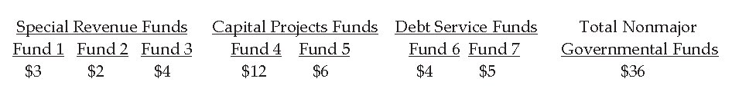
Governmental Funds
93
Information needed by fund type
If numerous funds
  Sub-combine statements by fund type
Notes:
COMBINING STATEMENTS RELATED TO THE GOVERNMENTAL FUNDS
When we think about the Basic Financial Statements, the total nonmajor governmental funds column combines info not only from different funds, but also from different fund types
Special Revenue
Debt service
Capital Projects and
Permanent funds
Therefore, the format for the combining statements for nonmajor governmental funds needs to provide not only the headings that identify the individual nonmajor govtl funds, but also their fund type, as shown in this example.

Slide 94
Format: Complete Sets of Financial Statements
94
Nonmajor governmental funds
  Balance sheet
  Statement of revenues, expenditures, and changes in fund balances
Nonmajor enterprise funds
  Statement of net position
  Statement of revenues, expenses, and changes in net position
  Statement of cash flows
Notes:
FORMAT OF THE COMBINING STATEMENTS
WHAT STATEMENTS TO INCLUDE
The financial subsection should be organized around complete sets of financial statements to match the Basic Financial Statements
Nonmajor governmental funds
Balance sheet
Statement of revenues, expenditures, and changes in fund balances
Nonmajor enterprise funds
Statement of net position
Statement of revenues, expenses, and changes in net position
Statement of cash flows

Slide 95
Format: Complete Sets of Financial Statements (cont.)
95
Internal service funds
  Statement of net position
  Statement of revenues, expenses, and changes in net position
  Statement of cash flows
Private-purpose trust funds
  Statement of fiduciary net position
  Statement of changes in fiduciary net position
Pension (and other employee benefits) trust funds
  Statement of fiduciary net position
  Statement of changes in fiduciary net position
Notes:
FORMAT CONTINUED
Internal service funds
Statement of net position
Statement of revenues, expenses, and changes in net position
Statement of cash flows
Don’t have major and nonmajor for Internal Service funds so all are reported; same is true for fiduciary funds
Private-purpose trust funds
Statement of fiduciary net position
Statement of changes in fiduciary net position
Pension (and other employee benefits) trust funds
Statement of fiduciary net position
Statement of changes in fiduciary net position

Slide 96
Format: Complete Sets of Financial Statements (cont.)
96
Investment trust funds
  Statement of fiduciary net position
  Statement of changes in fiduciary net position
Custodial funds
  Statement of fiduciary net position
  Statement of changes in fiduciary net position
Nonmajor discretely presented component units
  Statement of net position
  Statement of changes in net position
Notes:
FORMAT CONTINUED

Slide 97
Combining Statements
97
Cover page for each set of financial statements
  Description of the nature and operations of each of the individual funds or component units (if not readily discernable from the name of the fund or unit)
No reference to the notes to the financial statements for statements that receive only in-relation-to audit coverage
Notes:
COMBINING STATEMENTS SHOULD INCLUDE A
Cover page which should precede each set of Financial Statements, and include a description of the nature and operations of each of the individual funds or CU (if it can’t be readily discerned from the name of the fund or unit).
Combining statements would only contain a reference to the notes to the FS if the independent auditor renders an opinion on their fair presentation, which normally is not going to be the case.
Normally, the combining statements in the financial subsection only received an in-relation-to audit coverage, and so these statements normally would not include a reference to the notes to the FS.
TRANSITION
Next, we’ll look at individual fund statements.

Slide 98
Individual Fund Statements
98
Only for information beyond what is already presented in the combining statements
  Budgetary comparisons
    Governmental funds, other than the general fund and major special revenue funds with annual (or biennial) appropriated budgets
    General fund and major special revenue funds, if legal level of control is lower than the function/program level
  Comparative data for certain individual funds
  Additional detail, such as descriptive account titles
Notes:
INDIVIDUAL FUND STATEMENTS
There’s no reason to present individual fund statements if the individual fund data is included in the combining statements.
Where we will see individual fund statements are for budgetary comparisons for govtl funds other than the GF and major SR funds, which have annual or biennial appropriated budgets (these are required for govts that prepare a comprehensive report (GASB Cod Sec. 2400). So, these required budgetary comparisons are for govt’l funds that have legally adopted budgets but are excluded from the mandatory budgetary comparison reporting (CP funds, DS, permanent, and nonmajor SR funds).
You would also include more detailed budgetary comparisons for the GF or major SR funds that were included with the BFS or RSI, if their legal level of control is lower than the function or program level (which is the level at which the budgetary comparisons are presented in the BFS or RSI).
Some govts wish to provide comparative data for certain individual funds, for example enterprise funds; presenting data for the current year and the prior year. The comparative statements would be presented here in the financial subsection.
Finally, sometimes with combining statements, account titles may be a bit generic, especially if a govt. has multiple enterprise funds with different lines of business. In that case, presenting individual fund statements allows the govt to use more descriptive account titles, and the govt may choose to present those individual fund statements in this financial subsection, which is fine.
HOW MANY OF YOU HAVE AN INDIVIDUAL FUND STATEMENT SECTION IN YOUR ACFR?

Slide 99
Component Units
99
Data drawn from the entity-wide totals of the government-wide financial statements which appear in the component unit’s separately issued report
  If a separate report is not issued, the basic fund financial statements of the component unit must be included in the financial subsection of the annual comprehensive financial report
Notes:
COMPONENT UNITS
Data reported for a discretely presented CU should be taken from the entity-wide totals of the govt-wide statements for that discrete CU (as it may have some discretely presented Cus of its own).
Even if an entity-wide total is not presented in the discretely presented CU’s own BFS, it needs to ensure that the financial data that is presented does include any discretely present CU’s of its own that it may have (it should include its entire financial reporting entity).
Now, in the case where a discretely presented CU doesn’t issue a separate report, the primary govt must report the discretely presented Cus BFS in the financial subsection of the PG’s comprehensive report.
AMARILLO PAGES 40-42 AND FOOTNOTE INFO TOO

Slide 100
Format
100
Same approach as combining statements
  Complete sets of financial statements
  Cover page with a description of the nature and operations of the individual fund, if not readily discernable from its name
  No reference to the notes for individual fund statements that receive only in-relation-to audit coverage
Notes:
FORMAT FOR PRESENTING THE DISCRETELY PRESENTED COMPONENT UNITS IS
Same approach as combining statements
Complete sets of financial statements
Cover page with a description of the nature and operations of the individual fund, if not readily discernable from its name
No reference to the notes for individual fund statements that receive only in-relation-to audit coverage

Slide 101
Schedules
101
Purpose
  Demonstrate legal compliance
  Provide additional financial information of potential benefit to financial statement users
    Example: Schedule of cash receipts and disbursements – general fund
If related to a given set of financial statements, place immediately following those related statements
  If not, place in a separate section at the end of the financial section of the annual comprehensive financial report
Notes:
SCHEDULES
Often times govts will present other schedules to demonstrate legal compliance, or to provide additional financial information that may be of benefit to their readers (i.e. schedule of cash receipts and disbursements-general fund we see quite often).
Note, they are called “schedules” rather than “statements”.
If these schedules are related to a given set of FS, typically you could place them immediately following that given set of FS. If not, you would place them in a separate section at the end of the financial section of the comprehensive report.
AMARILLO PAGE 221

Slide 102
Question 1
102
Which of the following may be included in combining statements?
Major governmental funds other than the general fund
Nonmajor governmental funds
Both A and B

Slide 103
Question 2
103
Only one combining statement is required for custodial funds.
True
False

Slide 104
Question 3
104
A reference on the face of the combining statements to the notes to the financial statements is:
Normally inappropriate
Sometimes required
Both A and B

Slide 105
Question 4
105
If a combining statement is presented, individual fund statements are:
Always required
Never required
Sometimes required

Slide 106
Budgetary Reporting
106
Notes:
NOW LET’S LOOK AT SUPPLEMENTARY BUDGETARY REPORTING FOR INDIVIDUAL FUND STATEMENTS

Slide 107
Two Types
107
Mandatory reporting
  Must always be presented in connection with the basic financial statements
    Option 1: present as Basic Financial Statement
      “Statement”
      Audited
    Option 2: present as Required Supplementary Information (RSI)
      “Schedule”
      Not audited
Supplementary reporting
  Required in an Annual Comprehensive Financial Report
Notes:
TWO TYPES OF BUDGETARY REPORTING
Mandatory reporting
Must always be presented in connection with the basic financial statements
Option 1: present as Basic Financial Statement
“Statement”
Audited
Option 2: present as Required Supplementary Information (RSI)
“Schedule”
Not audited
Supplementary reporting
Required in an Annual Comprehensive Financial Report

Slide 108
Mandatory Reporting
108
Required for the General Fund and major Special Revenue Funds
“The minimum is the maximum”
  Exclude
    Other fund types
    Nonmajor Special Revenue Funds
Notes:
MANDAGTORY BUDGETARY REPORTING
Required for the General Fund and major Special Revenue Funds
“The minimum is the maximum”
Exclude
Other fund types
Nonmajor Special Revenue Funds

Slide 109
Supplementary Reporting
109
Required for funds that meet each of the three criteria:
  Governmental Fund (v. Enterprise Fund)
  Appropriated budget (force of law) vs. “financial plan”
  Annual (or biennial) v. project-length
Notes:
SUPPLEMENTARY BUDGETARY REPORTING
Required for funds that meet each of the three criteria:
Governmental Fund (v. Enterprise Fund)
Appropriated budget (force of law) vs. “financial plan”
Annual (or biennial) v. project-length

Slide 110
Content and Detail of Budgetary Reports
110
Mandatory reporting
  Original budget
  Final amended budget
  Actual (budgetary basis)
  Detail presented at function or program level
    Same as in the Statement of Revenues, Expenditures, and Changes in Fund Balances
Supplementary reporting
  Final amended budget
  Actual (budgetary basis)
  Detail presented at legal level of control
    The level at which resources cannot be reassigned without approval
Notes:
CONTENT AND DETAIL OF BUDGETARY RERORTS
Mandatory reporting
Original budget AND
Final amended budget
Actual (budgetary basis)
Detail presented at function or program level
Same as in the Statement of Revenues, Expenditures, and Changes in Fund Balances
Supplementary reporting
Final amended budget ONLY
Actual (budgetary basis)
Detail presented at legal level of control
The level at which resources cannot be reassigned without approval

Slide 111
GAAP vs. Budget
111
Mandatory reporting
  Reconcile the budgetary basis with GAAP, if different
    Either on the face of the comparison or in the notes to the financial statements
Supplementary reporting
  No reconciliation required
Notes:
GENERALLY ACCEPTED ACCOUTING PRINCIPALS (GAAP) BASIS vs BUDGET
Mandatory reporting
Reconcile the budgetary basis with GAAP, if different
Either on the face of the comparison or in the notes to the financial statements
Supplementary reporting
No reconciliation required
AMARILLO PAGE 176 -185

Slide 112
Variance Columns (Optional)
112
Presentation encouraged
  Difference between the final amended budget and actual amounts
    Almost always presented
Presentation permitted
  Difference between the original budget and the final amended budget (mandatory reporting only)
    Rarely presented
Notes:
VARIANCE COLUMNS
Presentation encouraged
Difference between the final amended budget and actual amounts
Almost always presented
Presentation permitted
Difference between the original budget and the final amended budget (mandatory reporting only)
Rarely presented

Slide 113
Labeling Variance Columns
113
Managerial accounting
  Favorable vs. unfavorable terminology
Problematical in the public sector
  Focus on providing services rather than generating revenue
    Spending less money than planned is not necessarily a “good thing”, if services suffered as a result
    Collecting more taxes than needed is not necessarily a “good thing”, from the point of view of taxpayers
Recommendation
  Neutral terminology (e.g., “variance” or “difference”)
Notes:
LABELING VARIANCE COLUMNS
Managerial accounting
Favorable vs. unfavorable terminology
Problematical in the public sector
Focus on providing services rather than generating revenue
Spending less money than planned is not necessarily a “good thing”, if services suffered as a result
Collecting more taxes than needed is not necessarily a “good thing”, from the point of view of taxpayers
Recommendation
Neutral terminology (e.g., “variance” or “difference”)

Slide 114
Summary – Budgetary Reporting
114
Requirements for the presentation of budgetary comparisons
Notes:
THIS TABLE SUMMARIZES THE BUDGETARY REPORTING REQUIREMENTS
REVIEW SLIDE

Slide 115
Question 1
115
A mandatory budgetary comparison schedule could be found as:
A basic financial statement
RSI
Either A or B

Slide 116
Question 2
116
Mandatory budgetary comparisons are:
Always audited
Sometimes audited
Never audited

Slide 117
Question 3
117
Which of the following would be included in a mandatory budgetary comparison?
Major Special Revenue Fund
Nonmajor Special Revenue Fund
Major Debt Service Fund
Nonmajor Debt Service Fund
Both A and C

Slide 118
Question 4
118
Budgetary reporting for Enterprise Funds is:
Always required
Sometimes required
Never required

Slide 119
Question 5
119
Which of the following would be required in connection with supplementary budgetary reporting?
Original budget
Variance column
Reconciliation between basis of budgeting and GAAP
All of the above
None of the above

Slide 120
Question 6
120
What is the minimum level of detail at which budgetary comparisons must be presented in connection with mandatory reporting?
Function or program level
Legal level of control
Either A or B

Slide 121
Required Supplementary Information
(Other than MD&A)
121

Slide 122
Topic Introduction
122
Budgetary comparisons
Condition assessments for infrastructure
Pension and other postemployment benefit (OPEB) information
Trend data for risk pools
Notes:
RSI is supplementary information that the GASB has concluded is essential to a reader’s understanding of the BFS and the notes by providing a context for them. The GASB has defined what types of information must be included in RSI, and only those types of information may be included.

Slide 123
1. Budgetary Comparison
123
Generally same guidelines as when included in the basic financial statements
Differences
  When presented in RSI, schedule rather than statement
  Present related disclosures as notes to RSI rather than as notes to the financial statements (except material violation)
Notes:
Summarize.
For GF and major SR funds with annual/biennial appropriated budgets.
Related disclosures- Describe budgetary basis if different than GAAP; an excess of budgetary expenditures over appropriations, if not visible on the face of the budgetary comparison.

Slide 124
1. Budgetary Comparison (cont.)
124
Use the budgetary framework for reporting
  Required even if scope of budgetary framework is broader than general fund and major special revenue funds
Provide reconciliation if basis of budgeting is different from GAAP

Slide 125
2. Modified Approach for Infrastructure: Condition Assessments
125
Three most recently completed condition assessments
  Only one assessment required at date of initial implementation of modified approach
Maintenance and preservation costs
(5 years)
  Estimate of amount needed
  Actual expense (always on GAAP basis)

Slide 126
2. Modified Approach for Infrastructure: Condition Assessments (cont.)
126
Notes to RSI
  Basis for condition assessment
  Measurement scale
  Target level
    If changed, effect of change on estimated maintenance and preservation in period
  Factors that significantly affect trends

Slide 127
3. Pension and OPEB Information
127
Single employers and agent multiple-employers
Cost-sharing employers
Nonemployer contributors
Notes:
SAY
Different RSI is mandated for employers in defined benefit pension and OPEB plans that offer benefits through the following types of plans:
Single-employer and agent multiple-employer plans;
Cost-sharing multiple-employer plans; and
For governmental nonemployer contributors in a special funding situation in which they make contributions directly to a defined benefit pension or OPEB plan.
TRANSITION
Let’s take a look at the mandated RSI for employers that offer pension or OPEB benefits to their employees through a defined benefit single-employer or agent multiple-employer plan.

Slide 128
Pensions/OPEB – Single Employers and Agent Multiple-Employers
128
Required disclosures
  Schedule of changes in the net pension/OPEB liability and
  related ratios (10 years)
    Reported as of the measurement date
  Schedule of funding progress (10 years)*
    Reported as of the measurement date
  Schedule of required contributions (10 years)
    Reported as of the most recent reporting date (fiscal year-end)
* For plans operated through a qualifying trust
Notes:
We’ll start with the mandated RSI for employers that offer pension or OPEB benefits to their employees through a defined benefit single-employer or agent multiple-employer plan.
3 required schedules but in reality, the first 2 are normally presented together as 1 schedule. READ
* Also note: The second schedule only applies to PN/OPEB plans that are administered through a GASB-compliant trust. If it’s a nontrusted plan, from a GAAP reporting perspective, the plan does NOT have any assets or contributions, so you will only be reporting the total PN/OPEB liability, not net.

Slide 129
A. Schedule of Changes in Net Pension Liability
129
Notes:
GASB 82 – covered payroll for pension

Slide 130
A. Schedule of Changes in Net OPEB Liability
130
Notes:
Generally, covered employee payroll used for OPEB

Slide 131
Covered vs. Covered-Employee Payroll
131
Covered payroll
  Only includes the payroll on which contributions to pension/OPEB plan are based
Covered-employee payroll
  Total payroll of employees covered in a pension/OPEB plan; may include certain forms of payment that are not included in calculating the pension/OPEB benefit of an employee, e.g., overtime
Notes:
GASB 67 and GASB 68 included a subtle change to the definition of the payroll amounts to be used in pension calculations, from covered payroll to covered-employee payroll. While the change in name was subtle, the definition used for covered-employee payroll was significantly different and created several major issues.
Historically, employers only reported their covered payroll, which is the payroll amounts used to calculate an employee’s pension. The functional or even legal ability for employers to report their covered-employee, or gross, payroll was questionable. Further, many of the actuarial calculations used covered payroll, not covered-employee payroll, which would add confusion to the users of financial statements. In addition to these concerns, there would be a significant cost and time burden with no discernable benefit in terms of developing the data gathering and reporting systems needed to report covered-employee payroll.
As a result, GASB 82 eliminated the need to report covered-employee payroll for pensions applying the GASB 67 and GASB 68 requirements.
Covered-employee, or gross payroll, often includes amounts that are not used in calculating an employee’s pension. These may include certain limitations on the amount of overtime pay received, payments for vacation, sick, or other leave time not taken, or specific benefits such as pay received for uniforms or other personal clothing or equipment.
For plans, use covered payroll unless, for OPEB only, the contributions are based on something other than payroll. Then use covered-employee payroll.
For employers with pension trusts, use covered payroll amount; nontrusts use covered employee payroll
For employers with OPEB, may be covered payroll or covered employee payroll; depending on how the contributions are calculated.

Slide 132
B. Schedule of Required Contributions
132
Required if contribution is
  Actuarially determined
  Not actuarially determined, but statutorily or contractually required
Contents
  Target contribution
  Actual contribution
  Difference (a – b)
  Covered Payroll (CP)*
  Contributions as % of CP* (b/a)
  * See discussion of measures of pay

Slide 133
Information on Contributions (Pension): Actuarially Determined Contribution
133
 | 2027 |  | 2026 |  | 2025 |  | 2024 |  | 2023
Actuarially Determined Contribution | $ 1,286,355 |  | $ 1,165,115 |  | $ 1,151,594 |  | $ 1,009,112 |  | $ 965,125
Contributions in Relation to the Actuarially
Determined Contribution | 1,296,111 |  | 1,167,249 |  | 1,157,177 |  | 1,009,242 |  | 959,442
Contribution Excess (Deficiency) | $ 9,756 |  | $ 2,134 |  | $ 5,583 |  | $ 130 |  | $ (5,683)
Covered Payroll* | $ 10,090,503 |  | $ 9,737,335 |  | $ 9,357,318 |  | $ 9,278,456 |  | $ 9,193,456
Contributions as a Percentage of
Covered Payroll* | 12.8% |  | 12.0% |  | 12.4% |  | 10.9% |  | 10.4%
*Or covered-employee payroll

Slide 134
Statutorily or Contractually Determined Contribution
134
Only applicable if an ADC is not calculated
Same type of information as in previous schedule
Notes:
TRANSITION
Next, we’ll talk about pension/OPEB information for cost-sharing employers.

Slide 135
Pensions/OPEB - Cost-Sharing Employers
135
Schedule of funding progress (10 years)
  Employer’s proportionate share of collective Net Pension/OPEB Liability (NPL/NOL) As a % and $
  Employer’s Covered Payroll (CP)*
  Employer’s proportionate share of collective NPL/NOL as % of CP* (a/b)
  Fiduciary Net Position as % of TPL/TOL
Schedule of employer contributions (10 years)
  If statutorily or contractually required
  As of the most recent reporting date
* See discussion of measures of pay
Notes:
2 schedules required: Schedule of funding progress- as of measurement date
Schedule of ER contributions- as of fiscal yr end
Measure of pay used (covered PR or covered EE PR) – again, depends on how ER contributions are calculated.

Slide 136
Pensions/OPEB - Nonemployer Contributors
136
Schedule of funding progress (10 years)
  Nonemployer share of NPL/NOL
    As % and $
  FNP as % of TPL/TOL
Schedule of nonemployer contributions (10 years)
  If statutorily or contractually required
Notes:
Govt nonER that contributes directly to a DB PN or OPEB plan that’s reported in a GASB trust, for the benefit of employees of another govt, and the nonER contributor recognizes substantial portion of collective NPL/NOL
If recognizes less than substantial portion of NPL/NOL, one 10-yr schedule that includes the non-ER’s share of collective NPL/NOL in dollars; and amount of non-ER’s contributions each year.

Slide 137
Notes to RSI
137
Significant methods and assumptions for actuarially determined contribution (if applicable)
Factors that significantly affect trends
  No restatement of information from prior years

Slide 138
Trend Data for Risk Pools
138
Trend data on revenue and claims development
  10 years of data
  Include changes in pool’s liability for claims
  Only required if no separate report is issued for the pool
    How to obtain separately issued report

Slide 139
Statistical Section
139

Slide 140

Focus of Statistical Section
140
Economic condition

Slide 141
Financial Position vs. Economic Condition
141
Financial position
  [Assets + deferred outflows of resources] – [liabilities + deferred inflows of resources] = net position
Economic condition
  Factors that indicate that today’s net position may improve or deteriorate in the future

Slide 142
Five Objectives
142
Financial Trends
  Trend information to help the reader understand how the government’s financial performance and well-being have changed over time
Revenue Capacity
  Information useful in assessing a government’s ability to raise own-source revenue
Debt Capacity
  Information useful in assessing a government’s ability to issue new debt

Slide 143
Five Objectives (cont.)
143
Demographic and Economic Information
  Demographic and economic indicators to help the reader understand the environment within which the government’s financial activities take place
Operating Information
  Information on the size of a government’s workforce, the levels of services that it provides, and its capital assets

Slide 144
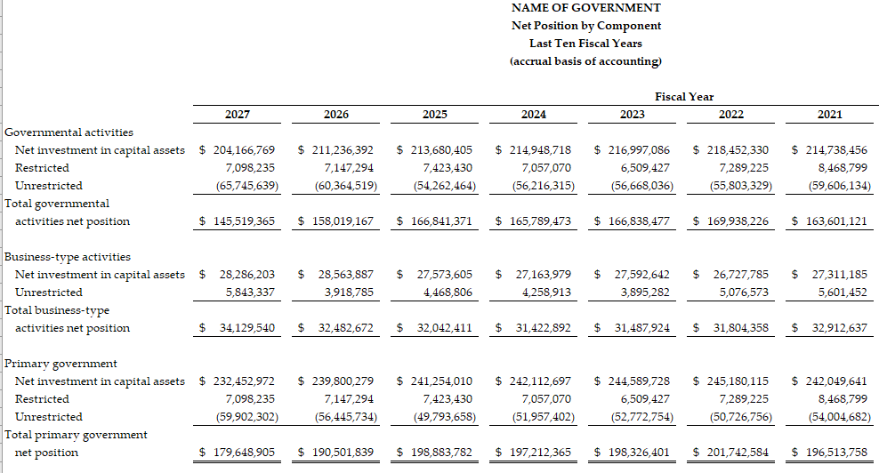
Financial Trends Example
144

Slide 145
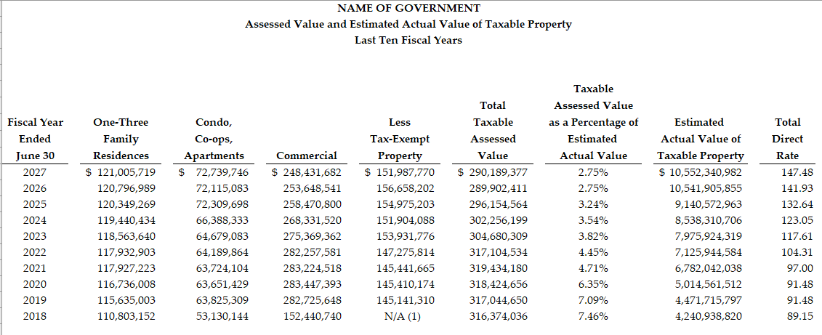
Revenue Capacity Example
145
Notes:
Information on the entity’s own-source revenues

Slide 146
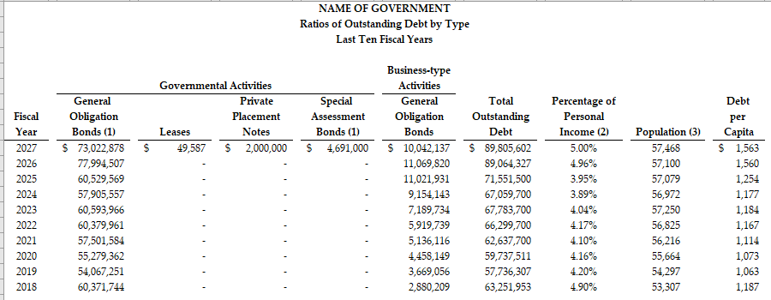
Debt Capacity Example
146
Notes:
When there has been a change in how a particular item is being reported from year to year, or a significant anomaly, a note at the bottom of the schedule will provide the detail for the readers.

Slide 147
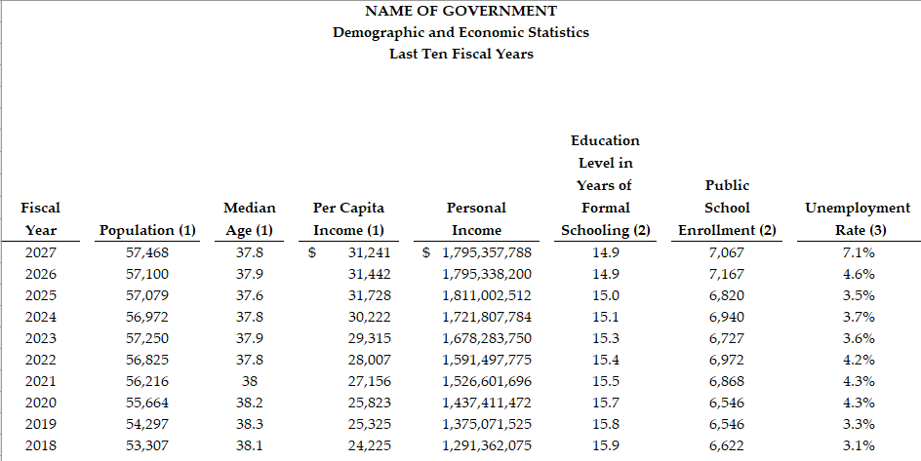
Demographic and Economic Information Example
147

Slide 148
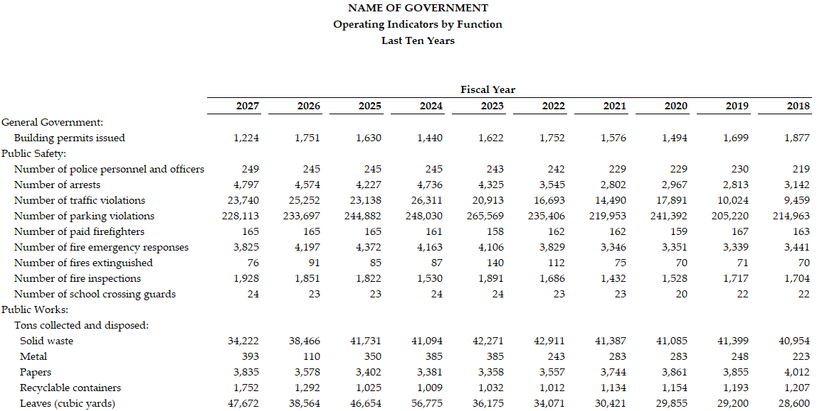
Operating Information Example
148

Slide 149
Statistical Section
EXERCISE
149
Notes:
NOW WE WILL COMPLETE ANOTHER EXERCISE ON THE STATISTICAL SECTION
THIS IS EXERCISE #10 IN THE MATERIALS PROVIDED BEFORE CLASS
YOU NEED TO USE APPENDIX D OF THE 2020 GAAFR – PULL UP FILE FOR APPENDIX D
www.gfoa.org/GAAFR/AppendixD

Slide 150
Statistical Section – Answer Key
150
a. (59,902,302)
b. (3,456,568)
c. 9,454,008
d. 19,161,724 (committed + assigned + unassigned)
a. 10,552,340,982
b. 147.48
c. Mall Management Co LP 3.82%; Electric Power Co 4.21%
3. a. 82,540,015
b. 563,561,568
c. 3.5
a. 7.1%
b. Hospital Center
a. 196
b. 127.1 miles

Slide 151
Review
151

Slide 152
Question 1
152
Which of the following statements best describes the relationship between authoritative standards and the issuance of an ACFR?
Authoritative standards require the issuance of an ACFR
Authoritative standards encourage the issuance of an ACFR
Authoritative standards permit the issuance of an ACFR

Slide 153
Question 2
153
An ACFR would provide information on which of the following?
Individual nonmajor governmental funds
Individual nonmajor enterprise funds
Individual internal service funds
Individual fiduciary funds
All of the above

Slide 154
Question 3
154
Which section of the ACFR normally is used to provide any subjective assessments that may be needed?
Introductory section
Financial section
Statistical section

Slide 155
Question 4
155
Analysis, strictly speaking, focuses on providing an answer to which of the following questions?
Why?
What?
How?
All of the above

Slide 156
Question 5
156
One of the key contributions of an MD&A is to allow management to provide a subjective assessment of the government’s finances.
True
False

Slide 157
Question 6
157
Governments may use charts and graphs to supplement or replace condensed comparative data in MD&A.
True
False

Slide 158
Question 7
158
Which of the following might properly be addressed in MD&A?
A potential grant
A planned rate increase
The settlement of a lawsuit
All of the above
None of the above

Slide 159
Question 8
159
Trend data normally are presented in which section of an ACFR?
Introductory section
Financial section
Statistical section

Slide 160

Stay connected to GFOA’s social media platforms for information
on upcoming educational opportunities, new research, best practices, and more!

Slide 161

Have you joined GFOA’s Member Community?
Want to talk about key public finance issues facing local governments? Have a question you’d like input on?
Every day members are visiting GFOA’s Member Community to ask questions, offer insights, and share resources.
Ready to join? Visit community.gfoa.org and log in using your GFOA username and password.
Need help joining? E-mail community@gfoa.org

Slide 162

For More Information…
162
Government Finance Officers Association
Technical Services Center
312.977.9700
GFOA.org

