Slide 1
CAFR blunders (other than Volunteering to do one in the first place)
Government Finance Officers of Texas
Austin, Texas
Tuesday, April 11, 2017

Slide 2
Learning Objectives
Learn from the mistakes of other in order to improve your government’s financial reporting
Better understand the “whys” as well as the “whats” of the standards to improve both reporting and disclosures in your financial statements
Recognize the impacts of rapid changes in GAAP on financial reporting.

Slide 3
Financial Reporting
Who sets the rules?
GASB is the standard setting body
GFOA provides a checklist award program
Who are the users and what is the purpose?
Citizenry
Legislative and regulatory bodies
Investors and creditors
Notes:
GFOA program:
- Established in 1945
Structured to encourage and assist state and local governments to go beyond minimum requirements of GAAP to prepare CAFRs
Designed to evidence the spirit of transparency and full disclosure and recognize individual governments that succeed in achieving that goal
Unique checklists for:
General Purpose Governments
School Districts
Stand-alone Business-type Activities
Postemployment Benefit Systems
Investment Pools
More than 4,200 governments submitted this CAFRs in 2015
6% of U.S. cities receive the award and 17% of U.S. counties receive the award
**************************************************************************************************************************************************************************************
Most revenue is generated by involuntary taxes – can help with setting of tax rates during budget process
Budget-to-actual comparisons
Assess overall financial condition and results of operations
Determine compliance with laws, rules, and regulations
Assist in evaluating efficiency and effectiveness
Compare w/ other local governments

Slide 4
Typical CAFR
Introductory Section
Transmittal Letter
Principal Officials
Organizational Chart
Last Year’s GFOA Certificate
Financial Section
Independent Auditor’s Report
Management Discussion & Analysis
Basic Financial Statements
Notes to the Basic Financial Statements
Required Supplementary Information
UA
LP
Minimum requirements for general purpose external financial statements
Audited
LP

Slide 5
Typical CAFR
Financial Section (continued)
Combining Fund Financial Statements & Schedules
Individual Fund Financial Statements & Schedules
Statistical Section
Ten Year Schedules on:
Financial Trends
Revenue Capacity
Debt Capacity
Demographic and Economic Information
Operating Information
IRT, A or UA
UA
UA= Unaudited, LP= Limited Procedures, IRT= In relation to opinion, A=Audited

Slide 6
Improving Together

Slide 7
Keeping Pace With An Evolving GAAP
GAAP is Changing Rapidly
Currently 83 statements
GASB went from Statement 73 to Statement 82 in ten months
Four more statements expected in 2017
Fiduciary Activities, Leases, Debt Extinguishments & Omnibus
Three implementation guides
GASB 74 & 75 and annual update
The Nature of GAAP is Changing
GASB 76- GAAP Hierarchy has substantially elevated implementation guidance
Most new standards are replacements or amendments of previous standards
GASB 67 & 68 have been modified four times in four years
Investment accounting and disclosures is based on five standards
Reliance on the Statements themselves can increase the risk of missing something.

Slide 8
GASB Codification Is the best gaap source
GASB’s Codification is a comprehensive one stop source
GASB statements, Interpretations, Technical Bulletins, Implementation Guides and Concept Statements
Applicable NCGA literature
Applicable AICPA accounting guidance
Consists of five parts:
Part 1 (1000 series) General Principles
Part 2 (2000 series) Financial Reporting Volume 1
Part 3 (3000 series) Measurement
Part 4 (Alpha designations) Specific Topics i.e. Pensions=P20 Volume 2
Part 5 (Alpha) Stand Alone Reporting-Special Units & Activities

Slide 9
GASB Codification Is the best gaap source
In addition to Numeric or Alpha designation:
Paragraphs .101-.499-Standards (authoritative-Category A)
Paragraphs .501-599-Definitions (authoritative-Category A)
Paragraphs .601-699-GASB Technical Bulletins (authoritative-Category B)
Paragraphs .701-.799-GASB Implementation Guides (authoritative-Category B)
Paragraphs .801-.899-AICPA literature cleared by GASB (authoritative-Category B)
Paragraphs .901-.999-Nonauthoritaive such as illustrations
Sample References
2200.102-Minimum Requirements for General Purpose External Financial Reporting
I50 741-11-Implementation Guide Question 11 on Investments
References in this presentation will be based on the Codification

Slide 10
How Can We Do Better?
Best Practices
Tone at the Top
Training and CPE
Start Planning Early and have clear “owners” for various areas
Utilize All Resources and Research
Benchmarking/Confer with Peers
Use Checklists
Monthly Reporting & Reconciliations

Slide 11
Other Tips
Boutique Standards
There are many standards that do not apply to most governments in most years. Examples include:
Asset Impairment
Pollution Remediation
Termination Benefits
Bankruptcy
Concession Arrangements
Boutique standards create the potential for misapplying or missing the standard altogether.
Develop a list of standards that could potentially apply and procedures for checking each year.

Slide 12
Common deficiencies-Transmittal and MD&A

Slide 13
Comprehensive Annual Financial Reporting (CAFR)
Introductory Section
(Required)
Transmittal Letter
Organizational Diagram
Principal Officials
Financial Section
(Required)
Auditor’s Report
MD&A
Basic F/S
Notes to Basic F/S
RSI
Supplemental Info.
Statistical Section
(Required)
Financial Trends
Revenue Capacity
Debt Capacity
Demographic and Economic Info.
Operating Information Section
Compliance Section
(Optional)
Auditor Report on IC over Fin. Reporting and on Compliance in Accordance with GAGAS
Auditor Report on Compliance Required by A-133
SEFA and Notes to SEFA
Schedule of Findings and Questioned Costs
Continuing Disclosure Section
(Optional)
GFOA Best Practice
Includes all tables and disclosures needed to meet SEC continuing disclosure requirements under SEC Rule 15c2-12

Slide 14
Transmittal Letter
Common Deficiencies
Incorrect date
Redundant information
Omissions
Correct Approach
No earlier than the date of the auditor’s opinion
Follow GFOA guidelines that reduced and shifted the scope of the TL after GASB 34 introduced MD&A
Follow the GFOA checklist and focus on financial “condition” factors rather than just financial position. Cheerleading (within reason) is allowed.
Notes:
Need to discuss:
Economic condition
Long-range planning
Progress of current projects
Relevant financial policies

Slide 15
Management’s Discussion & Analysis
Common Deficiencies
Elevator Analysis-Quantifying the $ and % variances without explaining
Why did it happen?
Timing is not an explanation by itself; be sure to dive into more meaningful details
Not explaining significant changes in major funds
Lack of two/three year comparative data
Amounts do not agree to financial statements
Restatements of Net Position must be presented
Insufficient details on the issuance of new debt
Not including currently known facts, decisions and conditions significantly affecting financial position or results of operations (2200.109 h)
Cheerleading or slanted to the positive
Correct Approach
Concise explanation of the root cause
No-Water revenues decreased due to declining sales
Yes-Water revenues decreased 8% from the previous year due to unseasonably cool, wet weather through the summer months reducing normal summer irrigation
Significant changes in fund balances of major funds should be explained
MD&A should always have one year more the FS. Comparative FS mean 3 year MD&A
Slot MD&A numbers in last, assign tick & tie duties to someone who likes detail
With all the new GASBs coming out just plan on it!
Describe main uses for new debt, reasons for refunding
Everything occurring between FYE and the date of the auditor’s opinion is fair game and easily googled
As Sgt. Joe Friday was known to say “the facts and only the facts”-objective and unbiased
Notes:
Reach out to your user departments to help explain the why

Slide 16
Government-wide Statements

Slide 17
Miscalculation of Net Investment in Capital Assets
Include: (2200.118 & 2200.709-1-17)
Less: Remaining balances of direct debt used for
acquisition, construction or improvement including retainages
Less: Deferred Inflows directly associated with the debt
Plus: Deferred Outflows directly associated with the debt
Capital Assets, Net of Depreciation

Slide 18
Miscalculation of Net Investment in Capital Assets
Exclude:
Debt used to finance other entities capital assets.
Deferred Inflows or outflows associated with excluded debt
Equity interest in joint venture
Unspent proceeds and related debt & DI/DO. Put in same category as the unspent proceeds.

Slide 19
Other Government-wide Issues
Failure to reclassify deferred inflows of resources for unavailable revenue
Reporting unearned revenues (a liability) as deferred inflows (not a liability)
Failure to report a deferred outflow/inflow of resources in connection with refunded debt
Net Position vs. Net Assets
Net Investment in Capital Assets vs. Invested in Capital Assets, Net of Related Debt
Notes:
In governmental funds, an inflow of resources must be available to be recognized as revenue of the current period. For the government-wide full accrual-basis, the timing of cash flows is irrelevant to revenue recognition. Accordingly, any deferred inflows of resources reported in governmental funds for unavailable amounts must be reclassified in the GW SNOP.
The difference b/w the carrying value of refunded debt and its reacquisition price (the latter typically exceeds the former) must be reported as a deferred outflow/inflow of resources. Rather than this amount being reported in the liability section of the SNOP (as an adjustment to the face amount of the debt), it s/b shown as a deferred outflow or inflow of resources.

Slide 20
Governmental Funds

Slide 21
Major Funds
Not reporting a major fund when it meets the criteria for major fund status
Not clearly identifying which funds are major
Not updating the major fund determination analysis before issuance, and also yearly, to ensure status hasn’t changed
Not including deferred inflows and deferred outflows when calculating major funds

Slide 22
GASB 54 Fund Balance
Not Reporting by Purpose
i.e. “Public Safety” is a Function whereas “Revenue Stabilization” is a purpose
Negative Assigned Fund Balance
Can only be positive
Cannot have positive Assigned Fund Balance and have negative Unassigned Fund Balance
Only the General Fund can have positive Unassigned Fund Balance
Outdated Terminology
Reserved, Unreserved, Designated & Undesignated
Improper Order; Must Be:
Non-spendable
Restricted
Committed
Assigned
Unassigned
Encumbrances should not be separately listed
Notes:
Not reporting restricted, committed or assigned fund balance by purpose, for example reporting by function
Reporting a committed fund balance due to an appropriation. The amount should not be classified as committed because the governing body does not have to take formal action to remove or modify that specific use-the purpose assignment expires with the appropriation.
Reporting deferred inflows for amounts that will not be an inflow, for example prepaid items and inventory.

Slide 23
Governmental Fund Reporting Issues
Deferred Inflows
amounts received prior to being earned or meeting eligibility requirements are a liability
Deferred Outflows
Unamortized debt issuance costs are no longer deferred; they are period expenses
Misuse of Special Revenue Funds
Established funds not meeting the definition in GAAP per the note disclosures
Budget Comparisons:
GAAP only requires General Fund and major Special Revenue Funds, if budget is legally adopted
Notes:
Deferred inflows of resources is used exclusively in situations where the sole factor preventing the immediate recognition of revenue is timing. In contrast, amounts that are received prior to being earned or meeting eligibility requirements are properly offset by a liability, since the critical underlying event (earning or meeting eligibility requirements) has not yet occurred. Unearned items are liabilities.
Unamortized debt issuance costs are no longer deferred; they are period expenses
Budget comparisons – General Fund and major S/R funds – cannot include others at your will

Slide 24
Reporting
Don’t report as governmental debt if:
Proceeds are used by the enterprise fund
Repayment is to be made by the enterprise fund
Capital contributions are reported on the Statement of Revenues, Expenses and Changes in Net Position
Capital contributions received - should be shown below the non-operating section
Capital contributions to other entities or other funds – shown as non-operating expenses

Slide 25
Component Units

Slide 26
Component Unit Considerations
Determination
Appoint majority of the board plus financial benefits/burden OR ability to impose will
If did not appoint board then, financial benefit/burden AND fiscal dependency
Report as discretely presented
Blend if…
Same governing body AND
Financial benefit/burden AND
PG operationally runs the C/U OR
Almost exclusively for the benefit of the PG OR
Almost all debt of C/U is repayable by the PG
Notes:
Under previous guidance GASB 14, the mere fact that the PG and CU shared substantively the same governing body was enough to justify blending.
GASB 61, The Financial Reporting Entity: Omnibus, narrows the criterion by also requiring either: 1) an ongoing relationship of financial benefit or burden; or 2) operational responsibility.

Slide 27
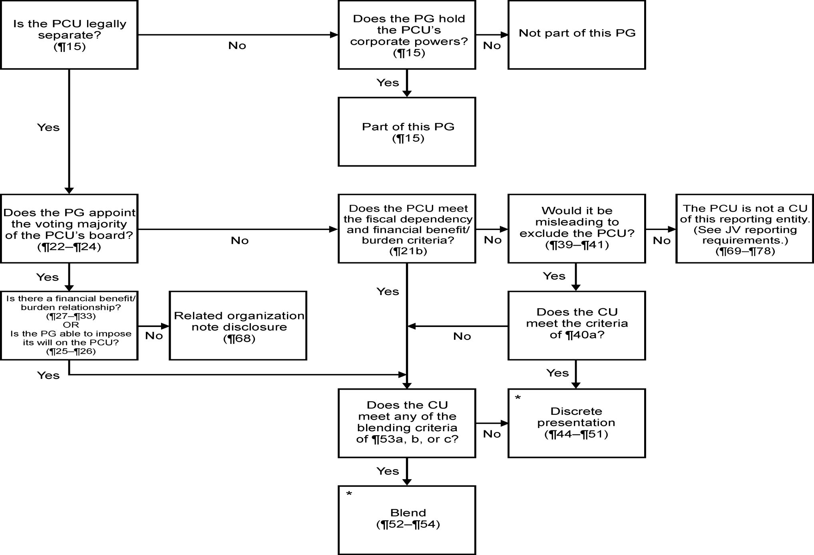
Notes:
Under previous guidance GASB 14, the mere fact that the PG and CU shared substantively the same governing body was enough to justify blending.
GASB 61, The Financial Reporting Entity: Omnibus, narrows the criterion by also requiring either: 1) an ongoing relationship of financial benefit or burden; or 2) operational responsibility.

Slide 28
Note Disclosures

Slide 29
Disclosures
Component Units
Describe criteria used for inclusion
Detail the criteria for blending
Specify which fiscal dependency criteria were met
Special Revenue Funds
Disclose the purpose and identify the specific revenue source(s)
Fund Balance
Describe the specific formal action taken by the government’s highest decision making body to commit funds
Identify the highest decision level making body that gives authority to assign resources
Revenue stabilization arrangements
Authority for establishing
Minimum balance
Conditions for spending
Conditions for replenishing
Notes:
For a blended component unit a government discloses that the governing body of the component unit is substantively the same as the governing body of the primary government as the main reason for blending. They do not also disclose that there is a financial benefit or burden or management of the primary government has operational responsibility for the component unit in addition to having the same governing body. Also, a government may disclose an incorrect criteria in addition to having substantively the same governing body, such as imposition of will or fiscal dependency for blending.
For the disclosure explaining why a component is discretely presented a government will only reference that the component unit is fiscally dependent, rather than further disclosing if the component unit has the potential to provide specific financial benefits or impose specific financial burdens to the government.

Slide 30
Disclosures (cont.)
Governments should disclose the policies that address each type of investment risk to which they are exposed including when no policy exists
For a deposit and investment policy to exist, it must be formally adopted either by the governing body or by state statute (I 50 736-1)
Provide specific website location (URL) when referencing separate reports of component units and/or other plans, etc.
Revenue Bonds:
Identify specific revenues and amounts pledged
General purpose for the debt and term of the commitment
Proportion of pledged revenue to total revenues
Comparison of pledged revenues recognized during the period to the P&I requirements for the debt directly or indirectly collateralized by those revenues
Segment Disclosures. Segments are not defined by lines of business but as dedicated repayment sources for specific indebtedness. (2500 101-102)

Slide 31
Disclosures (cont.)
For long-term debt, the terms by which interest rates change for variable rate debt should be disclosed
Must disclose which funds liquidate each long-term obligation other than debt including:
Compensated absences
Claims and judgments
Terminations benefits
Pension and OPEB
Unamortized gain/loss on refunding is a deferred inflow/outflow and should not be displayed with the long-term debt roll forward

Slide 32
Disclosures (cont.)
Notes should disclose the purpose of inter-fund balances
Inter-fund receivables/payables that are not expected to be repaid within a reasonable time should be reclassified as a transfer(1800.102(1)
Notes should describe the principal purposes of the entity’s interfund transfers
If the entity elects to disclose transfers by individual fund, it is recommended that the disclosure be formatted in a way that allows readers to trace the individual fund data to the corresponding column in the basic financial statements (e.g., by the use of headings or subtotals)

Slide 33
Interfund Disclosure

Slide 34
Other Reporting Issues

Slide 35
Required and Other supplementary information
RSI
Not disclosing the budgetary basis in the notes to the RSI
Not presenting all required years (e.g., 10 years)
Not reporting the legal level of budgetary control
Other Supplementary Information
Not reporting budgetary comparisons for non-major governmental funds that have legally adopted annual budgets
Not reporting at the legal level of budgetary control

Slide 36
Internal Consistency and Statistical
Internal Consistency
Transmittal, MD&A, financial statements, footnotes, RSI, OSI and Statistical amounts do not agree
Statistical Section
Debt Capacity schedules should include premiums/discounts
Debt Service as a Percentage of Noncapital Expenditures should use the capital outlay amount from the modified accrual/accrual reconciliation
Include all governmental activities’ debt for the direct debt in the direct and overlapping debt statistical table

Slide 37
PENSION REPORTING

Slide 38
Pensions - Statement of Net Position
Common Deficiency
Netting of deferred inflows or outflows from liability assumption different from actual or assumption changes
Not netting deferred inflow or outflows from investment return different from expected
Correct Approach
Deferred inflows must be reported separately from deferred outflows
Deferred inflows and outflows from investment return different from expected must be netted together

Slide 39
Pension Reporting - Statement of Net Position
Common Deficiency
Not reporting the total deferred outflows or total deferred inflows on the statement of net position that are disclosed in the notes for the employer’s balances of deferred outflows and deferred inflows for pensions.
Correct Approach
Pretend you are a GFOA Certificate reviewer and tick and tie until you want to scream

Slide 40
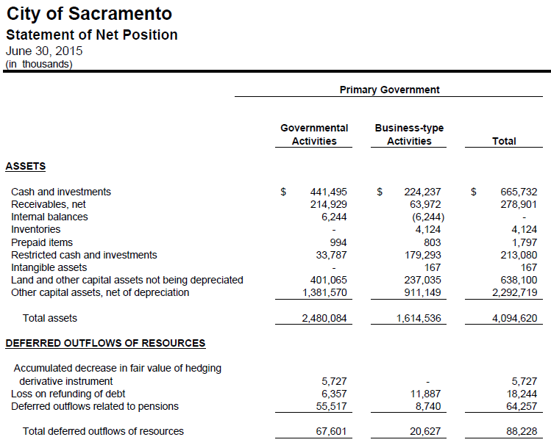
Pension Examples

Slide 41
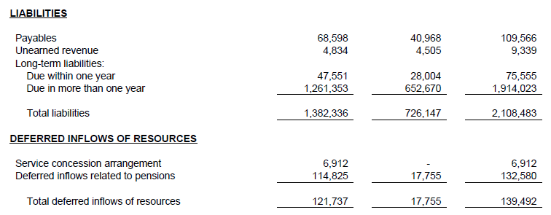
Pension Examples

Slide 42
Pension Examples

Slide 43
Pension Reporting - Statement of Net Position
Common Deficiency:
Netting the net pension liability and the net pension asset on the statement of net position when a government participates in multiple pensions.
Splitting the NPL between current and non current liabilities
Correct Approach
Each pension plan should be kept separate so as to not understate the liability or assets
Full amount reported as “due in more than one year”

Slide 44
Pension Note Disclosures
Deficiency: Does not disclose whether the pension plan is a single-employer, agent multiple-employer, or cost-sharing multiple-employer defined benefit plan.
Deficiency: Missing disclosure on whether the pension plan issues a stand-alone financial report. Also, should disclose how to obtain the report if it’s available (i.e URL link).

Slide 45
Pension Note Disclosures
Common Deficiency:
Not disclosing the total amounts for the total pension liabilities, pension assets, deferred outflows of resources and deferred inflows of resources, pension expense/expenditure for the period associated with net pension liabilities if the total amounts are not otherwise identifiable from information presented in the financial statements.

Slide 46
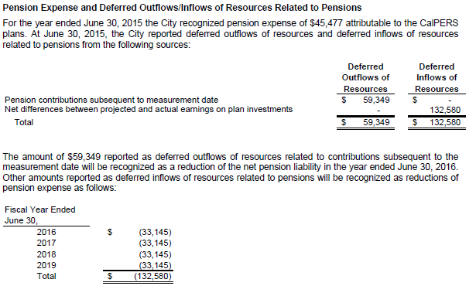
Pension Example

Slide 47
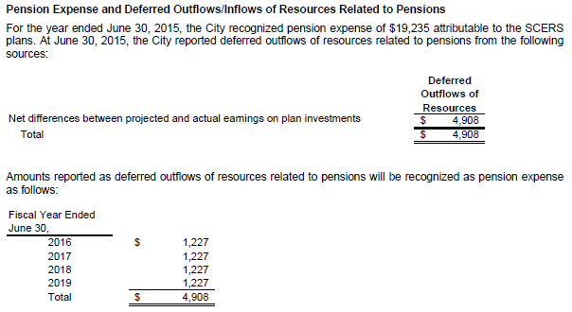
Pension Example

Slide 48
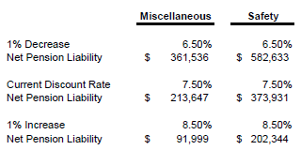
Pension Note Disclosures
Deficiency:
For the sensitivity analysis netting the amounts from multiple plans that an employer participates in, for example netting a net pension liability and a net pension asset

Slide 49
Pension Note Disclosures
Common Deficiency:
Participating in a cost-sharing multiple-employer plan and including the plan’s net pension liability rather than the employer’s proportionate share of the net pension liability
Not including the disclosure for the changes in net pension liability for a single employer or agent multiple-employer plan in the notes to the financial statements.
Not required for cost-sharing plans but is for agent and single-employer
Inclusion in RSI is insufficient
Not distinguishing pension amounts between primary government and discretely presented component units (i.e. sensitivity analysis and changes in the net pension liability)

Slide 50
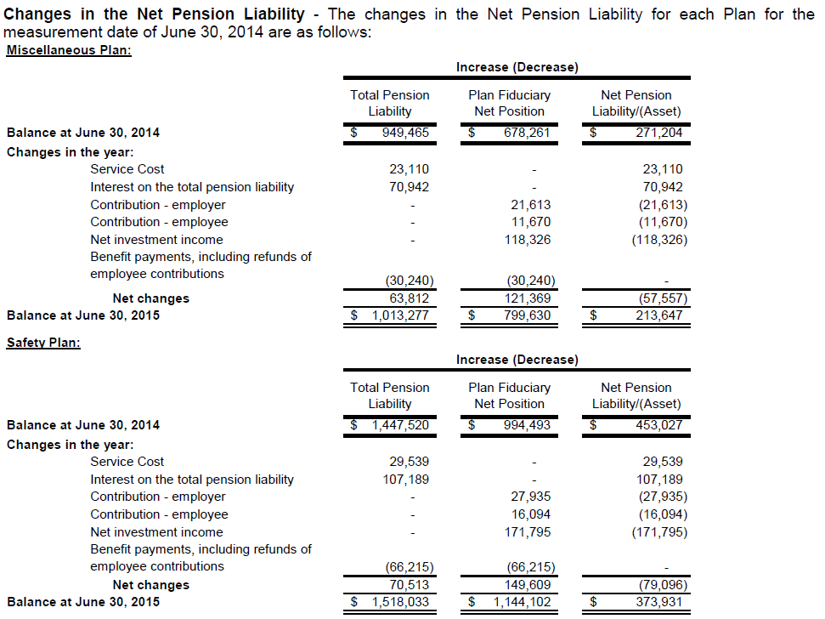
Pension Example

Slide 51
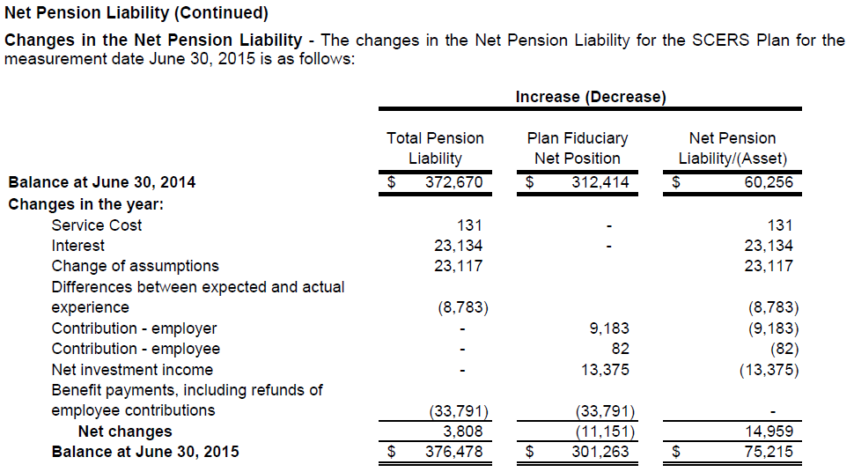
Pension Example

Slide 52
Pension Note Disclosures
Common Deficiency:
Missing actuarial assumptions and other inputs, for example, the dates of the experience studies, the source of mortality assumptions, etc.
The schedule of deferred outflows and deferred inflows that will be recognized in pension expense for each of the subsequent five years and aggregate does not appear to include the correct amounts, does not articulate to the balances of deferred outflows and deferred inflows when calculated by the reviewer. Also, includes the current year amount that was recognized in pension expense in addition to the subsequent amounts.

Slide 53
Required Supplementary Information – Pensions
Common Deficiency:
Missing the schedule of employer contributions or mislabeling statutory for actuarially determined
Including data for the schedule of employer contributions as of the measurement date
Correct Approach
It is statutory for all C-S and others if you cap your contributions at the statutory amount even if an actuarial valuation is performed
All actuarially based schedules are as of measurement date, contribution schedule is as of FYE which will result in two different amounts for covered payroll
Notes:
46. The information indicated in subparagraphs (a) [10-year schedule of changes in the net pension liability] and (b) [10-year schedule of total liab, fid net pos, net pen liab, etc.] should be determined as of the measurement
date of the net pension liability and may be presented in a single schedule. The information in subparagraphs (c) [contributions, if ADC is calculated]and (d) [contributions, if ADC is not calculated, but is statutorily or contractually established] should be determined as of the employer’s most recent fiscal year-end.

Slide 54
Required Supplementary Information – Pensions
Common Deficiency:
Not including ten years for the schedule of employer contributions as required in paragraph P20.145c.
Not including all the data for the schedule of changes in net pension liability and related ratios or the schedule of the employer’s proportionate share of the net pension liability, for example missing some of the ratios. Net pension liability does not trace to the statement of net position or the notes.

Slide 55
QUESTIONS?

