Slide 1
TMRS: A Great Partner For Cities
Anthony Mills, Director of Education Services
2024 GFOAT Fall Conference
November 1, 2024

Slide 2
TMRS Partners With Cities Across Texas
Serves 938 diverse Texas cities
Populations from 500 to more than 1.3 million
Workforce sizes from 1 employee to more than 8,000

Slide 3
TMRS Provides Cities With Benefit Options
TMRS provides a menu of benefits options:
Employee Contribution Rate
City Match
Supplemental Death Benefit
Service Credits
COLAs

Slide 4
One of Those Options: Non-Retroactive COLA
Provides cities a more affordable option to offer a COLA to its retirees
All retirees receive the same COLA percentage
Must be adopted by December 31, 2025

Slide 5
And After 76 Years…
TMRS is Better Than Ever

Slide 6
City Services
City Services Are Better Than Ever

Slide 7
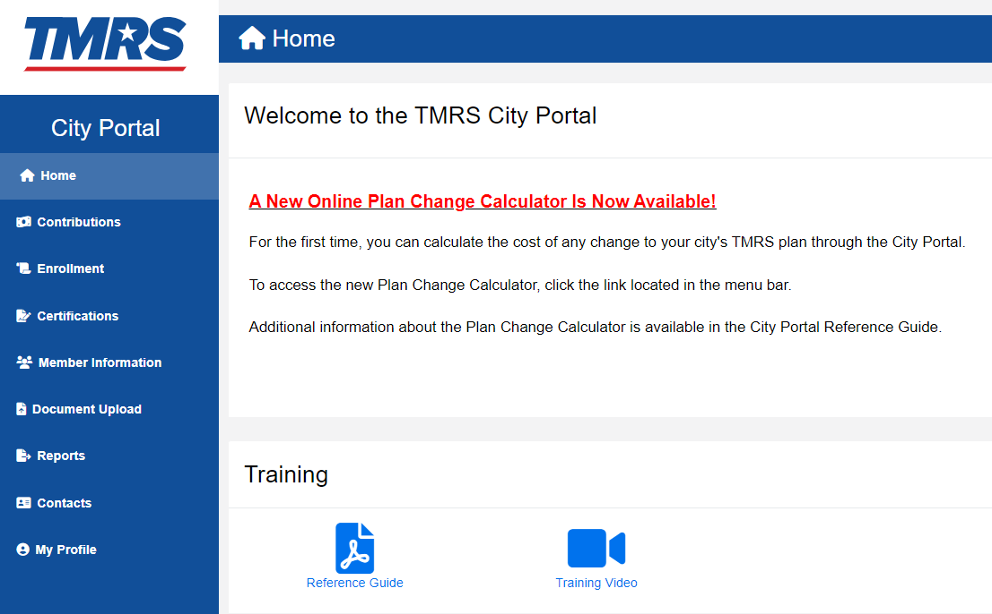
Robust City Portal
Cities can manage their TMRS plan 24/7 online
Enroll new employees, pay contributions, run reports
New Plan Change Calculator

Slide 8
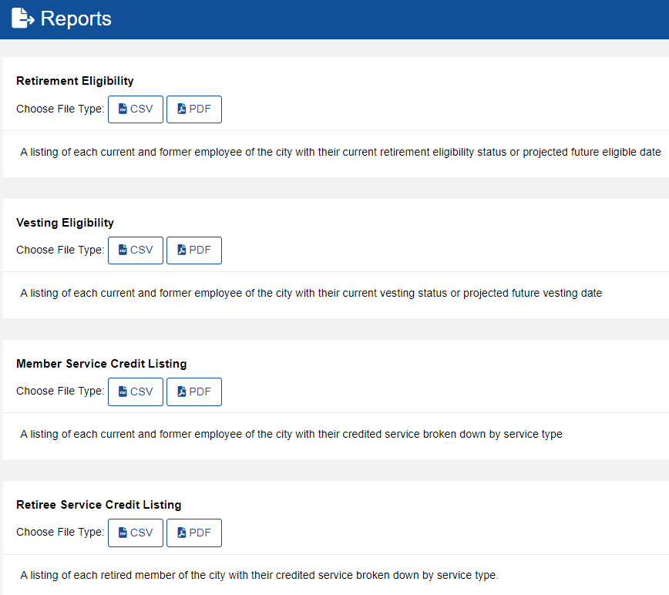
City Portal Reporting Capability
TMRS provides reports to help cities administer their TMRS plan
Reports are also available to assist with auditor requests

Slide 9
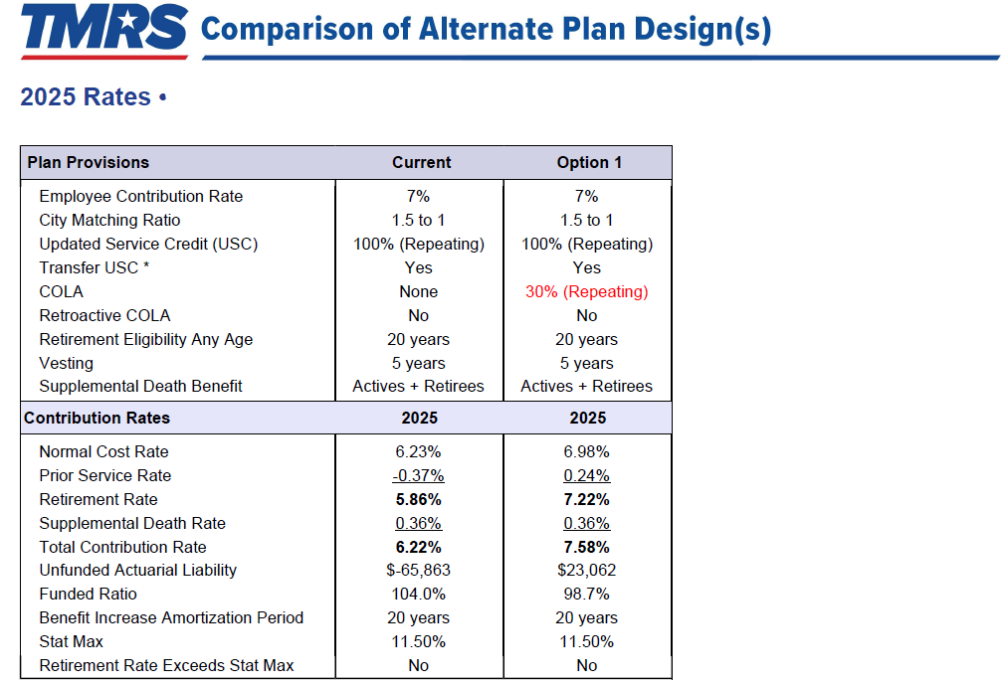
New Plan Change Calculator
Cities can now immediately calculate the cost of changing any TMRS benefit options in a couple of clicks - without calling TMRS
Since July, more than 450 cities have used the calculator

Slide 10
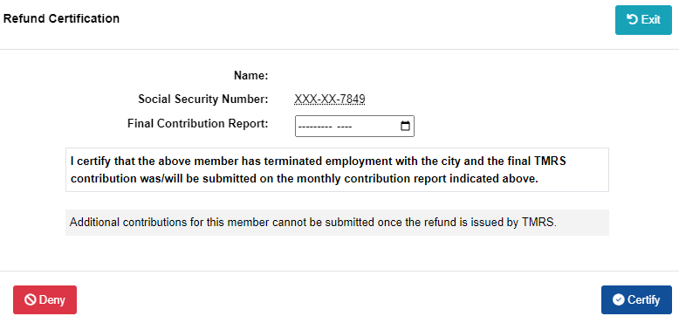
Online Refunds Are Now Available
No more paper
Cities certify former employees refund application online

Slide 11
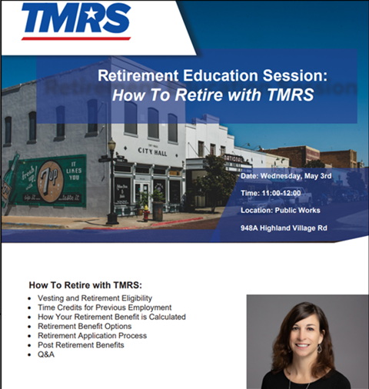
City Education
City training conference (October 22)
Plan funding and design
Model ordinances
City Council education
City focus group

Slide 12
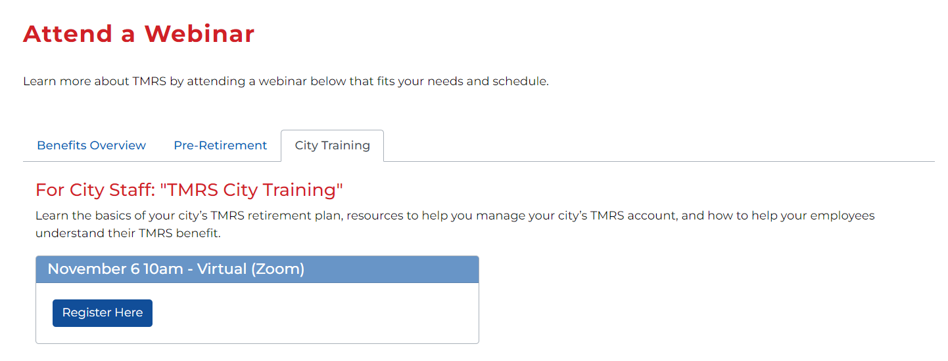
Monthly City Training Webinars

Slide 13
Member Services
Member Services Are Better Than Ever

Slide 14
Member Services
Unparalleled phone service: A TMRS customer service analyst answers Member calls in an average of seven seconds
Benefit fairs
Retirement planning seminars
Member education webinars
Individual Member counseling

Slide 15
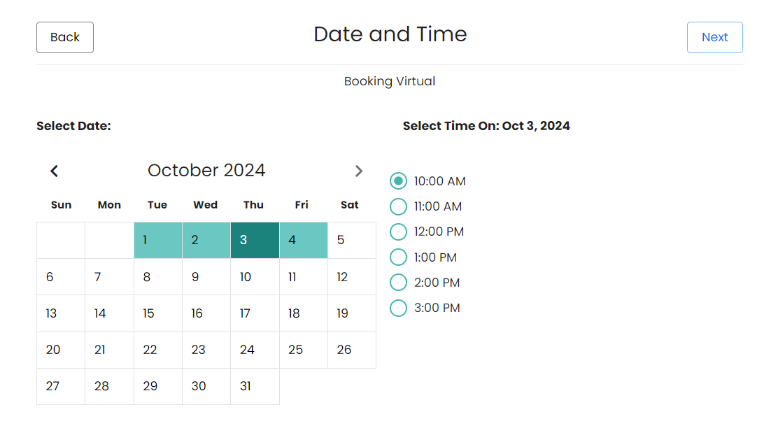
Member Counseling Sessions

Slide 16
City and Member Resources
Resources Are Better Than Ever

Slide 17
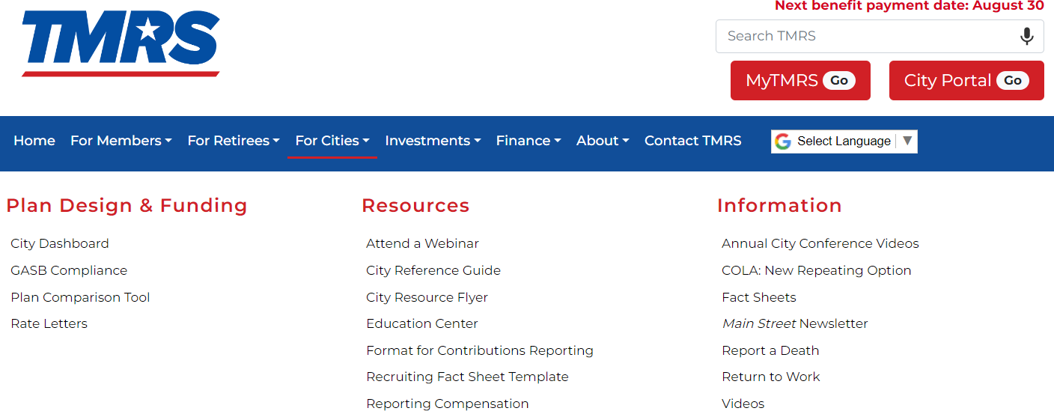
TMRS.com Has Everything You Need

Slide 18
Member Benefits Guide and City Reference Guide

Slide 19
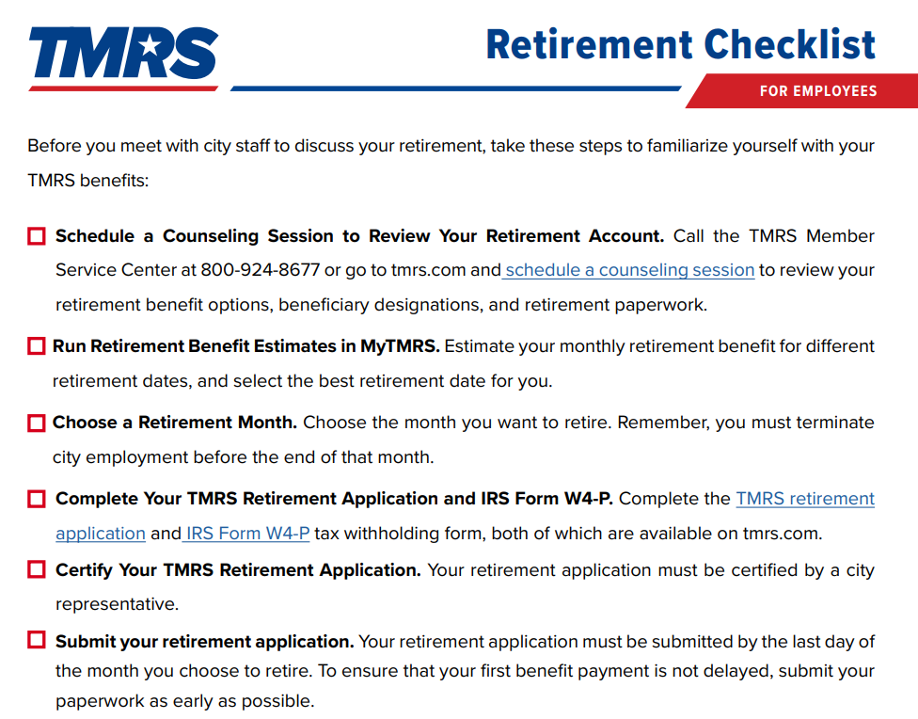
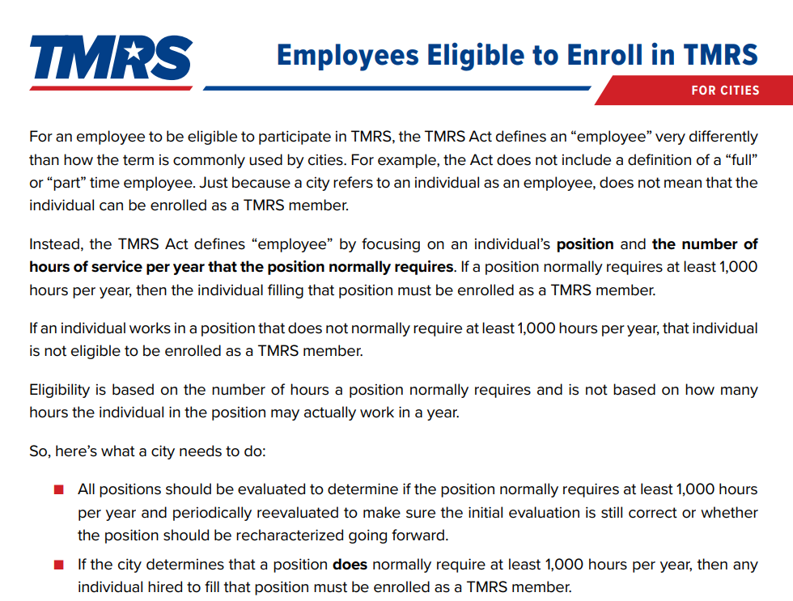
Member and City Fact Sheets

Slide 20
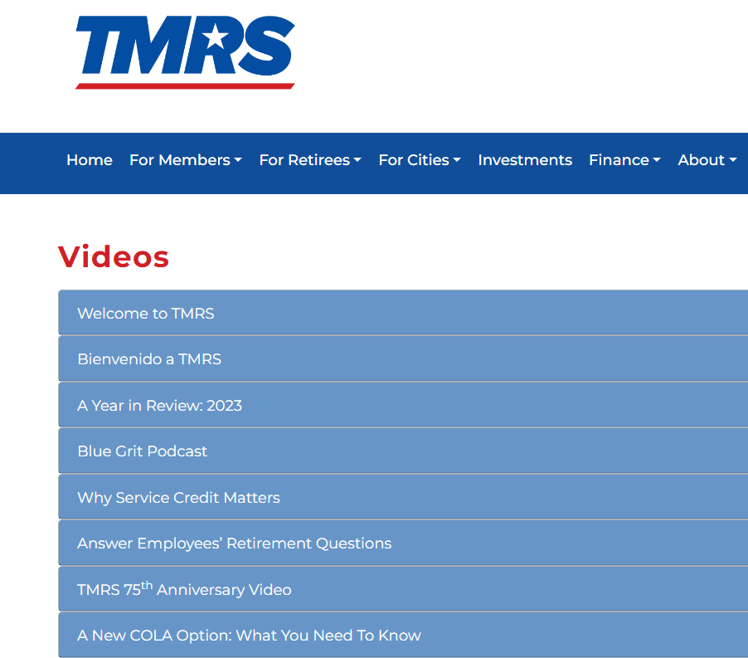
Video Library

Slide 21
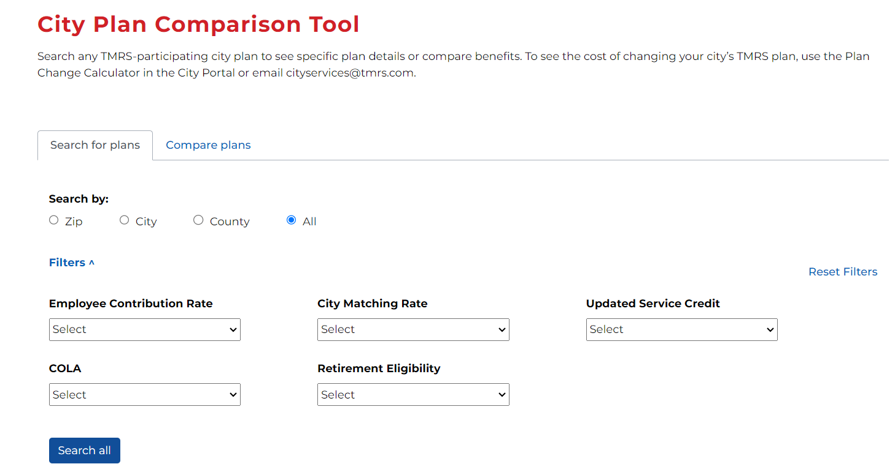
Plan Comparison Tool
Cities can compare TMRS benefit plans
Multiple search features
City contribution rates now included

Slide 22
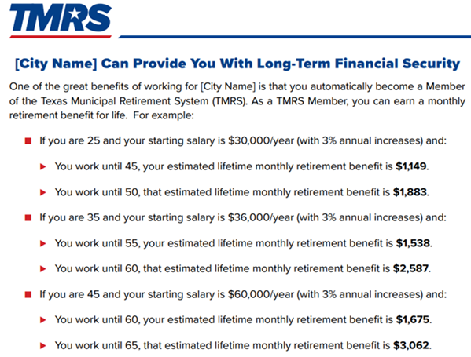
Customized City Recruiting Flyer

Slide 23
What’s Next

Slide 24
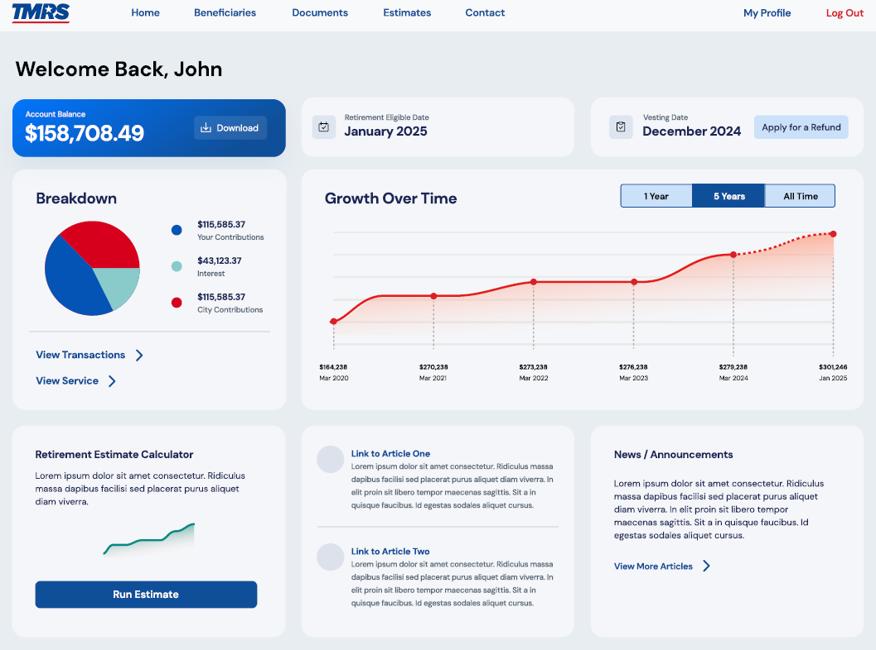
An Improved MyTMRS

Slide 25
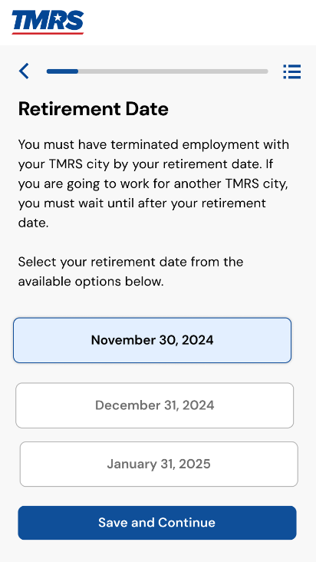
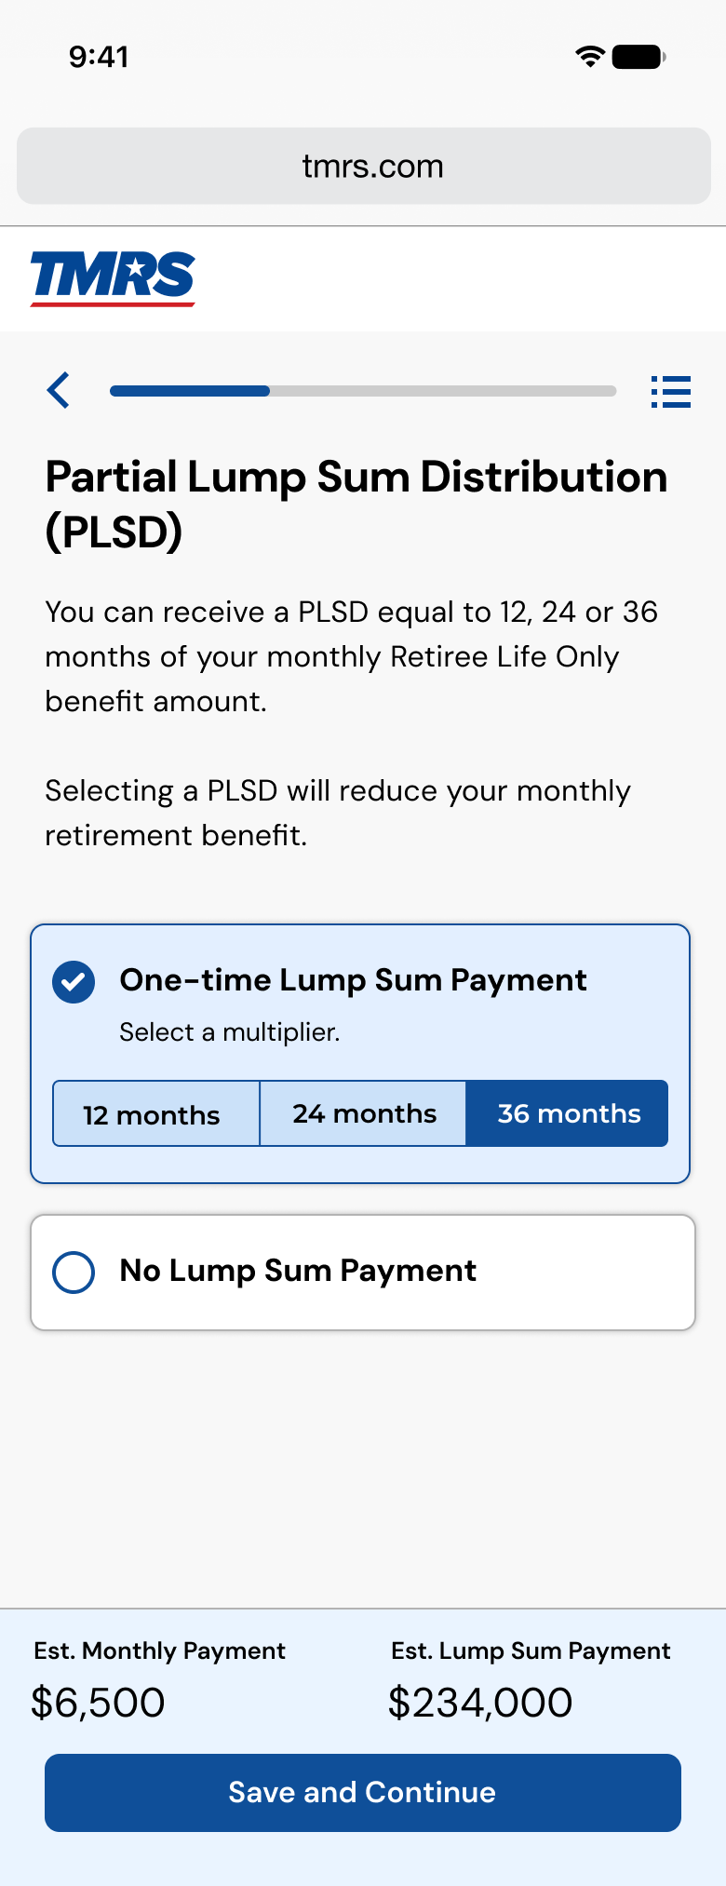
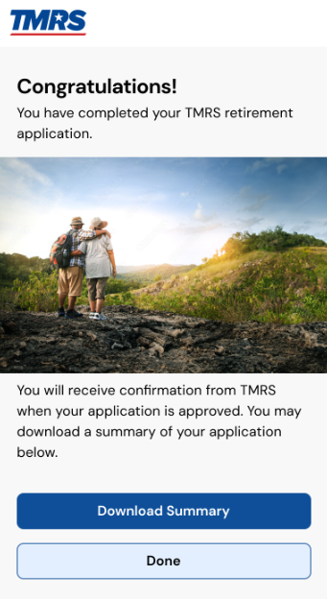
Online Retirement Application

Slide 26
Continuous Quality Improvement
Governor’s Award
2025
Organizational Profile + 50 pages
2024
Progress Level
AWARDED
IN PROGRESS
Organizational Profile + 35 pages
Commitment Level
2024
AWARDED
Organizational Profile + 20 pages
AWARDED
2024
Engagement Level
AWARDED
Organizational Profile + 10 pages
AWARDED
Pioneer Level
2023
AWARDED
Organizational Profile – 5 pages
Notes:
Talk about how we are working on the Progress level now, and before we can receive the Governor’s award, QTF will send a team for a site visit to watch how we do things first hand.

Slide 27
We Welcome Your Feedback
Anthony Mills
Director of Education Services
amills@tmrs.com
(512) 225-3764

