Slide 1
Cash Handling
Government Treasurers’ Organization of Texas
https://gtot.nctcog.org/
Patrick Shinkle
North Central Texas Council of Governments
https://www.nctcog.org/training-development-institute

Slide 2
Benefits of Cash Handling
Increased Accuracy
Proper training helps employees handle transactions accurately, reducing errors in cash handling and ensuring that the cash drawer balances at the end of each shift.
Fraud Prevention
Training includes best practices for detecting and preventing fraudulent activities, such as counterfeit bills and theft.
Improved Efficiency
Well-trained employees can process transactions more quickly, leading to shorter queues and improved customer satisfaction.
Enhanced Security
Employees learn how to handle cash securely, reducing the risk of loss or theft.
Better Customer Service
Training often includes customer service skills, helping employees interact positively with customers and handle difficult situations effectively.
Employee Confidence
Proper training boosts employee confidence in handling cash, which can lead to a more positive work environment and better overall performance.

Slide 3
Contents
You and Your Organization
Money Identification
Money Handling
Checks
Credit Cards
Money Orders
Entity Policy & Procedures
Fraud, Theft & Robbery
The Federal Reserve
Conclusion

Slide 4
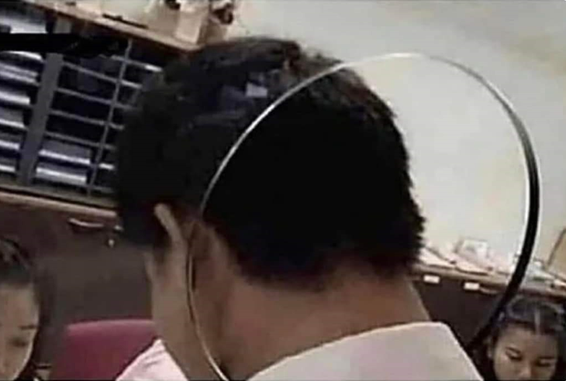
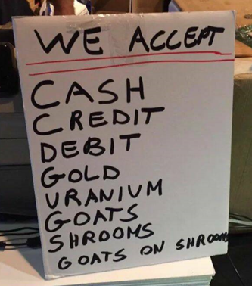
You and Your Organization
You as a cash handler
You as a supervisor
Effective cash handling
Where is the cash?
Cashiering functions and area responsibility
Cashiering customer interactions
Cashier functions and area
Cash drawers and tills
What is cash?

Slide 5
Money & Currency Identification
6 key features for money identification
Serial numbers
Unique for production, tracking
Color changing ink
Metallic flakes in the ink
Microprinting
Verifiable images difficult to scan or print
Intaglio printing
Magnetic ink and embedded into the substrate
Security threads & 3D ribbon
Vertical thread that changes color with UV light. 3D ribbon in the $100 substrate
Paper, fibers & watermarks
Cotton (75%) & linen (25%) with denim fibers. Watermarks are visible with lighting
https://www.uscurrency.gov/

Slide 6
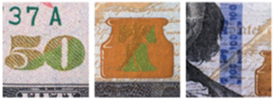
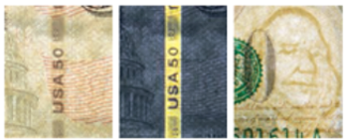
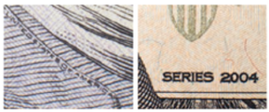
Money & Currency Identification
Methods for identification
Feel the paper
A rough touch on the jacket of the portrait
Tilt the note
Color shifting ink and 3D security ribbon
Check with light
Security threads and watermarks
Check with magnification
Microprinting at various locations
Standardization for verification
Locations and areas for verification

Slide 7
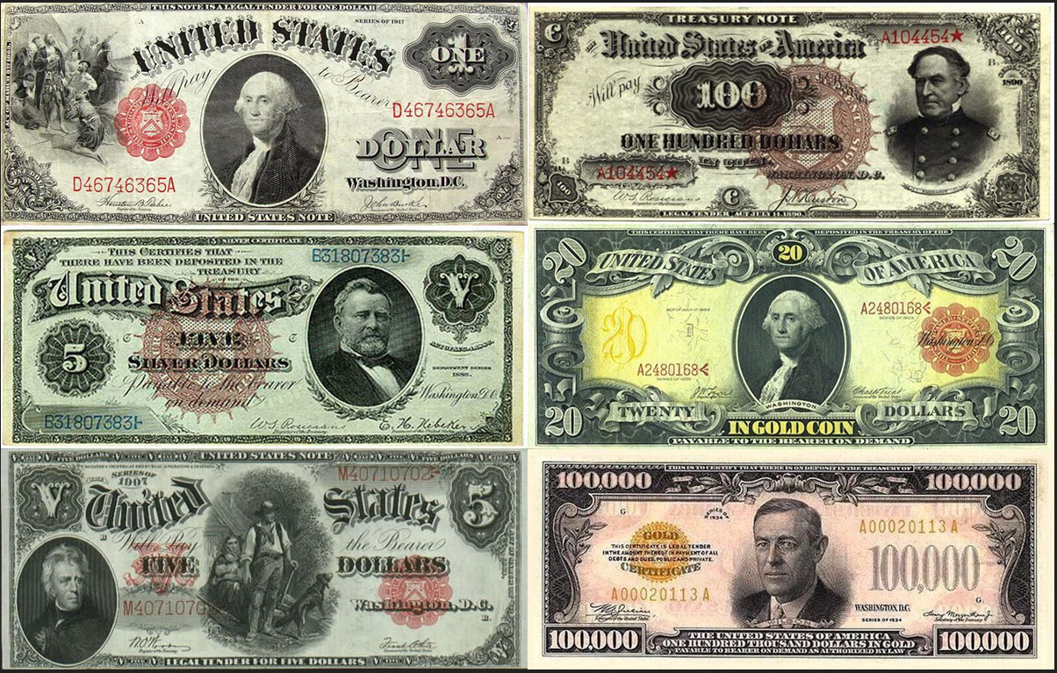
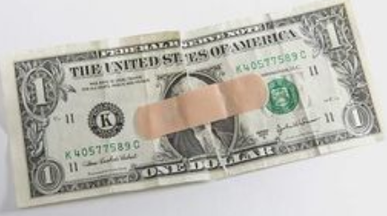
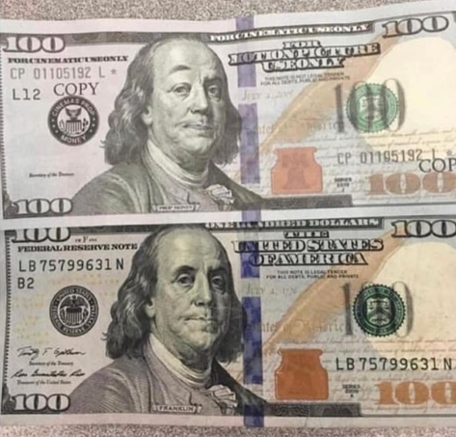
Additional Considerations
Dated Currency Valuation
Currency Portraits and Identifiers
Coins (Rolls, production, pennies, fraud)
Currency Straps
Lifespan
Composition (Bills & Coins)
Print Order from the Board of Governors
Mutilated money
Counterfeit money

Slide 8
Money Handling
Accepting cash
Quick verification for authenticity
Counting currency
Receiving
Hand-to-Hand
Distributing
Hand-to-Hand
Hand-to-Table
Walk-through
Surprise cash counts
Unannounced & random

Slide 9
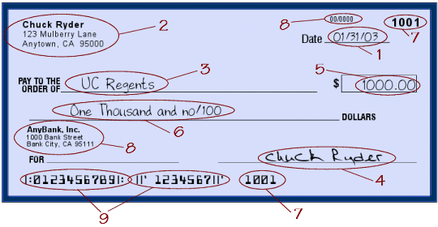
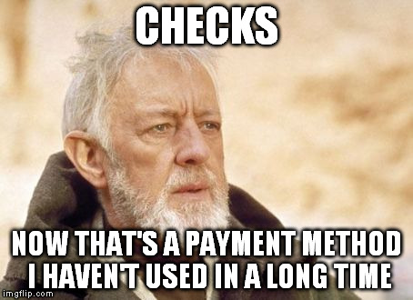
Checks
Payable on demand
Stale dates (Typically 6 mo.)
The 9 Points of negotiability
ABA numbers
Texas Region 11 (K) on the notes
MICR encoding
Security check features

Slide 10
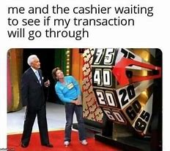
Credit Cards
The processing process
Transaction recommendations
Types of credit cards
EMV Chips –vs- Magnetic strips
Credit card fraud
PCI Compliance
Money orders

Slide 11
Entity Policy & Procedures
Use AI to assist with your initial drafting of policy & procedures
Each Entity department has an internal control memo that must include, but not be limited to the following information:
authorization of person(s) to collect cash;
separation of duties;
off-site cash collection procedures;
maintenance of cash receipt logs;
security and reconciliation of cash;
delivery of approved cash deposit to the Utility Billing office;
over/short procedures;
Notifying the Finance Department in the event of loss;
retaining of records
Department Heads and Division Supervisors-
Please review your department’s internal control memo to ensure that they include each of the criteria listed above. Any process updates need to be approved by Finance before they are implemented.

Slide 12
Entity Procedures
Cash Transactions
Department Heads or Division Supervisors will give authorization to departmental employees to handle cash.
All authorized employees must complete Cash Handling Training.
Training must be completed within the first 30 days of employment, if training is not completed, the employee will not be allowed to handle cash until they become compliant.
Training will reoccur on an annual basis in October.
If annual training is not completed by October 31st, cash handling responsibilities must be suspended.
Each authorized employee that has custody of entity cash has a fiduciary responsibility to handle all cash transactions appropriately.
Custodians of petty cash funds must comply with the Entity Petty Cash Policy.

Slide 13
Entity Procedures
Cash Transactions
It is the Department Head or Division Supervisor’s responsibility to verify that cash is properly secured, accounted for, and documented in accordance with entity policy and internal procedures developed by the department.
Departments must deposit cash daily, and in accordance with entity cash handling procedures and departmental internal control documents.
The Finance Department is responsible for performing spot audits to ensure all entity policies and procedures and departmental processes are adhered to at all times.

Slide 14
Entity Procedures
Separation of Duty
Each Department Head or Division Supervisor will be responsible for ensuring a structured separation of duties process to be always ensure that cash on hand and cash deposited matches actual receipts.
The Finance Department can assist departments in reviewing process changes to ensure compliance.
Please note that internal control memos are reviewed by Accounting and each department annually. These processes are audited each year by an external audit firm for compliance so please contact Finance before making any changes.
Overages & Shortages:
The Department Head or Division Supervisor will ensure that cash on hand and cash deposited matches actual receipts at all times.
Departments will adhere to their procedures when handling overages and shortages.

Slide 15
Entity Procedures
Consequences for Noncompliance
It is Department Head or Division Supervisor’s responsibility to track and maintain noncompliance issues.
Departments will adhere to their specific internal control memo on how this is handled.
Records Retention
It is the Department Head or Division Supervisor’s responsibility to track and maintain records for the department.
Departments will adhere to their specific internal control memo on how this is handled.
Contact the Entity Secretary’s office for additional, specific instructions.

Slide 16
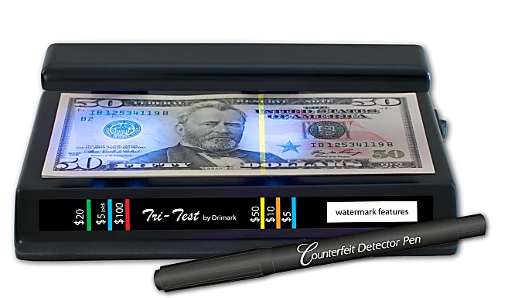
Locally approved Items
Tamper Proof Clear Plastic Deposit Bags
Zippered Bank Bag
Dual Bank Deposit Slips
Coin Wrappers & Currency Straps
Cash Receipt Forms (For manual transactions when needed)
Transport bag that conceals deposit
Tyler Cashiering Batch Report for daily reconciliation and batch closing
Bill Counter

Slide 17
Fraud, Theft & Robbery
Discount Scams (Sweet Hearting)
Line-Item Void
No Sale
Penny Trick
Manipulation of Voids and Refunds
Floating Receipt
Phony Walkouts
Short-Changing / Change-Raising
Technology Scams

Slide 18
Fraud
How do we protect against accusations of fraud?
How do we handle the transfer of cash within the organization?
How often and when do we count our cash and till deposits?
How do we protect the funds, organization, and personal reputation?
Fiduciary Responsibility
A fiduciary is a person who holds a legal or ethical relationship of trust with one or more other parties. Typically, a fiduciary prudently takes care of money or another asset for another person.
A fiduciary relationship encompasses the idea of faith and confidence and is generally established only when the confidence given by one person is actually accepted by the other person (TRUST).

Slide 19
Theft of Cash
Skimming –
Any Scheme in which cash is stolen from an organization before it is recorded on the organization’s books and records.
Employee accepts cash payment from a customer but does not record the sale and instead pockets the money.
Cash Larceny –
Any scheme in which cash is stolen from an organization after it has been recorded on the organization’s books and records.
Employee steals cash and checks from the daily receipts before they can be deposited in the bank.
Check Fraud Examples
ACFE Report to the Nations on Occupational Fraud and Abuse 2012

Slide 20
Theft of Funds (Fraud)
If found guilty of embezzlement, the penalties are dependent on the amount of money or value of goods taken.
If you are considered a “public servant” in your capacity as an employee when the situation happened, the charge you face will be enhanced. You will face the next higher category of offense.
Value of Offense | Possible Charge
0 to $1,500 | Misdemeanor Charge, up to 1 year in jail
$1,500 to $20,000 | State Jail Felony, up to 2 years in state jail
$20,000 to $100,000 | 3rd Degree Felony, 2 to 10 years in prison
$100,000 to $200,000 | 2nd Degree Felony, 2 to 20 years in state prison
More than $200,000 | 1st Degree Felony, 5 to 99 years in state prison
http://www.mytexasdefenselawyer.com/texas-criminal-laws-penalties/embezzlement/

Slide 21
Robbery
Use training from your local Law Enforcement Officials
Critical factors in order of priority
Protect human life and health (Safety)
Catching the criminal (Not stopping the criminal)
Protecting the entity’s funds
Don’t be a hero
Always assume there is a weapon even if not seen
Follow their instructions and tell them what you are doing as you follow the instructions
Observe, remembering distinguishing features, voice, items touched
Call 911 as soon as it is safe to do so

Slide 22
The Federal Reserve

Slide 23
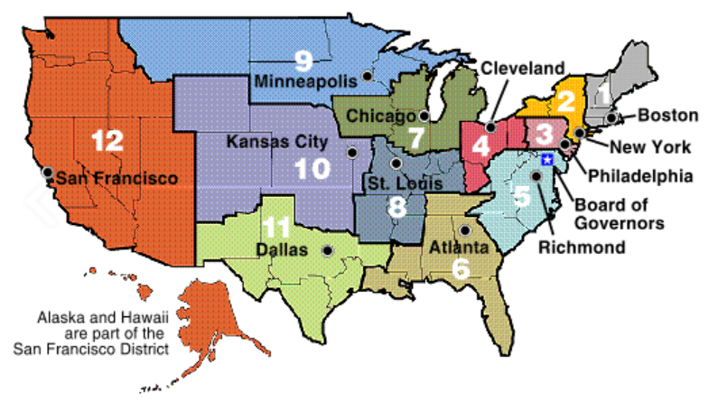
Federal Reserve Banks

Slide 24
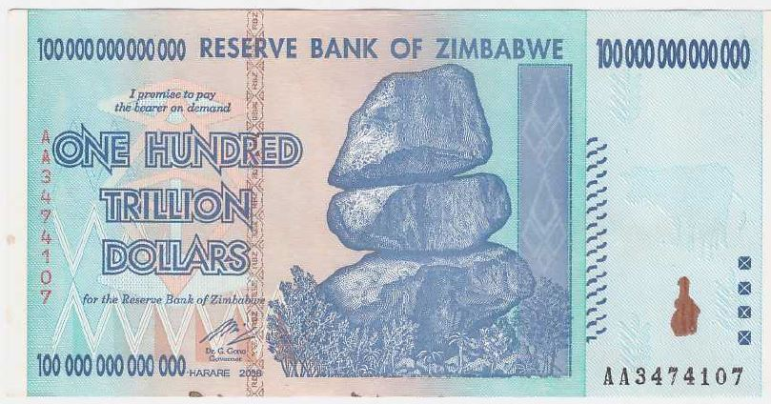
Purchasing Power - Inflation/Deflation
Inflation – Prices going up.
Deflation – Prices going down.

Slide 25
Cash Controls Quick Reference Guide

Slide 26
Quick Reference Guide
The Finance Department is the only department that can maintain bank accounts on behalf of the Entity.
“Cash” refers to currency/coin, checks, bank drafts, Automatic Clearing House (ACH) transactions, Electronic Funds Transfers (EFTs), money orders, traveler’s checks, cashier’s checks, or credit/debit card transactions.
Only authorized employees may handle cash on behalf of the Entity.
Cash Handling Training must be attended annually.
Each department that handles cash must develop written procedures for separation of duties and review them annually.

Slide 27
Quick Reference Guide
Separation of duties must be 2 people deep (3 is preferred when possible):
Collecting Cash
Maintaining Documentation
Preparing Deposits
Reconciling Records
Cash must be kept in a secured location (locked safe).
Checks must (Confirm the points of negotiability):
Be made payable to the entity
Be endorsed upon receipt
Have current date
Have written line and number amount match
Be signed

Slide 28
Quick Reference Guide
Deposits must:
Be delivered to Utility Billing within 1 business day
Be transported in a sealed tamper evident deposit bag which is inside of another bag (tote, backpack, purse, etc.)
Cash on hand and cash deposited must equal actual receipts at all times.
Receipts:
Regular sales = must issue receipt every payment
Occasional sales = must issue receipt with every payment OR keep sufficient transaction detail
If a cash transaction occurs a receipt must be provided to customer

Slide 29
Quick Reference Guide
Counterfeit – check paper, portrait, watermark, and security strip.
Using a counterfeit pen or UV light is encouraged.
Overages/Shortages must:
Be reported to supervisor at end of daily closing.
Be reported to the Finance department the next business day.
Be investigated if in a single incident or in aggregate during one-month period in the amount of $25 under the control of a single employee.
Have maintained written documentation.
Fraud or theft must be reported to Finance and local law enforcement on the day of occurrence.

Slide 30
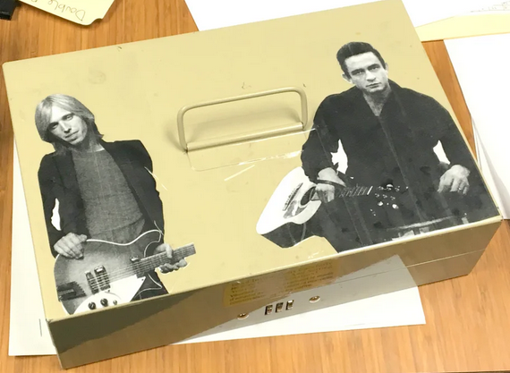
Quick Reference Guide
Petty Cash/Change Fund must:
Be kept in safe, not locked drawer.
Be reconciled at end of day funds are used.
Have maintained written documentation.
Be balanced at all times.
Refunds:
Do not issue refunds from petty cash.
Ensure refunds are charges back to the appropriate account or fund.

Slide 31
Cash Handling Questions
CASH HANDLING | Yes | No | N/A
Are cash and assets secured with locked cash drawers, locking cash registers, cashier cages or locked metal boxes always?
Are safes and drop safes bolted in place and smaller receptacles secured in locked areas?
Are the designated custodians and supervisors the only personnel who maintain combinations or keys for cash receptacles?
Is every cashier assigned an individual cash drawer?
Are cash drawers shared?
Are all checks endorsed immediately with the entity name and a cashier identifier upon receipt?
Is photo identification required for all over-the-counter checks taken?
Are reviews performed on each cash drawer’s assigned cash balance?
Are change drawers used for petty cash or cashing of personal, payroll or expense checks?
Are sequentially numbered receipts used for all transactions?
Are daily audits and balancing of the receipts (or system reports) to the drawer required as part of the closing process?
Are cash drawers balanced and closed out at the close of each cash handler’s work period?

Slide 32
Cash Handling Questions
Are all overages/shortages reported to the supervisor at daily closing and are they documented as overages/shortages in the balance process?
Are overages/shortages in a single incident or in total, during a one month period by a cash handler, investigated by the custodian/supervisor?
Are all deposits verified by two individuals?
Are all computer and credit card terminals closed out at the end of a cashier’s shift or at the end of the day?
Is documentation in the form of a summary sheet for each deposit prepared indicating the amount of funds, the breakdown of funds, the accounts to be credited and identification of the depositor?
Are all deposits prepared within one business day?
Are all deposits of physical checks and cash in secure bags with identifying deposit slips indicating the amount and location of collection for tracking purposes?
Are all deposits balanced to generated reports, daily? weekly? monthly?
Are Security codes/PINS/logins assigned to individuals/cashiers for all computerized systems?
Has your department investigated procedures for recycling coin and currency between departments and the minimizing change orders to minimize transport and vault charges?

Slide 33
Cash Handling Questions
CASH HANDLING LOCATIONS | Yes | No | N/A
Is working space provided for each cashier to maintain control of the cash handling process?
Does the area allow space for the processing of deposits and cash; is the area secure that is designated for balancing operations?
Does the cashiering area provide for security and separation between cash handlers and customers?
THEFT OR LOSS OF CASH/MONIES | Yes | No | N/A
Has any instances of theft or loss of cash occurred in this area?
On discovery of a possible theft or loss of funds are the Police notified?
If a theft is discovered does the supervisor/custodian make a verbal report to the Police and the appropriate Administration before close of business, followed by a written report within one business day?
Are procedures in place for handling theft or loss of funds and counterfeit currency?

Slide 34
Cash Handling Questions
TRANSPORT OF SYSTEM ASSETS | Yes | No | N/A
Are assets (cash / checks / deposits) securely transported from the point of collection to the Administration Office?
Is there a set schedule when assets are transported?
Are transfers of assets documented and signed by both sending and receiving parties; is an institution log maintained to document the transfer?
Are all off-site transfers made by contracted armored transport, secure transport, or security personnel?
Do armored car personnel receipt all items and provide a copy to the fund custodian/supervisor?
Do armored car personnel present adequate identification before each transport?

Slide 35
Build your Own Training or Attend GTOT’s

