Slide 1
Charting Your Course: Leveraging Long-Term Financial Planning to Ensure Smooth Sailing
Government Finance Officers Association of Texas Spring Conference – April 8, 2025

Slide 2
Presenter
Scott Catlett Director – Government Advisory Services
Nashville, TN
17 years in small, medium, and large finance departments supervising from 6 to 60 staff
Former Finance Director for the Cities of Newport Beach and Yorba Linda, California
Former Assistant Chief Financial Officer for the City of Riverside, California
8 years providing advisory services for state and local governments throughout the US
10 years as an adjunct professor teaching public sector financial management
Name, Designation Title
Location
2

Slide 3
Focus Areas for Today’s presentation
Financial Management in Local Government
Long-Term Financial Planning Basics
Key Components of a Long-Term Financial Plan
Pitfalls in Financial Forecasting
Presenting the Long-Term Plan
Helpful Resources
3

Slide 4
Why Long-Term Financial Planning?
A policy-based framework of comprehensive:
Long-term projections of what has been, but more importantly what will likely be
Long-term solutions to identified areas of concerns
Critical to:
Thoughtfully and proactively plan for the future
Identify and highlight future problems or opportunities
Think about the future before it is the present
Impose financial discipline on budgetary decision making
Avoid surprises
4

Slide 5
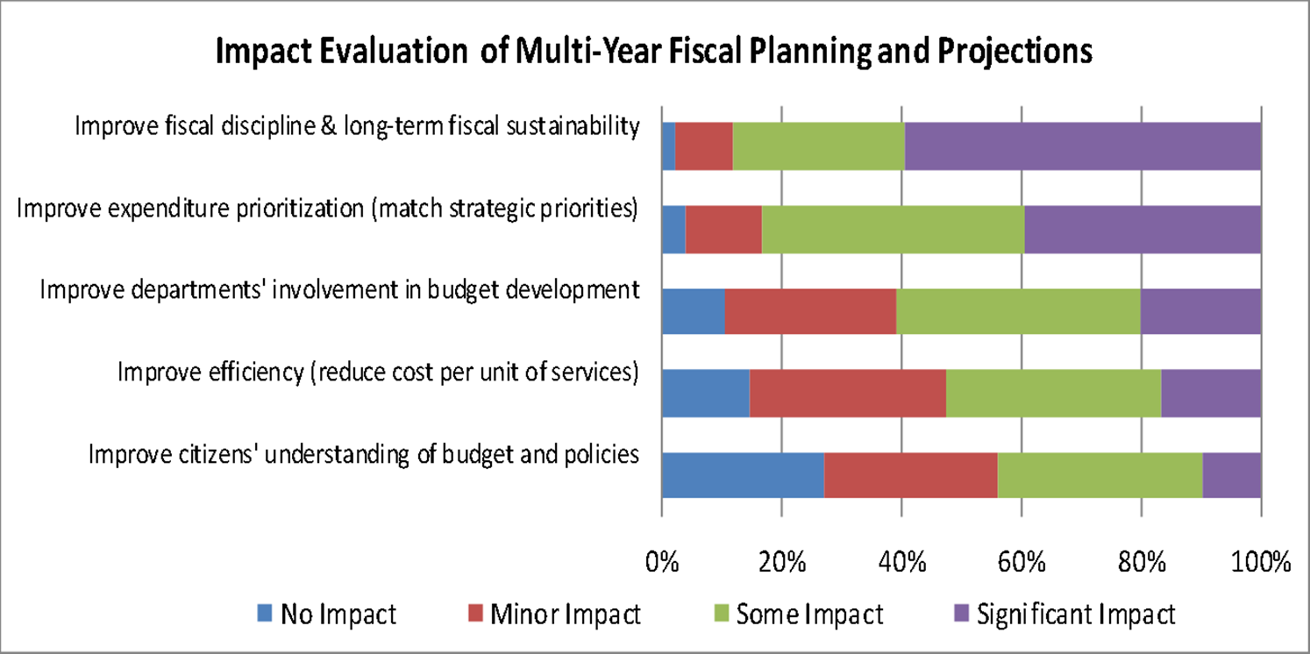
Impact of Long-Term Financial Planning on Local Governments
~90% highlight increased fiscal discipline
~85% highlight improved expenditure prioritization
5

Slide 6
Five Reasons to Embrace Long-Term Financial Planning
Transparency: Stating assumptions improves credibility and communicates true fiscal condition
Fiscal Discipline: Realistic forecasting precludes wishful thinking about capacity for revenue growth
Early Warning: Reveals adverse trends and gives staff and elected officials time to craft appropriate solutions and avoids crisis mode
Promotes Sustainability: Identifies long-term impacts of policy decisions and encourages sustainable solutions rather than short-term fixes through the annual budget process
Living Document: Continuously updated with new information: “The numbers never sleep.”
6

Slide 7
Financial Management in Local Government

Slide 8
Public Sector Financial Management Defined
A system of policies, procedures, systems, and reports that facilitates a better understanding of and helps to ensure the long-term fiscal health of an agency.
Finite resources are available to deliver a myriad of services
Poor financial management leads to:
Wasted resources
Poor budgetary decisions
Unanticipated surpluses and deficits
Lack of understanding of future challenges

Slide 9
Influences in the Financial Management Process
Financial management in government is impacted by multiple competing forces
Pressures to deliver to constituents
Requirements to have a balanced budget
Economic development efforts
Media and public pressures
Political Forces | Economic Forces | Social Forces | Legal Forces
Citizen input | Economic cycles | Population | Balanced budget
Citizen involvement | Economic subsidies | Age | Referendums
Campaign promises | Labor competition | Income | Voter approval
Campaign contributors | Competition with neighbors | Education | Unfunded mandates
Borrowed in part from A Budgeting Guide for Local Government
9

Slide 10
Why is Financial management and Analysis Important?
It’s not all about accounting!
Many finance officers start their careers as junior accountants or as auditors with a strong understanding of accounting and financial statements
Depending on the size of your agency and staffing, there may be little opportunity for exposure to other areas of financial management until you are promoted into a position with these responsibilities
As one rises in seniority, a thorough understanding of financial management and analysis becomes more and more critical
10

Slide 11
Why is Financial management and Analysis Important?
Analyze affordability of existing and desired service levels, policies, and programs
Provide warning of potential imbalances in the financial future
Explore what the fiscal future might look like
Create a basis for discussion of what actions can be taken to influence the future
11

Slide 12
Budget and Financial Reporting Lifecycle
Budget Development & Approval
Budget Reporting and Monitoring
Agency / Public Goals & Priorities
Year-End Financial Reporting / Audit
Long-Term Financial Planning
Long-Term Vision
Start Here
Financial Perspective
Financial History
Operational Execution
12
Transparency and Monitoring

Slide 13
The GFOA Distinguished Budget Presentation Award Program Provides a Great Roadmap
Strategic planning and performance measurement information
Organizational structure and policy information
Overview and summary budget information
Fund-level and department-level budget information
Long-term financial planning information
Capital improvement program information
Outstanding debt Information
Staffing information
Statistical and narrative data
GFOA recognizes the importance of long-term financial planning as part of a comprehensive and technically sound budget process
Integration of strategic planning, which informs long-term financial planning
Discussion of how long-term financial planning impacts the budget formulation process
13

Slide 14
Connection to Other Planning Activities
Start Here
General Plan &
Strategic Plan
Council / Board /
Community Input
Long-Term
Financial Plan
Budget and CIP
Results Evaluation
Management
Input
Operational Needs
Start Here
14

Slide 15
Long-Term Financial Planning Basics

Slide 16
Long- Term Financial Planning Defined
Long-term financial planning uses financial forecasting and analysis to identify future financial positions, conditions, challenges and opportunities, and identifies strategies to secure future financial sustainability.
16

Slide 17
Effective Financial Forecasting
“Forecasting is very difficult, especially if it is about the future.”
– Niels Bohr

Slide 18
So, What Does That Mean?
A roadmap to and of your future
Represents five, ten, or more individual annual budgets
Builds off prior year(s) information
Projects/predicts the future
Helps to guide current and subsequent year decision making and the possible timing of these decisions
Labor agreements
Program additions/changes
Capital expenditures
18

Slide 19
A Consensus-Driven Process
Involves elected officials, staff, and the public
Three core requirements of the plan:
Reflects council / community priorities
Provides strategies to achieve and maintain financial balance
Identifies, from a financial perspective, how the government will provide a consistent level of public services
The plan must demonstrate the sustainability of your organization’s decisions and long-term goals.
19

Slide 20
Five Pillars of Successful Long-Term Financial Planning
Effective framework of financial polices
Long-term service delivery vision
Technically sound analysis and forecasting
Collaborative and participative process
Connection to other plans
20

Slide 21
The Long-Term Financial Planning Process
Strategic Planning
LEGEND
Staff Task
Identify & Confirm Critical Issues
Council & Staff Task
Council & Staff Task with Critical Point of Public Input
Analyze Financial Trends, Debt, & Develop Forecasts
Analyze Critical Issues
Identify Imbalances
Implement through Budget
Financial Strategy Workshop
Deliberate & Approve Critical Assumptions
Prepare LTFP
Implement & Monitor
21

Slide 22
Essential Characteristics of A Long-Term Financial Plan
What is the time horizon?
5 – 10 years or more
What funds are considered?
What funds are appropriate for inclusion, either directly or as inputs to other funds’ projections
How often is a plan done?
Update on a regular basis
What is in it?
Contains a scan of the economic environment and long-term forecasts, debt analysis, scenario analysis, risk assessment, and financial strategies backed by supporting data and information
22

Slide 23
Best Practice Structure
Key policy statement, followed by explanatory detail covering required policy elements and related considerations for administration and reporting, which in this case includes:
Projecting revenues
Projecting expenditures / expenses
Identifying key internal factors impacting projections
Identifying key external trends and risk factors impacting projections
Review at least annually and update as needed
23

Slide 24
GFOA’s Key Benefits of Long-Term Financial Planning
Creating a long-term outlook into other planning processes like budgeting, capital planning, and revenue forecasting
Helping to diagnose potential risks and causes of fiscal distress
Stimulating “big-picture thinking”
Providing a tool for evaluating long-term compliance with financial policies
Allowing for pre-emptive action to mitigate forecasted financial distress
Defining parameters for decision-making
Communicating long-term financial position to residents and other stakeholders, including rating agencies and bond investors
24

Slide 25
Learn More
https://www.gfoa.org/best-practices

Slide 26
Key Components of a Long-Term Financial Plan

Slide 27
Long-Term Financial Planning
Beyond knowing how the current year is likely to end, finance officers need to be thinking about next year, five years out, and perhaps even 10, 20, 30, or more years in the future
Some of us are afraid to begin (or publicize) long-term financial planning because of the inherent uncertainty that goes along with forecasting
This fear can be mitigated with
Clearly stated methods and assumptions
Regular monitoring
Periodic updating and reporting
Evaluation of multiple alternative scenarios
Every forecast is…wrong!
27

Slide 28
Being Wrong is OK…Situations Change
The Great Recession
The COVID-19 Pandemic
Forecasts are designed to think about what is most likely to happen, not necessarily what will happen
In agencies where volatility is more likely to be a concern, scenario analysis is more important
28

Slide 29
Financial Data and Projections
Itemize existing major revenues
Must carefully determine what constitutes a major revenue
Aggregate existing minor revenues
Itemize existing major expenditures
Must carefully determine what constitutes a major expenditure
Typically, by type of expenditure or with certain sub-types (e.g., labor contracts or large service contracts)
Aggregate existing minor expenditures
Include assumptions about the future
Itemize projected new revenues
Itemize projected new services/programs
29

Slide 30
Example of Categorization - Revenues
Significant Items
Four union contracts
Health insurance rates for three plans
Pension costs
Sheriff’s contract
Park maintenance contract
Three bond issues
Transfer to golf course fund
Remaining Items
Operations and maintenance
Transfers to internal service funds
Property and sales tax
Charges for services
Fees and fines
Contract services – other
30

Slide 31
Develop Basis for Projections
Start with baseline existing budget
Project based on known information first
Existing labor contracts
Existing major service contracts
External expert forecasts for key revenues
Use appropriate trend information for remaining years
Historical trends
Expected development
Use external and internal experts to inform projections
Identify what’s missing (e.g., vehicle replacements, adequate facility maintenance funds, etc.)
31

Slide 32
Rolling Data Forward
Once you’ve built your first year’s forecast, roll it forward based on each significant or other category of revenues’ or expenditures’ expected growth factors
Examples
Negotiated cost of living rates
Health insurance trend data
Historical increases in Sheriff’s contract costs
Amortization schedule for debt
When the data that is more certain runs out, use your forecasting skills to make a logical projection based on the known facts
32

Slide 33
Foundation for Projections
Clearly articulate the assumptions, risks, and limitations
How is revenue growth determined?
How is expenditure growth determined?
What are the significant expected deviations from historical trends?
It must be clear to senior management and elected officials what is being addressed in the current baseline budget and what remains unaddressed absent further action
Scenarios based on risk assessment
Solutions are critical
A forecast projects what will happen in the future
A long-term financial plan provides solutions to what may happen in the future, giving adequate time to prepare rather than react
33

Slide 34
Foundation for Projections
Are the key assumptions valid and are independent third-party and internal experts involved?
Are revenue growth trends well understood?
Are there future one-time or new costs on the horizon?
What do departments know that you don’t know?
What is currently being ignored that should be addressed?
Unfunded liabilities (pension, OPEB, etc.)
Unfunded needs (facilities, vehicles, equipment etc. replacement)
Are roads and facilities adequately maintained?
Are resources sufficient to address current and future anticipated service levels at the desired level to avoid service level insolvency?
34

Slide 35
Scenario Analysis
Baseline scenario
What constitutes the baseline?
Professional judgment and expert insights
What-if scenarios
Assess the key risks for your agency, which will likely be unique versus your neighbors and peers
Higher or lower major revenues due to the economy, changing habits, or other factors
Higher or lower major expenditures such as addition of new programs or service levels
Loss or gain of key drivers of economic activity such as an auto dealer or lumber yard
Future development or annexations
35

Slide 36
A Word About Detail
Too much detail in the presentation of data can have the opposite impact of what was intended
Example: A line graph showing trends may be more impactful than a table showing the detail of those trends
Example: Discussing every revenue variance may cause those reviewing the report to miss the few variances that really matter
Having one key point heard is better than making 10 points that aren’t comprehended adequately.
36

Slide 37
Develop Solutions
Determine what problems your projections have identified
Duration – one-time or recurring
Scope – minor or major
Trajectory – growing or shrinking
Identify possible solutions to problems
Revenue enhancements
Expenditure reductions
Changes to future service level and program goals
Adjustments to assumptions (if appropriate and justifiable)
37

Slide 38
Narrative (If a Written Report Is Prepared)
Executive Summary – Brief overview & summary
Economic and demographic overview / trends
Summary of key financial data
Focus on expenditure & revenue projections
Look at one-time vs on-going figures
Offer “what if” scenarios
Provide a detailed discussion of your projections
Conclusion & summary
38

Slide 39
Pitfalls IN Financial Forecasting

Slide 40
Pitfalls in Financial Forecasting
Issue: Putting the forecast on the shelf for a year or more.
Concern: Information impacting the forecast is overlooked and the forecast becomes out of date and irrelevant.
Mitigate this issue by:
Throughout the year, the forecast must always be on your mind
Maintain a list of changes impacting the forecast and update it regularly
Assess whether addition to the list merit an immediate update to the forecast
Example: Will a mid-year decision in March take money away from critical issues that must be addressed in the upcoming fiscal year?
40

Slide 41
Pitfalls in Financial Forecasting
Issue: Salary and benefit projections are inaccurate or hurried.
Concern: Inaccurate baseline assumptions can incrementally increase the inaccuracy of the forecast over time.
Mitigate this issue by:
Maintaining an effective position control system
Make adjustment for and accurately include vacancies and related savings
Track unfunded and frozen positions and know when they will need to be filled
Account for the impact of retirements, such as accumulated leave payouts or lower benefit tiers applicable to replacement personnel
Be aware of negotiated salary and benefit increases, step increases, cost allocations for new positions, overtime impacts, and other related variables
41

Slide 42
Pitfalls in Financial Forecasting
Issue: Looking at historical trends to predict the future is insufficient.
Concern: Changes within the trend data may significantly impact the anticipate trajectory for the future.
Mitigate this issue by:
Identifying significant one-time occurrences in the past
Thinking through significant one-time occurrences anticipated for the future
Break apart categories of revenues and expenditures to minimize data aggregation masking these issues
Example: Adding a new program three years ago causes a long-term trend of 3% growth to become 5%
42

Slide 43
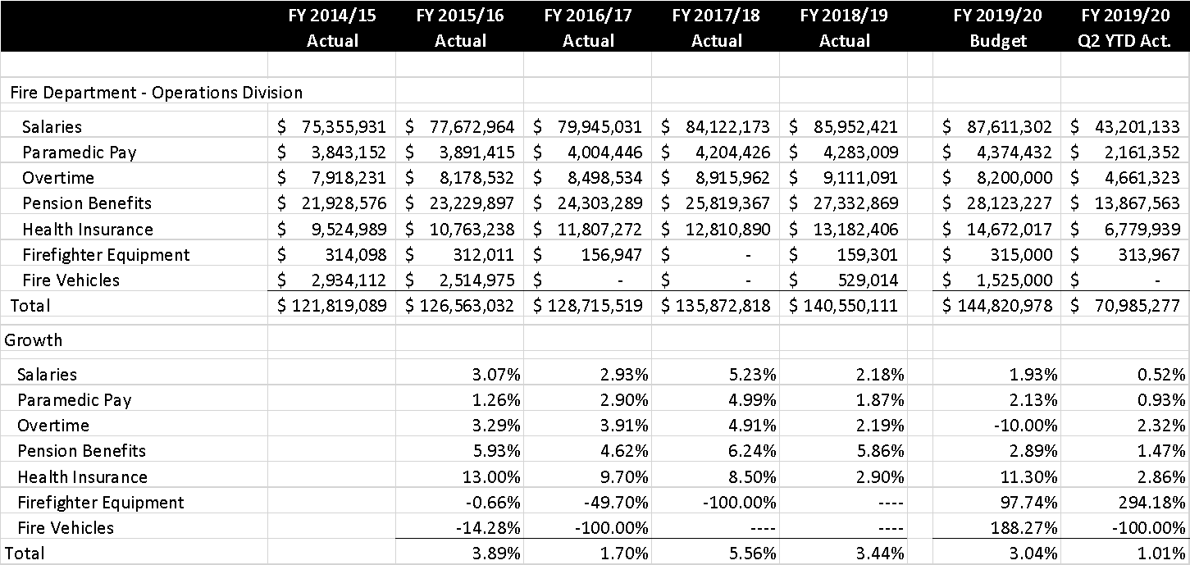
Example: Fire Department Expenditures
Concerns:
Overtime budget less than historical actual expenditures
Irregular equipment replacements
Irregular vehicle replacements
What is the necessary level of spending going forward?
43

Slide 44
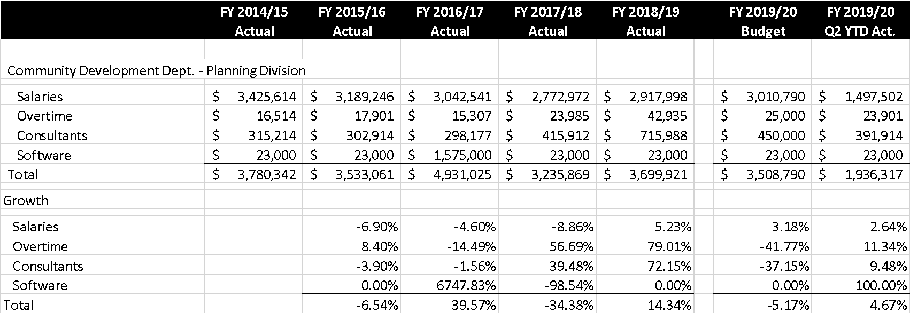
Example: Planning Department Expenditures
Concerns:
Overtime budget less increasing historical actual expenditures
Consultant costs increasing significantly above budget
Software replacement funded from baseline budget
What is the necessary level of spending going forward?
44

Slide 45
Things to Consider for Cities and Counties
Cities and counties, in particular full-service cities, are more vulnerable to recession and revenue volatility than other government agencies
Spend some time thinking about how your agency compares to others relative to the revenue mix – this is critical
How can you insulate against this issue?
Scenario analysis is important
Mix of expenditures
Public safety versus culture and recreation, etc.
Fixed versus variable costs can impact responses to reduced revenues
Debt service, minimum staffing, etc.
45

Slide 46
Things to Consider for Special Purpose Districts
Understanding customer demand and billing, as applicable
For rate-funded agencies
Regular updates to the rate plan
Rate plan structure and comprehensiveness of inputs
Scenario analysis is important
CIP/Grants/Reserves
Evaluation of debt versus pay-as-you-go financing for capital projects
Short-term vs long-term financial planning
46

Slide 47
Takeaways
The work involved in revenue forecasting is typically simple when compared to expenditure forecasting
But…your revenue forecast is critical and can sink your organization if it is inaccurate
Internal and external experts are invaluable – don’t try to do this yourself for the more complex revenues
Expenditure forecasts are complicated buy have less risk of unanticipated variances when done well
Engage department-level experts and those with knowledge of labor contracts to enhance accuracy
Understand the past, the unique aspects of each department, and likely future program and service needs
47

Slide 48
Presenting the Long-Term Financial Plan

Slide 49
Reporting on Long-Term Financial Plan Updates
If an annual long-term financial plan update has occurred or an update was initiated as a result of new information, highlight key information:
What changed?
What caused the change?
How will the agency respond?

Slide 50
Cautions When Presenting Forecast Data
Terminology is important
Call versions of your forecast other than the baseline “scenarios” – they are a planning tool
Don’t circulate draft versions of any forecast
Spreadsheet versions circulating via email or handed out at a meeting often delay or misstate key results
Annual updates of the baseline forecast should be done at a different time of year than the presentation of the ACFR and the budget to avoid confusion
Be careful about having too much detail in your presentation
The governing body may or may not have an interest in the details
Data can be presented only in PowerPoint versus a complete long-term financial plan document
Avoid providing more information than will be digested, which may prevent critical information from being understood and acted upon
50

Slide 51
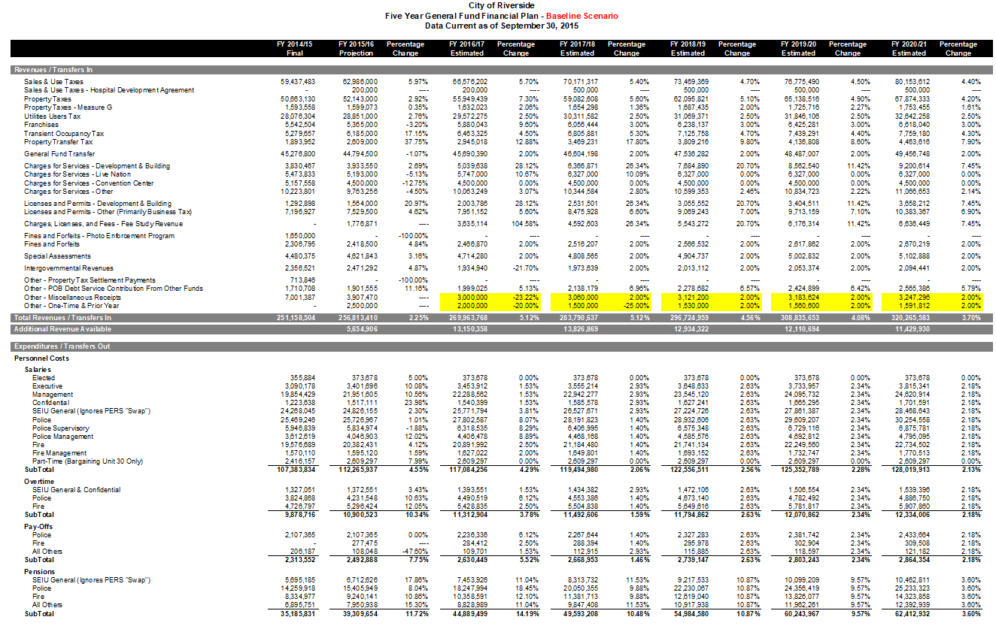
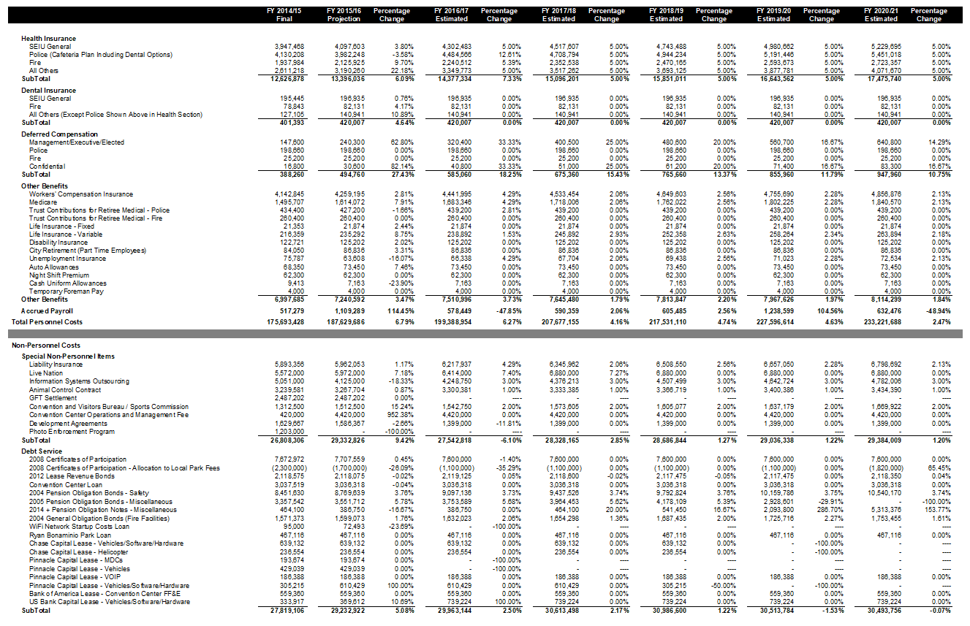
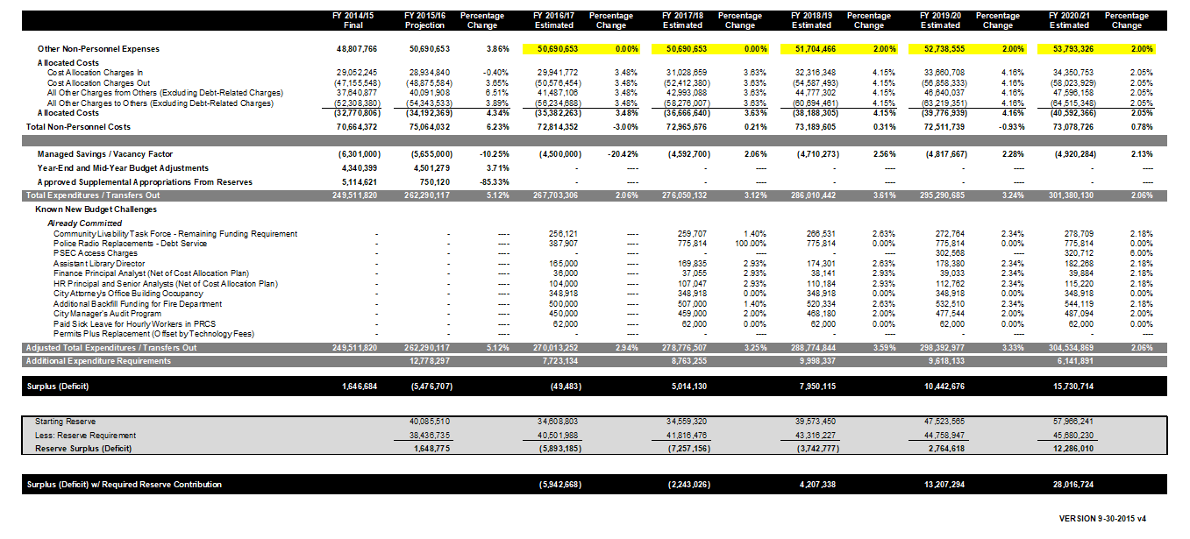
Example – Staff spreadsheet
51

Slide 52
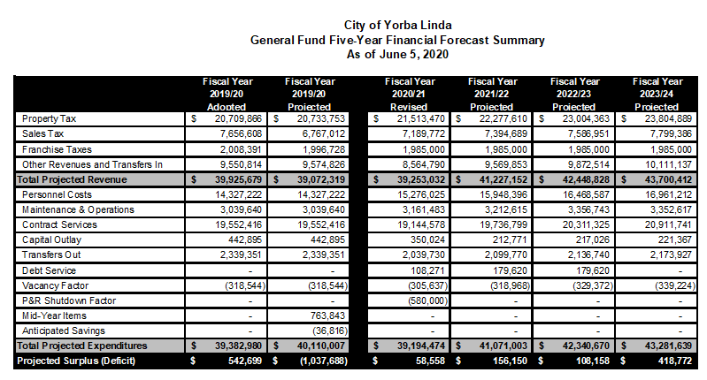
Example – Limited Governing Body Presentation
Budget adoption staff report
Budget adoption presentation – single slide
52

Slide 53
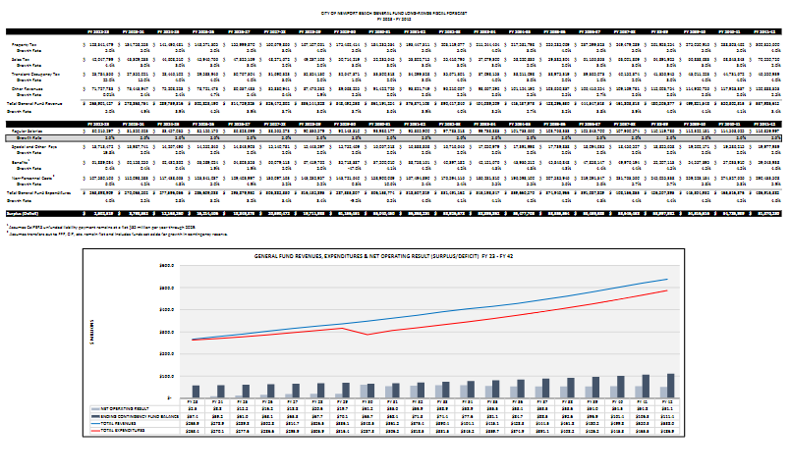
Example – Expanded Governing Body Presentation
Stand-alone annual staff report detailing major assumptions and forecasts for key revenue and expenditure elements
53

Slide 54
Don’t Forget About Charts and Graphs
54

Slide 55
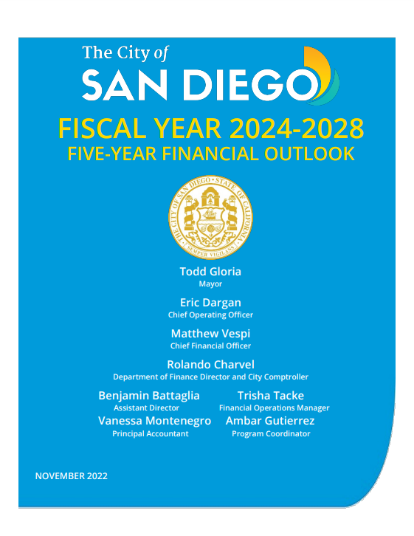
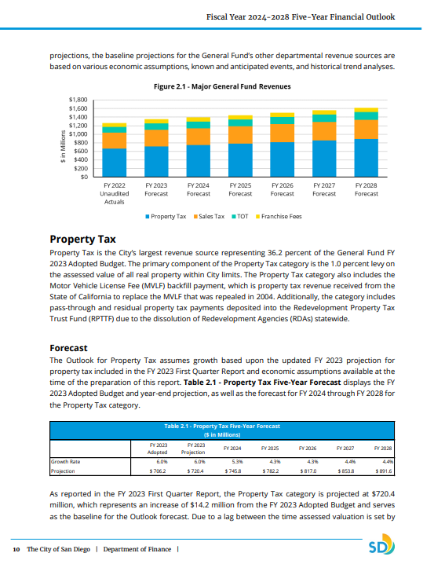
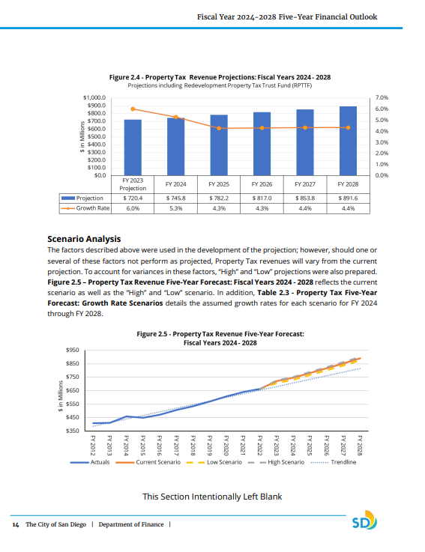
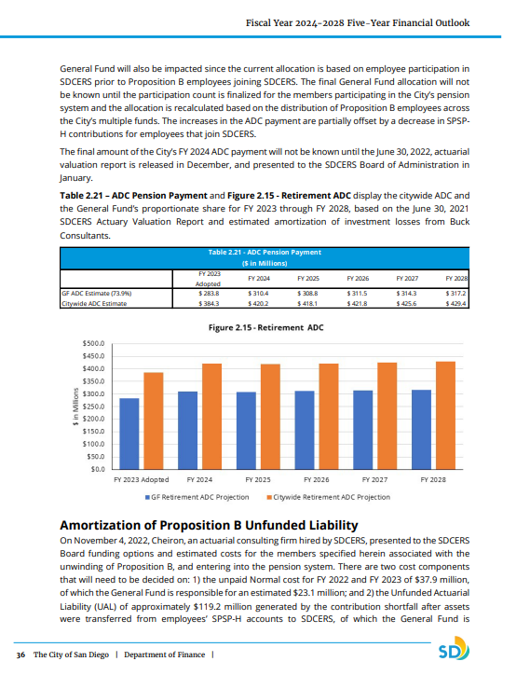
Example – Detailed Governing Body Presentation
Multi-chapter document with multiple public discussions
Detailed forecasts for each major revenue
Detailed expenditure projections
Full analysis of long-term needs (facilities, equipment, etc.)
Discussion of scenarios and solutions to gaps
55

Slide 56
Your Financial management Work Plan
Many agencies build a recurring, annual work plan that includes various financial management activities
Budget development
Periodic budget reporting
Long-term financial planning
Internal audit
Other appropriate elements
Everything that we just discussed can be incorporated into your agency’s work plan
Develop a routine
Get executive and legislative buy-in
Stick to it and repeat every year!
56

Slide 57
Craft A Process That Makes Sense For Your Agency
Small agency with 6 departments
Annual plan updates
Presentation to and approval by governing body
Large agency with 15 departments
Quarterly plan updates
Finance committee review of draft plan
Community and stakeholder meetings in concert with strategic planning process
Presentation to and approval by governing body
Finance committee review of plan – in detail
Initial governing body review with feedback and revisions

Slide 58
Helpful Resources

Slide 59
Helpful resources
Visit the Government Finance Officers Association library of best practices and other resources
https://www.gfoa.org/best-practices--resources
Take advantage of relevant educational sessions from GFOA and other organizations
Seek advice from your mentors and your network
Others have been in the same situation and solved the same problems
Find agencies with document / report / process formats that you like and ask for their original Excel and Word documents
A good place to start is larger cities or counties in your region
GFOA also has some direct links online to recommended documents from around the country
59

Slide 60
Contact Information
Questions?
Scott Catlett
Director – Government Advisory Services
Eide Bailly, LLP
775-337-3941
Email: scatlett@eidebailly.com

