Slide 1
Focus on Capital Planning
Don’t Get Sidetracked with Too Many Shore Excursions

Slide 2
Introductions
Kevin Klosterboer, CGFO Chief Financial Officer, City of Round Rock
Melana Taylor, CPA Deputy Chief Financial Officer, City of Round Rock
Notes:
During the introductions we should include a favorite or recent cruise or other vacation.

Slide 3
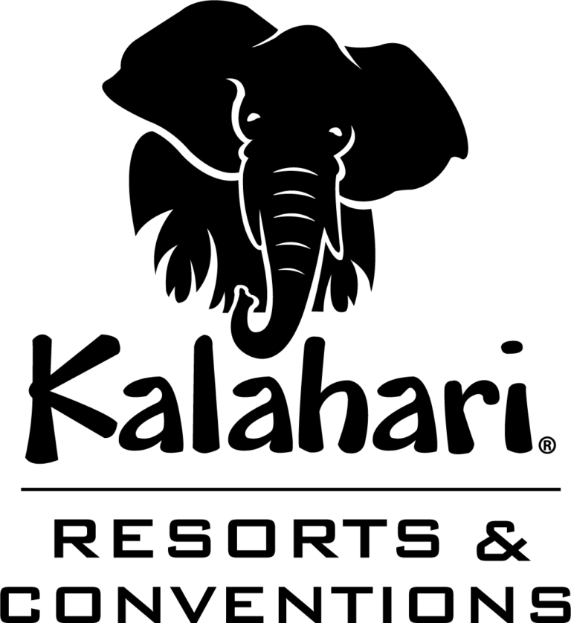
Round Rock Highlights
Population: 136,383
FY 2025 Budget: $682.2 million
General Fund: $179.7 million
Capital: $346.4 million
Est. full build out: 300,000+

Slide 4
What is Capital Planning?
Capital planning is the process of allocating financial resources to long-term investments and projects to support an organization’s strategic goals.
Notes:
ALL ABOARD! The capital infrastructure built and maintained by our governments is essential for thriving communities across Texas. However, the deficiencies in our communities’ infrastructure are growing. When the needs are low, there are more than enough resources, and Whether talking about transportation, utilities, or facilities, there are real big hairy needs out there, and for those of us in regions of the state that are growing in population – this maintenance and upkeep oftentimes gets pushed aside for infrastructure related to new growth. A big part of the challenge is deciding how to allocate our limited resources between not just between competing projects but also between broader interests or groups within your community – maintenance vs. new growth, development vs. redevelopment, bike lanes vs. lane miles, historic preservation groups vs. … well just about anything. Make it a peaceful adventure – while playing life guard in the chaos

Slide 5
Itinerary for Smooth Sailing
Identify needs.
Determine financial impacts.
Prioritize requests.
Develop a comprehensive financial plan.
Implementation
Notes:
There are five basic steps that we are going to cover today in the capital planning process: Identifying Needs, Determining Financial Impacts, Prioritizing Requests, Developing a Comprehensive Financial Plan, and finally Implementation. As we go through these steps this morning, keep in mind that the steps aren’t exactly a direct course, but can drift with the tides as the timelines for various projects all overlap on top of each other.

Slide 6
Identify Needs
Capital Asset Management
Local, state and provincial governments should establish a system for assessing their capital assets and then appropriately plan and budget for any capital maintenance and replacement needs.
Developing policies to guide capital asset management practices that are supported by both finance and operational/engineering expertise.
Condition/functional performance standards for each type of asset.
Monitoring and communicating progress toward stated goals and the overall condition of capital assets.
Notes:
The first step in capital planning is identifying the needs for capital projects and infrastructure in your community. For existing assets, a capital life cycle model can be a useful tool to evaluate the condition, to look for escalating maintenance costs, and to plan for the future replacement of assets to hopefully getting behind since that can be hard to catch back up from. Also helps to know who is the Captain and who is the Cruise Director – Too many Captains will sink the ship.

Slide 7
Identify Needs
Growth-Related Infrastructure Projects
GFOA recommends that economic development strategies and capital improvement planning should be coordinated and integrated within and among governments.
Alignment with the strategic plans and future land use plans is essential.
Evaluate potential impacts and benefits.
Recognize the value of public infrastructure as an economic development strategy.
Identify appropriate opportunities for developers to fund capital assets.
Notes:
GFOA has a best practice for Coordinating Economic Development and Capital Planning but with a broad definition of economic development to attract and retain businesses and residents, increase employment, promote private investment and influence the type and location of development within a community. Development increases demands on existing transportation and utility infrastructure as well as on schools, parks, and public safety services so successful economic development strategies require coordinated long-term capital planning to ensure that the necessary infrastructure is in place to support development.
Both the Capital Improvement Plan and economic development strategies should be consistent with your organization’s overall goals and objectives and the community’s priorities.
The potential impacts and benefits are important to evaluate for potential projects. The finance officer should be involved in capital planning and economic development well before commitments are made. Tools such as cost/benefit analysis and debt capacity models are helpful for analyzing and communicating the impact of projects. For large projects it can also be helpful to evaluate the potential impacts and benefits not only of proposed projects but also null alternatives, or what could develop on particular parcel if not for a large economic development project.
Capital improvements can promote growth such as investments in utility and transportation capacity, physical improvements to a downtown, or new cultural or recreational facilities. However, there is a balance to make sure that these growth-related investments are not made at the expense of maintenance existing infrastructure and facilities.
In some cases your government may be able to work with developers to fund or provide public and/or private infrastructure such as roadways, storm water facilities, or other improvements as part of an economic development agreement. Programs such as water or wastewater impact fees, park improvement programs where the developer pays in for additional park and recreation infrastructure, or roadway impact fees can also be useful tools to have private development help subsidize a portion of the capital infrastructure needed to serve the development.

Slide 8
Identify Needs
Master Plans and Capital Improvement Planning
Governments should consider multiple important elements of Master Plans during its Capital Improvement Planning.
Transportation Master Plan
Water & Wastewater Master Plans
Parks and Recreation Master Plan
Citywide Trails Master Plan
Facilities Master Plan
Arts Master Plan
Notes:
Many governments establish long-range strategies focused on community development and sustainability through the use of Master Plans – comprehensive plans or long range plans included. Some of the Master Plans that we have in Round Rock are shown here on the screen, ranging from Transportation to Utilities to Parks and Trails, to Facilities and Arts. Each of these plans is carefully researched and has input from stakeholder groups in the community and is updated every 5-10 years. These can provide great lists of future capital infrastructure investments that can serve as identified needs for the capital planning process. It’s important for finance officers to be involved in the creation of these master plan documents, however, and for financial factors to be considered as part of the development of Master Plans. Master Plans can be a useful tool for capital planning if the needs are aligned to the broader strategic plan of your community, but if they become just wish lists with unreasonable expectations it can be hard to wade your way through what are real future needs and what are not.

Slide 9
Determine Financial Impacts
Project Scope & Timing
The scope and timing of a planned project should be well defined in the early stages of the planning process.
Scope creep is best managed by having a defined scope early in the planning process.
Timing of projects should be coordinated to avoid conflicts and to align capital needs with funding capacity.
Notes:
Clearly defining what is included within the project scope and what is not helps manage expectations and prevents scope creep. Scope creep can SINK the VOYAGE – building in contingency dollars for material shortages, inflation, or other economic impacts due to the longer time frame often required for capital projects.

Slide 10
Determine Financial Impacts
Cost Estimates
Clear estimate of major project components: land/ROW, design, construction, contingency, post-construction.
External assistance can be used to estimate costs if needed.
Adjust cost projections based on anticipated inflation.
Notes:
GFOA recommends that the full extent of the capital project and associated life cycle costs be determined when developing the multiyear capital plan. Governments should identify and use the most appropriate approaches when estimating project costs. A clear estimate of all major components required to implement a project should be outlined including land acquisition needs, design, construction, contingency and post-construction costs such as furniture and fixtures.
If a government’s internal resources are not sufficient to estimate a capital project’s cost, outside assistance can be procured.
Cost estimation is importation but due to the long-range look of capital planning it’s important to project costs forward based on anticipated inflation to ensure that long-range financial planning and debt capacity models account for the eventual total project cost, at least as best as possible.

Slide 11
Determine Financial Impacts
Non-Capital Costs
Project Management capacity is limited
Operating costs and revenue offsets
Maintenance and replacement costs
Notes:
Besides the obvious but complex capital project costs, there are several non-capital costs that are also important to analyze and plan for.
Project Management work loads need to be managed. You can hire third-party project management services, often through engineering firms, to overstaff during periods of high demand, but the available capacity between in-house and third-party project managers still needs to be analyzed when planning future projects.
Operating costs and associated revenues should be estimated. The GFOA Distinguished Budget Presentation award requires governments to show these operating costs associated with capital projects in the multiyear capital plan because its so important for long-term financial strength.
Maintenance and replacement costs for new assets also needs to be accounted for. These include the cost of facility maintenance and repairs for facilities and the cost of renewal and replacement once the asset’s anticipated life draws to a close.

Slide 12
Prioritize Capital Requests
GFOA recommends that, when evaluating capital requests, governments should prioritize based on:
Health and Safety: Priority should be given to high-risk safety issues that require a capital project to correct.
Asset Preservation: Capital assets that require renewal or replacement based on capital asset life cycle.
Expansion/Addition: Infrastructure improvements needed to support government’s policies, plans, and studies.
Notes:
EXCURSIONS can overlap – not possible to participate in all of them. Prioritization is critical not just for determining what excursions to take, but also to clearly identify what is to be included within each excursion.

Slide 13
Prioritize Capital Requests
Coordination with departments can be useful to avoid conflicts/overlaps.
Alignment with the strategic plan.
Fight the pirates.
Notes:
Based on financial impacts, may have to batten down the hatches or even drop anchor in order to stay out of dry dock
Consider community involvement – open houses, neighborhood meetings, chamber of commerce

Slide 14
Develop a Comprehensive Plan
Anticipate expected revenue and expenditure trends including their relationship to multi-year financial plans and ongoing impacts to the operating budget due to the capital plan.
Prepare cash flow projections of the amount and timing of capital financing.
Consider sources and uses for debt service.
Evaluate the affordability of the financing strategy, including the impact on debt ratios, applicable tax rates, and/or service fees.
Notes:
GFOA recommends that governments develop a viable overall multi-year financing plan covering the multi-year period of the capital plan to ensure that the proposed capital plan is achievable within expected available resources.
Remember that the type of project and its geographic location may pose special concerns for public safety

Slide 15
Implementation of the Voyage
Design and Engineering
Groundbreaking
Construction
Lowest Bid
Competitive Sealed Proposal
Construction Manager/Agent
Construction Manager at Risk
Design-Build
Operational Set-Up
Ribbon Cutting
Notes:
Construction methods – part of Procurement processes and TML has an excellent document online: Microsoft Word - procurement_easy_final.docx
All of the rules are like the life jacket – keeps everything moving forward and afloat

Slide 16
Communications
Talking to Non-Finance Crew Members (Internal Communication)
Calendar year/fiscal year
Contract approval vs. money out the door
Contingencies
Competition for resources
Map looking for overlaps/conflicts
Signaling to Shore (External Communication)
Project updates to Council
Project dashboards or websites
Signage on site (make sure it’s up to date)
Notes:
CRUISE WITH CONFIDENCE
Internal workflow to manage oversight of financial considerations – CORR has New Project Budget packet, 5-year worksheet, Project Cost Stream reporting, Engineer invoice tracker, and Construction cost tracker (PayApp) managed between the project oversight department and Finance. Open communication and regular status meetings are critical

Slide 17
A Shameless Plug…

Slide 18
Questions?
Kklosterboer@roundrocktexas.gov
Mtaylor@roundrocktexas.gov

