Slide 1
Business Officials Feud!
2025 GFOAT Spring Conference
Nathan Smith
Director
smithn@pfmam.com*
Shelly Ilgenfritz
Key Account Manager
ilgenfritzs@pfmam.com*
* PFM Asset Management (PFMAM) is a division of U.S. Bancorp Asset Management, Inc., Texas Range’s investment adviser and administrator, that services public sector clients

Slide 2
About the Game
This fun, interactive game will review terms and topics finance and treasury management professionals hear on a daily basis. Dig through your closets and dust off that accounting textbook you swore you’d use again one day and come ready to play.
Learning Objectives
When you complete this session, you should be able to:
Identify and apply your knowledge of investments, accounting, and banking to your daily duties as an investment professional.
Apply the terms and concepts discussed to your everyday duties.

Slide 3
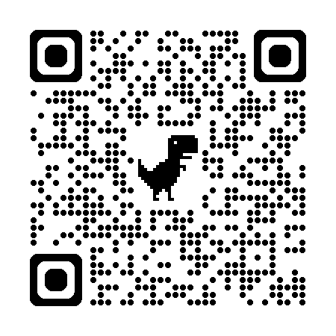
Rules of the Game
Each question is worth 1,000 points
Double jeopardy questions are worth 6,000 points
Participants must answer the question within 30 seconds
Scan the QR Code or go to https://pollev.com/pfm522 to Start!
https://pollev.com/pfm522

Slide 4
Important Disclosures
This information is for institutional investors, not for further distribution to retail investors, and does not represent an offer to sell or a solicitation of an offer to buy or sell any fund or other security. Investors should consider the Texas Range Investment Program's (the "Program’s") investment objectives, risks, charges and expenses before investing. This and other information about the Program is available in the Program's Information Statement, which should be read carefully before investing. A copy of the Program's Information Statement may be obtained by calling 1-866-839-8376 or is available on the Program's website at www.texas-range.com. While TexasDAILY and TexasDAILY Select seek to maintain a stable net asset value of $1.00 per share and TexasTERM seeks to achieve a net asset value of $1.00 per share at its stated maturity, it is possible to lose money investing in the Program. An investment in the Program is not insured or guaranteed by the Federal Deposit Insurance Corporation or any other governmental agency. Shares of the Program’s portfolio are distributed by U.S. Bancorp Investments, Inc., member FINRA (www.finra.org) and SIPC (www.sipc.org). PFM Asset Management is a division of U.S. Bancorp Asset Management, Inc., which serves as administrator and investment adviser to the Program. U.S. Bancorp Asset Management, Inc. is a direct subsidiary of U.S. Bank N.A. and an indirect subsidiary of U.S. Bancorp. U.S. Bancorp Investments, Inc. is a subsidiary of U.S. Bancorp and affiliate of U.S. Bank N.A.

