Slide 1
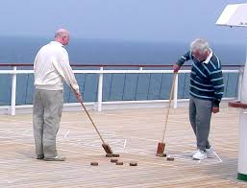
Making your budget public engagement more than just Shuffle-bored
Aaron Rector
City Manager
City of Keller
Jon Locke
Director of Finance
City of San Marcos

Slide 2
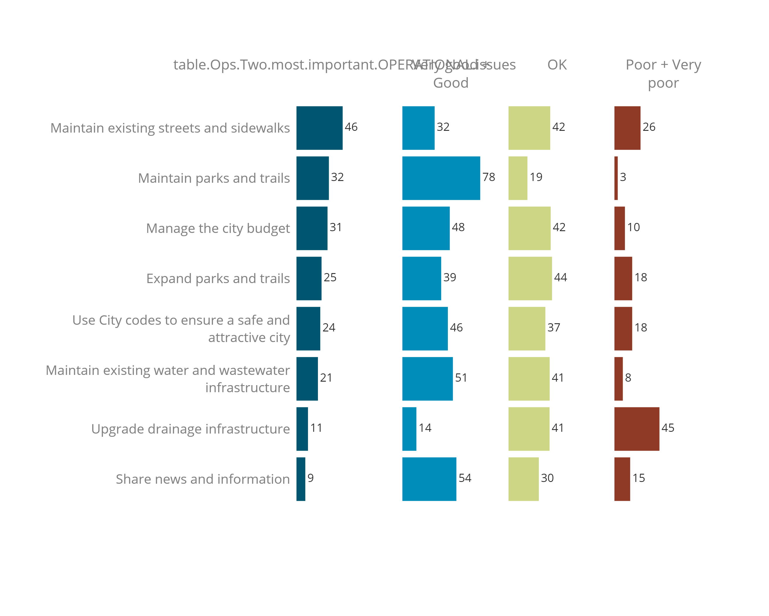
Community Survey - Operational
Rating % - if selected as Most Important
﻿
% Most Important
Very good/
Good
OK
Poor/
Very poor
﻿
Look over the Operational issues below. Which 3 should the city devote more time and resources to enhance?

Slide 3
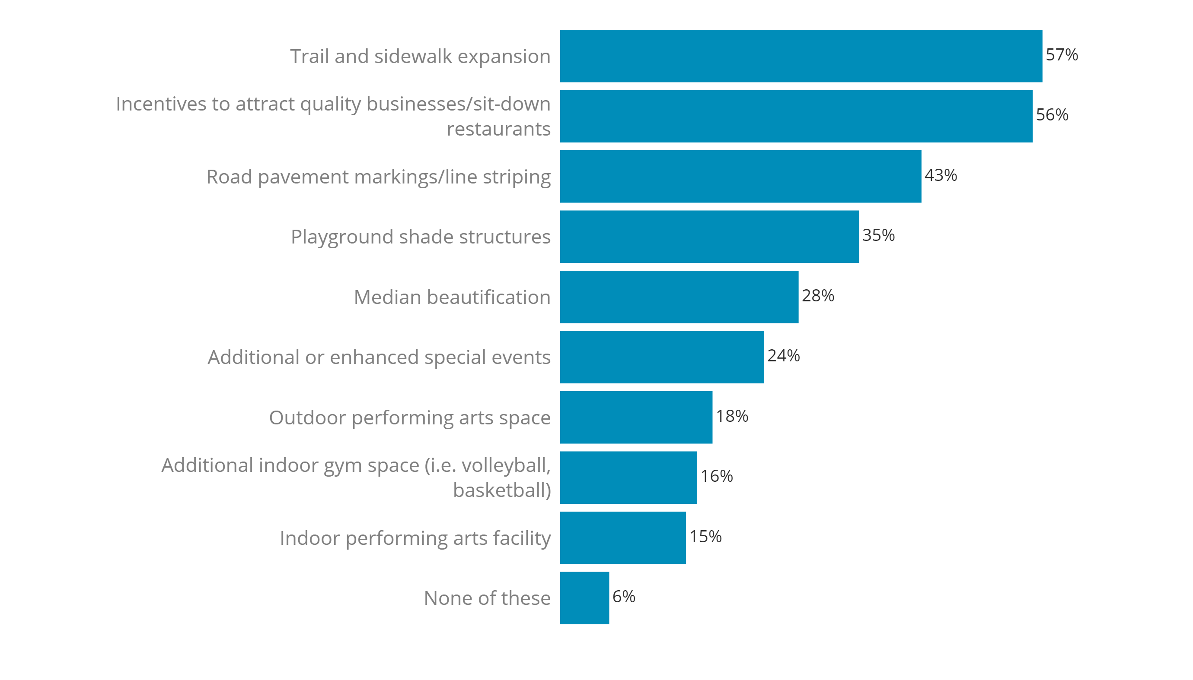
Community Survey - New Investment Priorities
Consider the ideas below. Which ones do you feel would be worth using city revenues to develop and maintain for Keller?

Slide 4
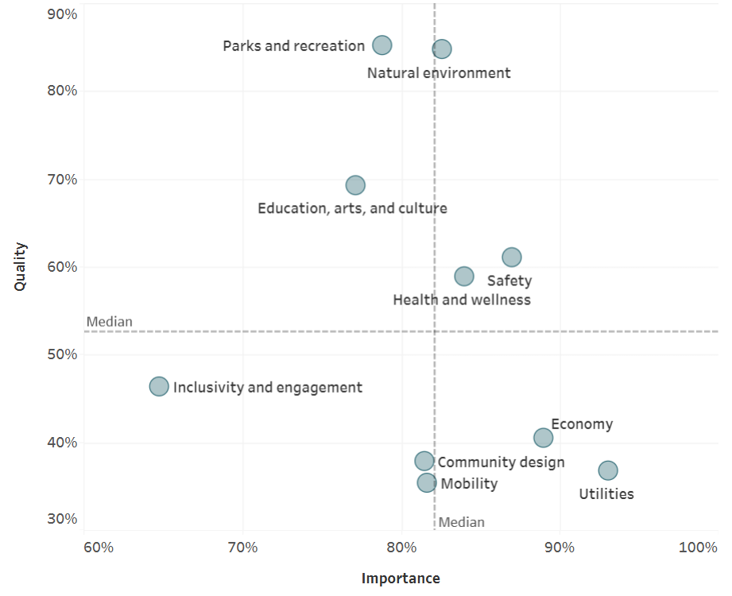
Community Survey – Combined Livability Results
Doing Better
More Important

Slide 5
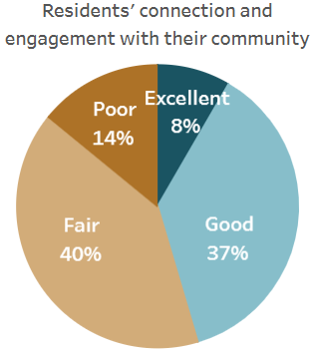
Community Survey – How Well is the City Doing?
Inclusivity and Engagement
Inclusivity refers to a cultural and environmental feeling of belonging; residents who feel invited to participate within their communities feel more included, involved, and engaged than those who do not.

Slide 6
Fiscal Year Budget Strategic Updates
Calendar Item | Date(s)
ACFR Presentation & Fund Types | March 18
Budget Priorities | April 1
Economic Development, Sales Tax | May 6
Other Revenue Trends | May 20
Five Year CIP (Streets & Parks) and Outstanding Debt | June 3
Water/WW & Drainage Fund Summaries & CIP | June 17
Five Year Forecasts | July 1
Compensation, Insurance, FTEs Update | July 15
Tax and Proposed Budget Update | August 5
Budget Workshop/TIRZ Board | August 27

Slide 7
Fiscal Year 2026 Budget Calendar
BUDGET EVENT | DATE | DONE
Council Visioning & Strategic Planning Work Session | January 30 - 31
Budget Policy Workshop | February 27
Budget Policy Adoption* | March 18
Neighborhood Commission Presentation | April 16
Budget Workshop & Preliminary CIP | May 20
Budget Workshop | June 26
Budget/CIP Submitted to Council & Maximum Tax Rate Set | August 19
Neighborhood Commission Presentation | August 20
Public Hearings on Budget, Tax Rate & Fee Changes* | September 2 & 16
Budget, Tax Rate & CIP Adoption* | September 16
PRELIMINARY
TAX ROLL:
APRIL 30th
CERTIFIED
TAX ROLL:
JULY 25th
*Public hearing

Slide 8
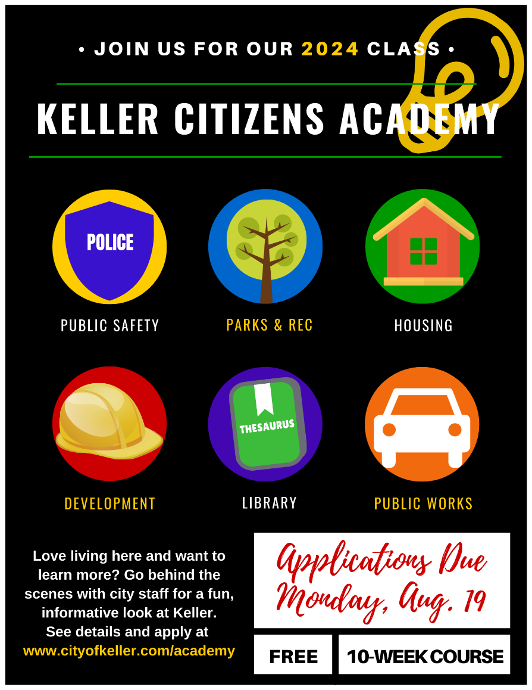
Keller Citizens Academy
10 Week Program
Directors Present Department
Explains how City works
Now have employee version
Finance ranks high on favorite session
https://www.cityofkeller.com/services/administration/keller-citizens-academy

Slide 9
UniverCity gives residents a behind-the-scenes look at city operations and provides opportunities for getting more involved
Free 8-week program includes informational sessions highlighting city departments and services they provide to residents and visitors
Course schedule includes:
City Overview, Mayor and City Council, City Manager's Office, City Clerk's Office, Communications, City Attorney, Economic Development
Parks and Recreation, Main Street, CVB with Arts
Library, Neighborhood Enhancement
Planning and Development Services, Engineering/CIP
Finance, Human Resources, Information Technology
Public Works, San Marcos Utilities
Fire Department, Police Department, Emergency Management, City Marshal's Office
Graduation at City Council Meeting

Slide 10
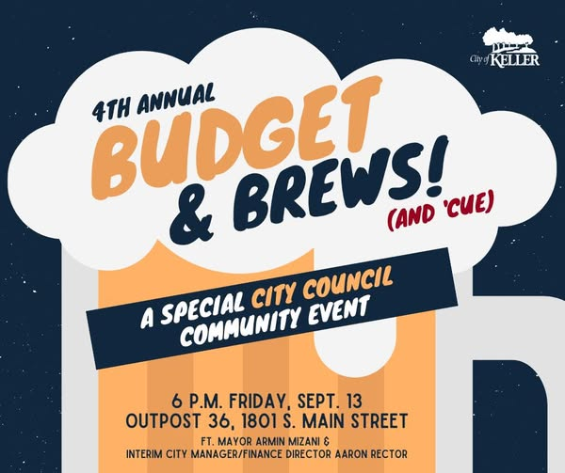
Budget & Brews
Mayor discusses Budget
No Presentation
B-Y-O-B
30-40 people attend
Open Forum for Topics

Slide 11
Neighborhood Commission
Vision is to have neighborhoods that are connected, cared for, and cherished by those who live there
13 voting members, four appointed by City Council that represent 9 sectors
Duties and activities:
Recommend improvements and protections for the public to enhance and retain neighborhood character
Advise on and promote initiatives that will provide equitable access to amenities and services to residents
Advocate for efforts that improve the appearance, maintenance, and safety of neighborhoods
Develop and lead efforts that improve the appearance, maintenance, and safety of neighborhoods

Slide 12
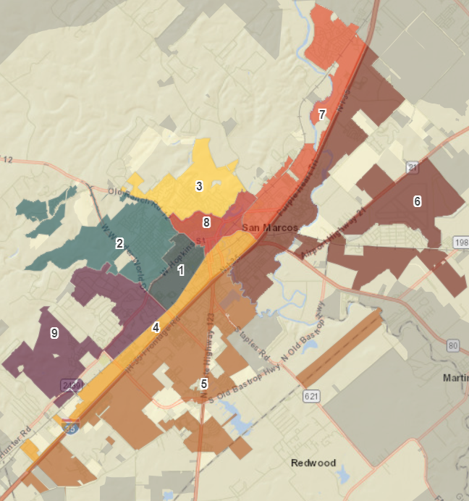
Neighborhood Commission Sectors

Slide 13
Dream Sessions
An opportunity to engage in the process of transformational change by contributing to the conversation and dreaming about what we, collectively, can achieve to enhance our community
Facilitated by Community Resource and Engagement Coordinator
Sessions are held at different locations and video conferencing
Budget related
Social vulnerability index for capital improvement projects
Ranking City Council’s Strategic Goals*
Ranking budget supplemental requests*
Operating and capital outlay
Ranking budget reinstatement requests*
*Interactive Online Platform

Slide 14
San Marcos Budget Tools
Interactive Budget Document
Goal Prioritization
Budget Supplemental Requests

Slide 15
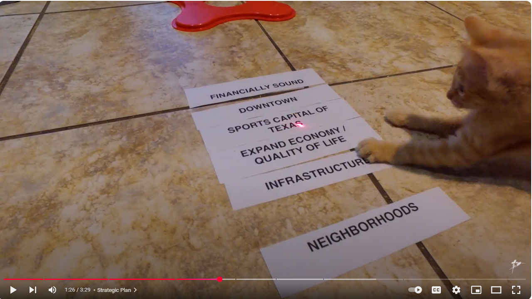
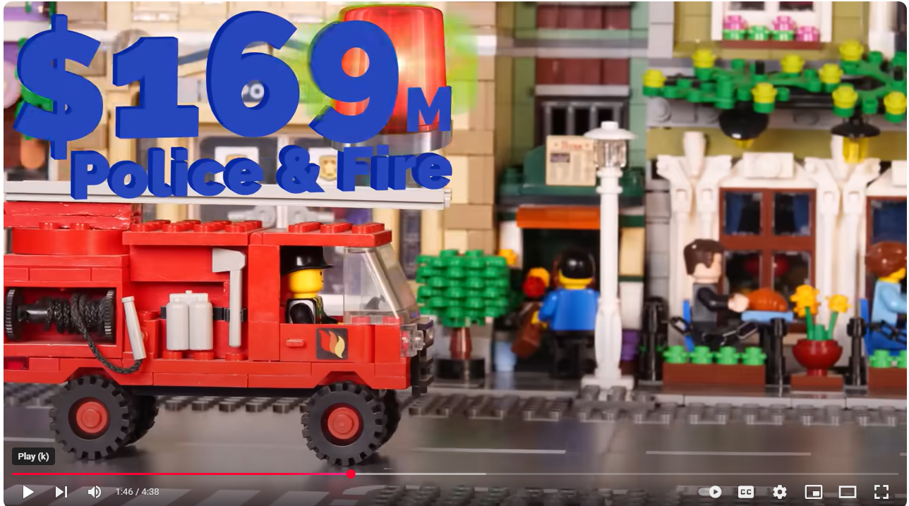
Videos
Round Rock Cat Budget Video
Arlington Lego Budget Video
Flower Mound News Budget Video

Slide 16
Contact Information
Aaron Rector | Jon Locke
City Manager | Director of Finance
City of Keller | City of San Marcos
817-743-4001 | 512-393-8176
arector@cityofkeller.com | jlocke@sanmarcostx.gov

