Slide 1
Navigating Indirect cost Allocations
No Hidden Fees, Just Smooth Seas
GFOAT Spring 2025 Conference (April 2025)

Slide 2
Welcome Aboard!
Chris Ekrut
Partner & CFO
Matthew Garrett
Partner & Managing Director

Slide 3
Today’s Topics
What is an Indirect Cost Allocation Plan (ICAP)?
When should I have one or update my current plan?
Why are indirect cost allocation plans essential?
What types of cost allocation methods are available?
What are the key considerations and challenges?

Slide 4
Understanding Indirect Cost Allocation Plans
GFOA Definition of Indirect Costs:
"Indirect costs include shared administrative expenses where a department or agency incurs costs for support that it provides to other departments/agencies (e.g., legal, finance, human resources, facilities, maintenance, technology)"
GFOA Definition of Indirect Cost Allocation:
"Indirect cost allocation is an accounting function by which estimates are made to distribute indirect costs to programs or functions, in order to approximate their full cost"

Slide 5
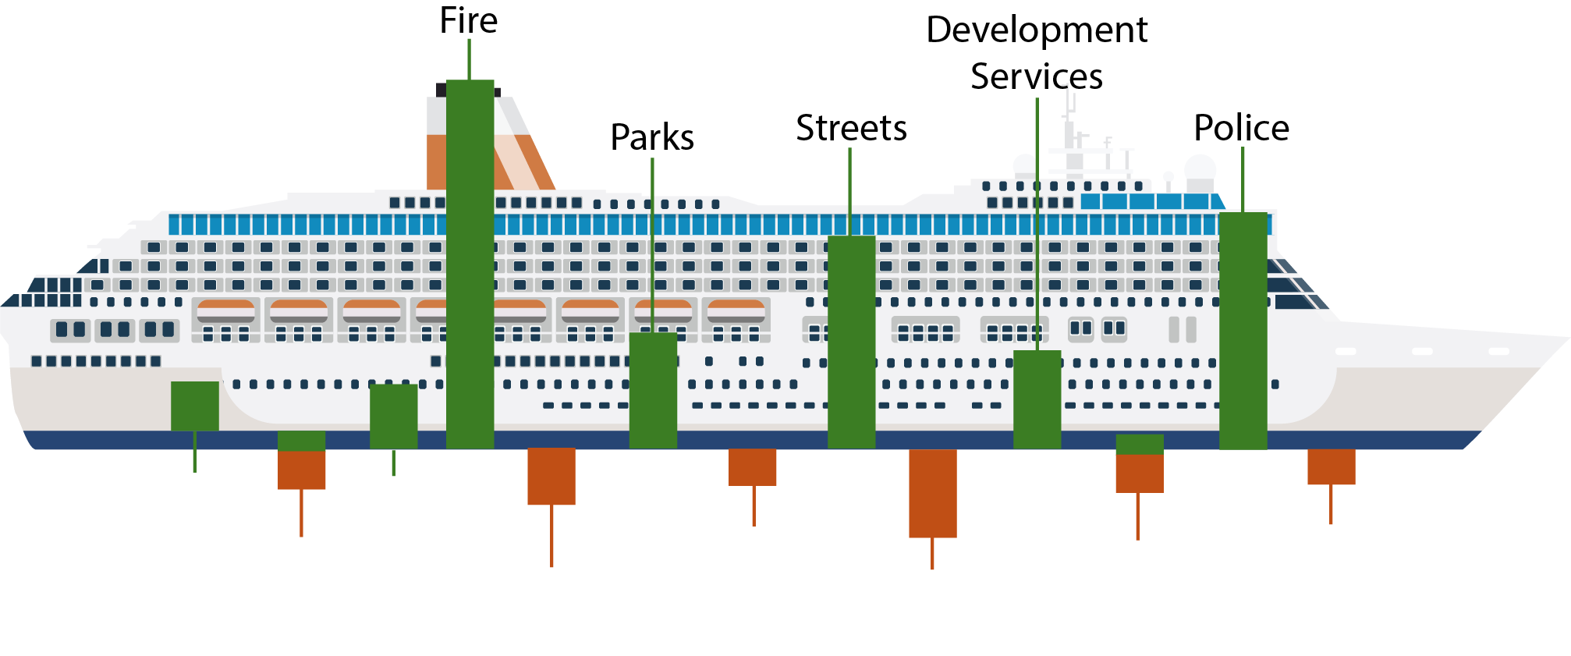
The Hull supports the whole ship to keep it afloat!
Public
Internal

Slide 6
Purpose and Benefits of an Indirect Cost Allocation Plan
Measure the full cost of government service
Establish Fees and Charges
Charge back costs of internal services to departments/agencies
Full utilization of restricted funds
Request/justify reimbursement from federal and state agencies

Slide 7
TRANSFERS​
Cost
Reimbursement
Payment in Lieu of Tax (PILOT)
Standard Franchise/ “Street Rental”
Explanations to the Council and Residents
General and Administrative Indirect Costs
Is the General Fund paying for its use of the utility?
Texas Water Code 13.192
Caution regarding PILOT to school or hospital district
Right-of-way management
Increased State scrutiny, especially Electricity
Notes:
May mention ROI as another

Slide 8
Question
What best describes the way Internal Services or General Fund Transfers are set each year?
Based on cost allocation study updated annually
Used the same number (maybe plus inflation) for years
Plugs any gaps during budget
Not sure

Slide 9
Who Should Prepare the Indirect Cost Allocation Plan?
Internal Resources
External Services
Knowledge of the organization and activities
Readily available cost information
Time
External knowledge on plan preparation
Credibility with Directors
Timing
Expertise
Independence
Federal/State compliance
Requires external provider selection
Cost
Still requires staff’s time

Slide 10
Frequency of Performing a Study
Annual evaluation
When Federal/State requirements change
Dependent on purpose
When organizational/accounting structures change
Significant changes in cost

Slide 11
Key Stakeholders Involved in Cost Allocation
Management
Line-level employees
Departmental employees responsible for record-keeping/ data management
Policymakers?

Slide 12
Understanding EXPENSES​
Must Identify Direct and Indirect Costs
Should be consistent
Know your major cost drivers/indices​
Personnel
​Contracts​
Fixed vs. Variable Costs​
​Visit with operations and management​

Slide 13
Choosing the right course: Allocation methods
Activity-based Costing
Pros: Accuracy, better decision-making, enhanced cost control, performance measurement, resource optimization/efficiency
Cons: Complexity, cost, data requirements, internal resistance, overly burdensome/unnecessary
Proportional Allocation
Pros: Equity, simple, transparent, flexible
Cons: Data requirements, potential for inaccuracy/ oversimplification
Step-Down (Sequential) Method
Pros: Recognizes interdependencies, systematic approach
Cons: Complexity, dependent on ranking

Slide 14
Common Allocation Factors
Personnel Effort
Headcount/FTEs
Square Footage
Budgeted Dollars
Number of Transactions/Agenda Items

Slide 15
Step Down Examples
Single Step-Down Allocation Method - Sequential
Creates a stair step of ordered allocation steps
Double Step-Down Allocation Method – Reciprocal in Step 1 and Non-Reciprocal for Service Providers in Step 2
Service Providers make and receive allocations in Step 1
Service Providers only make and do not receive allocations in Step 2

Slide 16
Navigating Challenges and Rough Waters
Common pitfalls in cost allocation:
Availability of data/information
Ability to accurately quantify
Unnecessary complexity
Overlooking potential regulatory requirements
Ineffective communication within the organization
Failure to regularly update
If needed, ensure compliance with federal/state regulations:
2 CFR Part 200 requirements

Slide 17
2 CFR Part 200 requirements
Federal regulations outlining allowable and reasonable costs for federal grants, which are pertinent to single audit recipients
Allowable indirect costs are:
The 10% de minimus rate OR
A Negotiated Indirect Cost Rate based on actual expenditures
Some expense types are ineligible

Slide 18
Best Practices for a Strong ICAP
Regular reviews and plan updates
Documentation and preparedness for regular updating
Leverage software and technology for accuracy

Slide 19
Thank you & Happy Sailing!
Chris Ekrut
Partner and CFO
Office: (972) 232-2234
cekrut@newgenstrategies.net ​
Matthew Garrett
Partner​ and Managing Director
Office: (972) 675-7699​
mgarrett@newgenstrategies.net ​

Slide 20
Additional RESOURCES​
GFOA Best Practices
https://www.gfoa.org/materials/indirect-cost-allocation https://www.gfoa.org/materials/measuring-the-full-cost-of-government-service
Code of Federal Regulations
2 CFR Part 200 -- Uniform Administrative Requirements

