Slide 1
Introduction to Credit Research Perspectives on Corporates and Banks Patrick Edler, CFA

Slide 2
Disclosures
This presentation is for informational purposes only and should not be considered an advertisement of our services. Data unaudited. The information contained herein has been obtained from sources that we believe to be reliable, but its accuracy and completeness are not guaranteed. The materials in this presentation are opinions of Public Trust Advisors, LLC and should not be construed as investment advice. The presentation is not a recommendation to buy, sell, implement, or change any securities or investment strategy, function, or process. Any financial and/or investment decisions should be made only after considerable research, consideration, and involvement with an experienced professional engaged for the specific purpose. All comments and discussion presented are purely based on opinion and assumptions, not fact. These assumptions may or may not be correct based on foreseen and unforeseen events. All calculations and results presented are for discussion purposes only and should not be used more making calculations and/or decisions.
Many factors affect performance including changes in market conditions and interest rates and in response to other economic, political, or financial developments. Investment involves risk, including the possible loss of principal. No assurance can be given that the performance objectives of a given strategy will be achieved. Public Trust Advisors is not a bank and your investment with Public Trust Advisors is not insured or guaranteed by the Federal Deposit Insurance Corporation or any other government agency. Past performance is not an indicator of future performance or results. Any financial and/or investment decision may incur losses.
There is no guarantee that investment strategies will achieve the desired results under all market conditions, and each investor should evaluate its ability to invest long-term, especially during periods of a market downturn. This information may contain statements, estimates, or projections that constitute “forward-looking statements” as defined under U.S. federal and other jurisdictions’ securities laws. Any such forward looking statements are inherently speculative and are based on currently available information, operating plans, and projections about future events and trends. As such, they are subject to numerous risks and uncertainties.
Any case studies or representative examples of specific securities used in this piece are not intended to be any sort of investment recommendation related to the security. These were selected because they were examples Public Trust felt conveyed the intended message of this presentation. The information presented is as of a specific point in time. The status of the companies selected may or may not have changed since the as of date of the data.
Any comparisons to indices are provided for illustrative purposes only. An index is a broadly diversified unmanaged group of securities, which may include large capitalization companies or companies of certain size. Broadly based indices may be shown only as an indication of the general performance of the financial services markets during the periods indicated. Such indices, if shown, should not be relied upon as an accurate comparison. Index returns assume reinvestment of all distributions. Historical performance results for investment indexes generally do not reflect the deduction of transaction and/or custodial charges or the deduction of an investment management fee, the incurrence of which would have the effect of decreasing historical performance results. It is not possible to invest directly in an index.
Public Trust Advisors, LLC, a registered investment advisor with the U.S. Securities and Exchange Commission, provides investment advisory services to the Fund. PMA Securities, LLC, an affiliate of Public Trust Advisors, is a broker-dealer and municipal advisor registered with the SEC and MSRB and is a member of FINRA and SIPC and provides marketing, and securities and other institutional brokerage services.
Public Trust Advisors
717 17th Street, Suite 1850
Denver, Colorado 80202

Slide 3
01
What is Fundamental Credit Analysis?
02
Corporate Credit Analysis (5 C’s)
Agenda
03
Bank Credit Analysis (CAMELS)
04
Fundamental vs Market Analysis
05
Conclusion
3

Slide 4
Learning Objectives
Learn what fundamental analysis entails and how it is used to inform the investment process.
Gain an understanding of how fundamental analysis is conducted on nonbank companies.
Look at how credit analysis is conducted on banks using the CAMELS framework.
Learn how fundamental analysis is different than market-based analysis and the drawbacks of using just a market approach.
Please refer to the disclosure slide for additional information.

Slide 5
What is Fundamental Credit Analysis?
Fundamental analysis attempts to develop insight by looking holistically at a business to determine its credit quality and potential risks.
Analyze the three financial statements (Income Statement, Balance Sheet, Cash Flows)
Look at the competitive environment and profit drivers (Porter’s 5 Forces, Peer Analysis)
Utilize specific credit ratios to form an opinion on credit quality (leverage, cash flow, interest coverage)
Develop an understanding of rating process to anticipate rating changes before they happen.
Speak with Nationally Recognized Statistical Rating Organization (NRSRO) analysts to understand thinking and process.
Analyze rating triggers to determine whether an issuer will breach them.
Both positive and negative migration present opportunities.
Please refer to the disclosure slide for additional information.
Notes:
Define NRSRO here.

Slide 6
Corporate Credit Analysis (5 Cs)
Please refer to the disclosure slide for additional information.

Slide 7
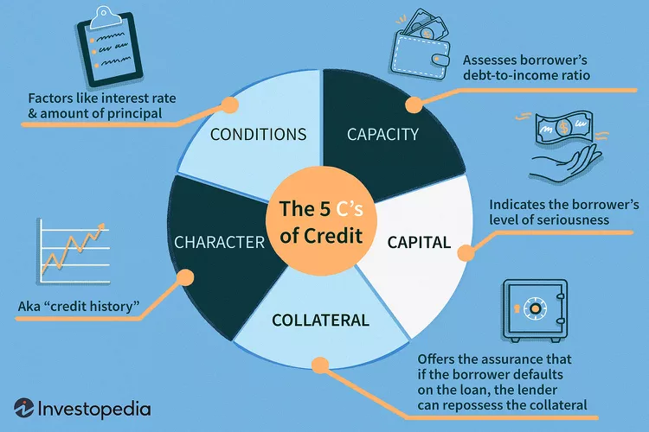
Corporate Credit Analysis (The 5 C’s)
Character
Capacity
Capital
Collateral
Conditions
Please refer to the disclosure slide for additional information.

Slide 8
Character
Character
Refers to a company's willingness to pay back debts.
Considers things like prior defaults, management, subordination of debt.
For investment grade (IG) - companies' default is not usually the biggest concern. We look at how management teams prioritize excess cash flow to judge “character.”
For example, a company using debt or excess cash to repurchase shares shows that the management team favors equity holders over debt holders.
Please refer to the disclosure slide for additional information.

Slide 9
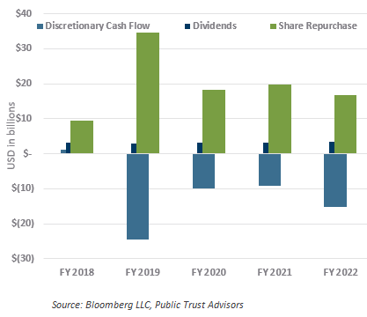
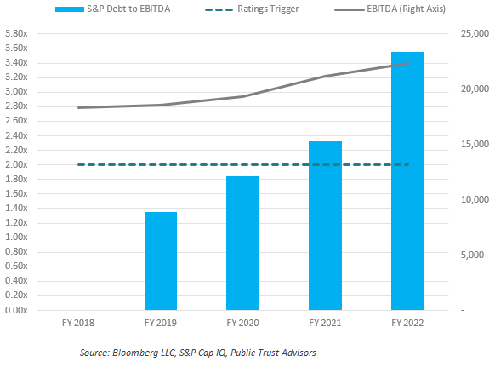
Character: Oracle Corp. Example
In 2019, Oracle began repurchasing significant amounts of stock at the direction of its CEO, Larry Ellison.
Repurchases in 2019 amounted to $34.50 billion which was ~3x higher than the prior year and used up the company’s excess cash balance resulting in a “net leverage position” for the first time in years.
Data as of 12/31/2022
Representative example. Not intended to be a security recommendation.
Please refer to the disclosure slide for additional information.
Notes:
Define net leverage:
Net leverage is the company’s debt minus available cash divided by EBITDA (earnings before interest, taxes, depreciation, and amortization). A net leverage position indicates that a company has more debt than available cash and a net cash position indicates it has more cash than its total debt outstanding. We use EBITDA because it represents the cash the company can generate from normal operations.

Slide 10
Character: Oracle Corp. Example (cont.)
From 2019 onward, Oracle repurchased between $16 to $20 billion of shares each year. We call this a “transfer of risk.”
Oracle’s management team was weakening the company’s credit profile in order to provide better returns for equity investors.
The increase in repurchases led to a one-notch downgrade at S&P in July 2019 and another in June 2020. Throughout the process, Oracle would not give guidance on the level of repurchases which left debt investors and rating agencies in the dark.
Finally, after formally breaching S&P’s leverage trigger in 2021, Oracle would go on to receive two more downgrades before settling at “BBB.”
Representative example. Not intended to be a security recommendation.
Please refer to the disclosure slide for additional information.

Slide 11
Capacity
Capacity refers to a company’s current level of debt and its ability to take on more.
We look at three main metrics to judge capacity.
Leverage = Net Debt/EBITDA
Interest Coverage Ratio = EBIT/Interest Expense
Discretionary Cash Flow = Free Cash Flow (FCF) - Dividends - Share Repurchases
If we know what leverage number will trigger a downgrade, it can help us determine how much additional debt a company can take on before it is downgraded.
Please refer to the disclosure slide for additional information.
Notes:
Define free cash flow and DCF:
Free cash flow measures the companies cash flow from normal operations minus its investments in CAPEX.
DCF takes free cash flow and subtracts distributions to shareholders to come up with the excess cash a company has left to pay down debt or add to its cash balance.

Slide 12
Capacity
Data as of 12/31/2022
Please refer to the disclosure slide for additional information.
Notes:
The green bars show the substantial increase in share repurchases starting in FY19. This is matched by the lighter blue bars which turned negative indicating that the company was spending more cash than it was generating to buyback stock. This led Oracle to turn to a net leverage position in FY19 and breach its 2x leverage trigger in FY21 (right chart). While not actually taking on additional debt, by burning through its available cash and DCF Oracle lowered its capacity to the point where it could not take on additional debt without being downgraded.

Slide 13
Capital
Capital is primarily a concern for retail borrowing which shows the borrowers level of seriousness.
Think the down payment on your home.
For companies, debt investors have a senior claim to equity investors in the event of liquidation which satisfies to the capital portion of the 5 C’s.
Please refer to the disclosure slide for additional information.

Slide 14
Collateral
Debt can either be secured or unsecured which is whether the loan is secured by some form of tangible asset.
Most IG debt is unsecured which means it is backed primarily by the company's cash flows and operations.
If debt is secured it generally means it is backed by a tangible asset. For example, to get better loan terms, a company may put up a manufacturing plant as collateral.
Please refer to the disclosure slide for additional information.

Slide 15
Conditions
Conditions refer to the descriptive characteristics of the loan or bond.
Maturity
Interest Rate
Covenants
Typically, the more highly rated a company by the NRSROs the more favorable the borrowing terms it can get. Companies also generally must pay a higher rate to borrow for longer periods of time.
Covenants refer to specific terms placed on a loan and are not very common in IG. These could be achieving specific financial targets or keeping leverage under a certain level.
Please refer to the disclosure slide for additional information.
Notes:
Subordination also plays a role in conditions. Company’s get a better rate on senior debt than subordinated debt.

Slide 16
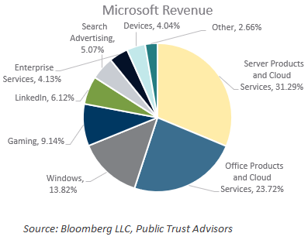
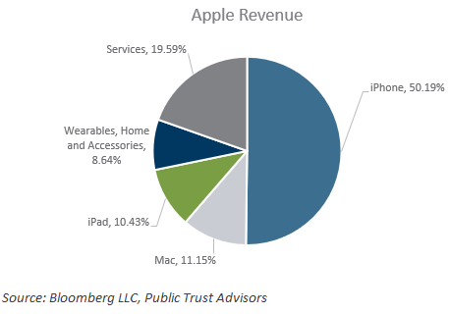
Other Factors
For corporates, the 5 Cs aren’t the only factors we look at.
A business’ competitive environment affects credit quality.
Intel was recently downgraded due to an erosion of its competitive position.
Revenue diversity is an important credit factor as well.
As of the end of 2021, Microsoft had a AAA rating because its revenues were more diversified. Apple did not get a AAA rating because 50% of its revenue comes from iPhone.
Representative examples. Not intended to be a security recommendation.
. Charts as of fiscal year end 2021.
Please refer to the disclosure slide for additional information.

Slide 17
Bank Credit Analysis (CAMELS)
Please refer to the disclosure slide for additional information.

Slide 18
Bank Credit Analysis (CAMELS)
Bank’s have a unique credit profile compared to corporates which requires a different approach.
Banks utilize a strategy called “Asset Liability Matching” which means that leverage is not as important of a consideration.
Banks issue loans using deposits and debt, then match assets with similar time frames to those debts.
Banks are the largest participant in the commercial paper market making them key to a successful money market investment strategy.
Please refer to the disclosure slide for additional information.

Slide 19
Bank Credit Analysis (CAMELS)
Capital
The amount of equity that can absorb losses.
Asset Quality
The underlying quality of the bank's loans.
Management Strategy
Earnings and Profitability
Liquidity & Funding
The bank’s ability to meet short-term outflows and fund itself through deposits and debt.
Sensitivity (to interest rates)
Please refer to the disclosure slide for additional information.

Slide 20
Capital
A bank’s capital is the amount of equity investment that can absorb losses. It is split into three tranches.
Tier 1 Capital
Going concern capital. High quality and absorbs losses first. Absorb losses while bank is still operating normally.
Tier 2 Capital
Absorbs losses after the bank is a gone concern. AKA after a bank has gone insolvent.
Tier 3 Capital
Mostly market risk instruments that could absorb some loss if needed. Lowest quality of the three.
Please refer to the disclosure slide for additional information.
Notes:
All the capital tiers together make up “Total Loss Absorbing Capital” aka TLAC.

Slide 21
Tier 1 Capital
Tier 1 capital is designed to protect banks and the financial system post-2008. Tier 1 capital is comprised of Common Equity Tier 1 Capital (CET1) and Additional Tier 1 Capital (AT1).
CET1:
Primarily common stock ownership. This capital was introduced in 2014 and can absorb losses immediately as they occur.
All banks are required to keep a minimum balance of CET1 Capital that is defined by their local regulators.
AT1:
Made up of non-CET1 instruments like a convertible security for example.
Please refer to the disclosure slide for additional information.
Notes:
For large IG banks Tier 1 capital is the most important from a credit perspective and the only one we will dive deep into. This is because the other capital tiers only come into play when the bank is a gone concern.

Slide 22
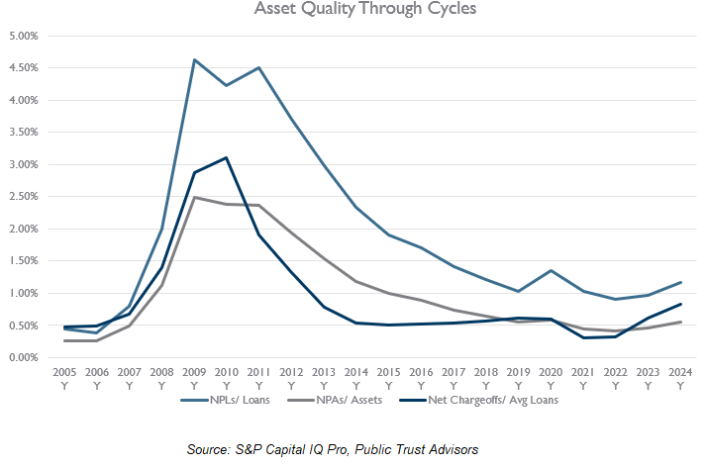
Asset Quality
Asset quality measures the health of a bank’s loan book.
Usually measured by:
Net charge offs (NCOs): actual losses taken on loans.
30,60, and 90+ day delinquencies: number of loans that are behind on payment.
Non-performing loans (NPLs): percentage of loans currently not being paid.
Non-performing assets (NPAs): are like NPLs but can include other assets like mortgage-backed securities or bonds.
Data as of 12/31/2024
Please refer to the disclosure slide for additional information.
Notes:
Looking at our data set from 2005 onward for large US banks >100B in assets you can see how the different metrics performed during the GFC and covid. NPLs take longer to work through because the bank will try to get as much out of these loans as possible, usually through working with the borrower and restructuring terms. NCOs tend to move down more quickly because they are actual losses and recede when borrowers begin making payments on nonperforming and performing loans. You’ll also notice how forbearance in the U.S. led to much lower credit losses than would have been expected during covid and has led to record low levels in the asset quality metrics we look at.

Slide 23
Management Strategy
Bank management teams generally lay out medium-term strategies and financial targets for investors.
We benchmark management teams on their ability to consistently hit these targets and make decisions that will grow the bank.
Compliance failures and reputational risks also fall to management and can have a significant impact on the credit quality of a bank.
Credit Suisse’s initial fall to BBB- is an example of this.
Please refer to the disclosure slide for additional information.
Notes:
Many banks, especially Eurozone banks, had to undergo substantial restructuring after the GFC and management teams that were competent and successful were able to use that to come out with stronger banks. UBS is a great example.

Slide 24
Earnings & Profitability
A bank’s ability to consistently generate profit and keep its expenses under control through cycles is a key credit consideration.
Banks derive revenue from interest on loans, investment banking activities, trading, wealth management, and more.
Metrics:
Return on equity (ROE)
Return on assets (ROA)
Net interest margin (NIM)
Noninterest income/expense
Efficiency ratio (costs/revenue)
Please refer to the disclosure slide for additional information.

Slide 25
Liquidity & Funding
Banks primarily fund their operations through deposits. But large banks with complex operations frequently also use wholesale funding to fill the gaps.
Wholesale funding is when a bank issues debt to investors which can be short-term (commercial paper) or longer-term (bonds).
Deposits tend to be cheaper but not all operations generate deposits.
Banks must keep enough liquid assets on hand to meet redemptions and operational expenses.
Liquid assets are those that can be sold/used without a substantial decrease in value.
Please refer to the disclosure slide for additional information.

Slide 26
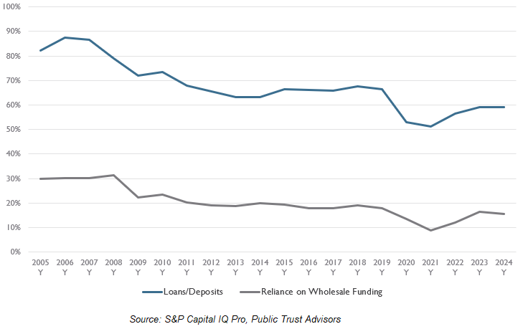
Liquidity & Funding (cont.)
Large U.S. Banks are flush with deposits post-pandemic but have increasingly relied on wholesale funding despite higher rates.
Data as of 12/31/2024
Please refer to the disclosure slide for additional information.

Slide 27
Sensitivity
Banks earn profit from the difference between the interest they can charge on loans and the interest paid on deposits.
Fixed rate loans lose value when rates rise/gain value when rates fall.
Variable rate loans gain value when rates rise/lose value when rates fall.
This can extend to the debt that the bank issues as well. How a balance sheet reacts to interest rate changes is what we call interest sensitivity.
Please refer to the disclosure slide for additional information.

Slide 28
Bank Analysis Case Study: Société Générale
Please refer to the disclosure slide for additional information.

Slide 29
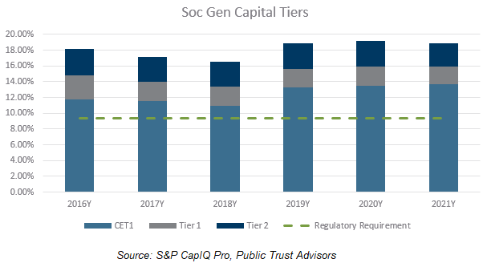
Capital: Société Générale (SG)
Beginning in 2017, SG saw material declines in its capital due to operational performance and issues with subsidiaries.
SG was forced to sell several subsidiaries to generate capital and hit managements 12% CET1 target.
However, the capital build that occurred in 2018 did lead to a positive outlook at the rating agencies.
Data as of 12/31/2021
Representative example. Not intended to be a security recommendation.
Please refer to the disclosure slide for additional information.

Slide 30
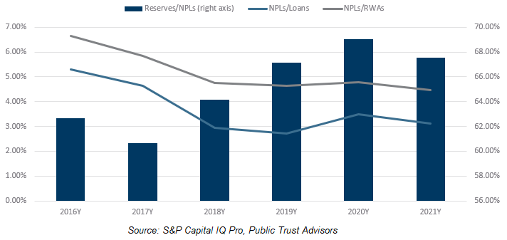
Asset Quality: Société Générale (SG)
Like most global banks, SG has seen its asset quality strengthen to near records.
Improving asset quality from 2016 to 2019 helped the bank to stave off downgrade while its capital balance declined.
However, the increase in NPLs during 2020 (because of the pandemic) led to higher provisions and a negative outlook at the rating agencies.
Data as of 12/31/2021
Representative example. Not intended to be a security recommendation.
Please refer to the disclosure slide for additional information.
Notes:
Higher provisions hit the bank’s already challenged profitability.

Slide 31
Management Strategy: Société Générale (SG)
SG’s management has undergone a three-year restructuring plan that focused on cutting costs, scaling back capital markets activity, and exiting high-risk geographies.
Execution of the three-year plan has led to better capital levels and more predictable financial performance.
Representative example. Not intended to be a security recommendation.
Please refer to the disclosure slide for additional information.

Slide 32
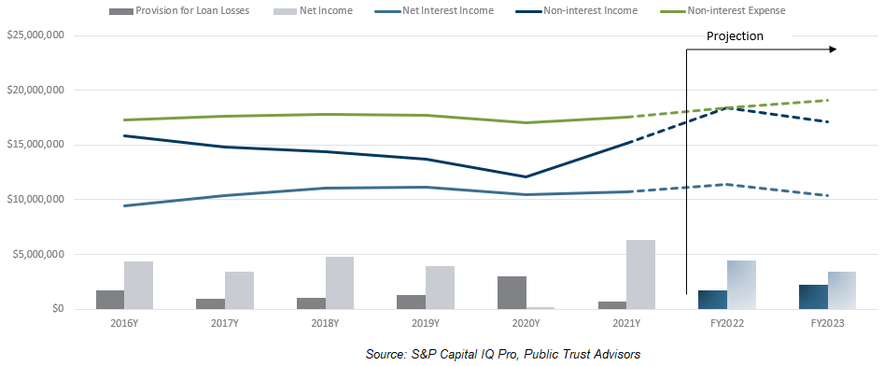
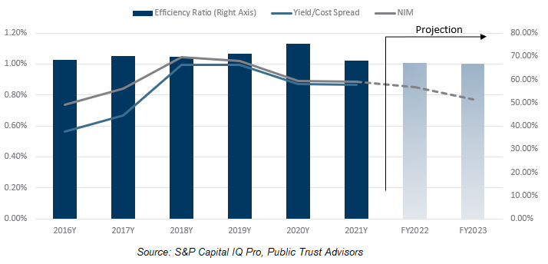
Earnings and Profitability: Société Générale (SG)
COVID hit SG particularly hard, and the bank nearly took a loss in 2020.
Since then, we have seen the bank bounce back strongly, and its restructuring plan has led to a positive trajectory on earnings and expenses.
Data as of FYE 2023
Representative example. Not intended to be a security recommendation.
Please refer to the disclosure slide for additional information. Data as of February 9, 2023.

Slide 33
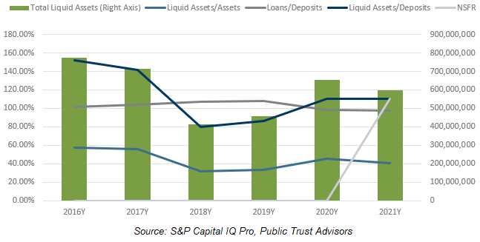
Liquidity & Funding: Société Générale (SG)
SG has historically lent more than its deposit balance, but the influx of deposits during the pandemic changed that. This has made the bank less reliant on market funding.
Banks are now required to report a Net Stable Funding Ratio which measures how stable and liquid the banks funding is.
Data as of 12/31/2021
Representative example. Not intended to be a security recommendation.
Please refer to the disclosure slide for additional information.

Slide 34
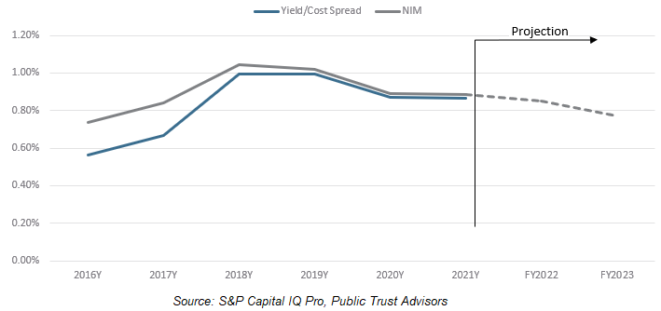
Interest Sensitivity: Société Générale (SG)
Because SG has a higher reliance on noninterest income, it is less sensitive to changes in interest rates.
This lower sensitivity means that it does not benefit as much from rising rates, and its revenues are more closely tied to financial markets than central bank policies and rates.
Data as of FYE 2023
Representative example. Not intended to be a security recommendation.
Please refer to the disclosure slide for additional information. Data as of February 9, 2023.

Slide 35
Fundamental vs. Market Based Credit Analysis
Some managers use market-based credit analysis in conjunction with ratings.
Most market-based approaches look at the spreads on credit default swaps (CDS) to determine how the market feels about a company's debt.
Increases in CDS spreads indicate that a company may have weakening credit quality, and decreases can indicate a company has improving credit quality.
There is a lot of noise in CDS spreads though, and it can be tough to determine what is material and what isn’t.
Please refer to the disclosure slide for additional information.

Slide 36
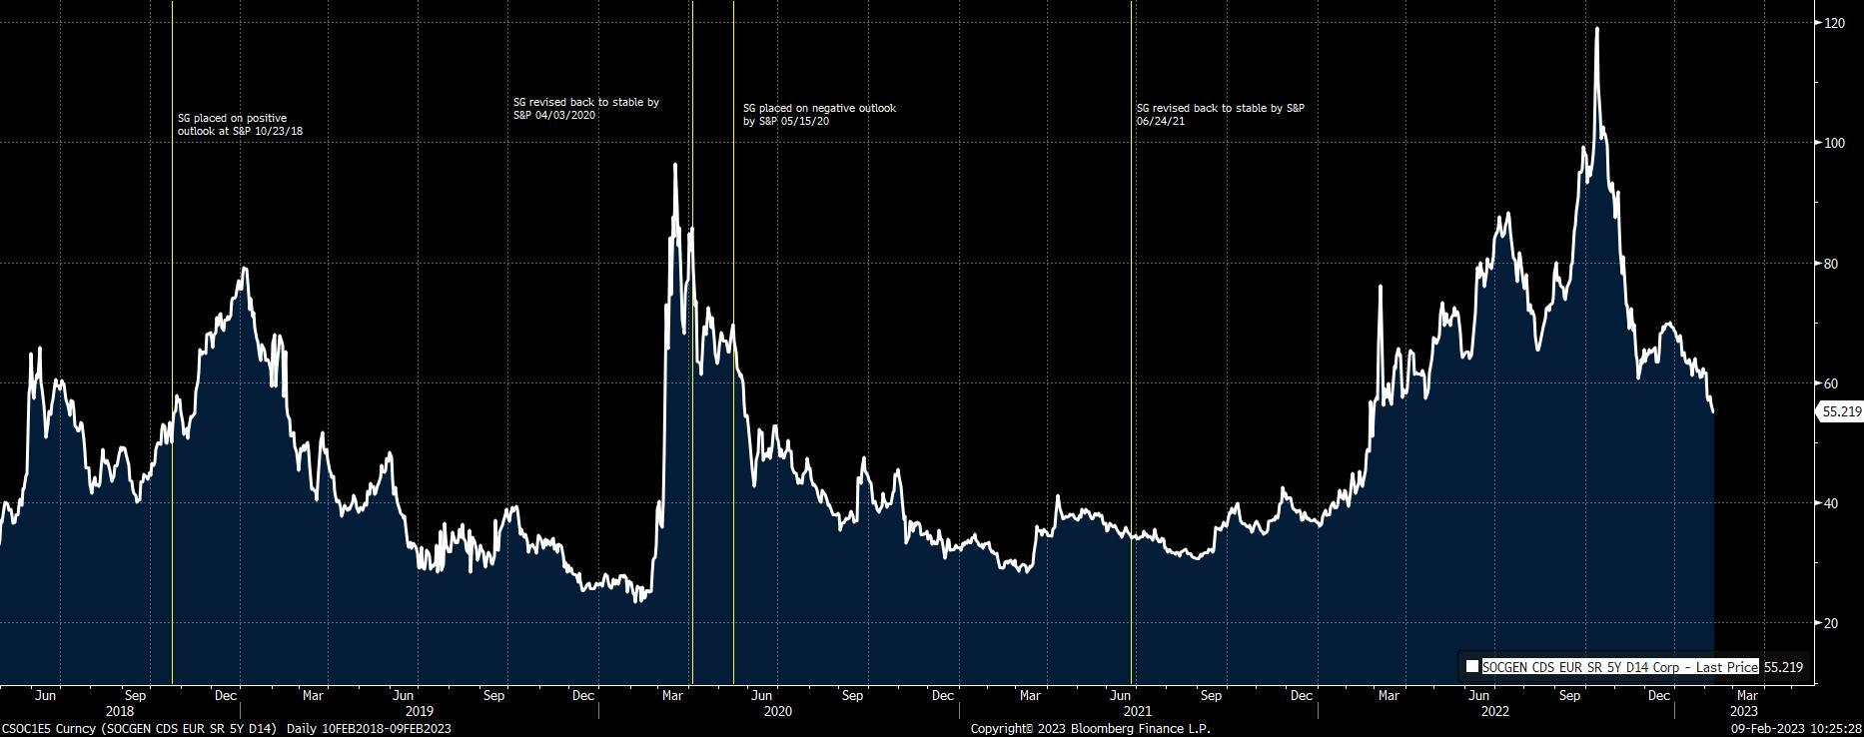
Fundamental vs. Market Based Credit Analysis
Please refer to the disclosure slide for additional information. Data as of February 9, 2023.
Source: Bloomberg LLC
Notes:
You’ll notice that CDS spreads lag or sometimes move opposite of real rating agency changes. For example, in 2018 SG saw its CDS spread widen after being placed on positive outlook. In 2020, the bank saw its spread tighten after the initial covid shock despite the fact the bank was placed on a negative outlook. After being revised back to stable in 2021, we’ve seen SG’s spreads blow out to levels much higher than 2018 or 2020 amid financial market volatility, however, this has not been met by any rating action so far.
CDS spreads can provide color into how the market is feeling about a name, but it is not always a strong indicator of how the rating agencies feel about the issuer or that a material credit event is about to occur. There is a lot of noise in the data and our job as analysts is to separate “noise from signal” which is a key objective of fundamental credit analysis.

Slide 37
Conclusion
Please refer to the disclosure slide for additional information.

Slide 38
Conclusion
Fundamental credit analysis is a framework that looks at a company from a wholistic perspective to judge its credit quality.
It seeks to analyze trends in operating performance to stay ahead of rating agency actions and credit events.
Corporates utilize a framework based on the 5 C’s and are focused on business operations, capacity for additional debt, use of cash, and competitive environment.
Banks utilize a framework that’s based on capital, asset quality, profitability, liquidity, and interest sensitivity.
Market approaches can provide insight but can move opposite or lag real actions.
Please refer to the disclosure slide for additional information.

Slide 39
Questions?
Please refer to the disclosure slide for additional information.

Slide 40
APPENDIX: MONEY MARKET CREDIT INVESTMENTS
Please refer to the disclosure slide for additional information regarding this presentation.

Slide 41
COMMERCIAL PAPER
Please refer to the disclosure slide for additional information regarding this presentation.

Slide 42
COMMERCIAL PAPER (CP)
CP is essentially an unsecured promissory note issued for a specific dollar amount and maturity date. It is considered extremely safe & issued by very high-quality counterparties. Primary risk is related to issuer performance.
Unsecured and relatively inexpensive source of short-term cash and bridge financing. Highly liquid market enable issuers to easily roll balances, thereby becoming a source of consistent financing
CP is a discount security, meaning the security pays no interest and the investor purchases at a price less than par and receives face value at maturity. Typically offers ~10-20bps more than T-bills.
Issues are in large denominations ($100K+) and are sold directly by the issuer to either primary market or the investor.
Please refer to the disclosure slide for additional information regarding this presentation.

Slide 43
ASSET-BACKED COMMERCIAL PAPER (ABCP)

Slide 44
ASSET-BACKED CP (ABCP)
ABCP is issued by high-grade issuers, typically generates yields above treasuries in a flexible range of maturities, and provides exposure to diverse asset classes (i.e. auto loans, receivables, credit card balances).
Additional spread is the “complexity premium”
Issuers are by bankruptcy remote entities called “conduits”, which may be fully or partially backed by a sponsoring bank. The ABCP conduit structure inherently reduces risk, resulting in credit risk approximately akin to CDs.
Exempt from SEC registration which is more costly and takes time for approval.
Primary risk is systemic.
Please refer to the disclosure slide for additional information regarding this presentation.

Slide 45
CERTIFICATES OF DEPOSIT
Please refer to the disclosure slide for additional information regarding this presentation.

Slide 46
CERTIFICATES OF DEPOSIT (CD/YCD)
CDs are time deposits issued electronically by domestic banks for a stated term providing interest reflecting both a small maturity premium and an illiquidity premium.
CDs are insured by the Federal Deposit Insurance Corporation (FDIC) and the National Credit Union Administration (NCUA) for amounts equal to or below $250,000. These may be available to institutions through brokered CD structures.
Yankee CDs (YCDs) are negotiable CDs issued by the U.S. based branch of a foreign bank in US dollars. YCDs generally provide greater yield than domestic CDs, but do not receive FDIC backing.
Foreign banks issue YCDs to increase their dollar reserves and grow their asset base
Please refer to the disclosure slide for additional information regarding this presentation.

Slide 47
REPURCHASE AGREEMENT
Please refer to the disclosure slide for additional information regarding this presentation.
47
Please refer to the disclosure slide for additional information regarding this presentation.

Slide 48
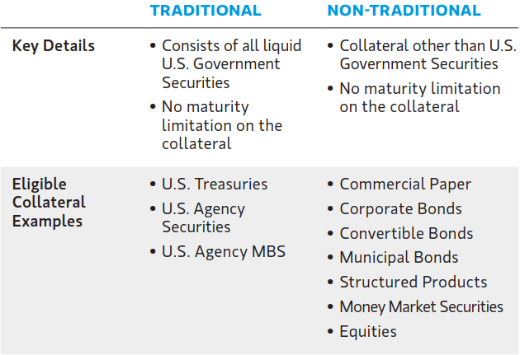
REPURCHASE AGREEMENT (REPO)
Repo are short-term borrowing agreements wherein securities are loaned to a counterparty with a guaranteed repurchase at a future date for a stated price. The repo rate is the difference between the original sale and promised repurchase price.
General collateral (GC) enables counterparties to transact swiftly with high-quality collateral identified after settlement.
GC may be either traditional or non-traditional. Traditional
repo risk is equal to that of the underlying assets.
Non-traditional repo risk is related to both the assets
and the counterparty.
Source: Morgan Stanley Investment Management
Please refer to the disclosure slide for additional information regarding this presentation.

