Slide 1
MISSING IN ACTION
Accounting for Compensated Absences
2025 GFOAT Spring CONFERENCE
Bob Scott, Town of Prosper

Slide 2
Old School Raise thy Hand Polling Question #1
How familiar are you with GASB 101, Compensated Absences?
Read the standard
Currently evaluating the impact to my government
Mocked up entries already
What, we’re already over 100 GASBs?

Slide 3
No. 101, Compensated Absences
Effective Date
Reporting periods beginning after December 15, 2023

Slide 4
New Definition
Definition – Compensated Absence
Statement 16 | Statement 101
Absences for which employees will be paid, such as vacation, sick leave, & sabbatical leave | Leave for which employees may receive one or more Cash payments when the leave is used for time off Other cash payments, such as payment for unused leave upon termination of employment which includes voluntary resignation or retirement Noncash settlements, such as conversion to defined benefit postemployment benefits

Slide 5
Compensated absences – Statement 16
Why was a change needed?
Benefit practices have evolved
Inconsistent application of standards
Lack of guidance for new leave types
Changes to the conceptual framework since the issuance of the existing guidance
5

Slide 6
Compensated absences – Statement 16
Distinguished between types of paid leave
Providing different guidance for vacation leave and sick leave
Use of Paid time off and compensatory time are more common
Distinction between vacation and sick leave does not apply when government provide PTO
6

Slide 7
Examples of Compensated Absences
Vacation & sick leave
Paid time off (PTO)
Parental leave
Bereavement leave
Holidays
Compensatory time
Certain types of sabbatical leave

Slide 8
Sabbatical Leave
Sabbatical leave in which an employee is not required to perform any significant duties for the government -unrestricted sabbatical leave - is a compensated absence
Sabbatical leave in which an employee is required to perform duties of a different nature for the government - is not a compensated absence

Slide 9
Recognition
GASB Statement 101 provides recognition criteria for both of the following situations:
Leave used but not paid or settled
Unused leave

Slide 10
Recognition – Leave Used but Not Paid
A liability should be reported when leave is used for time off but has not yet been paid in cash or settled through noncash means – including unlimited leave & date-specific holiday leave.
The liability should be measured at the amount of the cash payment or noncash settlement to be made for the use of the leave.
Pay Rate
Generally, the employee’s pay rate at financial reporting date
Exception: More likely than not to be paid at a different rate
Salary-Related Payments
Directly & incrementally related
DC pension or OPEB recognized as related leave is earned – not pension or OPEB liability
DB pension or OPEB excluded

Slide 11
Salary-Related Payments
Directly associated – if the payment amount is a function of salary to be paid
Incrementally associated – if the government will make payment in addition to the salary payment

Slide 12
Recognition – Unused Leave
A liability should be recognized for leave that has not been used if all of the following criteria are met:
Leave is attributable to services already rendered
Employee has performed the services required to earn the leave
Leave accumulates
Can be carried forward from reporting period when earned to a future reporting period when it will be used or otherwise paid or settled
Leave is more likely than not to be used for time off or otherwise paid or settled
Likelihood of more than 50 percent

Slide 13
More Likely Than Not
Management judgment still required by assessing the following relevant factors:
The government’s compensated absences employment policies
Whether benefits for which services have been rendered will become eligible for future payment
Historical information about the use, payment, or forfeiture of compensated absences
Information known to the government that would indicate that historical information may not be representative of future trends or patterns

Slide 14
More Likely Than Not
Leave that is more likely than not to be settled through conversion to defined benefit postemployment benefits should not be recognized as a liability for compensated absences
This prevents the actuary from double counting the benefit when performing the actuarial calculation for the plan

Slide 15
Compensated Leave Calculation Methods
Same methods as currently used for GASB 16
Days Used Approach
Days Used Average Approach
Days Paid Approach
Dollars Paid Approach
If the calculation method for GASB 16 works, then keep doing it!

Slide 16
Disclosure Requirements
Long term liability disclosure options:
Present separate increases and decreases (gross presentation)
Present a net increase or net decrease
Disclose that it is net amount
Short term/long term estimation

Slide 17
Transition
Transition changes at adoption should be reported as a change in accounting principle in accordance with Statement No. 100, Accounting Changes and Error Corrections
Effective for fiscal years beginning after December 15, 2023 and all reporting periods thereafter. Earlier application is encouraged.

Slide 18
No. 100, Accounting Changes & Error Corrections
Effective Date
Reporting periods beginning after June 15, 2023

Slide 19
Two separate classifications in GASB 100:
Accounting changes
1. Change in accounting principle
2. Change in accounting estimate
3. Change to or within the financial reporting entity
Error Correction
Correction of an error in previously issued financial statements

Slide 20
1. Change in Accounting Principle
A change in accounting principle results from either:
A change from one generally accepted accounting principle to another that is justified on the basis that the newly adopted accounting principle is preferable, based on the qualitative characteristics of financial reporting
Implementation of new pronouncements

Slide 21
Accounting
Change in accounting principle
Reported retroactively by restating prior periods presented, if practicable
Change in accounting estimate
Change to/within the reporting entity
Reported by adjusting current period beginning balances
Error correction
Reported retroactively by restating prior periods presented
If not practicable, restate beginning balances of current period
Recognized in current-period flows
Reported prospectively

Slide 22
Financial Statements & Disclosures
The nature of the change or error and its correction
Reason for the change
The effects on beginning net position, fund balance, or fund net position, as applicable, presented in a tabular format
Aggregate amount of adjustments to & restatements of beginning balances should be displayed for each reporting unit.
Disclosures vary depending on the type of item, but common disclosures include:

Slide 23
Required Supplemental Information (RSI) & Supplemental Information (SI)
The Statement addresses how to present in RSI & SI information that is affected by an accounting change or error correction.
Periods earlier than those presented in basic financial statements should not be restated for changes in accounting principles.
Periods earlier than those presented in basic financial statements should be restated for error corrections, if practicable.

Slide 24
Practical Considerations

Slide 25
Impact Will Vary Greatly By Government
Implementation
Even within states or region, leave policies can vary significantly
The more complicated the leave policy, the more complicated the implementation
Complexity can be added through:
Pension plan conversions (ask pension plan actuary about assumptions used)
Discounted payouts (sick paid at 50% payrate)
Different policies for certain employee groups
Vacation Buy Back
Donated Leave Programs
Strict and sudden accrual stops (i.e. once you reach 240 hours, accrual stops)
Holiday Banking

Slide 26
Impact Will Vary Greatly By Government
Increase in the reported liability
The liability will increase due to:
Broader Scope-Paid or Used
Lower probability threshold More Likely than Not vs. the Old standard of Probable
The amount of the increase can vary significantly
Governments with generous leave policies but stingy caps for paying upon termination will have the biggest increase in liability
Governments with relatively stingy leave policies but higher caps for payout will have a smaller increase in liability because GASB 16 will already have captured much of it.
Flow assumptions and other estimation techniques can significantly impact the number so be prepared to use usage patterns, forfeiture rates, demographics and differences between groups to justify the estimation approach
Start with the simplest approach first and see if it makes sense which often will be what won’t be paid (aka forfeitures upon termination), rather than what will be paid.

Slide 27
Plan for Prosper Implementation
Prosper Policies
Vacation 2weeks<2yr, 3 weeks<5, 4 weeks<10, 5 weeks> 10+ to a maximum accrual of twice your annual accrual
Sick One day per month up to a maximum accrual of 720
Vacation Buy Back for up to 80 hours per year
Maximum pay out upon termination is your maximum accrual for vacation and 120 for sick
Vesting is tied to probationary period with no payouts upon termination for first six months
Fire is proportionately higher due to higher work year
Donated leave policy exists but is on an individual basis with caps not a sick leave pool
Public Safety demographics are different in that employees are generally younger when hired and have longer tenure

Slide 28
Plan for Prosper Implementation
Vacation-under GASB 101 expanded definition and given the vacation buy back policy, all vacation accrued by all employee groups is a liability. It is deemed more likely than not that new employees will vest.
Sick-Employees divided into three groups, Police, Fire and General Employees with total accrued hours for each being the starting point. Forfeiture rates upon termination are determined for each group using multi-year historic experience.
The forfeiture rate is multiplied by the accrued sick leave hours by group =forfeited hours.
Forfeited hours are multiplied by each groups average hourly rate = forfeited leave.
Forfeited leave is subtracted from the total accrued leave to determine the GASB 101 Sick liability.

Slide 29
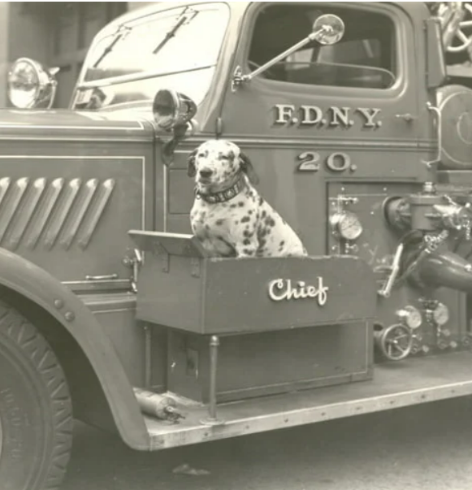
Plan for Prosper Implementation
Sabbaticals- N/A
Holiday Banking- Probably immaterial but will analyze for
public safety.
PTO-N/A
Jury/Bereavement-as used, no liability
Parental Leave- included in the sick and vacation accruals.
Due within one year-Total vacation and sick hours used for last three years compared to beginning hours for each year, that average percentage is then multiplied by the year calculated liability. (FIFO) LIFO could also be used (if usage patterns justify it) and would produce a lower to much lower amount.
Average rates per employee group used if actual rates for each employee is not practicable.
TMRS and FICA is applied to the liability.

Slide 30
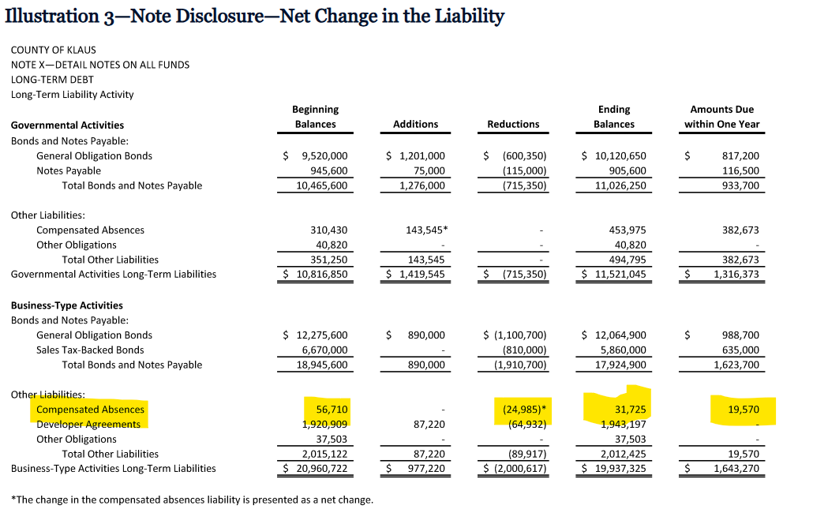
GASB Illustrated Walk forward

Slide 31
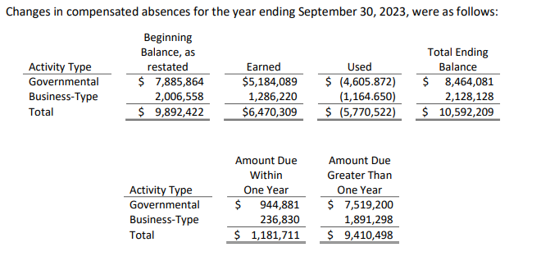
City of College Station, Texas
College Station early implemented in 2023 with no sick leave liability recorded under GASB 16 as there are no sick payouts upon termination. Under GASB 101, the beginning liability for all leave types increased 88.5%
Excerpt from Note 1 of 2023 ACFR.

Slide 32
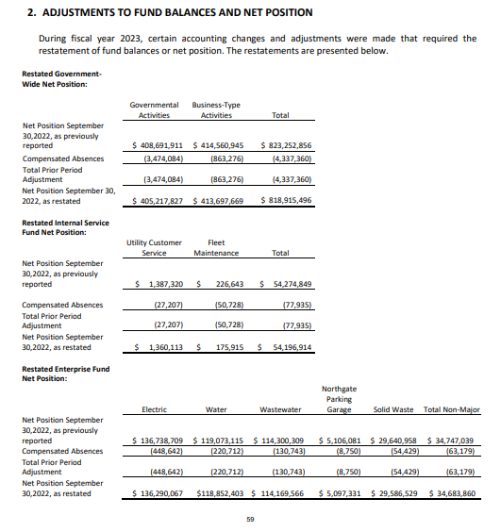
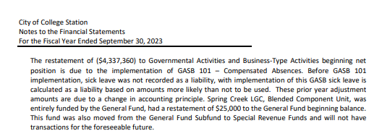
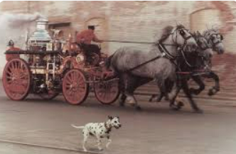
City of College Station, Texas
College Station early implemented in 2023 with no sick leave liability recorded under GASB 16 as there are no sick payouts upon termination. Under GASB 101, the beginning liability for all leave types increased 88.5%
Note 2 of 2023 ACFR.

Slide 33
Questions?

