Slide 1
Sailing Off Into the Distance
Lessons Learned From Retirement
GFOAT Spring 2025

Slide 2
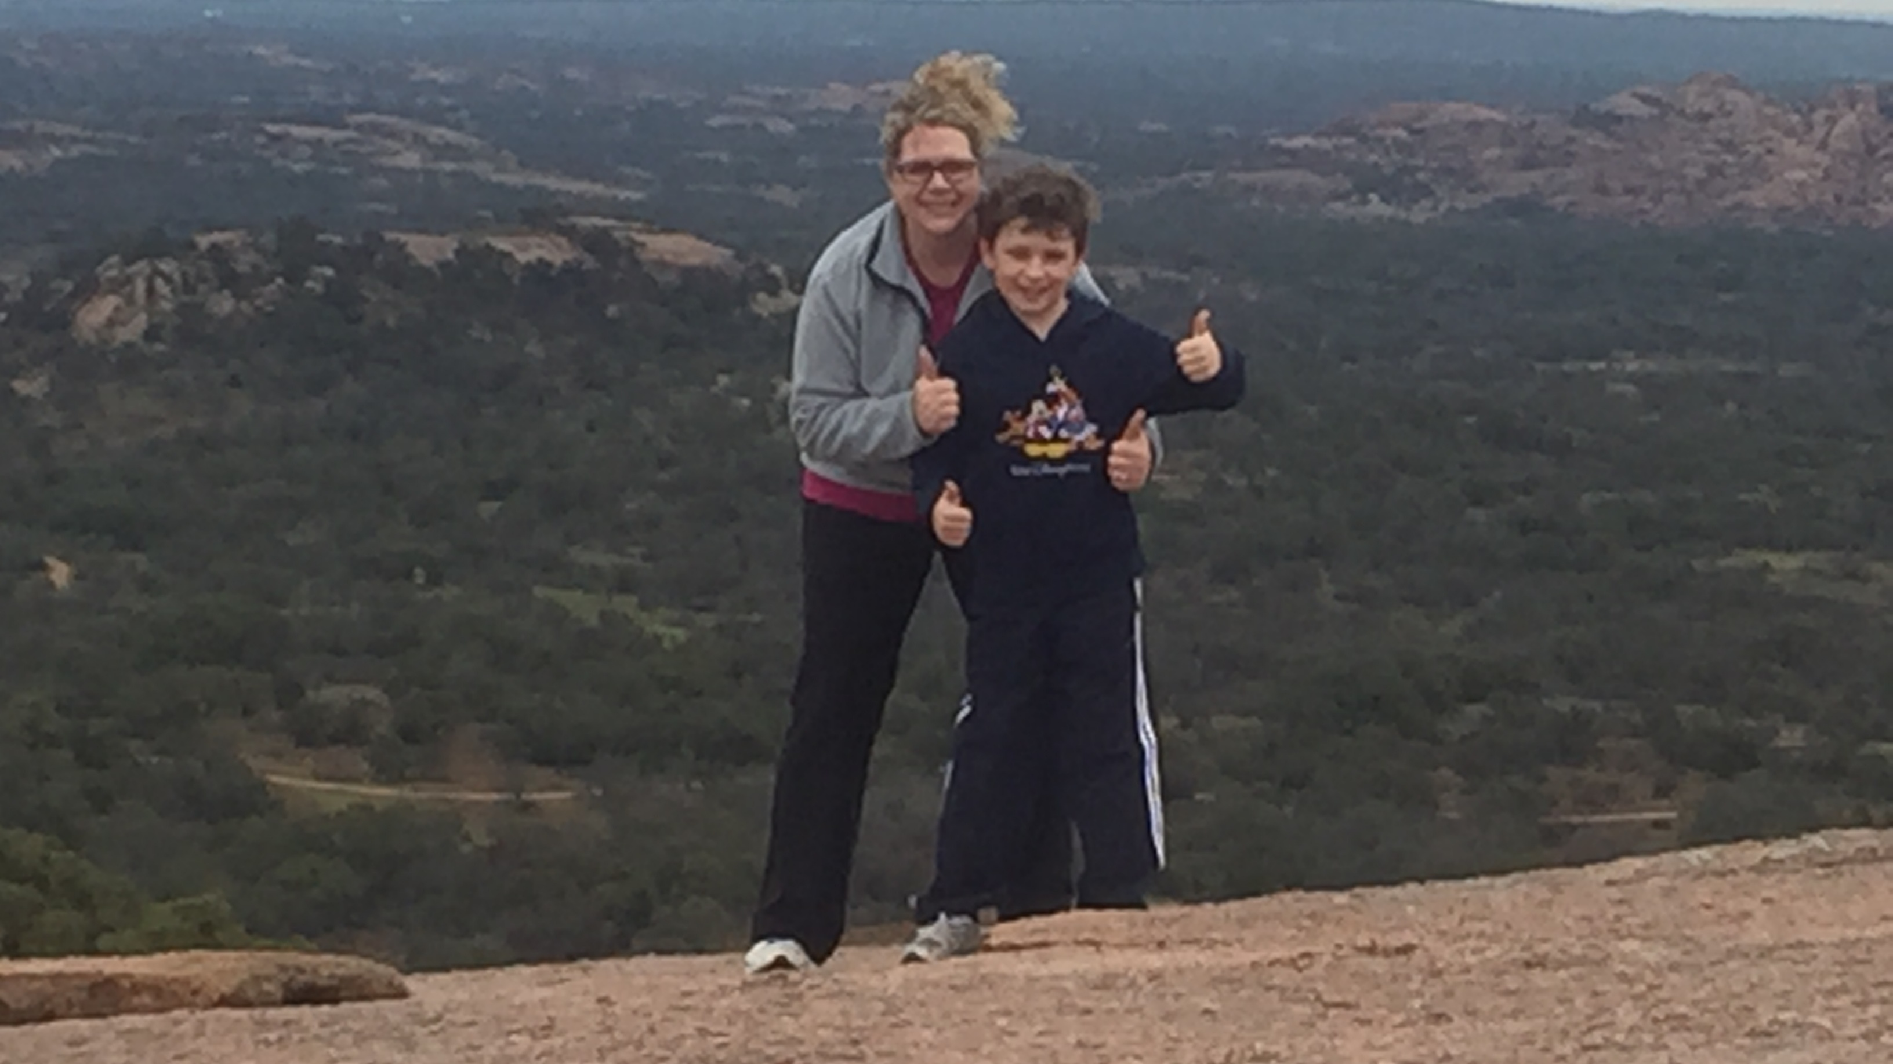
Know Your Plan
Notes:
Guadalupe Peak State Park, TX – Started working for a city in January 1998, eligible to retire in December 2022, married in March 2015 and inherited a 9-year old. Do you have more kids or move on? When can your spouse retire, what does their benefit package look like?

Slide 3
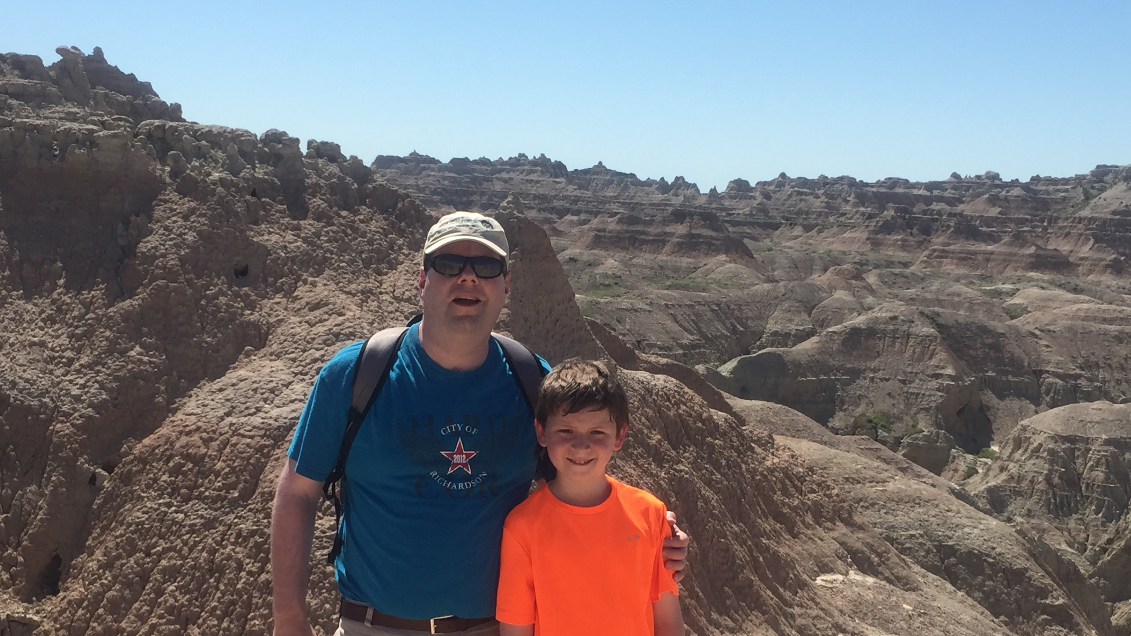
Be Prepared
Notes:
Badlands National Park – near Wall, SD – wife and I had worked with a financial planner, paid off the house, paid cash for cars, and had savings set aside for college, maxed 401K and 457 plans each year as well as funded HSA accounts, plus additional savings. Corporate bonuses and vacation sellbacks were used for one-time purchases such as home improvements, trips, etc.

Slide 4
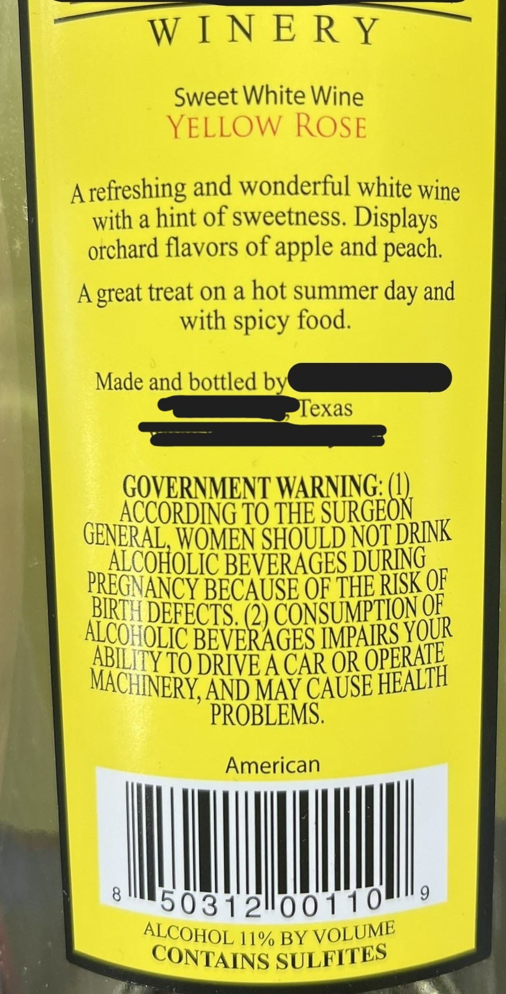
Know the Rules
Notes:
Various wine labels from well known Texas producers – For Sale in Texas Only, American (on back), American on front, Texas grapes, High Plains AVA – educate yourself on the rules – how and when to apply for TMRS retirement, health insurance eligibility, any requirements your city has, taxability of 457 or 401k withdrawals before 59 ½ versus TMRS payments, rollover rules, continuing HSA contributions, IRA, Roth IRA contributions, professional certifications (age 60 to retire with CPA

Slide 5
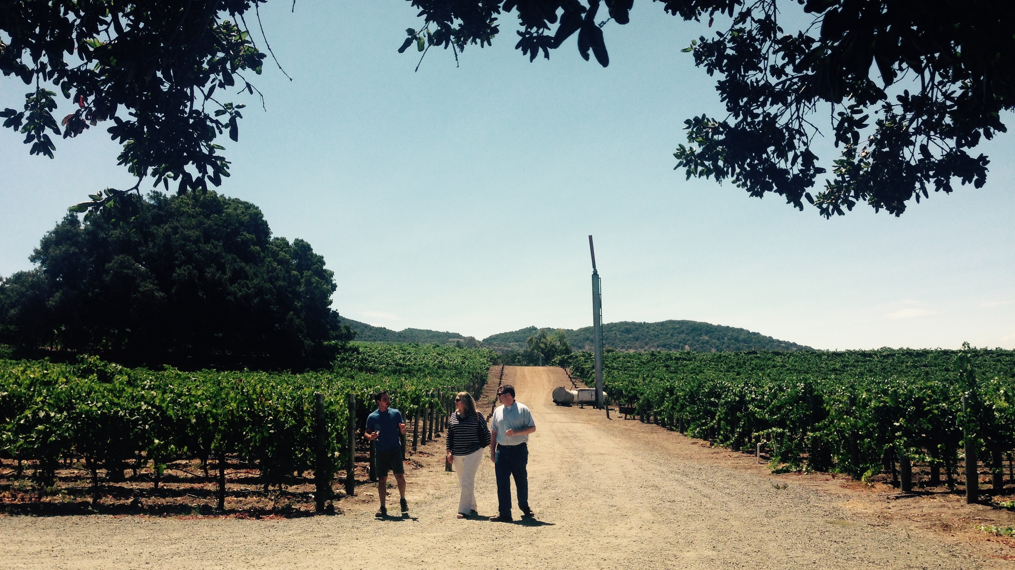
Prep Your City
Notes:
Haynes Vineyard in Coombsville, CA outside of Napa – after a software conversion, rough audit, pandemic, turnover, ready to go – let boss (CFO/ACM) know at end of March 2023 that September 30, 2023 was the final date – coordinated announcements with CM, told executive staff, then my direct reports who shared with full finance team, began focused working with Assistant FD to teach key processes while CFO began process of executive search

Slide 6
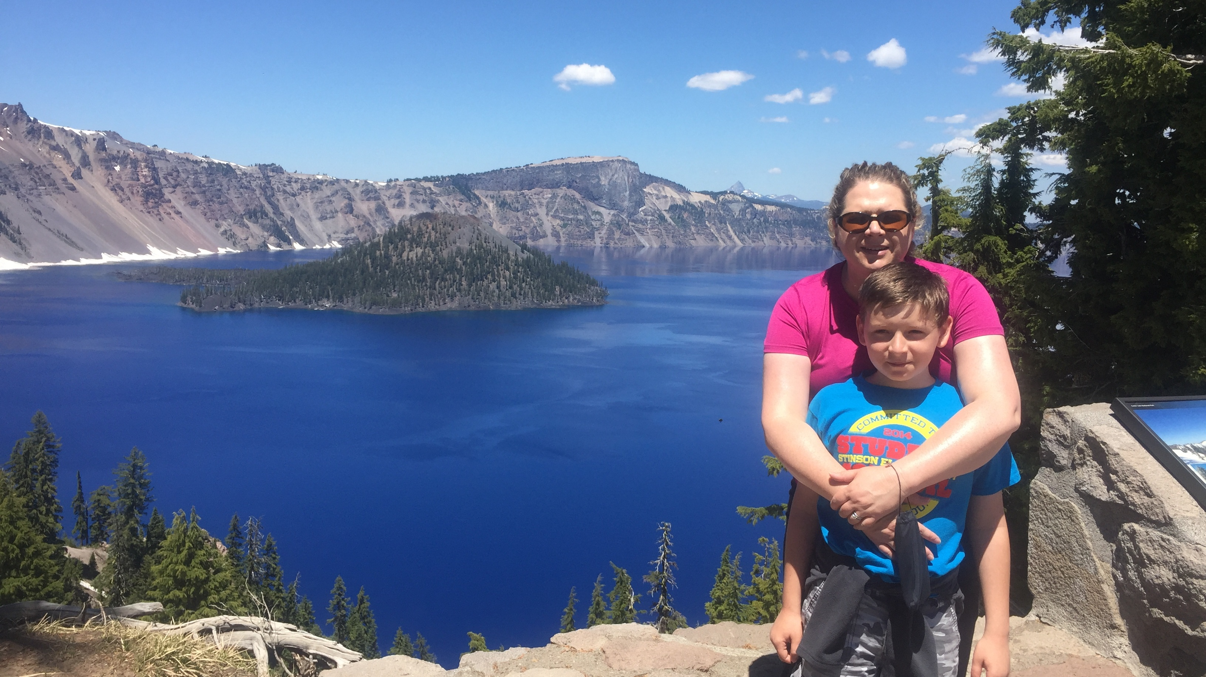
Prep Yourself
Notes:
Crater Lake National Park, OR – know that as you get closer to retirement, it is going to be different – you may no longer be looped in on important stuff, you may no longer be the go-to you were, you may not be apprised of the replacement search, you may not get say in staffing or strategic decisions – you’re also going to get a lot of people who question if you’re too young (still working) or folks who wish they did it sooner (retired)

Slide 7
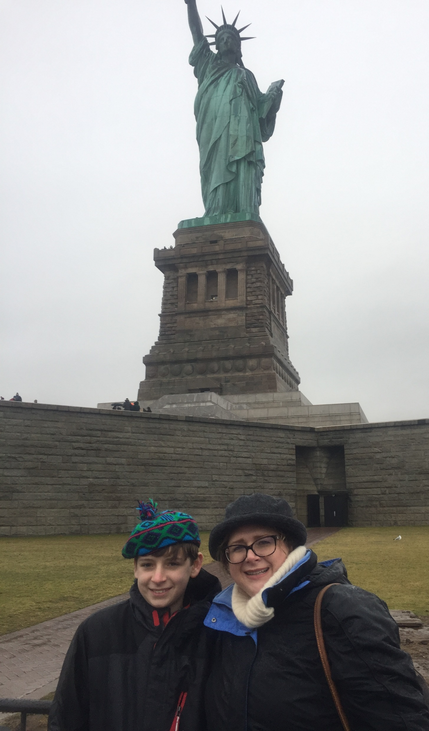
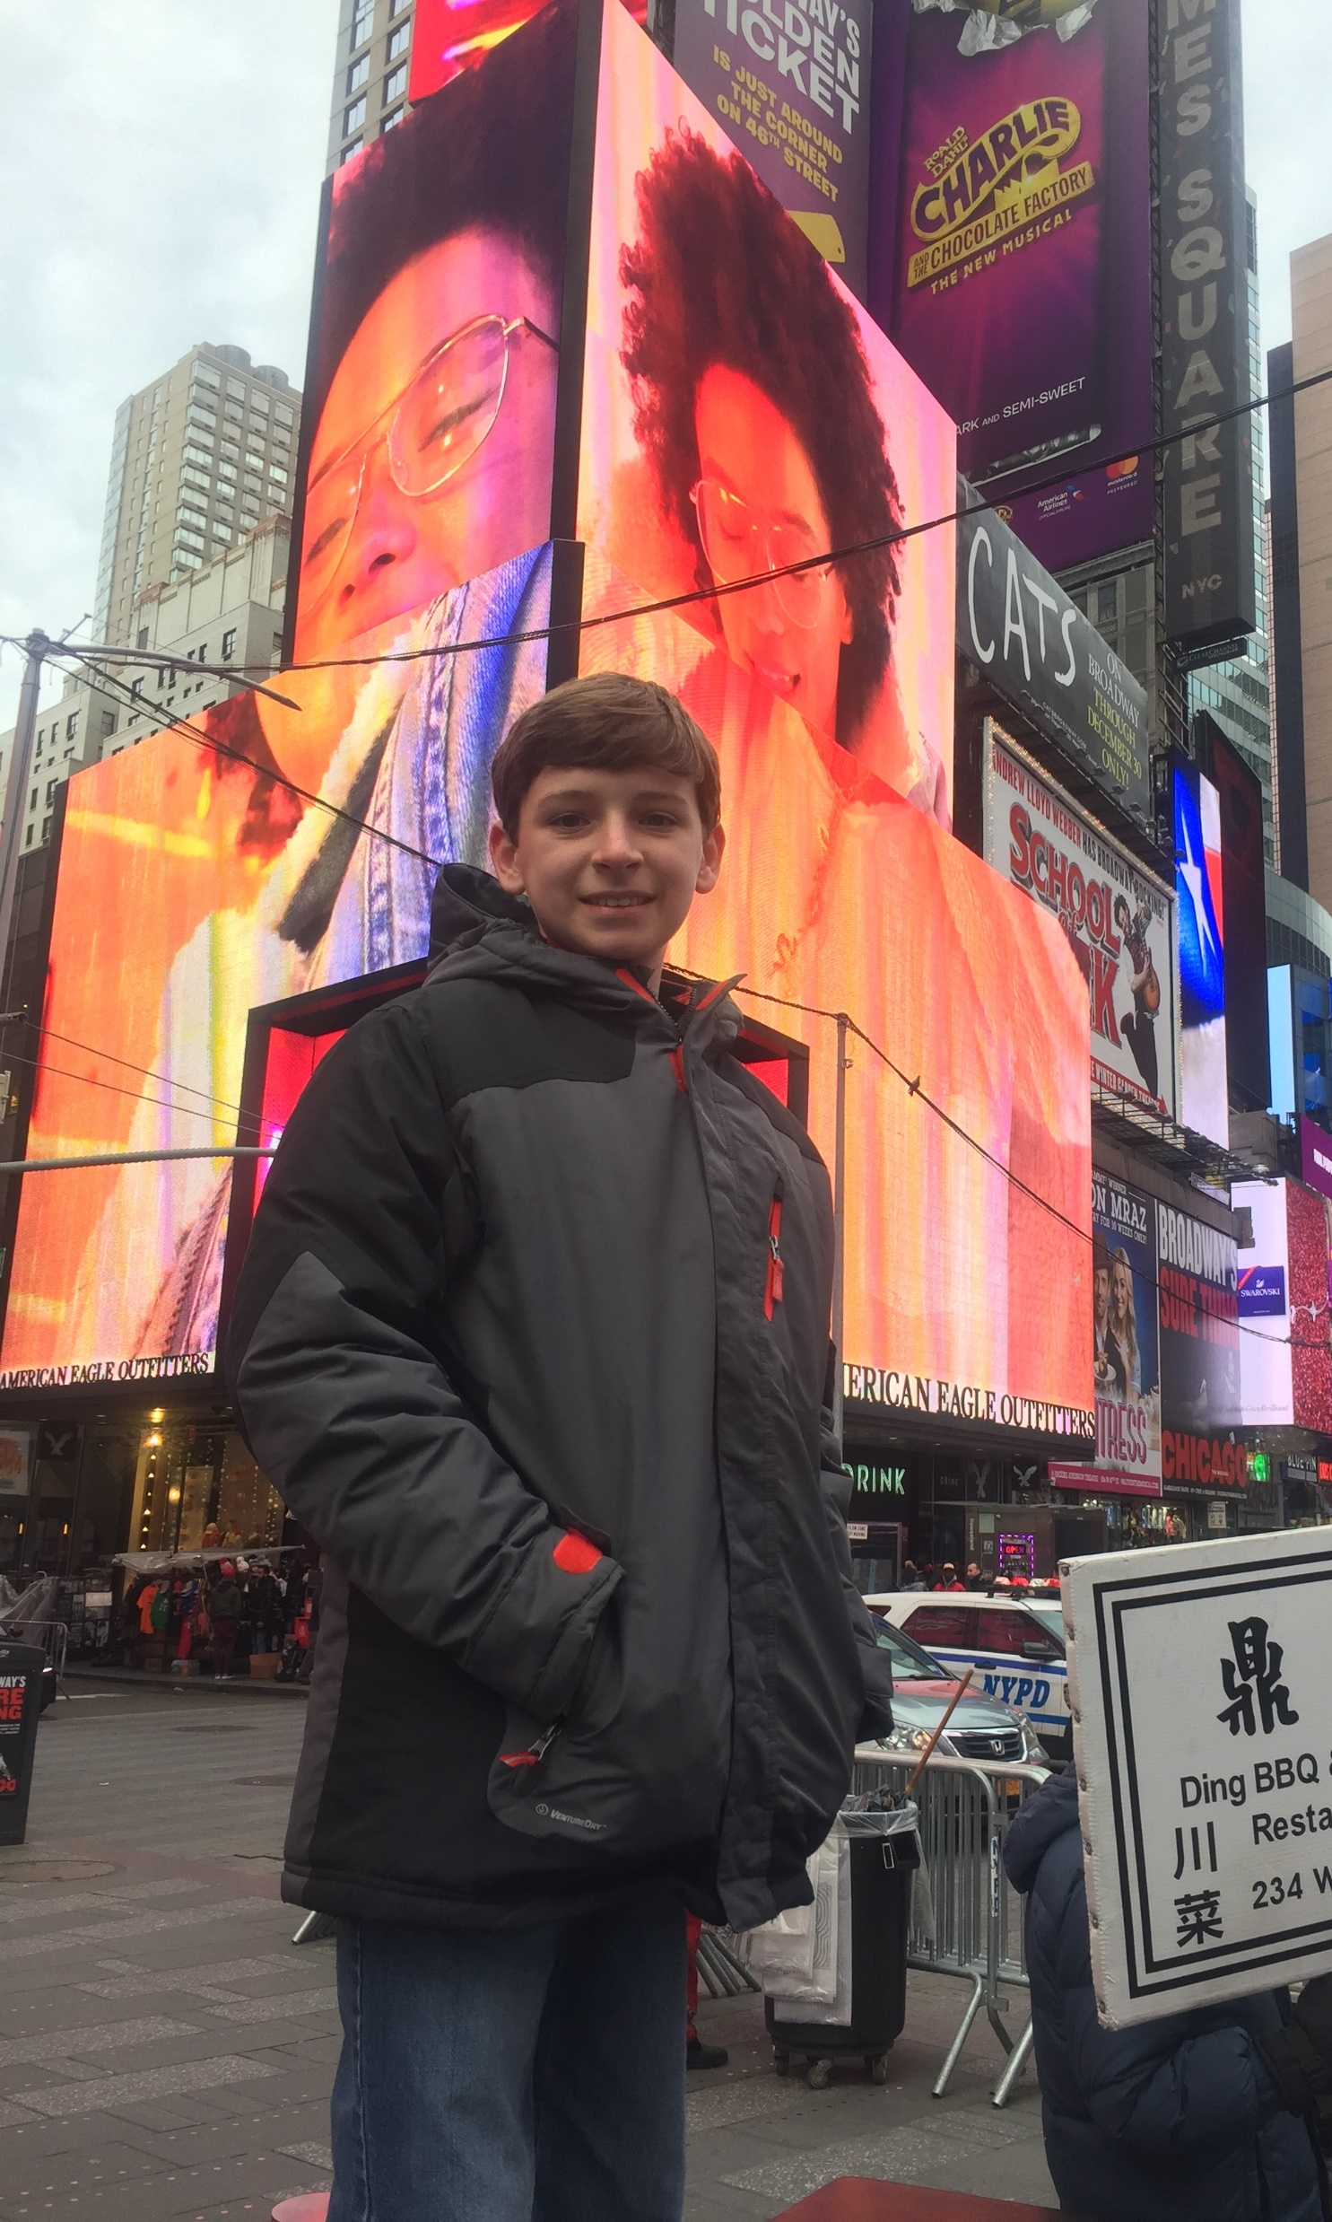
Prep Your Family
Notes:
Liberty Island and Times Square cold and snowy on Christmas Day, limited restaurants open, etc. - talk to your spouse and kids about your retirement, what are their expectations of you, what are your expectations of them, are you messing with someone’s routine

Slide 8
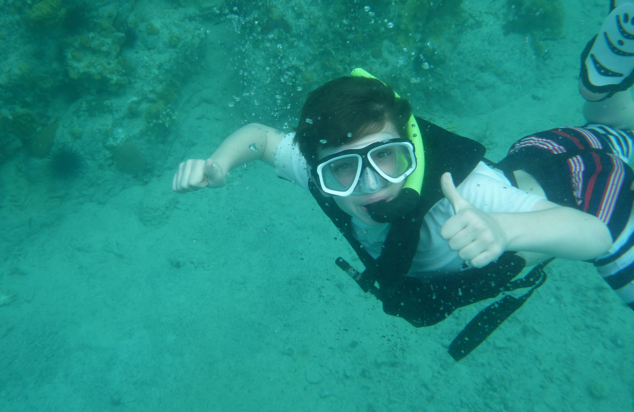
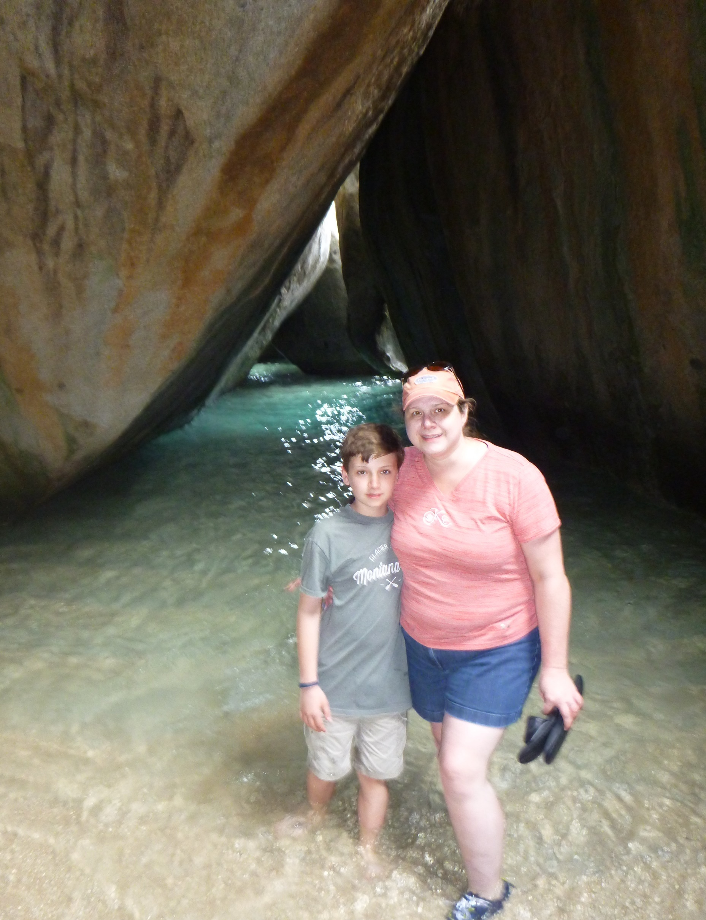
Set Expectations for the Exit
Notes:
Snorkeling in the British Virgin Islands and The Baths, Virgin Gordon, BVI – Chad earned this trip by getting straight A’s after being a dyslexic student who had a solid B/C average – make sure that you express your desires as it relates to going-away parties, how will your exit work (new hire overlap, meeting to update, supervisory transitions), are you willing to stay on if needed or work part-time or as a consultant if the city desires

Slide 9
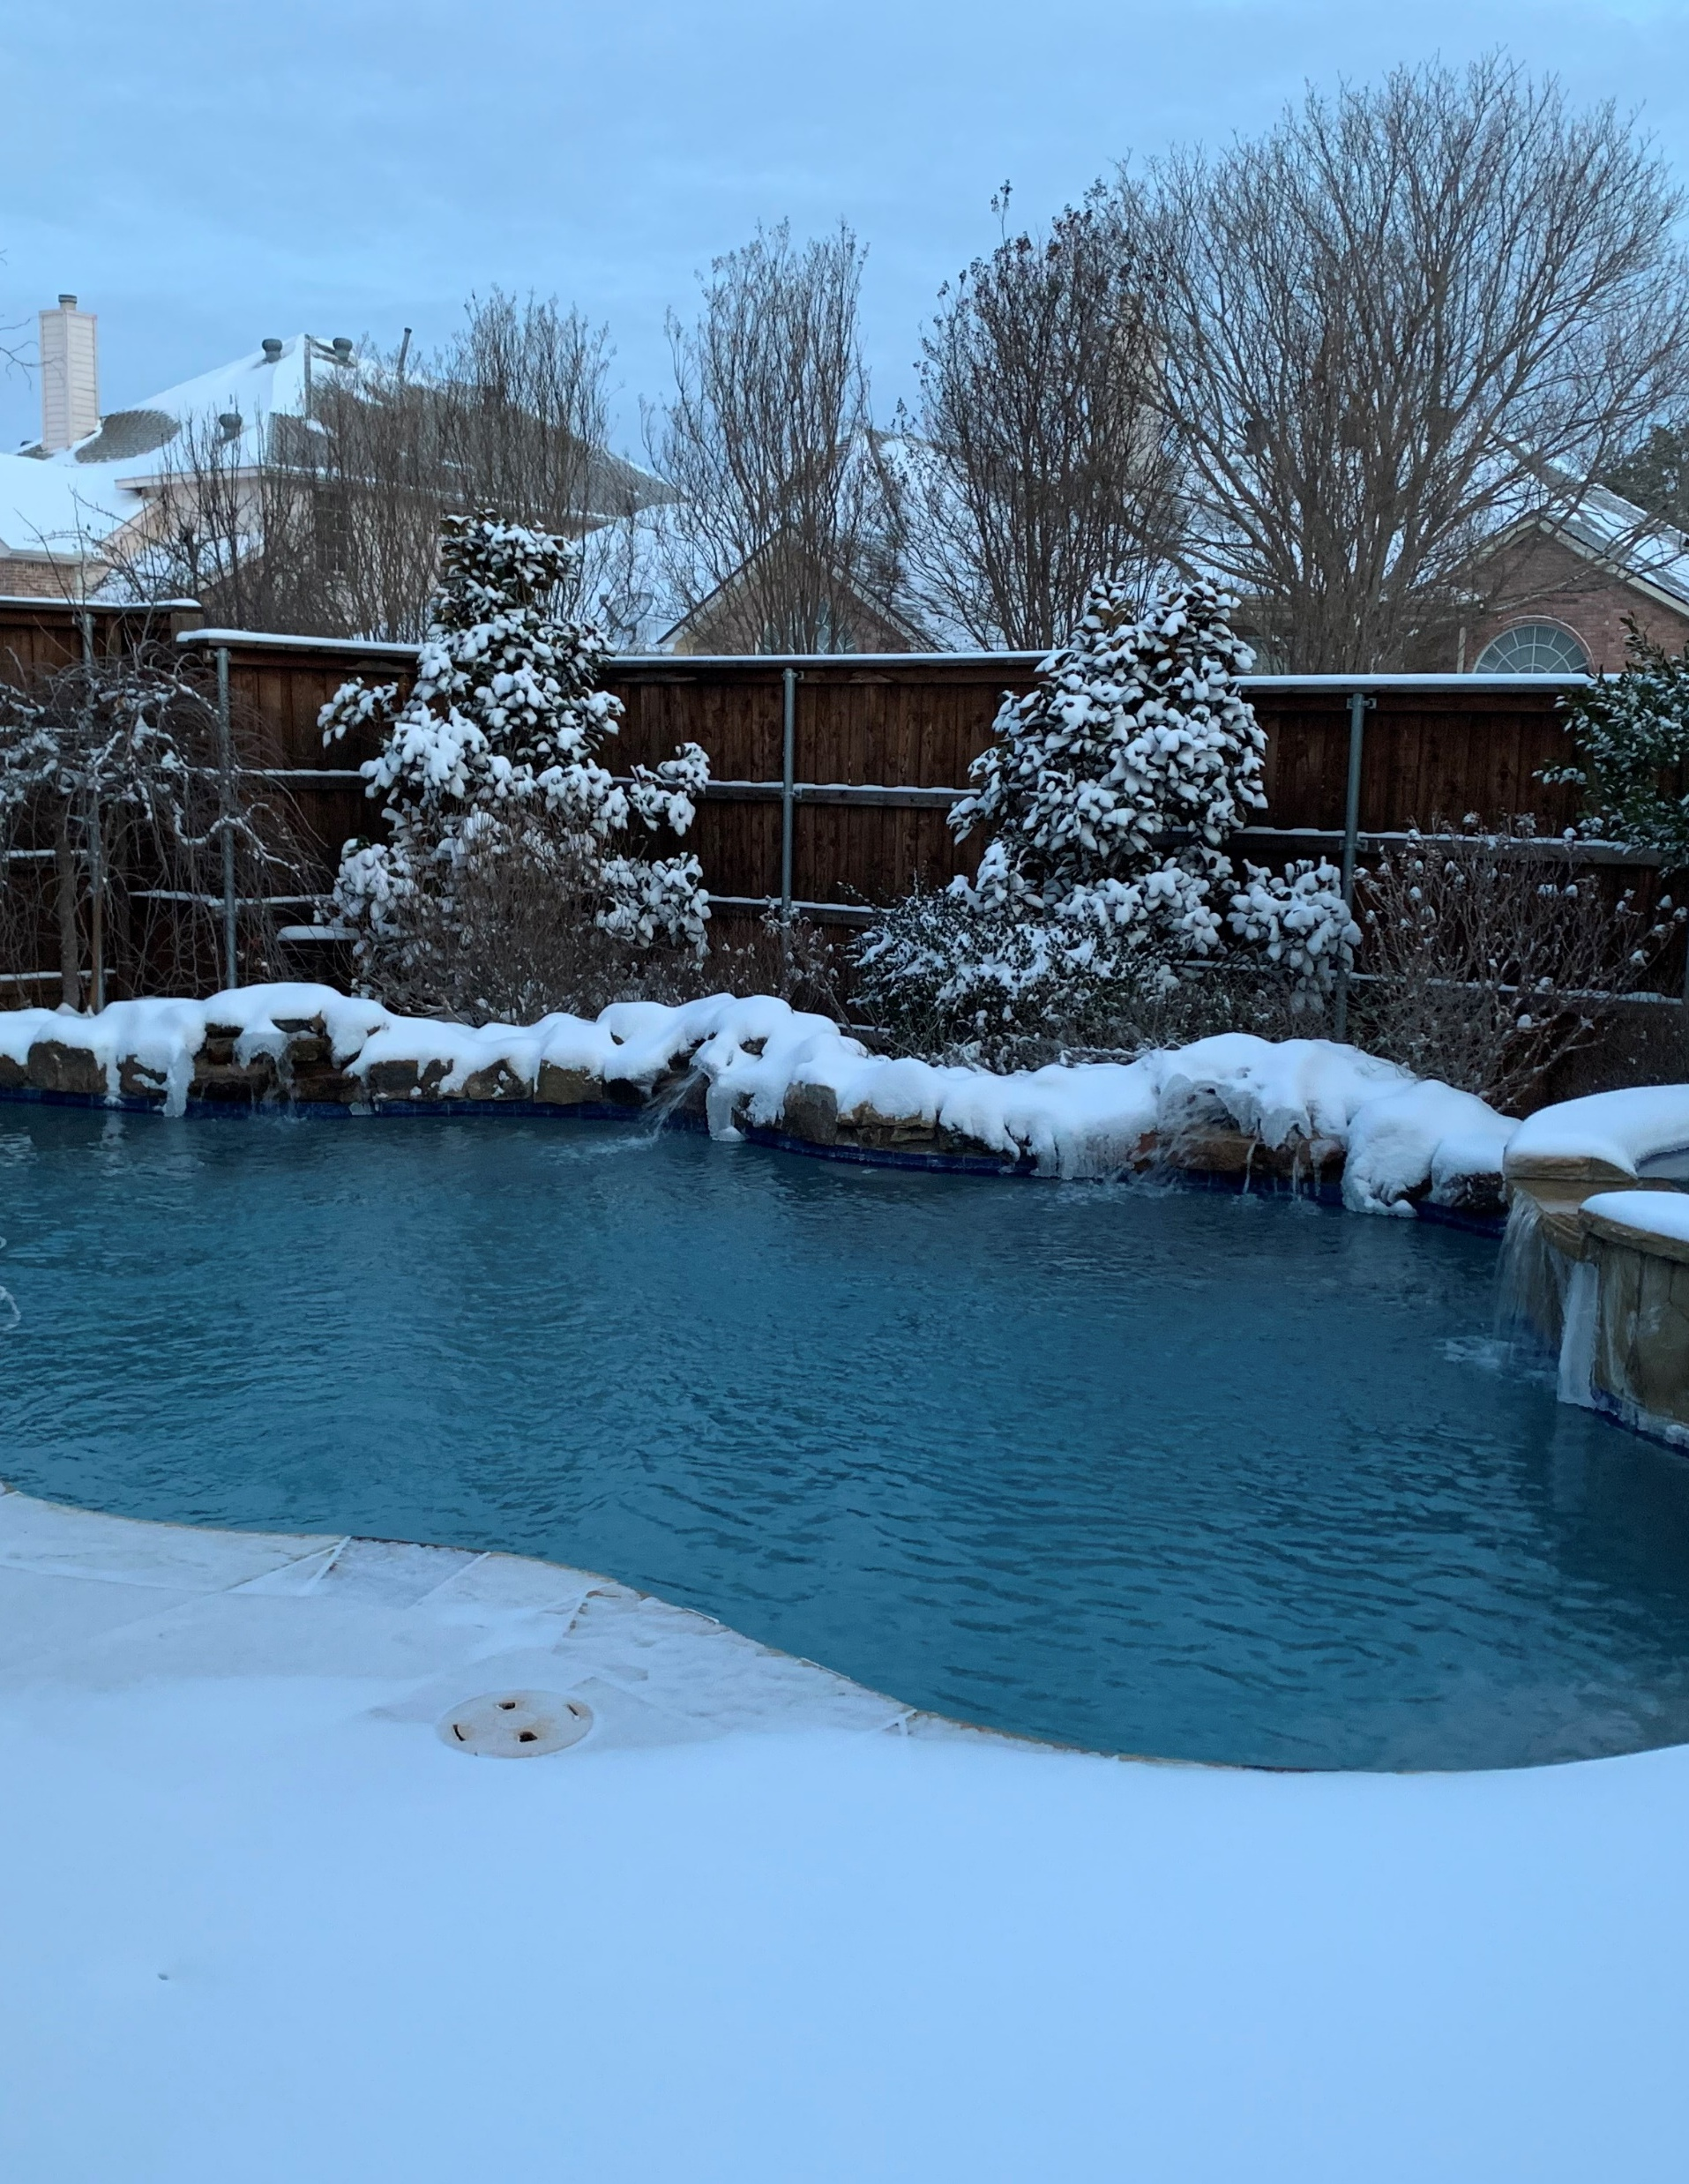
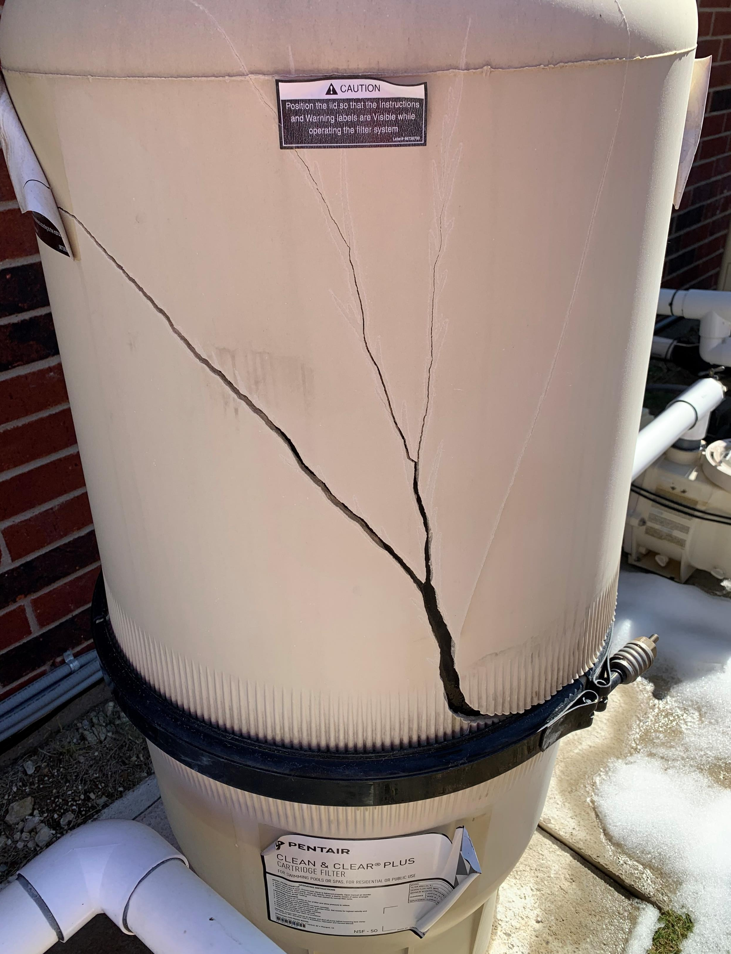
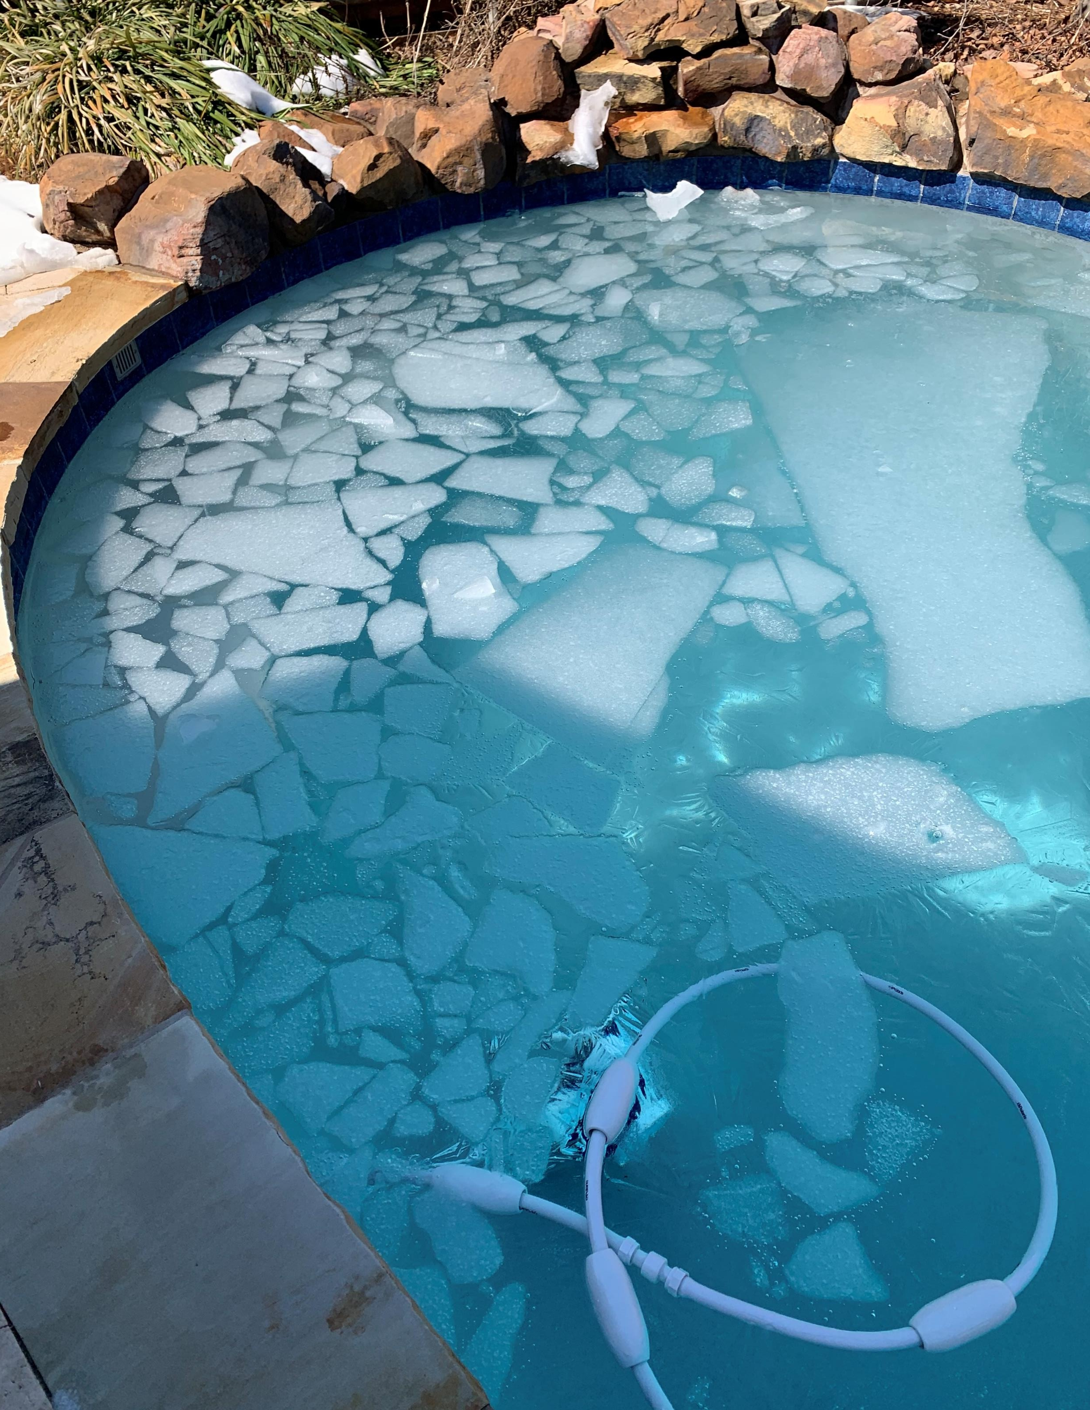
Expect the Unexpected
Notes:
Keith’s Backyard in February 2021 after three days of power about one hour out of eight – something unexpected will happen – it may be a missed press release (my case – many friends wondered if I had quit), (device manager on phone coming off was like pulling teeth, started from scratch basically) – weird last minute phone calls from our critical citizens congratulating me

Slide 10
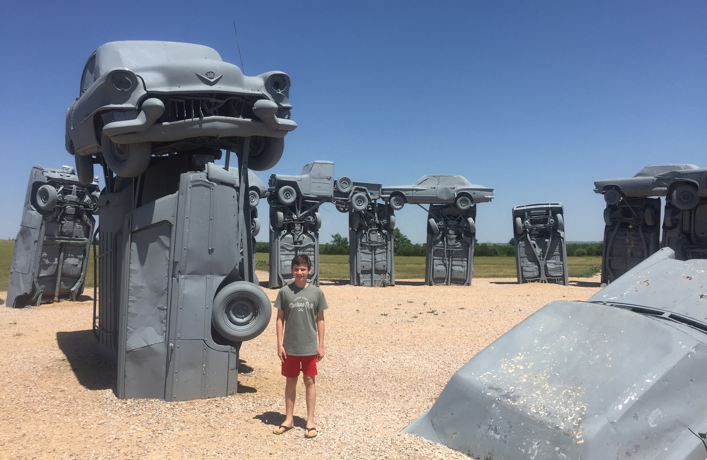
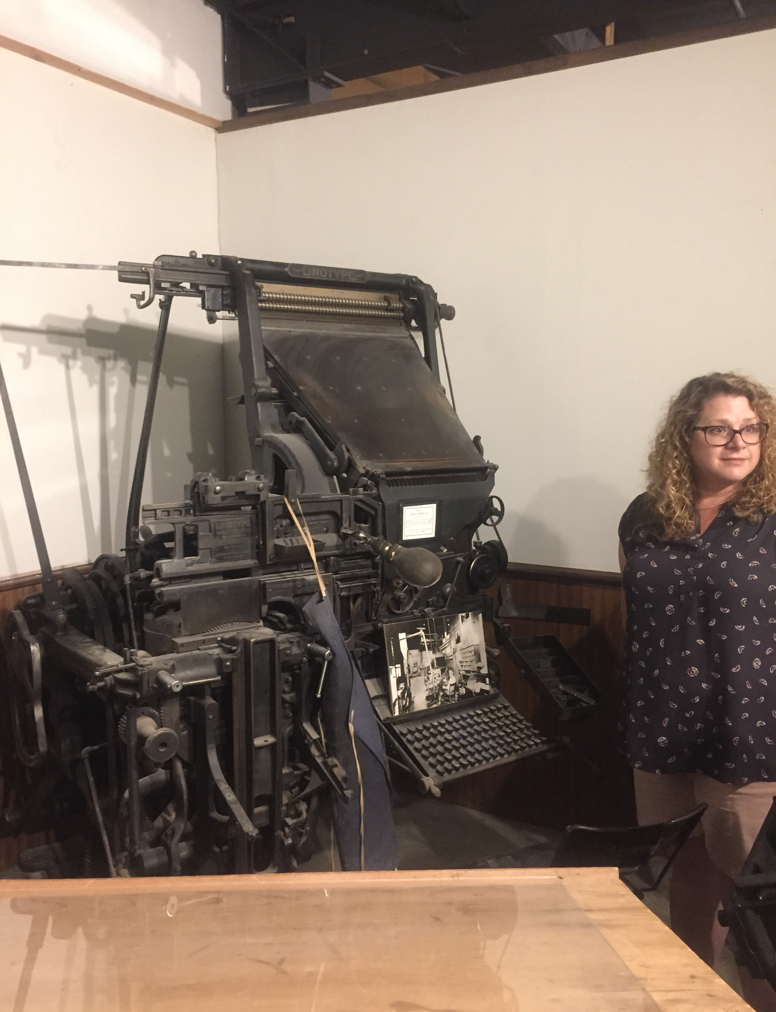
Let It Sink In
Notes:
Carhenge near Alliance, NE and Dawson County Historical Society & Museum, Lexington, NE – once you’re gone it will take a while to really set in – what I hear most is it’s two to three weeks – most people take a trip after they go and when they get back it sinks in that they don’t have emails to respond to; needed a new wardrobe and donated most of my dress clothes to charity (moral victory), blood pressure issues lessened

Slide 11
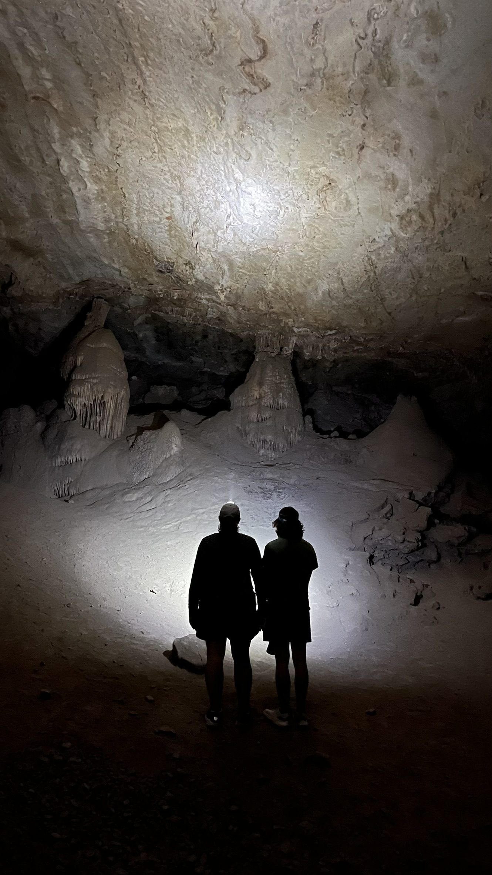
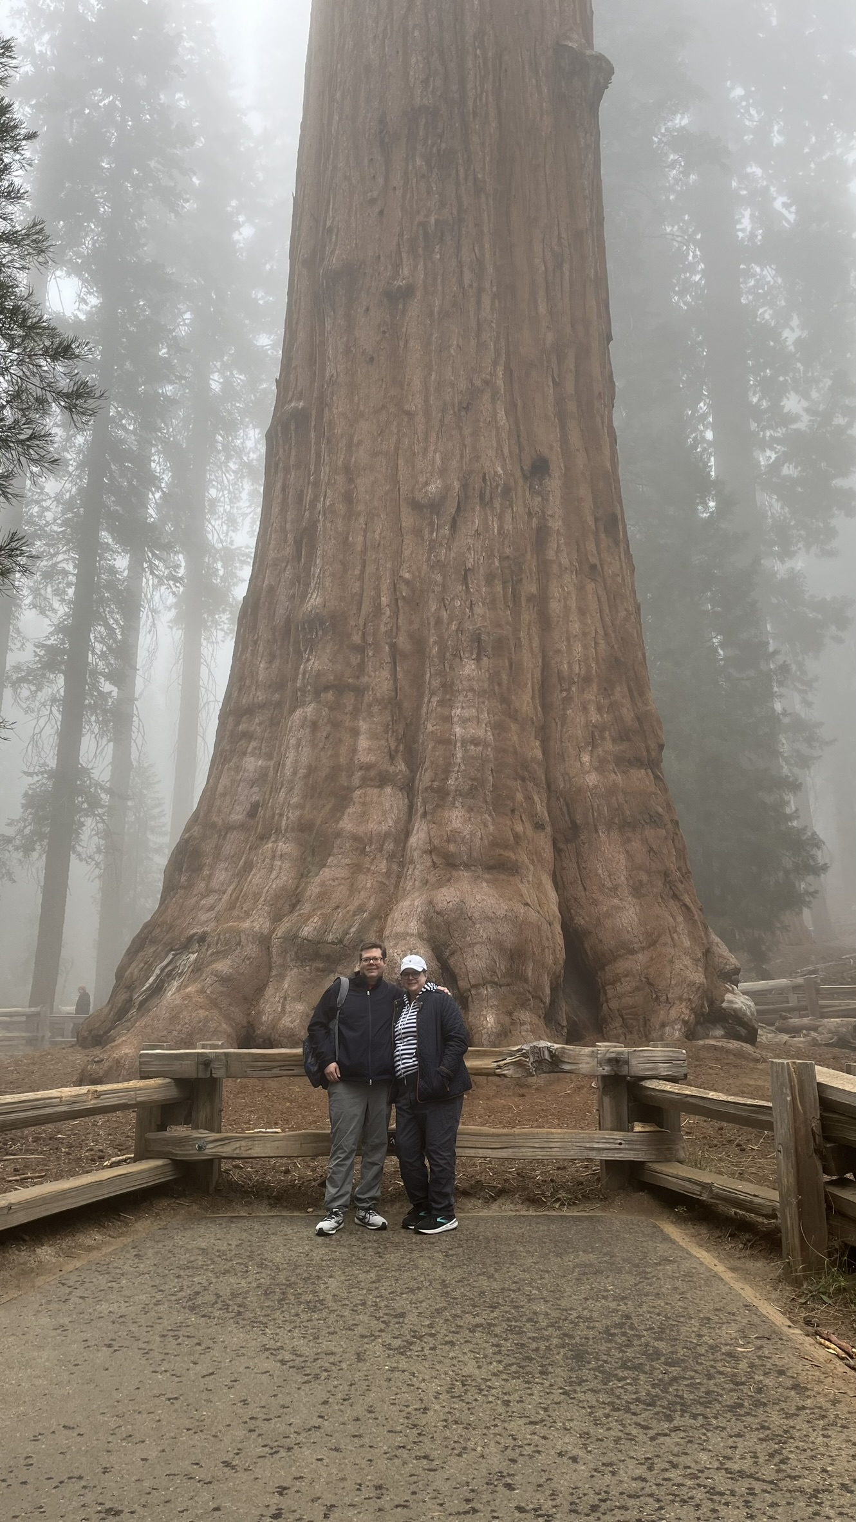
You Must Get Bored or Have a Lot of Free Time
Notes:
Coronado Cave in southern Arizona and General Sherman Tree in Sequoia National Park – what does a day look like – no alarms, morning caffeine and Wordle, breakfast, hour-plus walk and clean-up, noon, chores, fix-it projects, grocery store, etc. Same productivity but relaxed and less stressful – grocery store at 2PM on Saturday is vastly different from 2PM on Thursday. More time for volunteer work (weekly reading at elementary schools or baking for school staff, more time with friends on weekends)

Slide 12
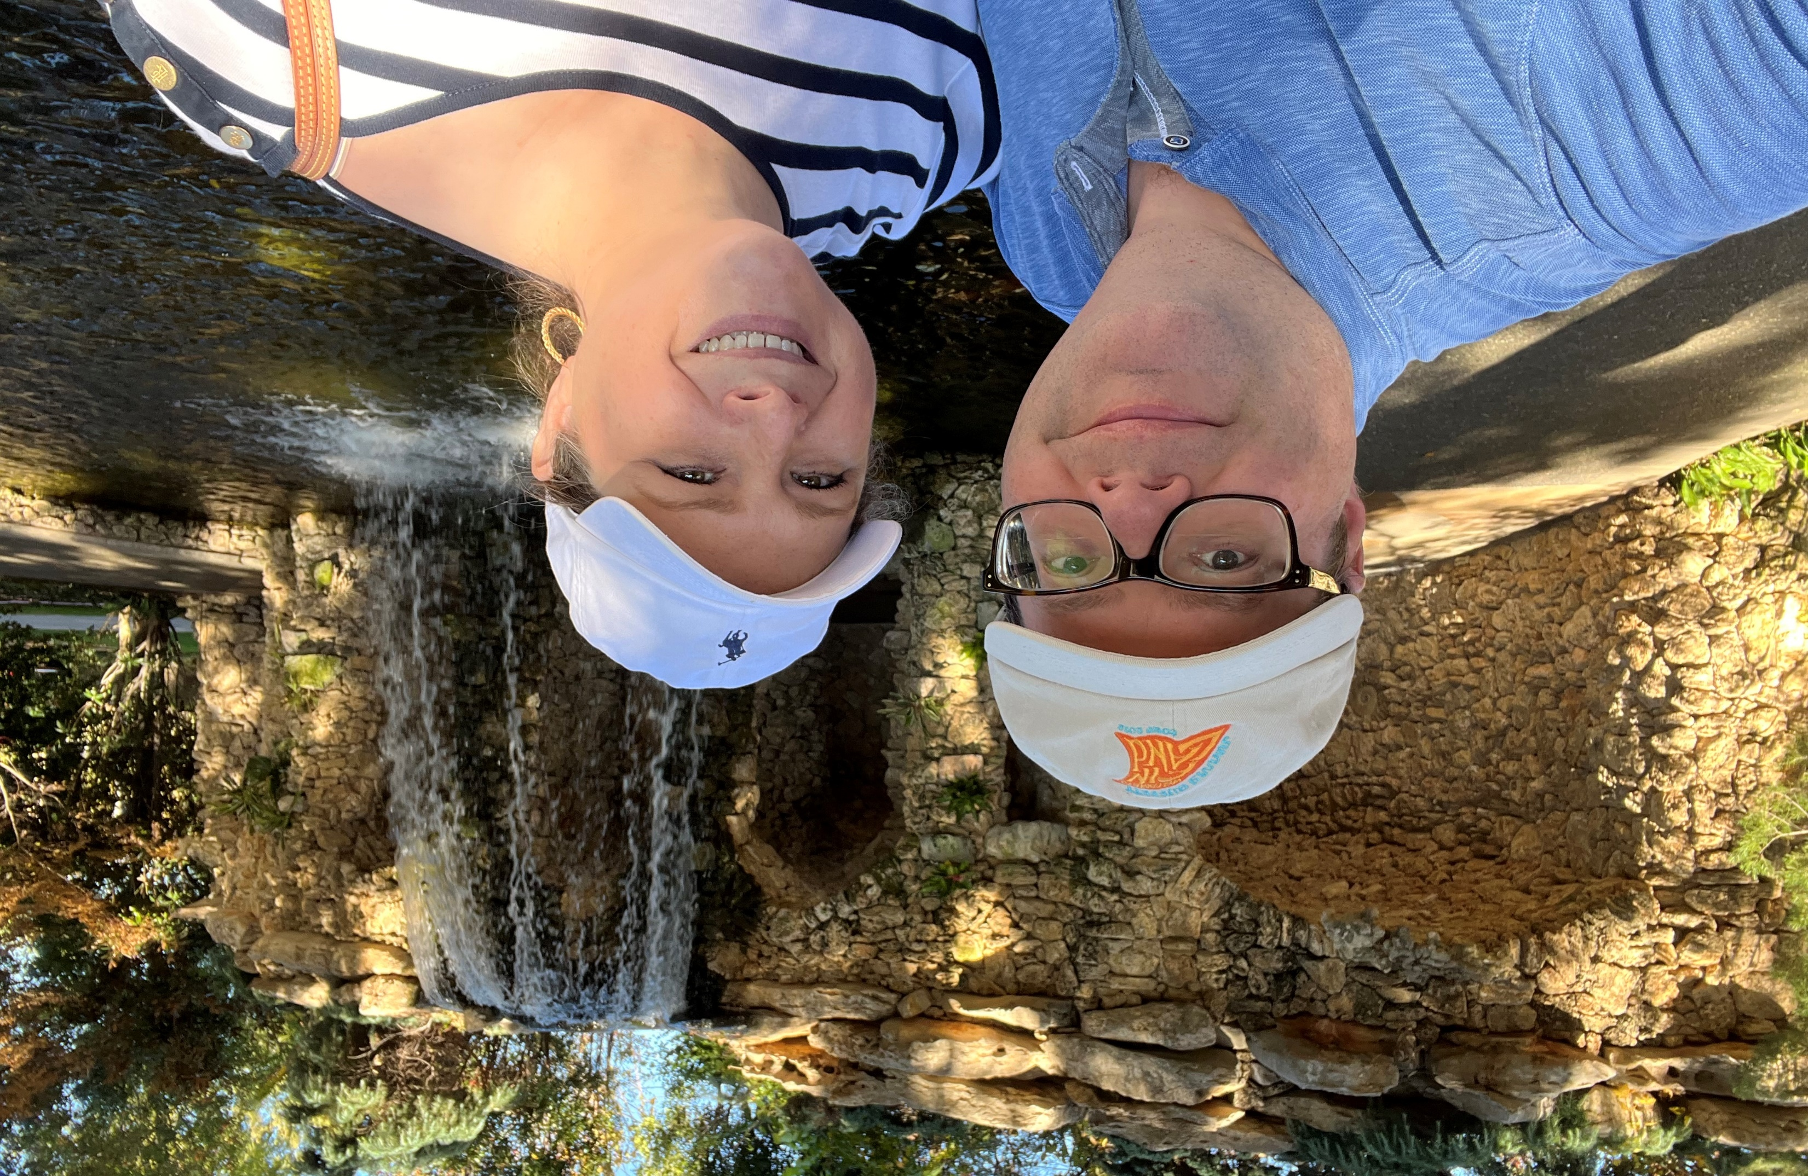
Every Day Can Be Magic
Notes:
Dallas Arboretum in December 2023 – set time to go out and experience what you missed in and around your community – Tuesday Date Days, Dallas Arboretum, Dallas World Aquarium, Fort Worth Botanical Gardens, Dallas Zoo, chicken fried steak quest, local wineries, Cedar Hill State Park

Slide 13
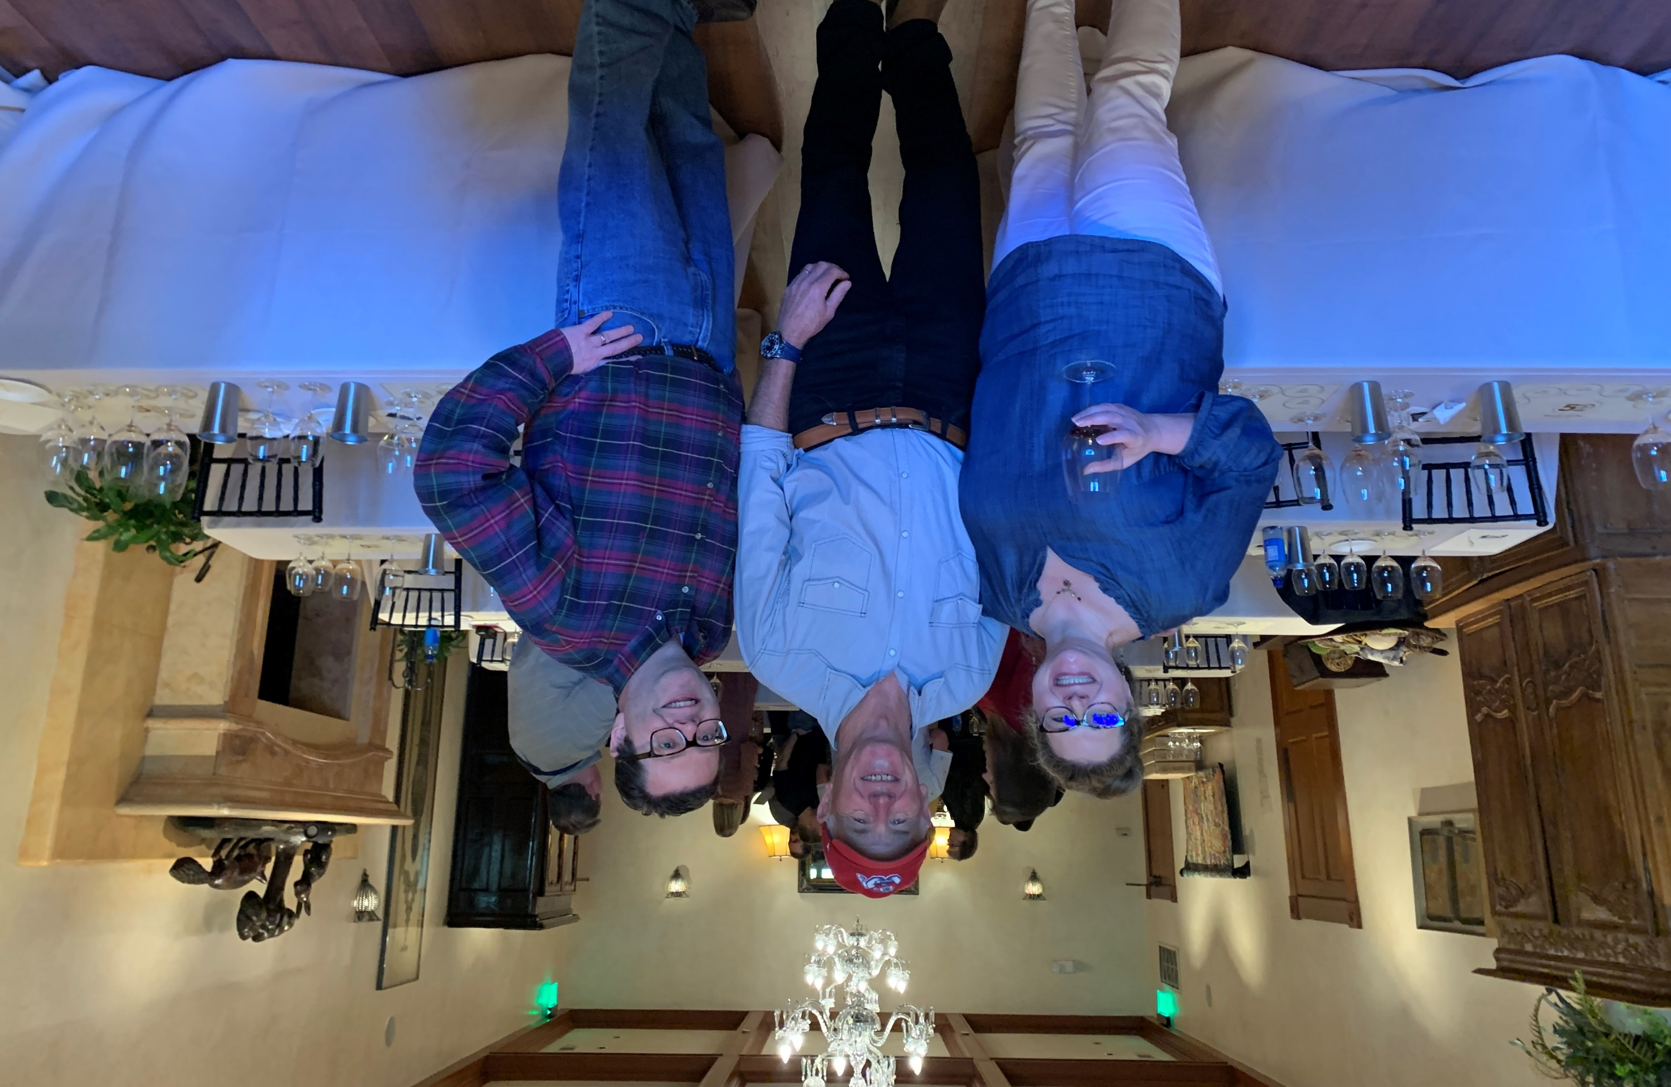
Don’t Save the Buckets Till You’re Gone
Notes:
Bo Barrett, owner of Chateau Montelena in Calistoga, CA (Bottle Shock) – first time you dip into savings you’re going to get nervous and with TMRS paying one time a month, it’s going to happen – the first time it does is not pleasant – work on your bucket trips while you have full cash flow

Slide 14
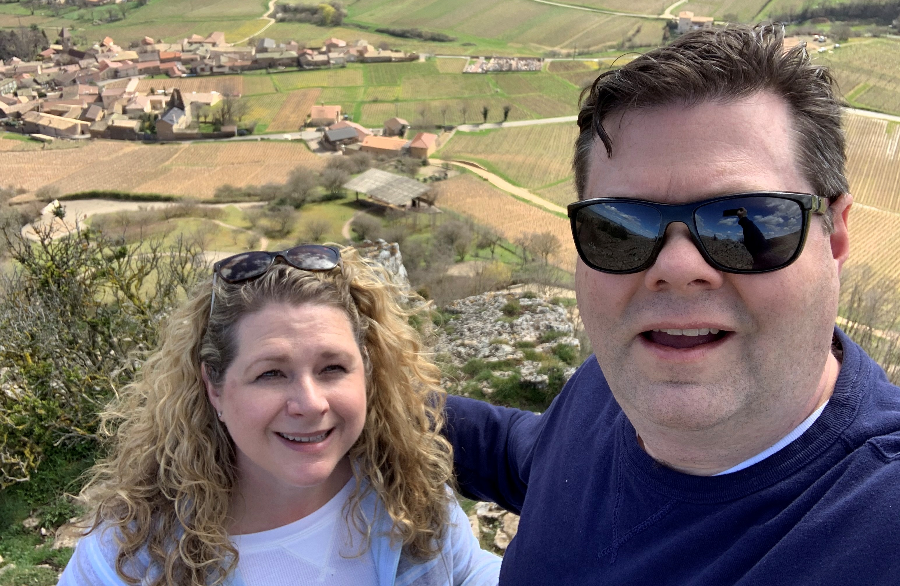
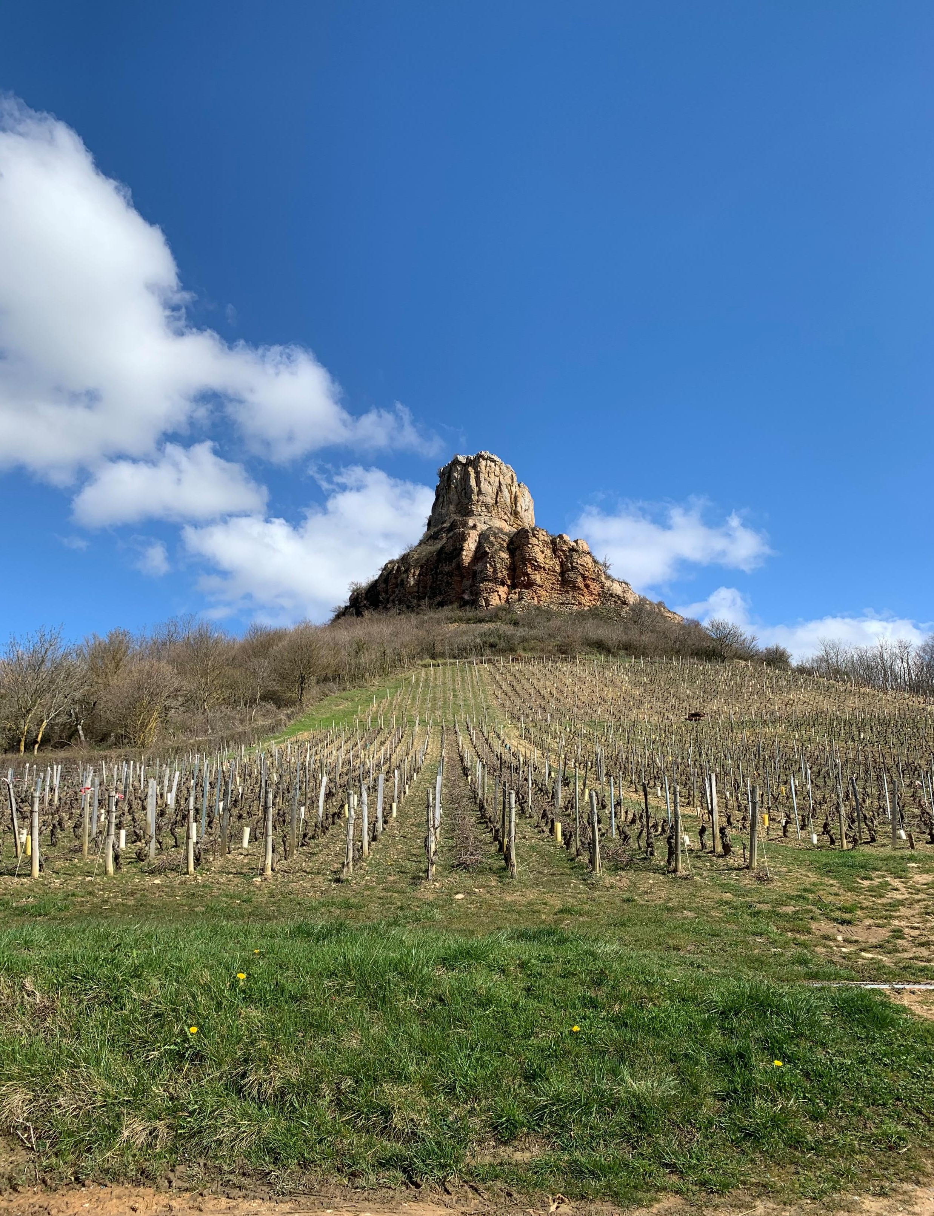
Take the High Road
Notes:
View from and of the Roche de Solutre in the Pouilly-Fuisse wine region of Burgundy – thirty-minute hike – at some point, you’re going to get PO’d at your city – you’re now their worst enemy – a fully educated critic who understands government – don’t be that former employee, you spent 20+ years being an advocate – continue to do so and keep the criticism to yourself

Slide 15
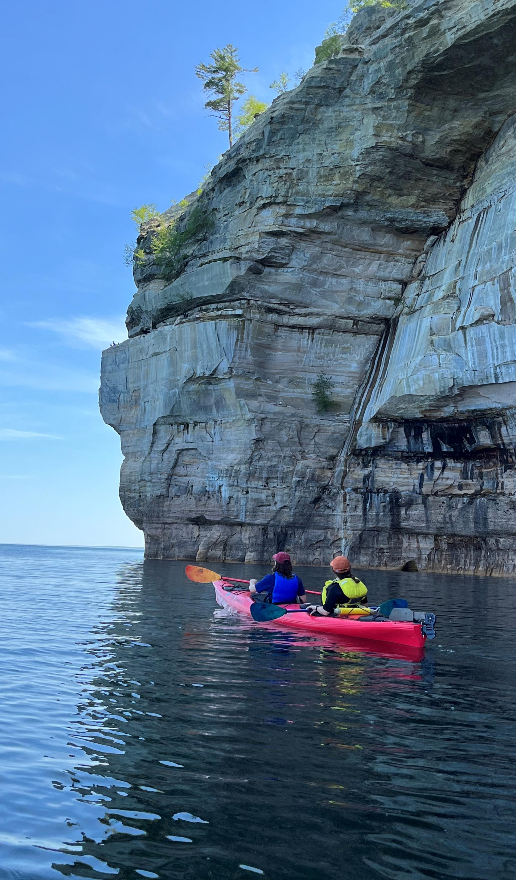
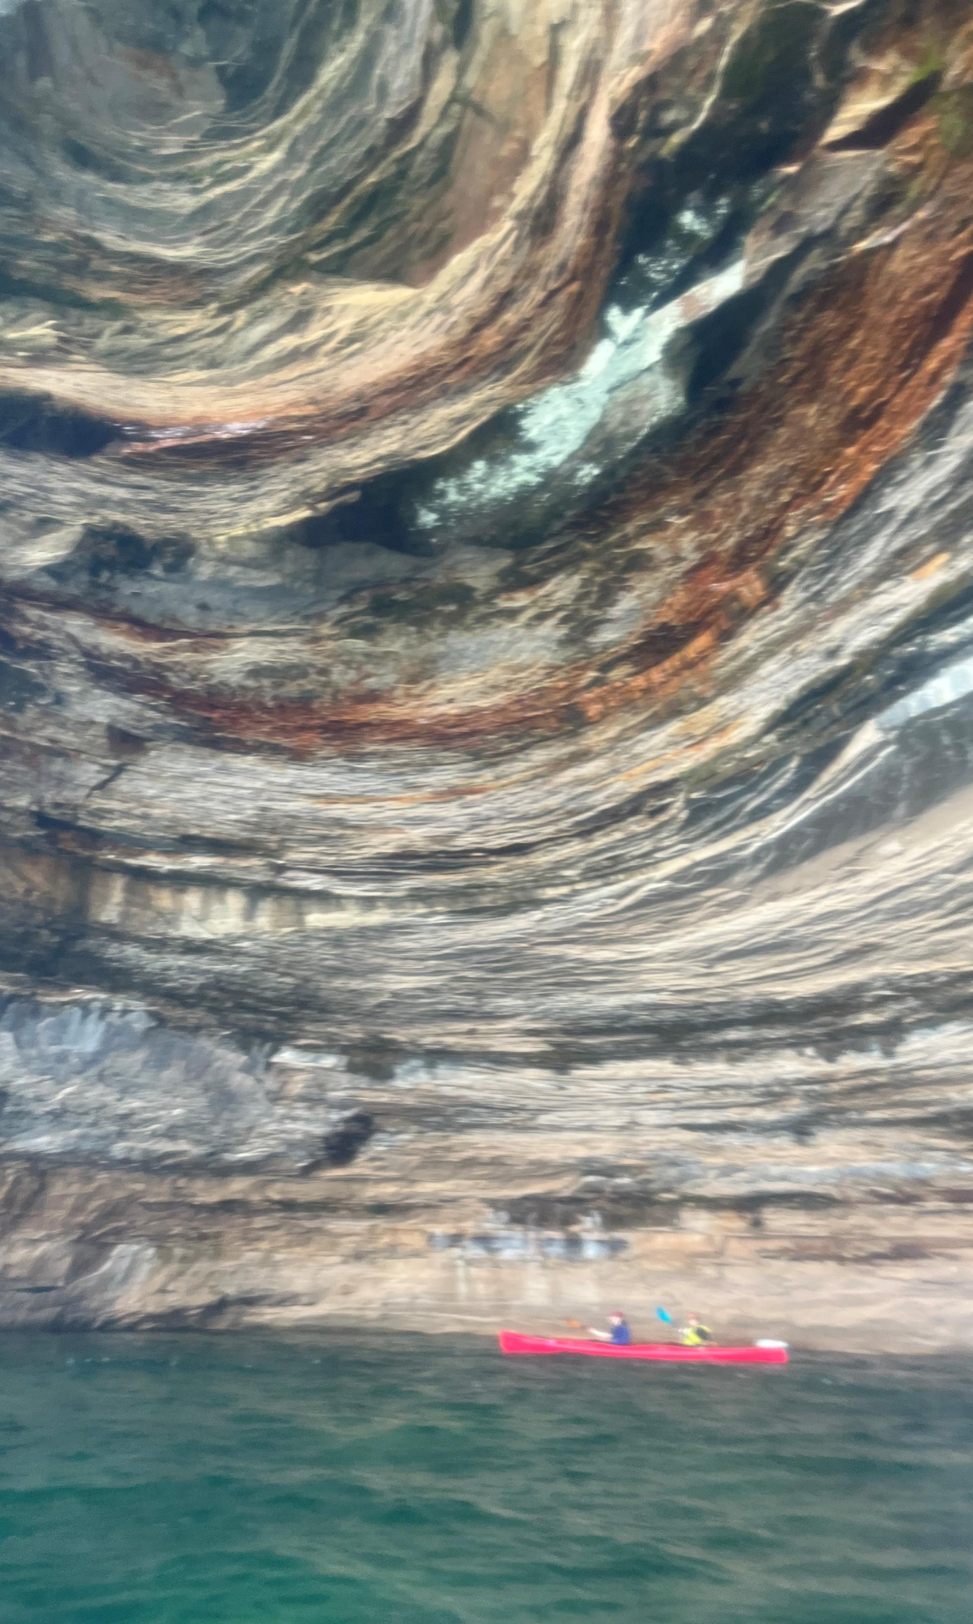
Circling Back
Notes:
Pictured Rocks National Seashore, Lake Michigan – you may need cash or you’re bored – take time to understand options – lot goes into working as a consultant (marketing, insurance, licensing, taxes) – the higher paycheck is eroded by unbillable activities and extra costs you have, need to stay relevant and you’re now paying for training yourself – do it because you want to, not because you think the grass is greener – typical year while full-time = 10 late nights and 8 nights of overnight travel – first year as a consultant (starting mid-May) = 36 nights overnight + 15 more contracted + initial 8 for total of 59 nights away (although wife came for 7 of them); Silver and Gold status at a hotel doesn’t make the bed any more comfortable

Slide 16
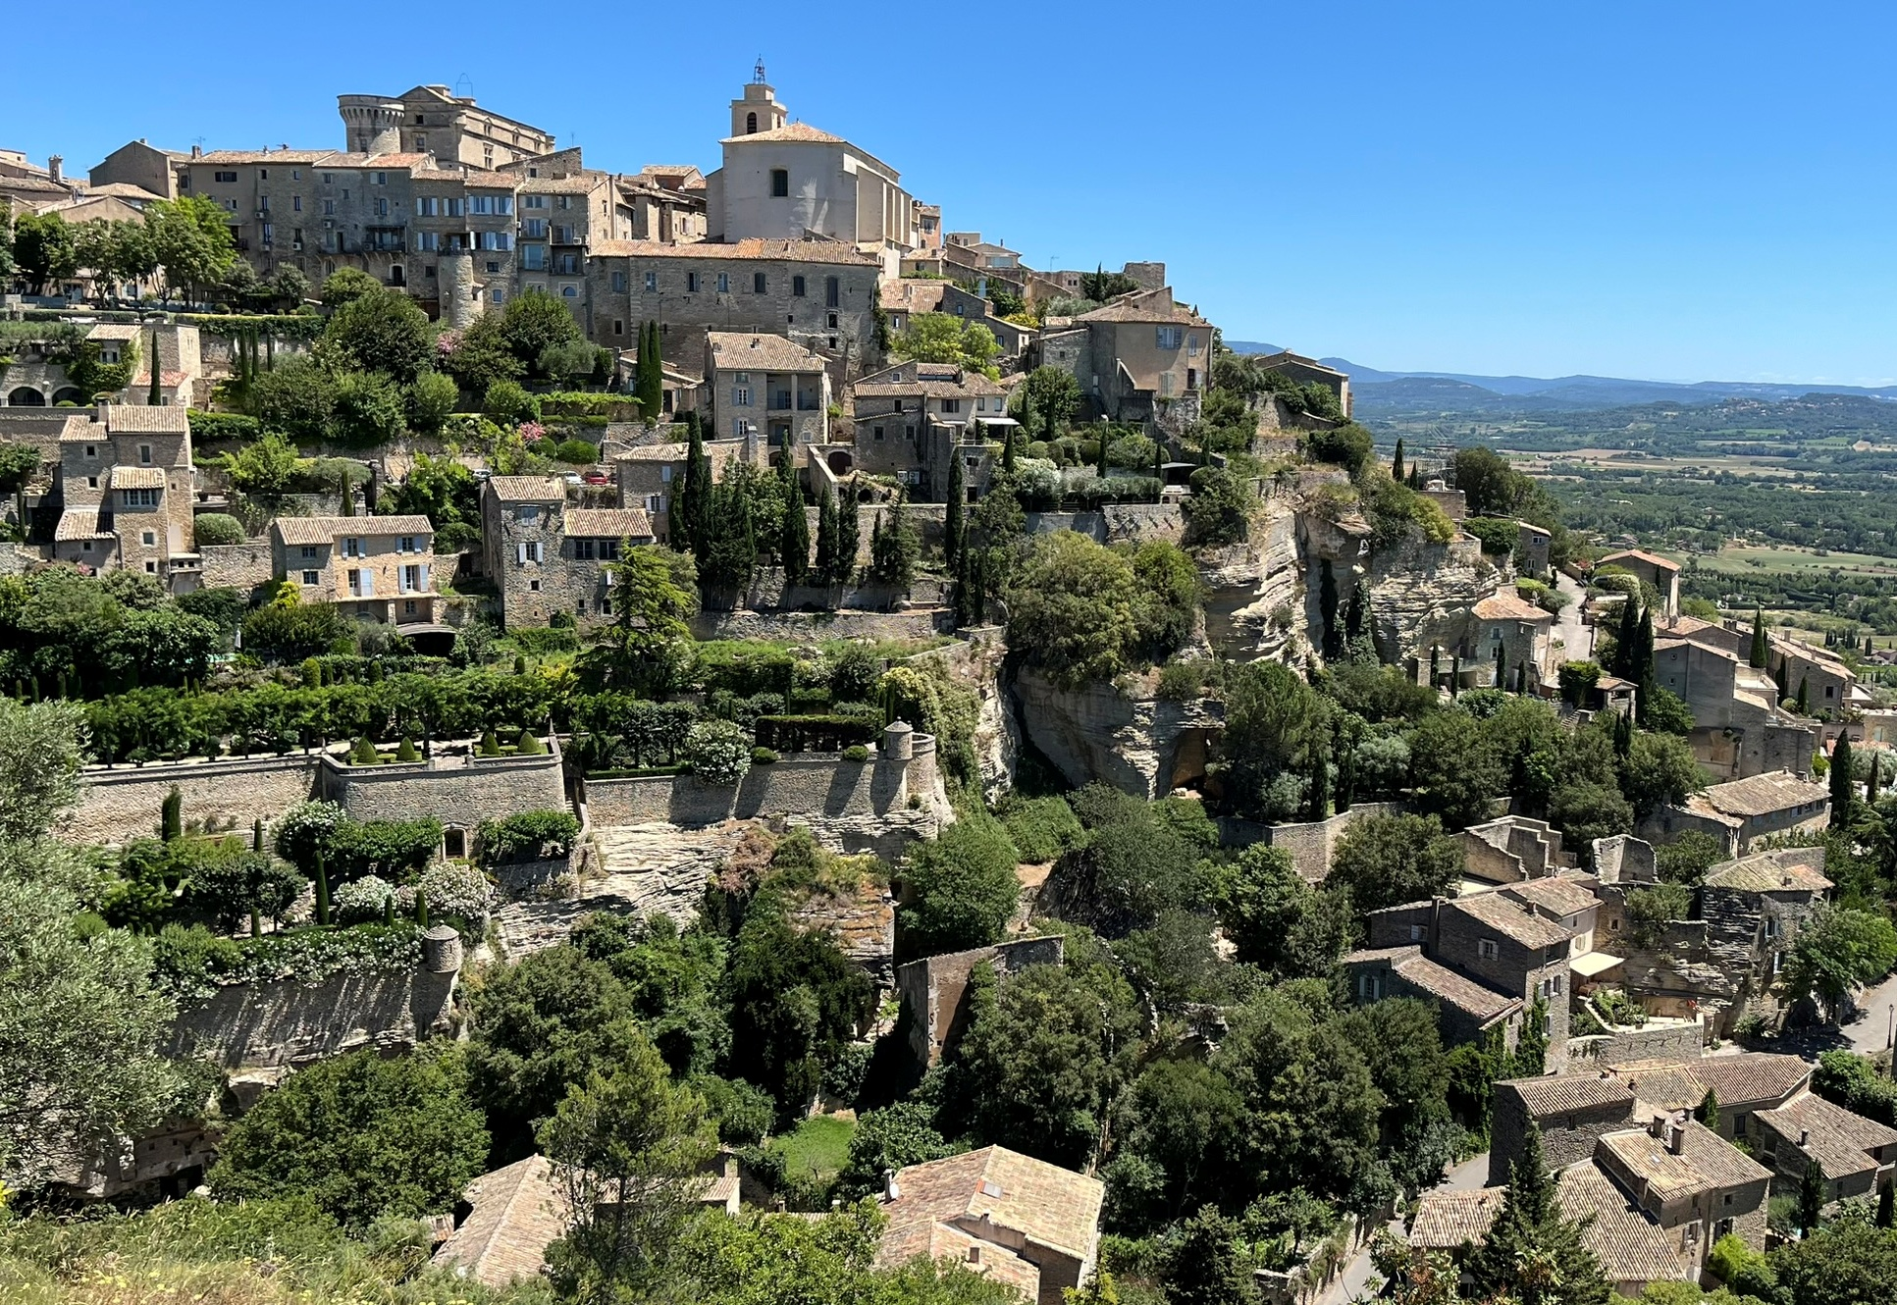
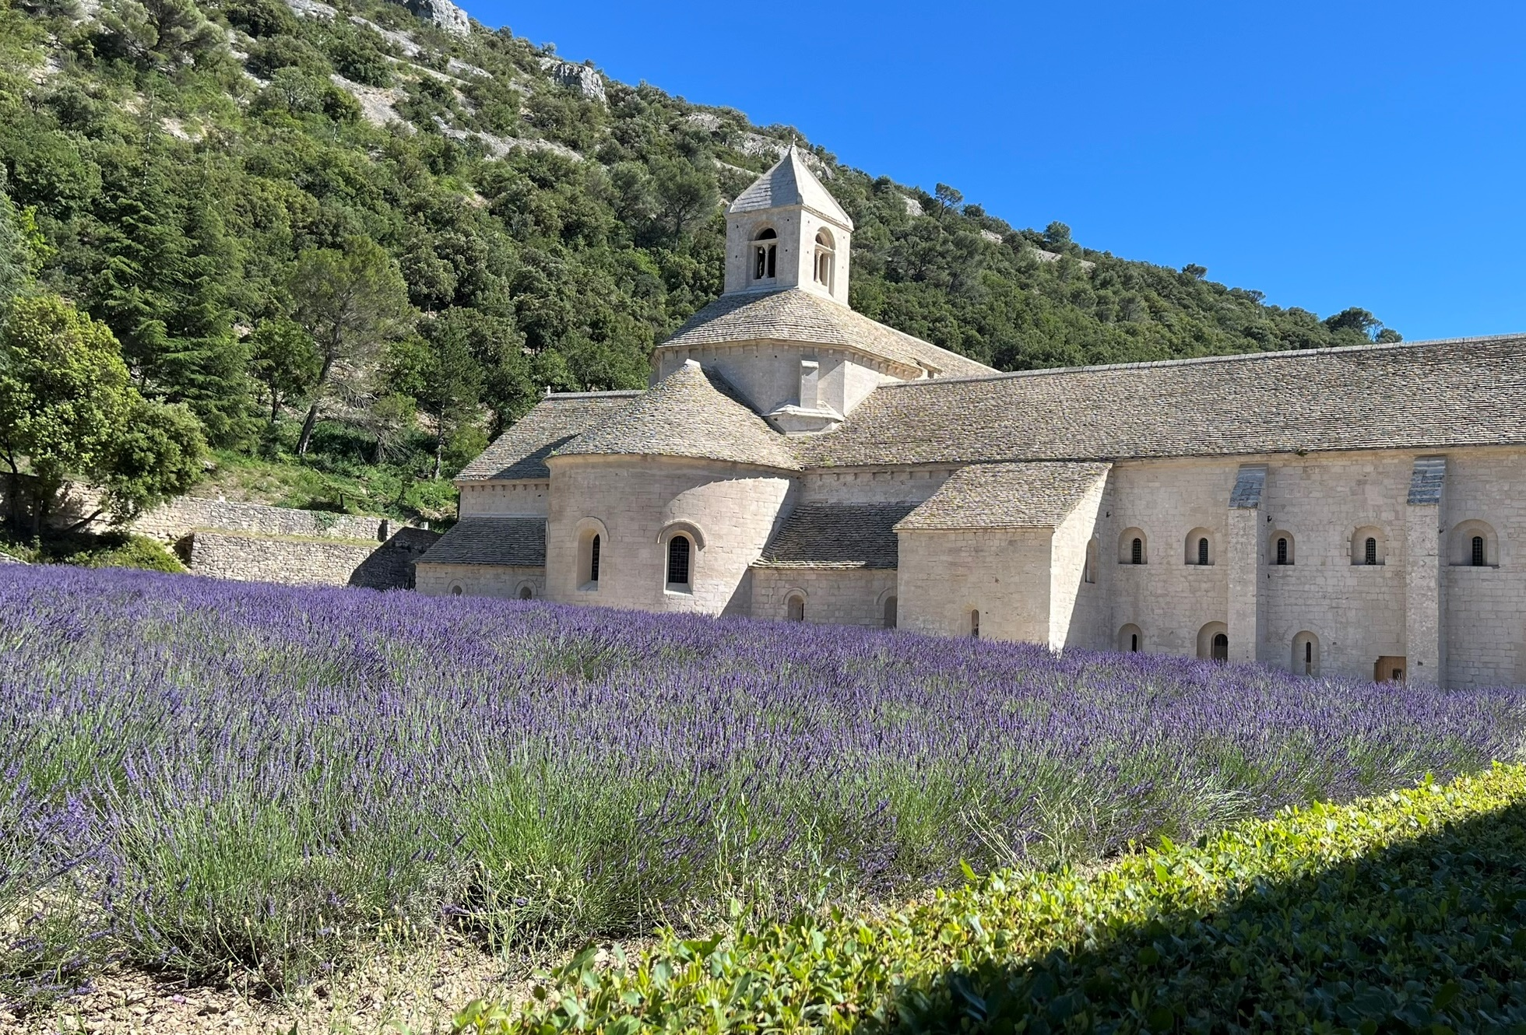
Achieve Your Dream! Questions
Notes:
Gordes, France in the Provence and the Abbaye Senanque nearby

