Slide 1
Legislative Update
2025 GFOAT Spring Conference

Slide 2
TML Legislative Team
Bennett Sandlin, Executive Director – bennett@tml.org
Monty Wynn, Director of Grassroots and Legislative Services – monty@tml.org
JJ Rocha, Grassroots and Legislative Services Manager – jj@tml.org
Bill Longley, General Counsel – bill@tml.org
Mike Martin, Legislative Counsel – michael@tml.org
(And the entire TML Legal Department)

Slide 3
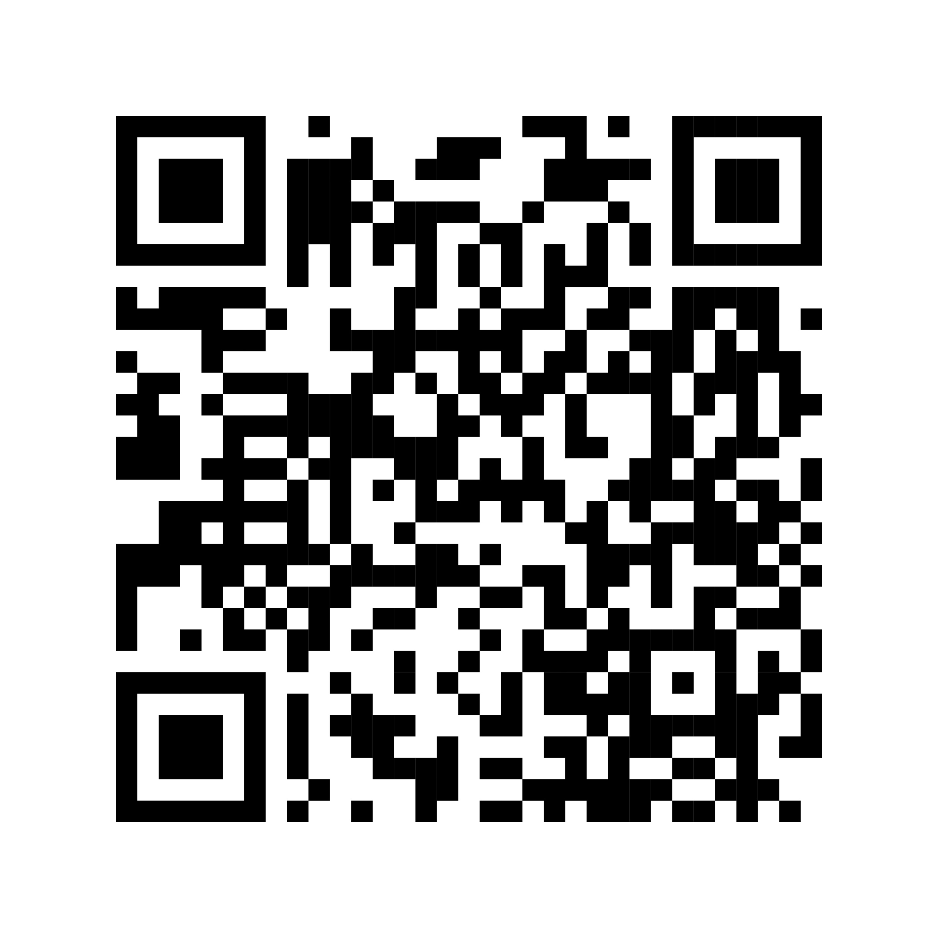
Get Engaged
Now is the time to communicate with your senator and representative about issues important to your city!
TML Resources:
TML Legislative Update
Weekly-Updated City-Related Bill Summaries
TML Legislative Toolkit
Grassroots Involvement Program

Slide 4
89th Legislative Session

Slide 5
Governor’s Priorities
Property Tax Relief – Tax and Debt Elections
School Choice
Teacher Pay
Water Investments
Expanding Career and Technology Training
Bail Reform
Texas Cyber Command

Slide 6
Lt. Governor’s Priorities
S.B. 2 – Education Savings Accounts (Passed the Senate)
S.B. 4 – Increasing the homestead exemption to $140,000 (Passed the Senate)
S.B. 7 – Increasing investments in Texas water supply (Passed the Senate)
S.B. 8 – Requiring local law enforcement to assist federal deportation efforts (Passed the Senate)
S.B. 15 – Removing barriers to affordable housing (Passed the Senate)
S.B. 19 – Stopping taxpayer dollars for lobbyists (Passed the Senate)

Slide 7
TML Priorities
Seek introduction and passage of legislation that:
Increases street maintenance sales tax flexibility
H.B. 884 (C. Hernandez)/S.B. 178 (Menendez)/S.B. 1277 (Parker); S.B. 1277 reported from Senate Local Government
Allows cities alternate methods for publications of legal notices
H.B. 1028 (Shaheen)/S.B. 1508 (Hagenbuch)/ S.B 1062 (Kolkhorst)/H.B. 1080 (Curry)
Increases the competitive bidding threshold to account for increased costs to cities
S.B. 1173 (Perry); reported from Senate Local Government
Creates new law enforcement grant programs or expands current law enforcement grant programs
H.B. 2217 (Wharton)/S.B. 1788 (Hagenbuch) /H.B. 3577 (Little)/H.B. 4264 (Hefner)

Slide 8
Community Advocacy
No Public Funds for Lobbyists or State Nonprofit Associations (Association Exception)
S.B. 19 (Middleton) – Political subdivision may not spend public funds to hire lobbyist, but exception for nonprofit state associations; passed the Senate.
No Public Funds or Other Compensation to Directly or Indirectly Influence Legislation
S.B. 1695 (Hall) – Governing bodies of cities and counties may not spend public funds or provide any other compensation to directly or indirectly influence legislation, but exceptions for providing information to legislators, elected official advocacy, and actions that don’t require registering as a lobbyist

Slide 9
Property Taxes
Property Taxes
H.B. 9 (Meyer) – $250,000 exemption for appraised value of business personal property; passed the House
S.B. 32 (Bettencourt) – $25,000 exemption for appraised value of business personal property; reported from Senate Local Government
H.B. 5490 (Troxclair) – All debt and property tax elections to November; 2/3 of voters needed to pass GO bonds; 2/3 of voters to approve tax rate exceeding voter-approval rate
S.B. 1025 (Bettencourt) – any ballot that increases taxes must say “THIS IS A TAX INCREASE”; passed Senate
S.B. 2478 (Bettencourt) – 75% of council must approve GO bonds; 75% of council must approve tax rate exceeding no-new-revenue rate
S.B. 3026 (Bettencourt)– Prevents a city from backing new property value out of no-new-revenue rate, takes out 3.5% multiplier, does away with de minimis rate for cities under 30,000, eliminates disaster allowances for property tax rate adoption

Slide 10
Sales Taxes
Sales Taxes
H.B. 134 (Meyer) – destination sourcing for intrastate sales taxes; reported from House Ways and Means

Slide 11
Debt
Debt
H.B. 19 (Meyer) – All bond elections to November; eliminates COs except under very limited circumstances; city cannot issue GO debt if the debt service would exceed 20 percent of total property tax collection for the preceding three years
S.B. 533 (Sparks) – All bond elections must be in November; passed Senate
H.B. 1453 (Tepper) – Prohibits use of COs for roads, administrative buildings, courthouses, airports, libraries, parks, and convention centers
S.B. 1024 (Bettencourt) – Five-year waiting period for COs and TANs after failed bond election; amount of TAN can’t exceed 5% of bonded indebtedness; passed Senate
S.B. 393 (Sparks) – Length of debt can’t exceed useful life of property financed; voted from Senate Local Government

Slide 12
Land Use – Density
Lot Size and Accessory Dwelling Units (ADUs)
S.B. 15 (Bettencourt) – Caps minimum lot size for greenfields and other zoning restrictions for small lots; bracketed to cities over 150K pop in counties over 300K. Passed Senate
S.B. 673 (Hughes) – Allows ADUs by right; reported from Senate Local Gov
Mixed-Use and Multifamily Residential Developments
S.B. 840 (Hughes) – Must allow mixed-use and multifamily developments and residential conversions in non-residential areas; bracketed to cities over 150K population in counties over 300K; passed the Senate.
S.B. 854 (Middleton)/H.B. 3172 (Gates) – Must allow mixed-use and multifamily developments on religious-owned land; SB 854 on Senate intent calendar
H.B 369 (Tepper)/H.B. 5514 (Schofield) – Limits multifamily developments in single-family zoning districts

Slide 13
Land Use – Zoning Changes, Protests, and Lawsuits
Zoning Changes
H.B. 2687 (Guillen) – Cities must send zoning change notices by certified mail and allows nearby property owners to petition for reconsideration for up to two years
S.B. 1160 (Campbell) – Expands zoning notice requirements to 1,500 feet
Zoning Protests
H.B. 1742 (Hickland) – Raises protest threshold to 50% and reduces supermajority requirement
S.B. 844 (Hughes)/H.B. 24 (Orr) – Raises protest threshold to 60% under certain circumstances; HB 24 reported from House Land and Resource
Zoning Challenge Lawsuits
S.B. 2215 (Campbell) – Challenges to city zoning authority or actions can only be enforced by mandamus or injunctive relief

Slide 14
Land Use – ETJ and Disannexation
ETJ
S.B. 1509 (Bettencourt) – No city regulations in the ETJ
S.B. 2522 (Bettencourt) – No subdivision regulations or more stringent utility regulations in ETJ
S.B. 2523 (Bettencourt) – S.B. 2038 ETJ release changes
H.B. 1901 (Cook)/H.B. 2024 (Turner)/H.B. 2512 (Geren) – S.B. 2038 fixes
ESD Annexations
S.B. 1503 (Bettencourt) – ESD can’t annex city territory without city consent
H.B 3897 (C. Bell)/S.B. 2965 (Creighton) – City can’t annex ESD territory if ESD finds that city can’t provide adequate services
Disannexation
H.B. 950 (Hayes) – Disannexation of annexed areas unless city provides full municipal services by 9/1/29
H.B. 2494 (Craddick)/S.B. 1844 (Paxton) – Disannexation of most city areas unless city provides full municipal services (no deadline)

Slide 15
Land Use - Planning
Impact Fees
H.B. 2225 (Buckley)/S.B. 1883 (Bettencourt) – Pre-notice requirements for impact fees, supermajority vote to approve impact fee, and a waiting period for increases; SB 1883 voted from Senate Local Government
Development Moratoria
H.B. 2559 (Patterson)/S.B. 1882 (Bettencourt)/H.B. 5489 (Dyson) – Limits or temporarily prohibits a city’s ability to adopt a development moratorium. HB 2559 reported from House LRM; SB 1882 reported from Senate Local Government Committee
Parking Minimums
H.B. 3275 (Richardson) – No city parking minimums for new commercial buildings
Housing Finance Corporations
H.B. 21 (Gates)/H.B. 2937 (Anchia)/H.B. 1585 (C. Bell) – HFC’s can’t exempt property outside jurisdiction; HB 1585 reported from House IGR

Slide 16
Land Use - Permitting
Third-Party Review
H.B. 23 (Harris)/S.B. 2354 (Creighton)/H.B. 4677 (Harris)/S.B. 1450 (Bettencourt) – Applicant may request third-party review of development documents or land improvements by a certified engineer or building inspector; HB 23 voted from House Land and Resource; SB 1450 reported from Senate Local Government
Building Materials
H.B. 3299 (Reynolds) – Building material regulation restriction no longer applies to commercial buildings
S.B. 783 (Menendez) – Building material regulation restriction no longer applies to certain energy codes and standards; on Senate intent calendar
HUD-Code Manufactured Homes
S.B. 785 (Flores)/H.B. 1835 (Guillen) – City must allow HUD-Code manufactured homes in residential zoning districts; SB 785 on Senate intent calendar.
Permitting After a Disaster
H.B. 1228 (Gates) – Landowner can immediately begin repairing buildings after disasters; reported from House Land and Resource Management

Slide 17
Land Use – Other
Short-Term Rentals
H.B. 2464 (Hefner) – Prohibits regulations on certain home-based businesses
H.B. 2767 (Landgraf) – Prohibits regulating online global marketplaces
Occupancy Limits
S.B. 1567 (Bettencourt)/H.B. 2797 (Vasut) – Prohibits home-rule cities from adopting occupancy limits based on the relationship between the occupants; S.B. 1567 reported from Senate Local Government
Non-conforming Uses
H.B. 2149 (Tepper) – Various procedural requirements added before a city can stop a non-conforming land use; voted from House Land and Resource Management

Slide 18
Super Preemption
H.B. 5042 (Hayes) – Adds Health and Safety Code to the list of “field occupancy” preemption codes; preempts cities on prohibiting elephants.
H.B. 5203 (C. Bell) – Adds Election Code and Penal Code to list of “field occupancy” preemption codes; allows AG to bring suit against city with significant penalties; moves jurisdiction over lawsuit directly to Texas Supreme Court
H.B. 5612 (C. Bell) – Adds subtitles of Local Government Code related to land use to list of “field occupancy” preemption codes; AG lawsuits with penalties; moves jurisdiction over lawsuit to Texas Supreme Court
H.B. 5266 (C. Bell) – Would allow AG to investigate and file suit against city for alleged violation of law

Slide 19
Public Safety
Immigration Enforcement
H.B. 2361 (Spiller)/H.B. 2390 (Kerwin) – Local law enforcement agencies must enter into agreement w/ICE to enforce state and federal immigration laws
Active Shooters
H.B. 33 (McLaughlin)/S.B.2862 (Flores) – Uvalde Strong bill requiring local active shooter planning and response oversight
Public Camping Ban
S.B. 241 (Flores) – Cities must enforce public camping bans; voted from Senate Local Government; on Senate intent calendar
Drones
H.B. 41 (Hefner) – City cannot acquire or use drones from certain foreign countries or companies located in certain foreign countries

Slide 20
Public Safety
E-Cigarettes
S.B. 464 (Campbell) – No sales of e-cigarettes or vaping products within 1,000 feet of a school, city can be stricter; on Senate intent calendar

Slide 21
Personnel
Civil Service
H.B. 1677 (Canales) – Requires meet and confer requirements for fire fighter disciplinary actions in non-civil service cities under 10,000
H.B. 2098 (A. Martinez) – Mandatory civil service in cities over 25,000
H.B. 2713 (Darby)/ S.B. 1331 (Hancock) – Cities over 70,000 may not repeal civil service after it has been in effect for at least one year
H.B. 3171 (Lujan)/S.B. 777 (Hughes) – Collective bargaining agreement or home rule charter provisions govern prevailing wage determinations and impasse process

Slide 22
Elections
Election Dates
S.B. 1209 (Hughes) – Eliminates May uniform election date; reported from Senate State Affairs
S.B. 1494 (Johnson) – City may change its May election date to November through 2026; on Senate intent calendar
Charter Amendments
S.B. 1059 (Parker) – City council can’t put an initiative or charter amendment on the ballot if applying the provision would be contrary to state law; on Senate intent calendar

Slide 23
Elections
Ballot Propositions
H.B. 524 (Tepper) – Home rule cities must submit proposed ballot initiatives to AG to review for compliance with state law before ordering election
H.B. 631 (Swanson) – Establishes mandatory ballot language, city or voter can ask SOS to review ballot language, and voter can file lawsuit challenging ballot language
S.B. 506 (Bettencourt) – Ballot proposition language must be clear, and voter may submit ballot proposition for SOS review
S.B. 1548 (Zaffirini) – Petition for home-rule city ballot initiative must be signed by five percent of the city’s qualified voters (removed or 20,000 qualified voter threshold)

Slide 24
Utilities
Water Infrastructure Funding
S.B. 7 (Perry) – Creates New Water Supply for Texas Fund for water infrastructure projects; on Senate intent calendar; passed the Senate
Telecommunications Line Relocation Costs
S.B. 2015 (Bettencourt)/H.B. 4272 (Patterson) – City may require that a telecommunications company relocate lines due to a city road project, but relocation will be at city’s expense
Utility / Franchise Revenue
H.B. 4972 (Cain) – Prohibit transferring city-owned utility revenue to general fund
S.B. 924 (Hancock) – No franchise fees on streaming services; passed Senate.
Residential Energy Backup Regulation
S.B. 1252 (Schwertner)/H.B. 3493 (King) – Prohibit a city, but not an MOU, from adopting or enforcing an amendment to local electrical code regulating or requiring city inspection of backup energy systems; SB 1252 passed Senate
S.B. 1202 (King) – 3rd party inspection of energy backup systems; passed Senate.

Slide 25
Open Government
Open Meetings Act
H.B. 1522 (Gerdes) – Governmental bodies must provide three business days notice for all public meetings and budget meeting notice must include physical copy of budget; on House Calendar 4/8
H.B. 3850 (Canales) – Governmental bodies must allow public to address the body on items not on the agenda before/during the agenda discussion; can limit to five people
S.B. 2485 (Bettencourt) – would require every governmental body to broadcast each open meeting on the governing body’s website
S.B. 2424 (Hall) – Lt. Governor or member of legislature can attend closed session of meeting of governmental body upon request
Public Information Act
H.B. 111 (Capriglione) – would subject organizations receiving 51 percent of revenue from public funds to PIA; would limit attorney-client exception to disclosure
S.B. 824 (Middleton)/S.B. 852 (Middleton)/S.B. 919 (Zaffirini) – Omnibus PIA bills – (shortens some deadlines, in some cases, governing body must complete PIA training) S.B. 986 (Bettencourt) – Bad faith AG request penalty, expedited response program
H.B. 675 (Vasut)/H.B. 2248 (Smithee) – Limits charges that can be imposed under PIA; H.B. 675 on House Calendar 4/8

Slide 26
City Administration
Must Allow Licensed Carry in City Leases
H.B. 1715 (Cain)/S.B. 1065 (Hall) – Must include language allowing licensed carry in leases of city-owned property
Preempting Local Food and Agriculture Regulations
S.B. 1008 (Middleton) – Preempts local food service, health and sound regulations; reported from Senate Bus and Commerce
H.B. 2844 (Landgraf)/H.B. 2683 (Harrison) – Preempts local food truck regulations
H.B. 1964 (Spiller) / S.B. 1035 (Sparks) – Injunctive and declaratory relief for last session’s agriculture preemption bill HB 2380; HB 1964 reported from House Ag and Livestock; SB 1035 on Sente intent calendar
City Finance and Economic Development
H.B. 5267 (C. Bell) – Expenditure limit on all cities, city can only exceed with election
S.B. 1851 (Nichols) – Subject to no-new-revenue rate for not conducting annual audit
S.B. 878 (Birdwell) – 380 incentive agreement reforms; passed the Senate

Slide 27
City Administration
Enforcing State Drug Laws
S.B. 1870 (Perry)/H.B. 5082 (Leach) – Cities and counties may not hold an election on a charter provision prohibiting or limiting enforcement of state drug laws, or adopt a similar local ordinance or policy
Road Contractor Liability
S.B. 2823 (Bettencourt) – Contractor who designs, installs, constructs, repairs or maintains a highway, road, street, or related traffic management devices for local government is not liable for harm if contractor’s performance materially complied with relevant contract documents
Severance Pay
H.B. 762 (Leach)/S.B. 2237 (Bettencourt) – Cap severance pay for city employees at 20 weeks’ pay; SB 2237 voted from Senate Local Government
Nuisance/Environmental Lawsuits
S.B. 779 (Middleton) – Preempts many city common law nuisance lawsuits

Slide 28
City Administration
City Audit
S.B. 1851 (Nichols) – Audit late by more than 6 months results in tax rate no greater than no new revenue rate; voted from Senate Local Government

Slide 29
Questions?

