Slide 1
The Bermuda Triangle of Budgeting
Steering Clear of Budget Games

Slide 2
Insert sherrif start

Slide 3
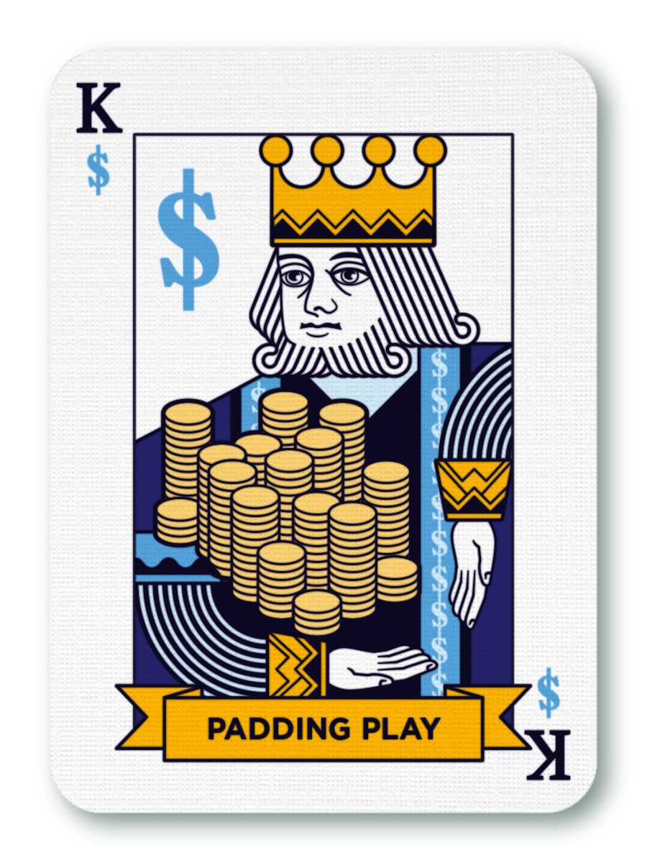
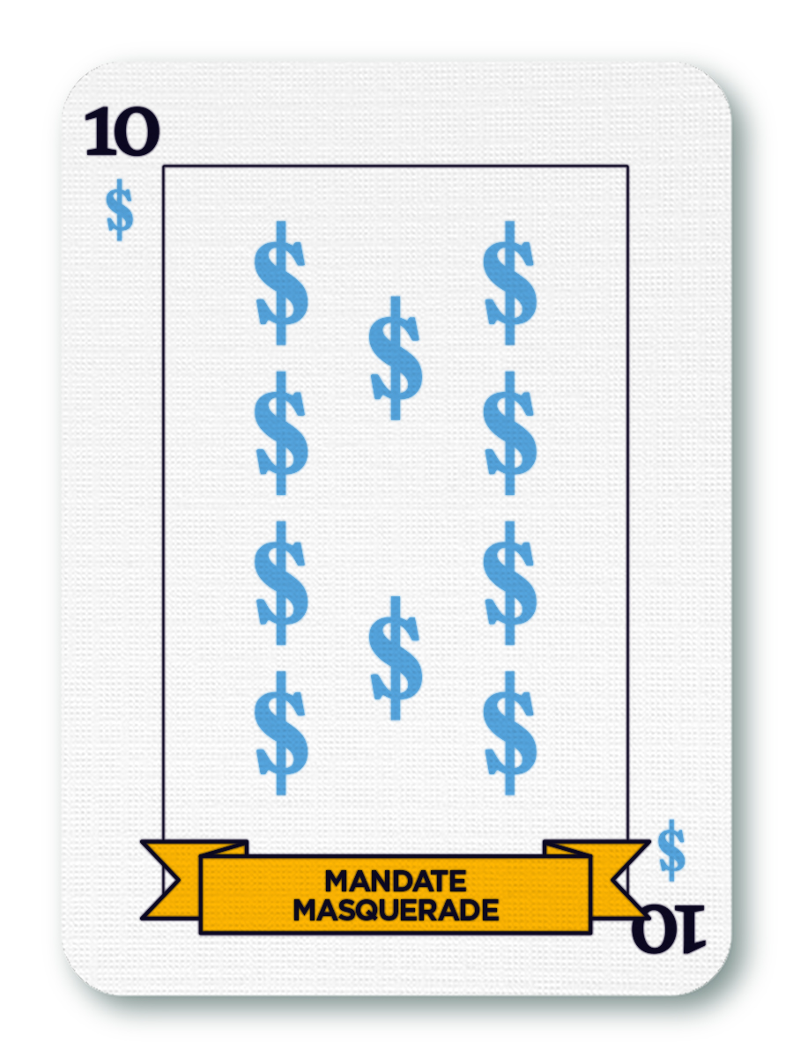
The Padding Play and the Mandate Masquerade

Slide 4
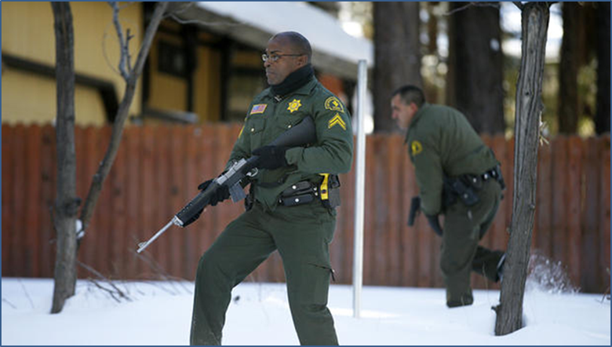
Ending the Games in the Sheriff’s Office
Pool the Risk
Solve Future Problem
Notes:
Some local government revenues have legal restrictions on how those funds can be used. A department might seek to protect some funds by exaggerating the degree to which those funds are restricted. San Bernardino County’s Sheriff was also familiar with this tactic. As part of the effort to reduce spending across the county, the sheriff’s restricted funds came into question. Rather than attempt to confiscate the funds (and thereby send the message to the sheriff that he would need to get better at playing the budget game), the CEO worked with the sheriff to divert these funds toward funding the sheriff department’s substantial accrued time-off liability. Whenever a Sheriff employee separated, the sheriff had to pay out accrued leave and then hold the position open for a while (sometime months) to make up the cost of the payout. This resulted in lesser service to the public and increased overtime costs. The solution was not to take the funding away but to direct it to a purpose that benefited both the sheriff (better staff coverage) and the county (reduced liabilities, lower overtime costs).

Slide 5
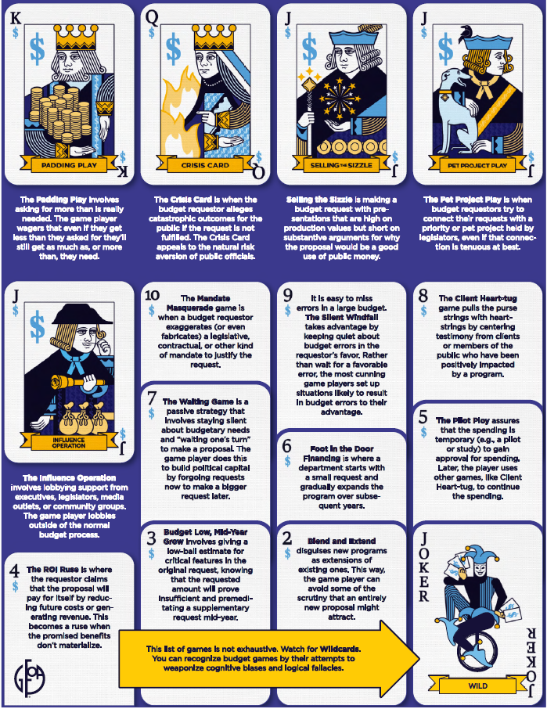
WHAT TODAY’S SESSION WILL COVER
Defining budget gameplay and why it occurs in local government budgeting
Describe the types of gameplay tactics departments use in budgeting
Playing defense

Slide 6
DEFINING BUDGET GAMEMANSHIP
Departments using non-technical strategies to acquire more resources

Slide 7
Why We Should be Concerned About Budget Games

Slide 8
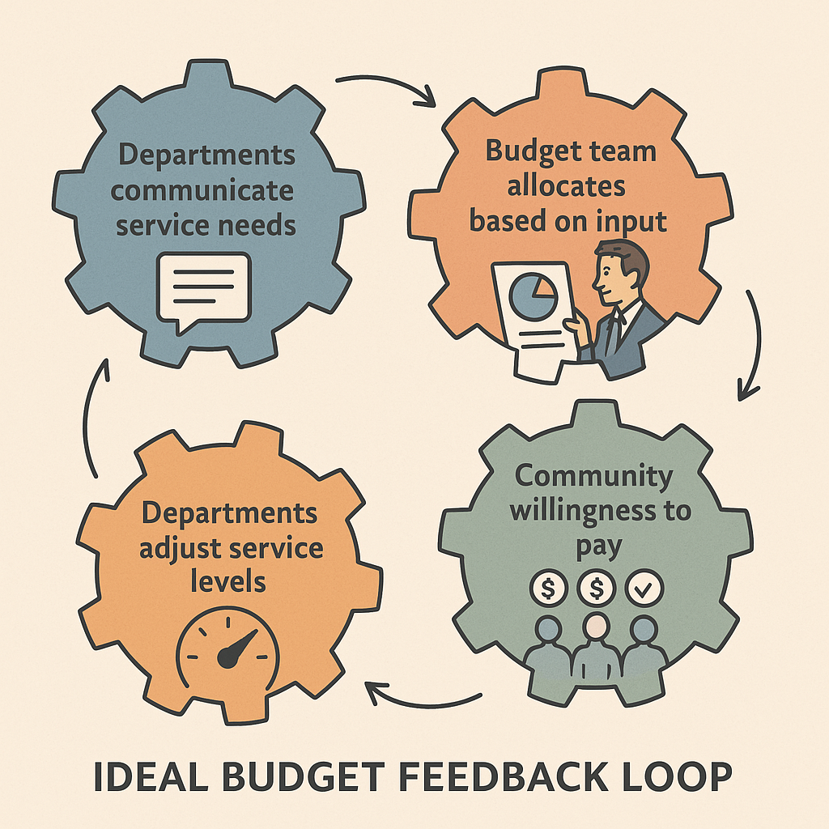
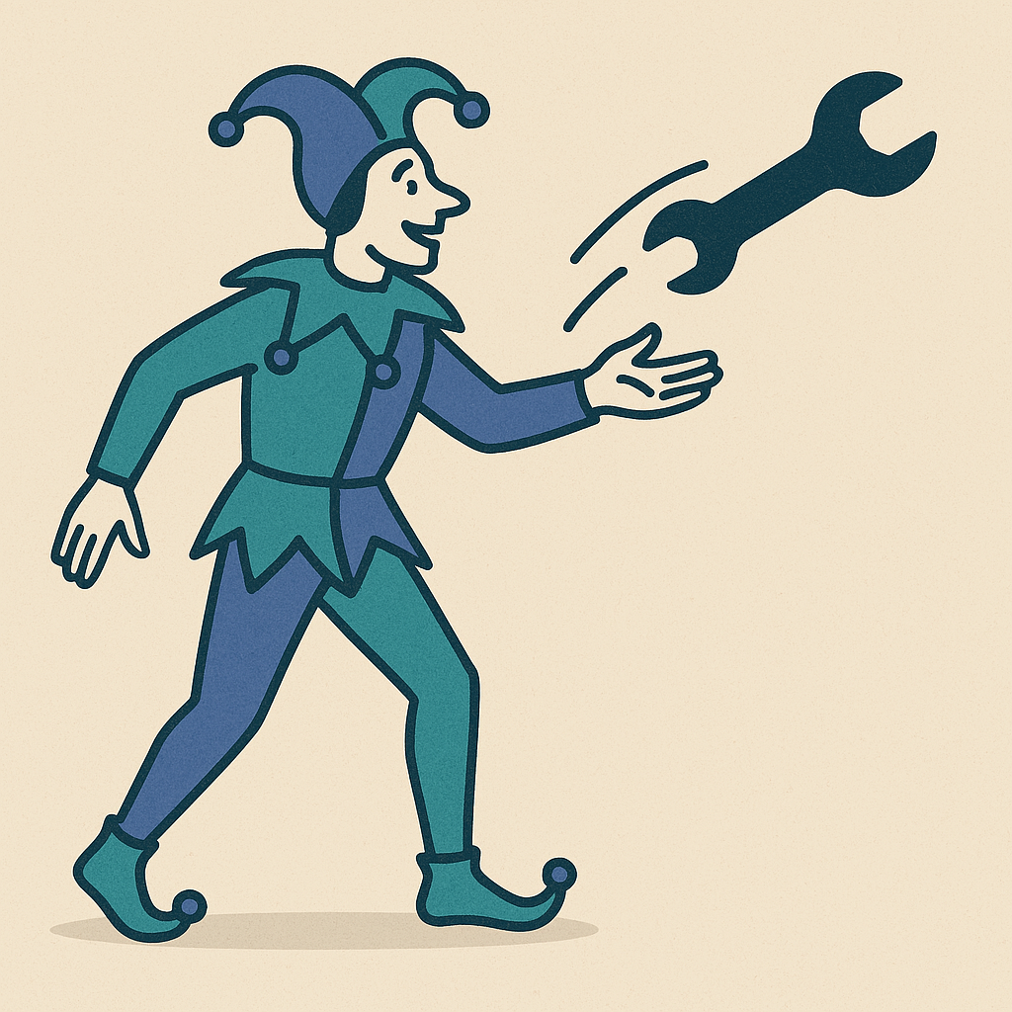
Notes:
First, budget officers need good information to make savvy and wise budget decisions. The better Budget officers need good information to make savvy and wise budget decisions. The better the information, the better the chances of good decisions. However, budget games can distort or hide information. the information, the better the chances of good decisions. However, budget games can distort or hide information. Central budget authorities must read between the lines, recognize the “tells”, and call bluffs to uncover the players’ true intentions and resource needs. Thus, gamesmanship degrades the feedback loop between budget requestors and budget authorizers. High-quality feedback loops are essential for an effective system. Ideally, departments communicate an accurate picture of their needs to central authorities who then use this information to determine the best tax and spending portfolio for the community. If the community is not willing to pay the taxes to support the proposed service levels, departments can adjust and provide an affordable level of servic

Slide 9
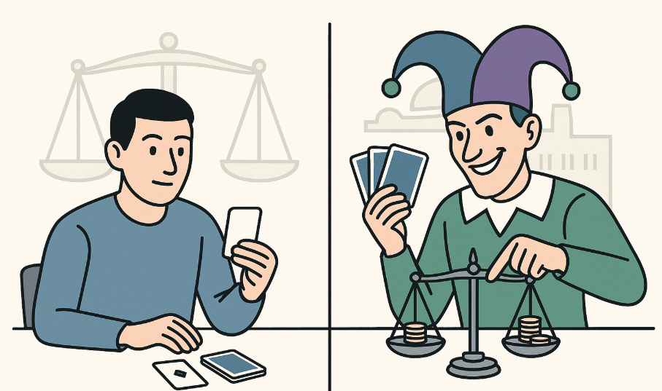
Notes:
A budget process expects participants to provide their best estimate of the funds they need to provide a service and to use public funds in ways that benefit taxpayers the most. However, budget games aim to get more money than needed, avoiding the scrutiny that separates the important requests from the less important ones. This means resources are allocated based on how clever and bold the players are rather than on what would benefit the community the most. In this case, budget success favors those who play the games with the greatest skill—the card sharks of the budget process—instead of those who follow the rules and provide honest estimates. Thus, gamesmanship detracts from the budget process’s reputation of fairness. A sense of fairness is essential to encourage all budget participants to give their best effort during the process and afterward to implement the budget, even if they fail to get what they wanted.

Slide 10
Notes:
Second, effective gamesmanship requires bending if not breaking the rules of the budget process. A budget process expects participants to provide their best estimate of the funds they need to provide a service and to use public funds in ways that benefit taxpayers the most. However, budget games aim to get more money than needed, avoiding the scrutiny that separates the important requests from the less important ones. This means resources are allocated based on how clever and bold the players are rather than on what would benefit the community the most. In this case, budget success favors those who play the games with the greatest skill—the card sharks of the budget process—instead of those who follow the rules and provide honest estimates. The most successful game players are those most effective at subverting the rules. Thus, gamesmanship detracts from the budget process’s reputation of fairness. A sense of fairness is essential to encourage all budget participants to give their best effort during the process and afterward to implement the budget, even if they fail to get what they wanted.

Slide 11
Why Budget Games are Played

Slide 12
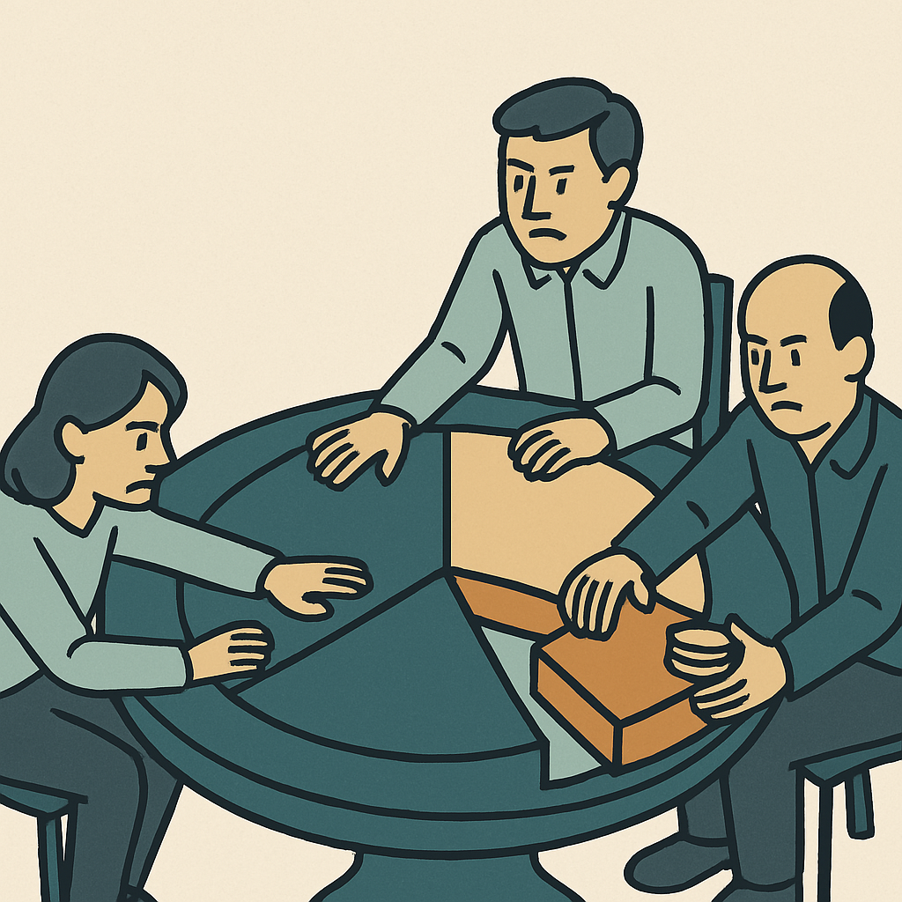
Desire to Solve Public Problem
Zero Sum Competition
Empire
Building
Notes:
The most obvious reason is that budgeting takes place in an environment of scarce resources. This can lead to zero-sum competition, where budget participants are pitted against each other in a battle for resources. For example, allocating funding to one player often means less funding for another who may not have played the game as skillfully. Unfunded mandates, legal restrictions, and legislative priorities all can reinforce feelings of scarcity, leading to increased competition among players to get their share of the pie.
Another reason is that budget requestors have motivations that encourage gamesmanship. A laudable motivation is the desire to solve a public service problem. For example, department officials may see their role as providing the best service possible within their department, such as expanding a service to more people or improving its quality or quantity. That requires more resources. Thus, the end goal of providing the best service to the public is justified by the means of gamesmanship.

Slide 13
THE LIKELY PLACE WHERE GAMES EXIST

Slide 15
What are the Budget Games?

Slide 16
King – The Padding Play
Padding Play – Asking for more than you really need
Similar to Highball Pricing in negotiations – Set the price high knowing you are willing to settle for less
Uses anchoring bias
High success rate and widespread use; very common for governments to have material amount of padding in operating budget
Notes:
The Padding Play is crowned King because of its high success rate and widespread use. It is common for government departments to have non-trivial amounts of padding in their budget. This is seen when departments rush to spend all their remaining budget at the end of the year. T

Slide 17
King – The Padding Play
Padding Play motivated by perception of risk
Insurance against unplanned and unavoidable costs
Budgeting for contingencies
Also a hedge against poor budget planning
Buys time to ‘figure it out later’
Can create a perception of savings/thriftiness but ultimately results in potentially significant opportunity cost

Slide 18
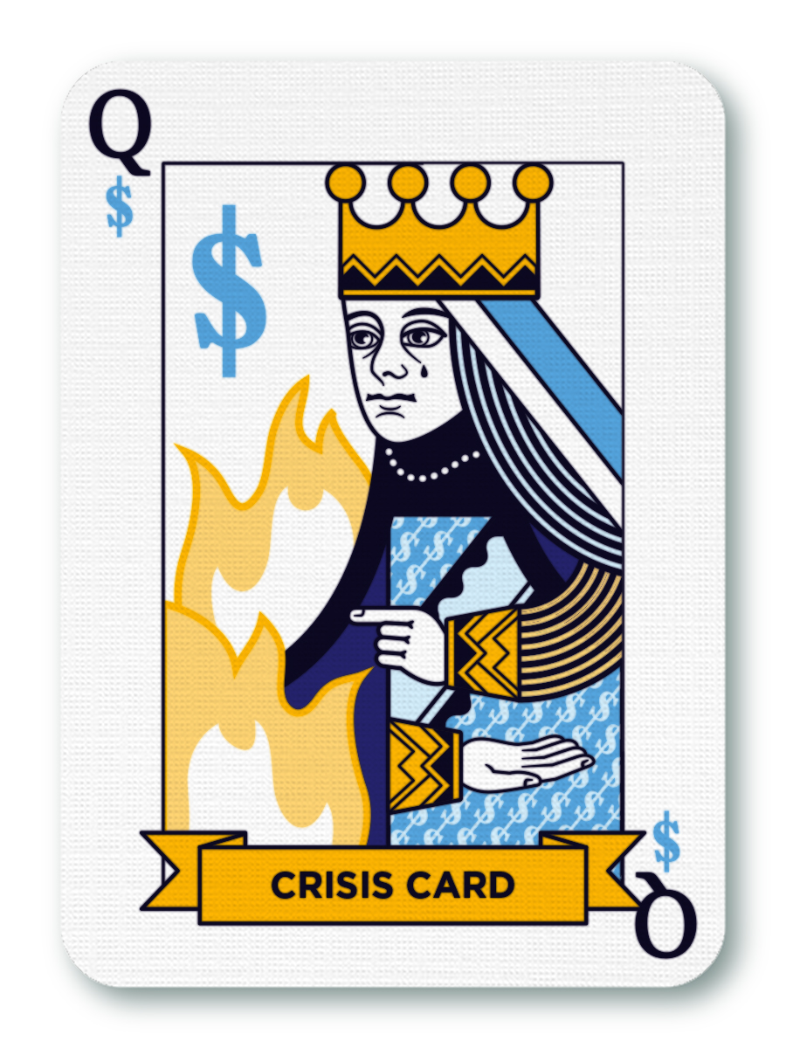
Queen – The Crisis Card
Claim of catastrophic outcomes to the public if the request is not fulfilled
Blood will run in the streets!
Appeals to risk aversion of public officials; don’t want to be responsible for predicted outcome
Takes advantage narrow framing
Effective game that plays on fear

Slide 19
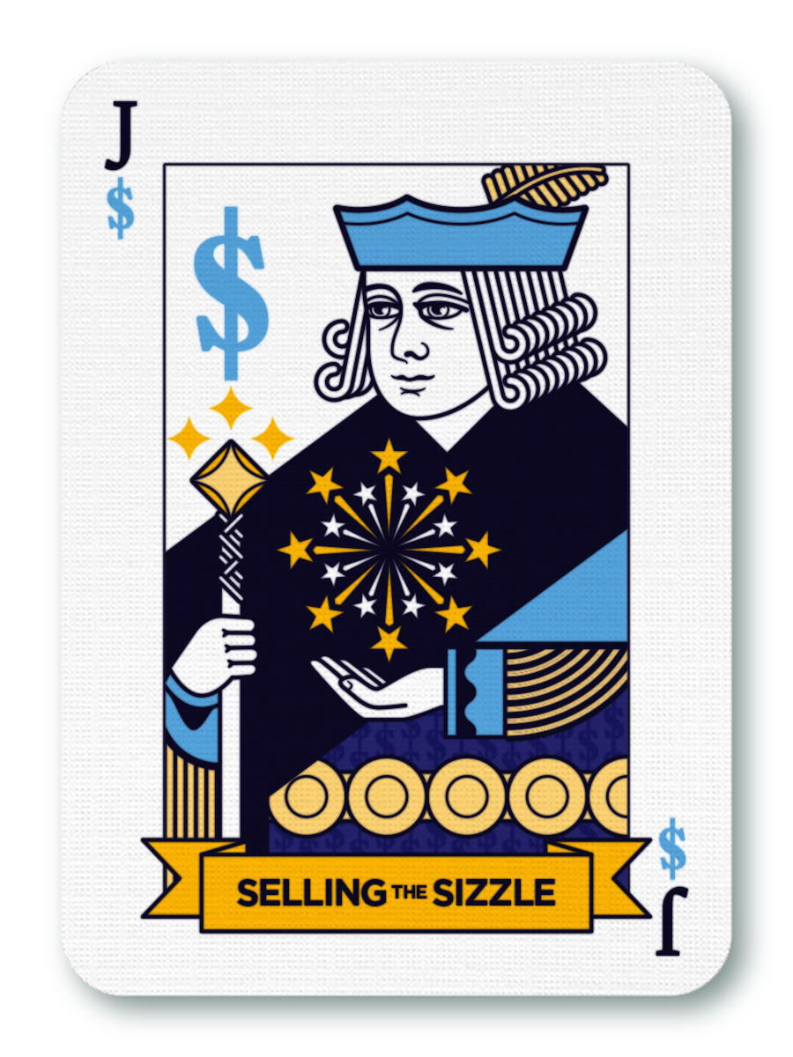
Jacks – Selling the Sizzle
Budget requests long on flash but short on substance
Using production quality to mask lack of value
Fine line between a well-reasoned budget argument and flashy presentation
Often relies on reasoning from anecdote
Using a single example to imply a broader conclusion
Expensive traffic engineering solutions due to an accident based on human error

Slide 20
Jacks – Selling the Sizzle
Technobabble
Jargon or technical language to impress audience and imply sophistication
Overconfidence in outcomes
Overstating outcomes of the proposal or downplaying uncertainty
Selective data presentation
Present data in support, ignore data against – confirmation bias

Slide 21
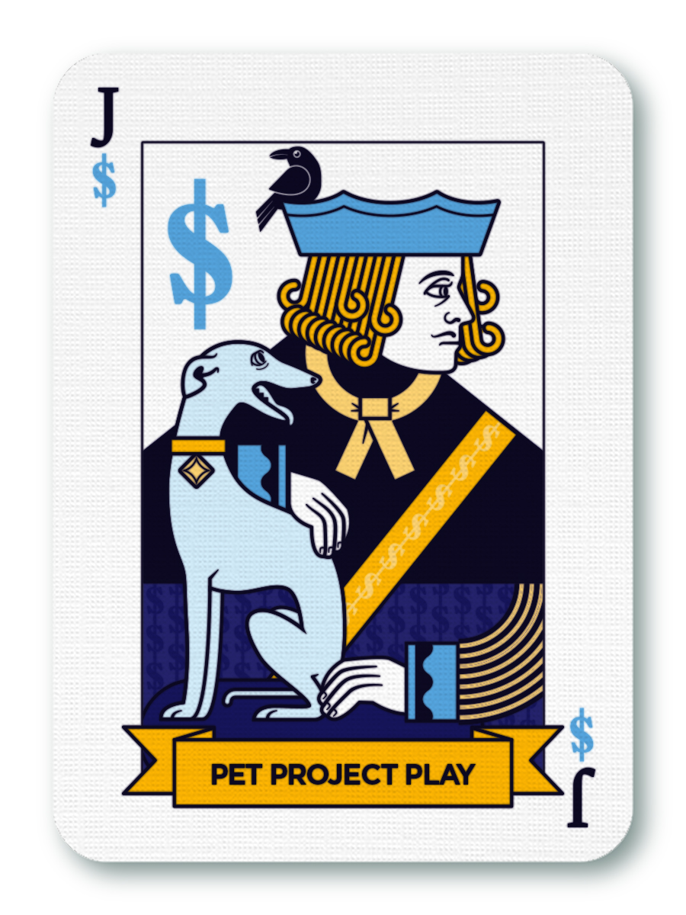
Jacks – Pet Project Play
Linking a budget request to a priority of elected officials
Relies on the halo effect
Easy to attempt when legislative budget has broad policy objectives

Slide 22
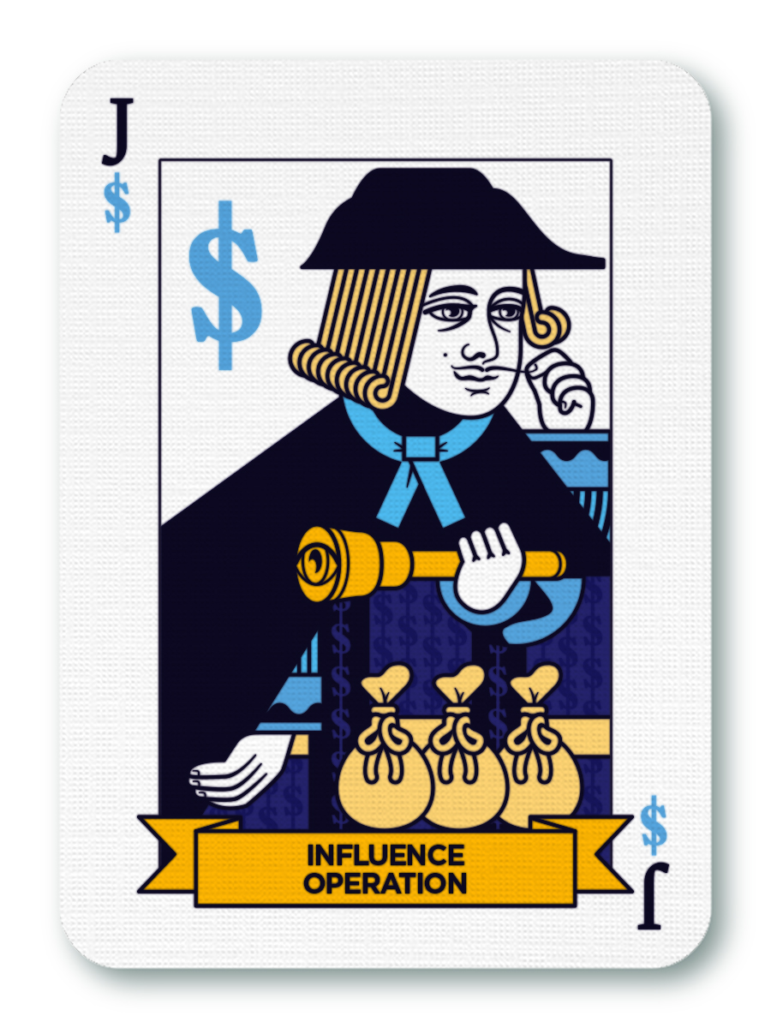
Jacks – Influence Operation
Lobbying for support for budget requests from legislators, community, executives, media
Going outside the process!
Not always staff driven; often comes from outside stakeholders

Slide 23
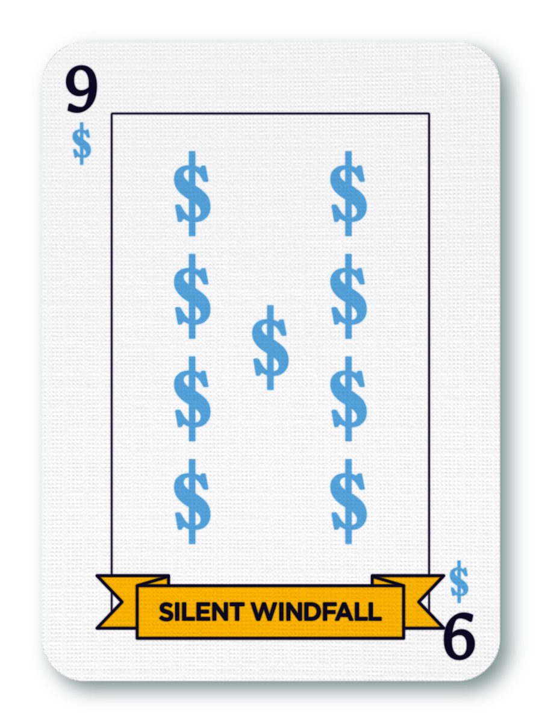
The Other Cards
Mandate Masquerade
Exaggeration or fabrication of a mandate
Appeal to authority fallacy
Especially susceptible in local government setting
Silent Windfall
Keeping silent about budget errors that work in the favor of the requestor

Slide 24
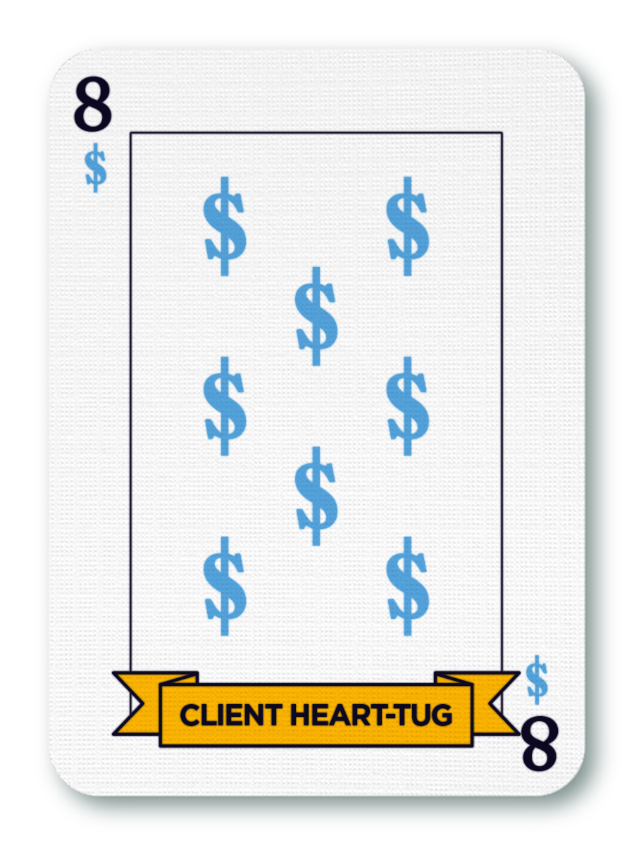
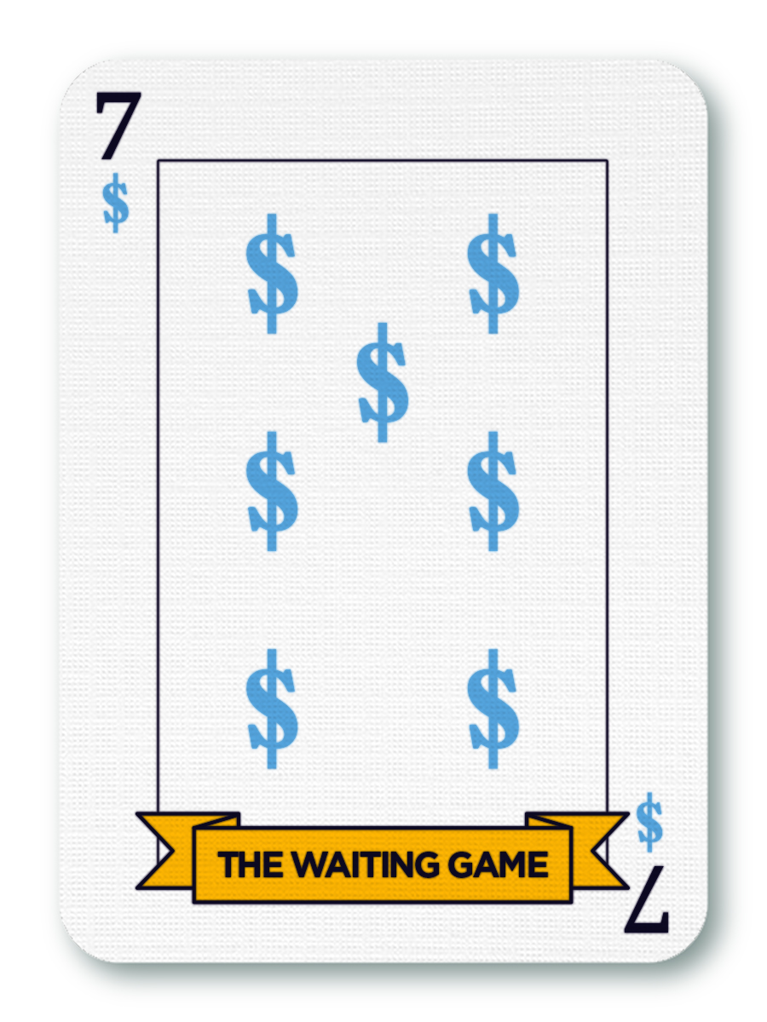
The Other Cards
Client Heart-Tug
Making an emotional pitch for a budget request
Do it for the kids!
Waiting Game
Passive strategy focused on waiting until “the time is right”
Could obscure risks of failure due to budget deficiencies

Slide 25
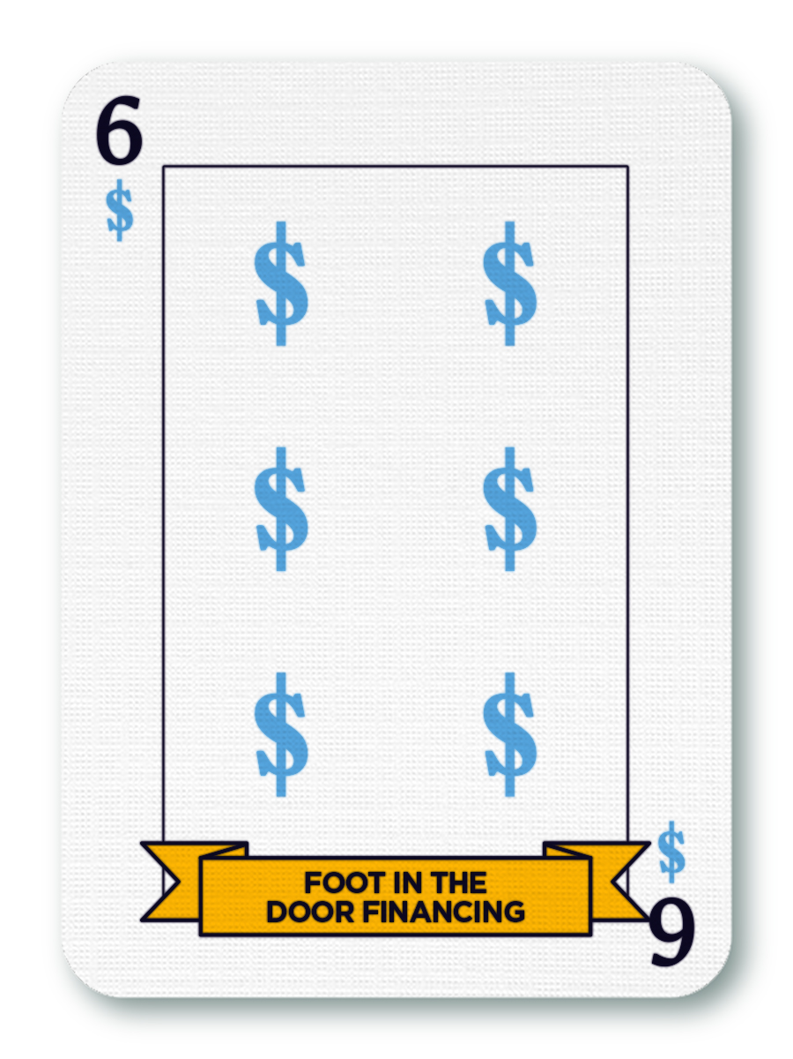
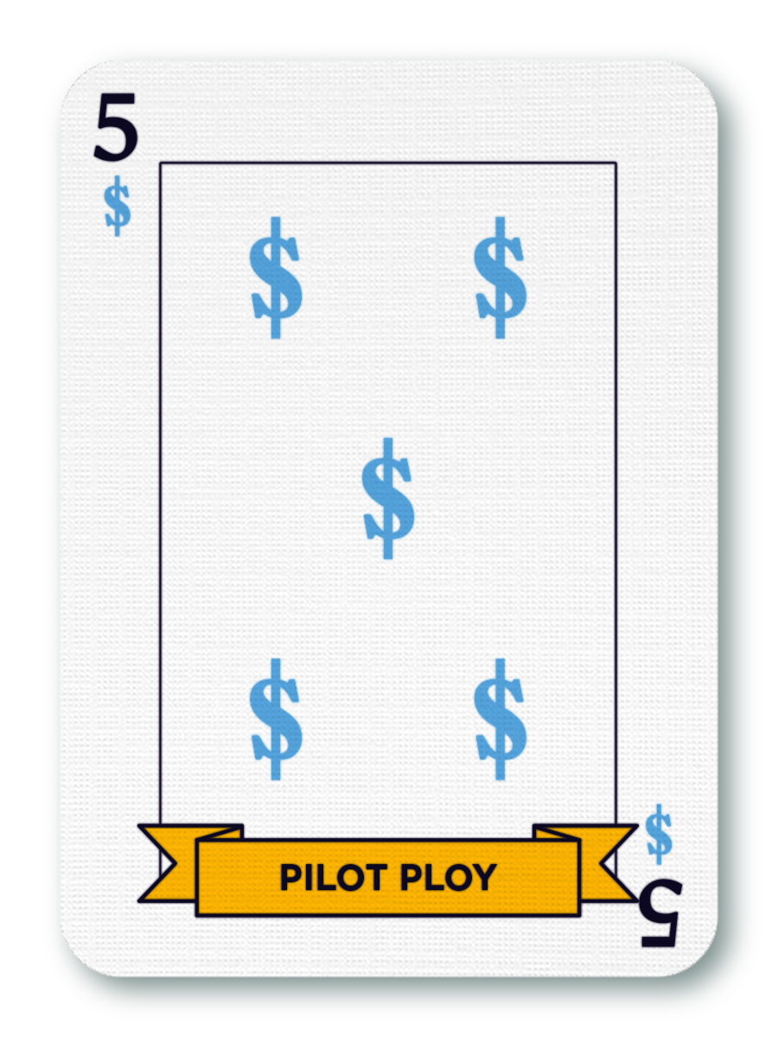
The Other Cards
Foot-In-The-Door Financing
Make the initial request small enough to get approved and request additional funds when in process
Popular gameplay for one-time initiatives
Pilot Play
Pitch the request as a pilot, which often become permanent with little scrutiny

Slide 26
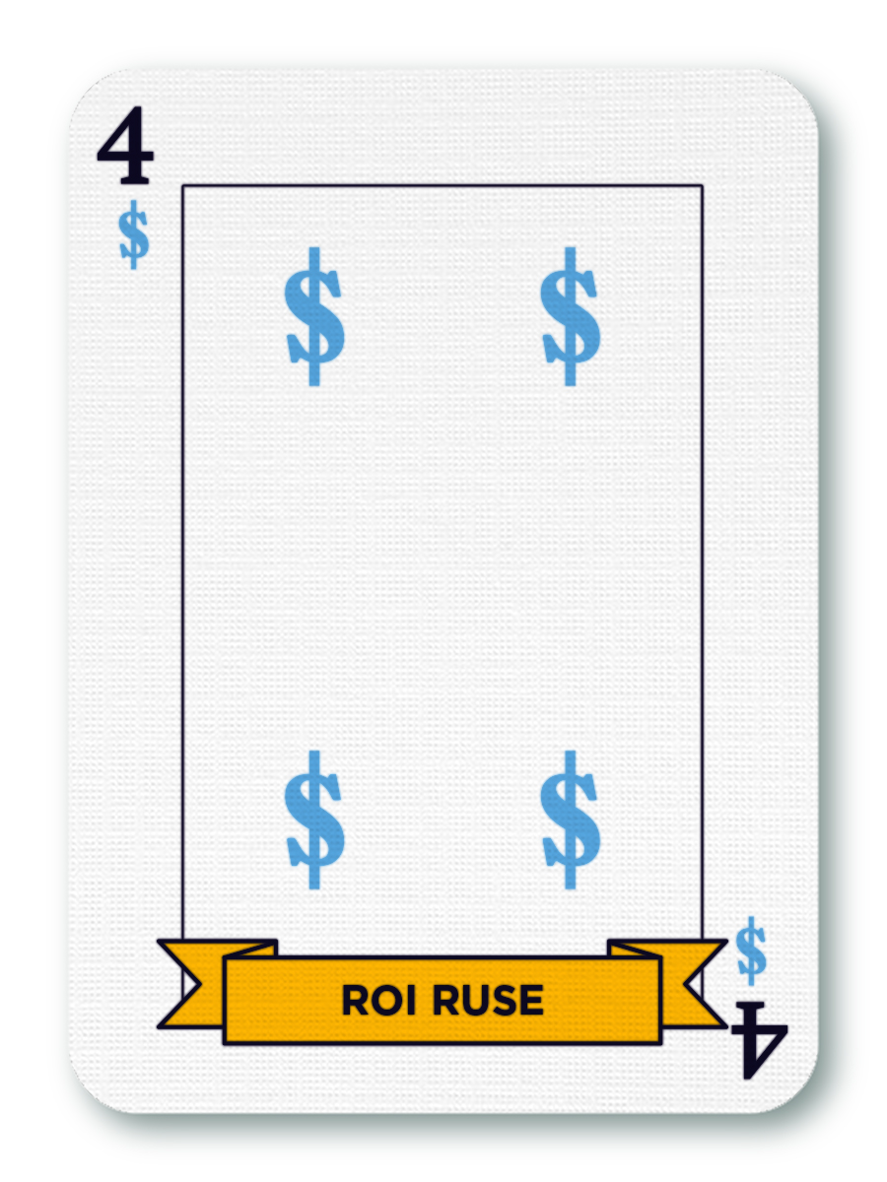
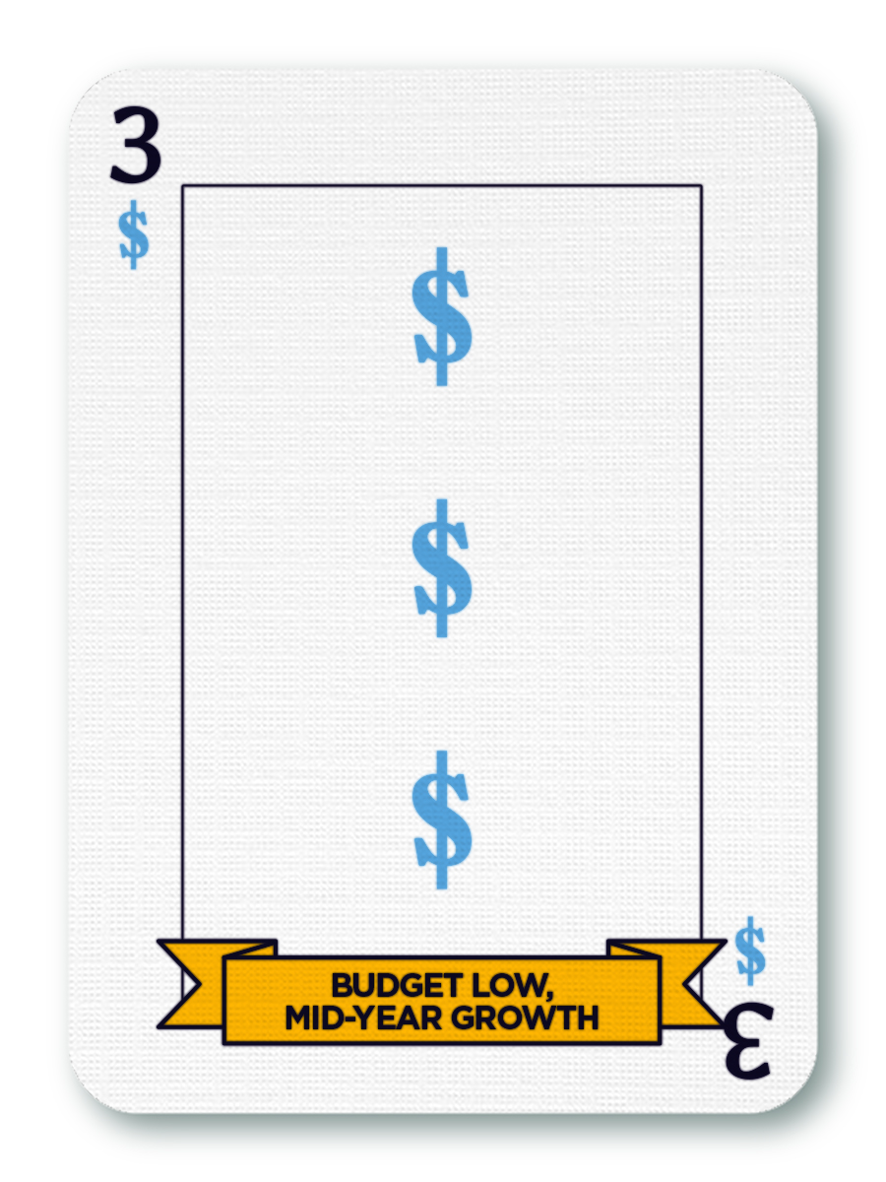
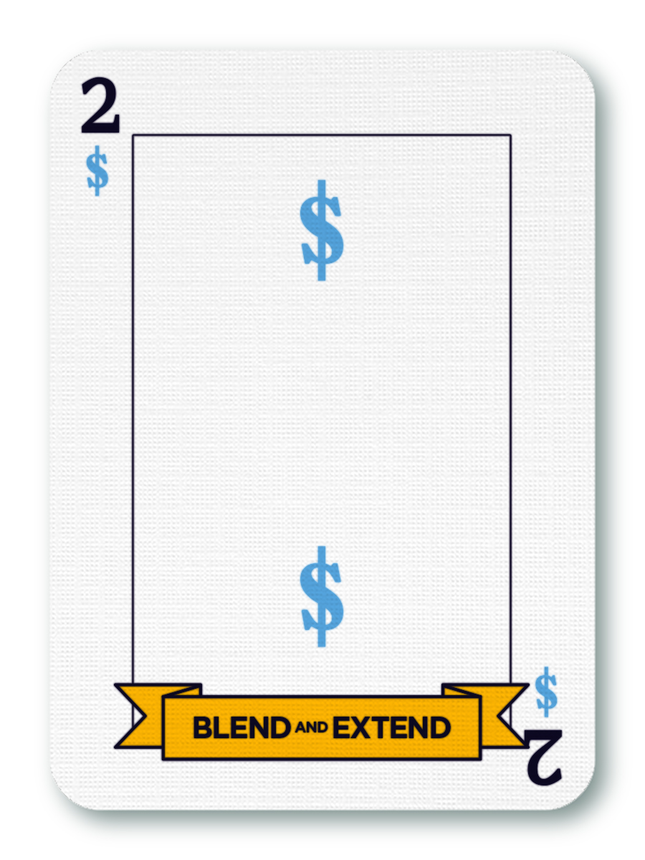
The Other Cards
ROI Ruse
Pitched as an investment due to offsetting revenues
Budget Low, Mid-Year Grow
Leaving key components out of the ask
A request for personnel that doesn’t include a required vehicle and technology
Blend and Extend
Disguises new programs as extensions of existing programs

Slide 27
Wildcards!
What games have you seen?
Games weaponize…
Overconfidence bias
Confirmation bias
Anchoring bias
Sunk cost fallacy
Reasoning from anecdote
Narrow framing

Slide 28
What to do about it?

Slide 29
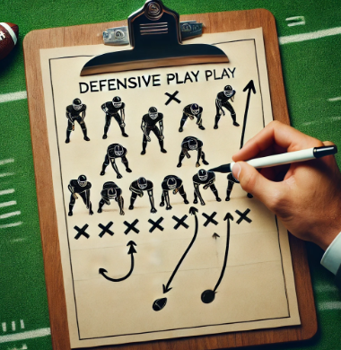
DEFENSIVE COUNTERMEASURES
Notes:
we might look to American football. In budget games, just like football, the offense has the initiative. They decide when to snap the ball and what play to run, while the defense must react and counter the offensive attack. Subterfuge is a big part of the offense, with trick plays, fake handoffs, and deceptive player movements being important parts of their playbook. Yes, defense is hard, and shutouts are rare, but many Super Bowl-winning teams are built around a great defense.
The lesson for budget games is that good defense is not just about reacting to the offense. The foundation is a solid “defensive scheme,” which is the larger strategy and concepts used to stymie the offense. Good defensive play-calling complements the scheme by adapting the defense to what the offense does.
Similarly, a budget office must have a good defensive scheme they can deploy in anticipation of department game-playing tactics. This involves creating a budget environment that is not conducive to gameplay. While this won’t stop all gameplay, it will reduce it. Just like in football, the budget office will need defensive play calls to counter specific attempts by game players to circumvent the decision architecture. Let’s explore what defensive schemes and play calls look like in the context of budgeting

Slide 30
Playbook – Countering Gameplay
Foundation is environment not conducive to gameplay
Won’t eliminate but will reduce/mitigate
Reference GFOA’s Financial Foundations for Budgeting
1. Strong sense of identity and purpose for the local government
4. Local autonomy
5. Graduated sanctions and rewards
6. Benefits proportional to cost
7. Fast and fair conflict resolution
8. Appropriate relations with other groups
2. Fair and inclusive decision making
3. Monitoring agreed-upon behavior
Notes:
A scheme can be effective because most game-playing is not the result of conscious “bad behavior.”. it is a response to incentives. The “mental model” that participants have of the budget process is often a “win-lose game,” where each participant must get their piece of the pie; and if they don’t get it, someone else will. Unsurprisingly, such a mental model can lead to aggressive game-playing behavior. Fortunately, there is a different mental model called Financial Foundations for Budgeting .
Just like playing good defense in football does not require mastering every defensive strategy in the game to be effective, a local government does not have to master each of the eight principles. Doing well in a few could be more than adequate.
Redmond example
Focusing on Citywide, shared priorities encourages a strong sense of identity and purpose for the local government, not just for individual departments.
Making budgeting decisions as the entire executive team promotes fair and inclusive decision-making.
Because everyone is in the room when decisions are made, there is monitoring of agreed-upon behavior.
It is also worth noting that Redmond also engaged our fifth principle: graduated sanctions and rewards. People want the approval of their peers. If other departments are seen as peers, not competitors, then being rebuked by them is a strong disincentive against playing games.
A final lesson we can take from Redmond relates to our sixth principle: benefits proportional to cost. This means that participants must experience an adequate return from their investment of time, energy, or money to continue as willing participants in a system. A monetary return is not necessary. People just need to feel their effort is “worth it” on some level.

Slide 31
Playbook – Countering Gameplay
Foundation is environment not conducive to gameplay
Won’t eliminate but will reduce/mitigate
Reference GFOA’s Financial Foundations for Budgeting
1. Strong sense of identity and purpose for the local government
4. Local autonomy
5. Graduated sanctions and rewards
6. Benefits proportional to cost
7. Fast and fair conflict resolution
8. Appropriate relations with other groups
2. Fair and inclusive decision making
3. Monitoring agreed-upon behavior

Slide 32
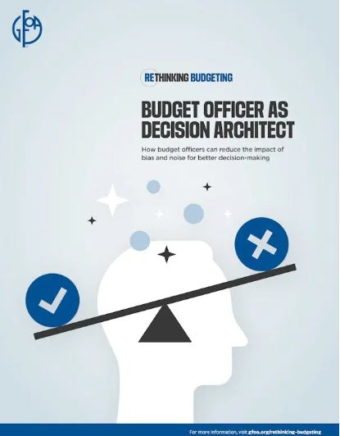
Defensive Playbook – Decision Architecture
Shape the decision-making environment to counteract the weaponization of cognitive biases and logical fallacies that game play relies on.
Padding play
Examine assumptions behind the request
Propose higher value options to achieve the same outcome
Notes:
The Padding Play, the King of games, involves overestimating the amount of funds really needed. Testing assumptions and finding high-value options are effective counters to the Padding Play. For example, the budget office could work with the requestor to look into the number of units and unit costs behind the request to ensure the assumptions are solid. This shifts the focus from the total size of the request to the details of how the money is to be used. Details are more concrete and therefore harder to game.
Departments often use the Padding Play to protect themselves against unplanned, unavoidable costs. The decision architect could explain that the cost of self-insurance across all departments can be quite high and suggest other, cheaper ways to cover the risk departments are worried about.

Slide 33
Playbook – Countering Gameplay
Crisis Card
Crisis card works through narrow framing
Widen the option set
Fairness is Essential
Process perceived as fair
Includes staying within the process and not rewarding work arounds
Notes:
Widening the option set might begin by recognizing that the goal is to have enough officers on the street at any given time. Then, explore options to achieve this without increasing officer headcount. For example, if there are long delays in filling vacant positions, finding ways to speed up hiring might help maintain adequate patrol coverage at a lower cost.

Slide 34
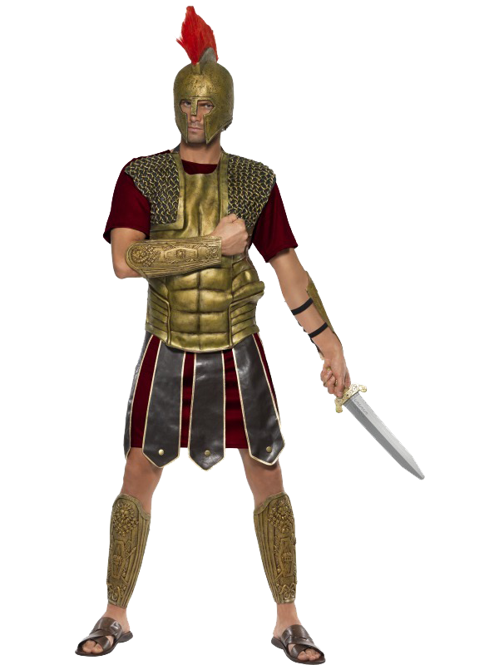
TARGET BASED BUDGETING
Defensive strategy to minimize gamesmanship behavior
This Photo by Unknown Author is licensed under CC BY-NC

Slide 35
REMOVING PLAY FROM THE EQUATION – Target Based Budgeting
TRADITIONAL BUDGETING
TARGET-BASED BUDGETING
Department request funding
Revenue estimates
Evaluate Bottom line
Negotiate reductions with departments until you get to the desired bottom line
Revenue forecast
Core services
Supplemental services
Decide desired bottom line
Set department targets (limits) for core services
Departments submit two proposals
Core services
Supplemental services
Negotiate for supplemental decision packages

Slide 36
TBB ADVANTAGES DIMINISH COMPETITION
Revenues set spending limits
Isolates new spending while preserving past service levels
Special, one-time projects
Premium services
Inefficiencies → unfairness
Autonomy to Departments with limits
Affordability (within means)
Innovation
Incentives for efficiencies and effectiveness
This Photo by Unknown Author is licensed under CC BY-SA-NC

Slide 37
Playbook – Countering Gameplay
Foundation is environment not conducive to gameplay
Won’t eliminate but will reduce/mitigate
Reference GFOA’s Financial Foundations for Budgeting
1. Strong sense of identity and purpose for the local government
4. Local autonomy
5. Graduated sanctions and rewards
6. Benefits proportional to cost
7. Fast and fair conflict resolution
8. Appropriate relations with other groups
2. Fair and inclusive decision making
3. Monitoring agreed-upon behavior

Slide 38
Share your Top Take Away with a Friend

Slide 39
The End
Questions?
Connect on LinkedIn - Shayne Kavanagh at GFOA
And I can always be reached at skavanagh@gfoa.org

