Slide 1
APRIL 8, 2025
Enhancing Your Investment Program & Portfolio Strategies
Nick vaccari, CtP REGIONAL DIRECTOR, ADVISORY SERVICES
BARRY BAUGHIEr Director, Advisory Services

Slide 2
Today’s Discussion Leaders
NICK VACCARI, CTP®️
Regional Director Advisory Services
BARRY BAUGHIER
Regional Director Advisory Services

Slide 3
Agenda
Investment Plan
Cash Flow Planning
Cost of Liquidity
Investment Strategies
Economic Update

Slide 4
Investment Plan

Slide 5
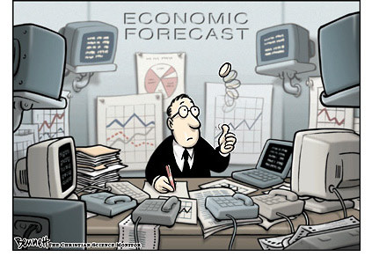
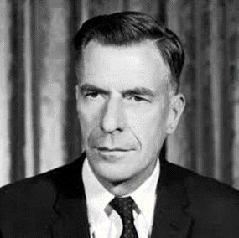
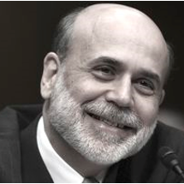
Can Anyone Time the Market Accurately Over the Long Run?
“The only function of economic (and interest rate) forecasting is to make astrology look respectable.”
JOHN KENNETH GALBRAITH Economist
“ The Federal Reserve is currently not forecasting a recession.”
BEN BERNANKE Former Fed Chair January 10, 2008
“It’s tough to make predictions, especially about the future.”
YOGI BERRA New York Yankees
“Our ability to forecast is limited.”
ALAN GREENSPAN Former Fed Chair November 2019
Source: Federal Reserve, Google

Slide 6
How Good are You at Predicting Future Events?
CASH FLOW TIMING
01 | While I don’t know the exact amount, I generally know my big ticketed cash outflow items and approximately when they will go out
02 | I generally know when I receive big cash inflows
03 | My investment policy’s primary objective in order of importance is safety of principal, sufficient liquidity, and yield
04 | My investment policy does not state anywhere that my duties are to time the market

Slide 7
Primary Objectives of Investment Programs
1 | Safety of principal
2 | Sufficient liquidity
3 | Market rate of investment income

Slide 8
Investment Policy versus Investment Plan
Policy
Plan
Portfolio
RULE BOOK
Legal
Words
General
Static
PLAY BOOK
Suitable
Portfolio
Specific
Dynamic

Slide 9
Opportunity to Create Longer-term Certainty
Short-term interest rates topping out?
Opportunity to lock in high interest rates for the long-term
Creates budgetary certainty for the long-term
AS OF 7/31/2024 SOURCE BLOOMBERG. Average LGIP represented by LGIP7D Net Index.

Slide 10
Hypothetical Illustration: Value of a Long-term Plan
Monthly Yield Comparison (%)
Growth of $50 million ($)
$78,486,607
$70,610,197
$68,930,592
ILLUSTRATION IS HYPOTHETICAL IN NATURE, DOES NOT REFLECT ACTUAL INVESTMENT RESULTS, AND DOES NOT GUARANTEE FUTURE RETURNS. Charts illustrate the yield and related performance of three sample yield curves over time. Growth of $50 million chart assumes reinvestment of monthly income. LGIP 7D Yield represents the S&P LGIP Index of rated LGIP programs that maintain a stable net asset value of $1 per share. The 2 Yr and 5 Yr Rolling Yield figures represent the constant maturity yield on Treasury securities at the indicated maturity derived from the daily yield curve for non-inflation indexed Treasury securities
The hypothetical chart does not project investment income from any investment or portfolio and is intended solely to illustrate that portfolios comprised of longer duration securities will produce more income over time than portfolios utilizing shorter durations over the selected period. Yield assumptions were developed with the benefit of hindsight and the securities purchased for such an account may generate more or less than the illustrated yield. Clients cannot invest directly in these indexes and the actual yield for any portfolio invested consistently with the illustration will vary from the hypothetical data shown here. Unmanaged Index returns do not reflect any advisory fees or expenses
10
1010-MPF-3/10/2025

Slide 11
What Can You Do?
Have a Plan.
SOURCE: FDIC

Slide 12
Cash Flow Planning

Slide 13
The Investment Portfolio
The only place in local government where revenue can be generated without assessing taxes or fees
Budget Stability of Investment Income
Sleep Adjusted Returns

Slide 14
Cash Allocation
CASH $1 million
CASH
$5 million
LIQUIDITY RESERVE
$3 million • Earning 4.00%
LIQUIDITY RESERVE
$11 million • Earning 4.00%
CORE
$16 million • Earning 4.00%
CORE
$4 million • Earning 4.00%
PROJECTED ADDITIONAL EARNINGS OF $160,000

Slide 15
Cash Flow Analysis
Historical Data
Cash Reserves 20%
Core Portfolio 80%

Slide 16
Operating Fund Portfolio Maturity Structure
Overnight Liquidity
5%−10%
Secondary Liquidity
10%−20% | 0−3 months
Core 60%−80% | 3 months−5+ years
A more stable investment income budget
Source: Meeder Public Funds

Slide 17
The Cost of Liquidity

Slide 18
“It’s free as long as I keep some money there.”
“They don’t charge me anything.”
“I don’t think I get charged for that.”
“I’ve never seen a bill.”

Slide 19
Direct Costs: Where Can I Look to Find the Fees?
Boxed items are intended to be excerpts from documents
Information Statement
Annual Report
INFORMATION STATEMENT
ANNUAL REPORT
Liabilities
Administration and Investment Advisory Fees $X,XXX,XXX
Fees and Expenses
The Trust has entered into an arrangement with XYZ whereby XYZ is paid a fee, calculated daily and paid monthly, at an annual rate of up to 0.12% (12 basis points) of the individual investment of each Participant.

Slide 20
How Local Government Investment Pools Respond to Falling Rates
Source: Bloomberg, S&p Global Ratings

Slide 21
Incidental Costs
How Rate Cuts Effect Earnings Credit Rates
Today
3.5% earnings credit rate
$100,000 annual banking fees
Required balance to offset fees
$100,000/3.5% = $2,857,143
2% Rate Cut
1.5% earnings credit rate
$100,000 annual banking fees
Required balance to offset fees
$100,000/1.5% = $6,666,667

Slide 22
Opportunity Costs
How Interest Rates React to Fed Rate Cuts
Source: Bloomberg
Notes:
Speak to how much Fed has cut in the past…when they move overnight rates it has an effect on longer-term rates as well. The opportunity to lock in high rates goes away. We know today that longer-term rates have already started dropping…the question is how much they fall.
Average drop of 450 basis points

Slide 23
Investment Strategies

Slide 24
Who Will Help You Invest?
Know the types of service providers and perform due diligence before investing
Investment Pools
Know the underlying investments in the program
Look over the annual report
Understand how program works
Banks
Make sure they understand nuances of public entities
Work with banks you know and trust and with strong financials
Investment Advisors
Acts as a fiduciary in the client’s best interest
Who do they work with?
What are their credentials?
Check them out: www.investor.gov
Brokers
Recommends suitable investments
Who do they work with?
What do they do and how much do they charge?
Check them out: www.finra.org

Slide 25
Interest Rate Outlook
As markets change, so should your investment strategy
Uncertain
Maintain average maturity
Diversification across security types
Rising Rates
Reduce average maturity
Frequent short-term maturities
Falling Rates
Increase average maturity
Favorable to longer dated maturities

Slide 26
Short-term Portfolio
SOURCE: MEEDER PUBLIC FUNDS. FOR ILLUSTRATIVE PURPOSES ONLY.

Slide 27
Breakeven Analysis: 5-Year versus 1-Year Investment
5-year: US Treasury at 3.9% |  |  |  | 1-year: US Treasury at 4.2%
Maturity | Amount | Interest Earned |  | Maturity | Amount | Interest Earned
Year 1 | $0 | $39,000 |  | Year 1 | $1,000,000 | $42,000
Year 2 | $0 | $39,000 |  | Year 2 | $0 | ?
Year 3 | $0 | $39,000 |  | Year 3 | $0 | ?
Year 4 | $0 | $39,000 |  | Year 4 | $0 | ?
Year 5 | $1,000,000 | $39,000 |  | Year 5 | $0 | ?
TOTAL | $1,000,000 | $195,000 |  |  | $1,000,000 | $42,000
$195,000-$42,000 = $153,000
$153,000/4 = $38,250 Per Year
$38,250/$1,000,000 = 3.825%
What’s my breakeven rate?
SOURCE: MEEDER PUBLIC FUNDS. FOR ILLUSTRATIVE PURPOSES ONLY.

Slide 28
Laddered Portfolio
SOURCE: MEEDER PUBLIC FUNDS. FOR ILLUSTRATIVE PURPOSES ONLY.

Slide 29
Strategic Portfolios
SOURCE: MEEDER PUBLIC FUNDS. FOR ILLUSTRATIVE PURPOSES ONLY.
29

Slide 30
Hypothetical Portfolio Illustration
Sample Portfolio
Sample Asset Allocation
Cash | 20%
Securities | 80%
Sample Securities
Weighted Average maturity | 2.07 Years
Sample Maturity Distribution
portfolio Illustration is hypothetical in nature, does not reflect actual investment results, and does not guarantee future returns. The Portfolio Illustration projects the weighted average yield of a hypothetical portfolio invested on the date shown and allocated across the indicated asset classes and maturities.
30

Slide 31
Value in Commercial Paper
SPREAD IN BASIS POINTS | 270-DAY
3/26/2025 | 24.2
3/19/2025 | 26.3
2/26/2025 | 28.3
Source: Bloomberg as of mm/dd/yyyy. Note: commercial paper yields are annualized by multiplying by 365 and dividing by 360 to compare with T-bills using the same day count basis
Notes:
Update closer to webinar

Slide 32
Is Now a Good Time to Implement?
Source: Bloomberg

Slide 33
Market Update
Notes:
MOVE TO THE BACK

Slide 34
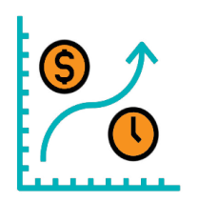
“FIGEY” Model of Interest Rates
Fed, Inflation, Growth, Employment, Yields
Fed Policy
Inflation
Growth (GDP)
Employment
Yields
U.S. Treasury Yields/Rates
Primarily a function of Federal Reserve policy, inflation, economic growth, and employment.
Shorter-Term Yields
Highly correlated with the Fed Funds rate set by the Fed’s Federal Open Market Committee (FOMC).
Intermediate-Term and Longer-Term Yields
More correlated to the expected future rates of inflation, economic growth, and the unemployment rate.
Source: Meeder public funds

Slide 35
FIGEY Outlook and Commentary
 | METRIC | ANALYSIS
 | Fed Funds Rate | The Federal Reserve is expecting to lower the Fed Funds rate 50 basis points (0.50%) in 2025. The Fed Funds futures market is pricing in approximately 70 basis points of cuts for 2025 and end the year at 3.65%.
 | Inflation | The Consumer Price Index (CPI) has been rising the past few months and is currently at 3.0% on a YoY basis. Economists surveyed by Bloomberg expect CPI YoY to average 2.7% for 2025.
 | Growth | Gross Domestic Product (GDP) grew faster in 2024 than most economists expected, although it slowed in Q4 2024 to 2.3% from 3.1% in Q3 2024. The Federal Reserve is expecting GDP to average 2.1% for 2025.
 | Employment | Weekly initial unemployment (jobless) claims remain near historically low levels but continuing jobless claims (those receiving ongoing unemployment benefits) continue to climb. The unemployment rate remains low at 4.0.%.
 | Yields | The 2-year Treasury yield has risen about 45 basis points from last September’s low of 3.54%, but is still approximately 120 basis points from the 5.22% cycle high of October 2023.
Source: Bloomberg, Meeder public funds as of 2/28/25
35

Slide 36
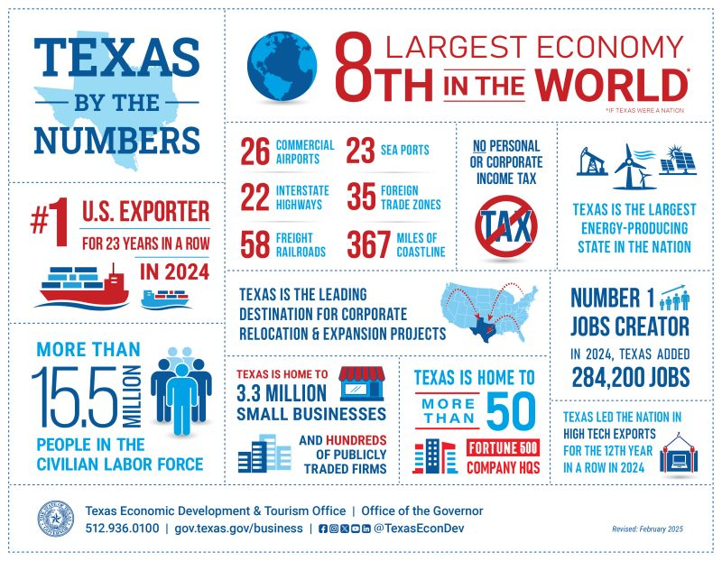
Texas by the numbers
36
Source: Texas economic development & Tourism office as of February 2025
Notes:
Add this slide in

Slide 37
Unemployment Rate by State
Unemployment Rates by State | Seasonally Adjusted, December 2025
(U.S. Rate = 4.1 percent)
Source: U.S. BUREAU OF LABOR STATISTICS
37

Slide 38
Growth Sectors in Texas 2024
Source: Federal reserve bank of Dallas Note: Shown are the January through December 2024 single family housing permits per thousand residents. Per the census bureau
38

Slide 39
Texas Job Growth
Source: Federal reserve bank of Dallas Note: Shown are the January through December 2024 single family housing permits per thousand residents. Per the census bureau
39

Slide 40
Texas Builds A Lot Of Houses!
Permits per thousand residents
Source: Federal reserve bank of Dallas Note: Shown are the January through December 2024 single family housing permits per thousand residents. Per the census bureau
40

Slide 41
Cost of Living Index by State
41
Source: u.s. bureau of economic analysis march 2025

Slide 42
Texas Inflation Slips Below U.S. as National CPI Turns Up
Source: Federal reserve bank of Dallas Note: Data are seasonally adjusted and monthly through November 2024 for Texas and December 2024 for the u.s. 6-month percent changes are annualized rates. Per bureau of labor statistics; adjusted by the federal reserve bank of Dallas
42

Slide 43
Egg-Flation!
Since January 2021
The overall Consumer Price Index is up approximately 22%
Nominal wages are up 20%
However, the price increase of eggs has been a different story…up 238%!
Waffle House announced that it will add a 50-cent surcharge to all egg items sold because of soaring egg prices caused by the bird flu.
JAN 2025
The price of large Grade A eggs climbed to a record high of $4.95/dozen
Chart Source: Bloomberg, Bureau of Labor Statistics copy source: nbc news

Slide 44
Key Takeaways
Have a plan!
Cash flows are key
Liquidity is costing you
Customize your strategy
The market will do what the market does…be prepared

Slide 45
Disclosures
Past performance does not guarantee future results.
Commentary offered for informational and educational purposes only. Opinions and forecasts regarding markets, securities, products, portfolios, or holdings are given as of the date provided and are subject to change at any time.
No offer to sell, solicitation, or recommendation of any security or investment product is intended.
Certain information and data has been supplied by unaffiliated third parties as indicated. Although Meeder believes the information is reliable, it cannot warrant the accuracy, timeliness or suitability of the information or materials offered by third parties.
Investment advisory services provided by Meeder Public Funds, Inc.
©️ 2025 Meeder Investment Management
XXXX-MPF-04/06/25_49442

